Slide 1

Welcome!
News, Updates & Reminders
Graduate School Department

Slide 2
New Faces
Name
Role
Time in position
Notes:
New Staff/Transitional

Slide 3

Dr. Sarah Larsen
Vice Provost and Dean of the Graduate School Dept.

Slide 4
Shari Corprew
Director of Graduate School Dept.

Slide 5

Notes:
New Staff/Transitional

Slide 6
Stefan Johnsson
Coord, Sr, SEVIS Compliance
ISSSO

Slide 7
Online Enrollments
Federal Regulation: 8 C.F.R. § 214.2(f)(6)(i)(G)
For F-1 students enrolled in classes for credit or classroom hours, no more than the equivalent of one class or three credits per session, term, semester, trimester, or quarter may be counted if taken on-line or through distance education in a course that does not require the student's physical attendance for classes, examination or other purposes integral to completion of the class. An on-line or distance education course is a course that is offered principally through the use of television, audio, or computer transmission including open broadcast, closed circuit, cable, microwave, or satellite, audio conferencing, or computer conferencing.

Slide 8
Online Enrollments
Are any of your degree programs moving to online only?
  Implications to I-20 issuance
What long term actions are you taking to allow F-1 students to come and study at UH in the future?
http://www.uh.edu/oisss/resources/files/online_or_distance_education_course_policy_for_f1.pdf

Slide 9
Final Semester RCL’s
Student’s are limited to one per semester with the following term being full-time.
This is the policy unless it is changed. If you know that a student will not graduate, do not approve it.
Difference between Non-Thesis and Thesis Equivalency
http://www.uh.edu/oisss/resources/files/RCL%20Graduate%20Students.pdf

Slide 10

Tashemia V. Jones, Ed.D.
Assistant Director of Programs/Student Records

Slide 11
Transfer credits
No transfer credit is awarded for courses with grades below B at other institutions
No transfer credit is awarded unless it is considered to be advanced work (graduate or professional)
No more than 9 credits of transfer credit can be awarded Transfer credit is not awarded for degrees completed at other institutions.
Transfer credit must be recent (cannot exceed degree time limitation when the student graduates from UH)
Notes:
New Staff/Transitional

Slide 12
Transfer credits
Colleges may have stricter guidelines (ex: Engineering limits to 6 credits; some allow for no transfer credit)
If student has taken classes at UH with graduate NDO status, no more than 6 credits can be used toward a degree (inside time limit)
If student completed a master’s degree at UH, the college dean can approve up to 6 hours to count toward a second master’s degree.
No hours can be counted forward toward a doctoral degree
Notes:
New Staff/Transitional

Slide 13
Transfer credits
If a student is classified as Postbaccalaureate and is allowed to take a 6000+ level course, the student can petition to have those courses apply toward a future master’s degree.
If a student wishes to pursue two UH graduate degrees at the same time [must be within the same college and have dean’s approval, unless in dual degree program approved by GPSC and Provost], college determines how many credits can count toward both degrees, with a maximum of 12.
Only counts for truly concurrent degrees
Concurrent master’s degrees Admitted to PhD and earning master’s along the way
Notes:
New Staff/Transitional

Slide 14
Updated Graduate petition
The old version of the petition will no longer be accepted as of Monday, 2/11/19.
The GS website is updated with the new form and will be sent via email with the slides.
Any changes you are requesting to make to a student’s plan (swapping, adding, and dropping courses, etc) you will either need a signature from the student, or an email confirming they are asking you to make the request.
Notes:
New Staff/Transitional

Slide 15
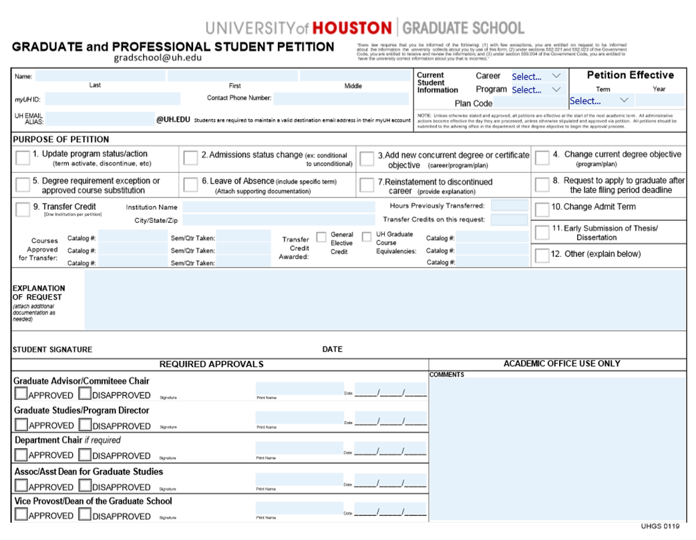
Notes:
New Staff/Transitional

Slide 16
Reminders/updates
Review the discontinue list from OUR
Graduation application deadline
Thesis and dissertation deadline
New front matter for all colleges
Dissertation Boot Camp
Graduate Catalog Updates
TA Training
Notes:
New Staff/Transitional

Slide 17
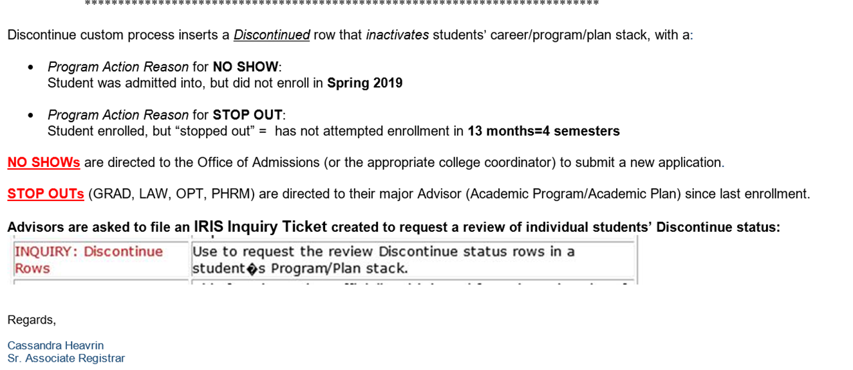
Discontinued students
Notes:
New Staff/Transitional

Slide 18
Shawn Washington
Assistant Director of Grad/Int’l Admissions.

Slide 19
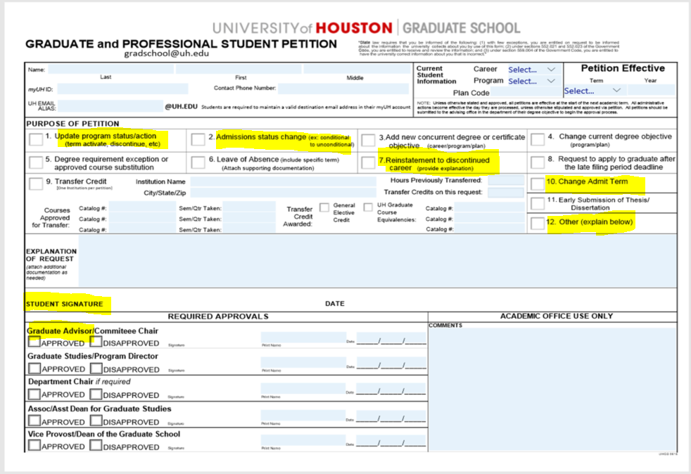

Slide 20
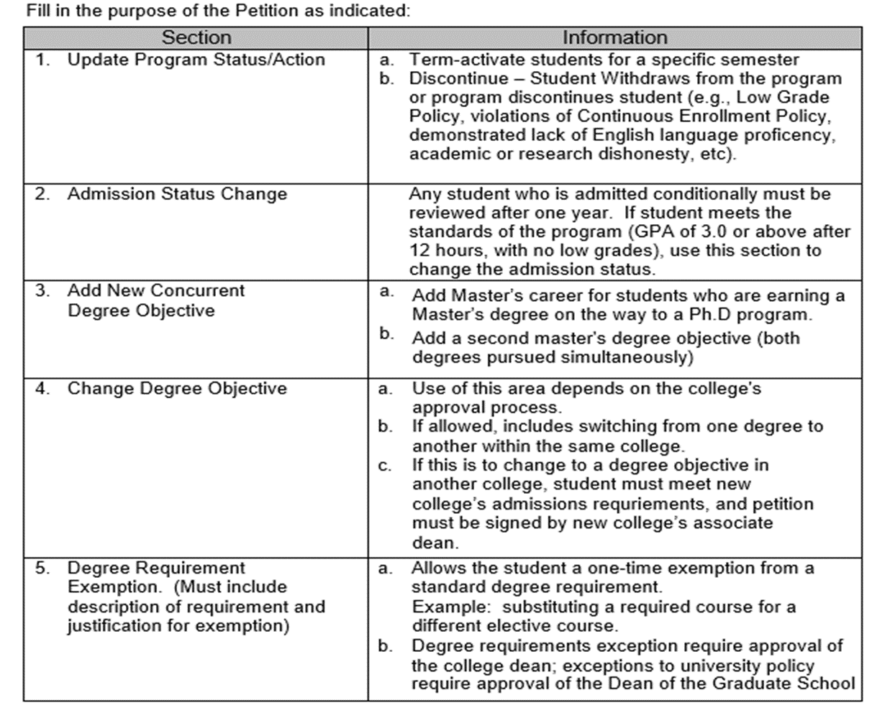
Notes:
New Staff/Transitional

Slide 21
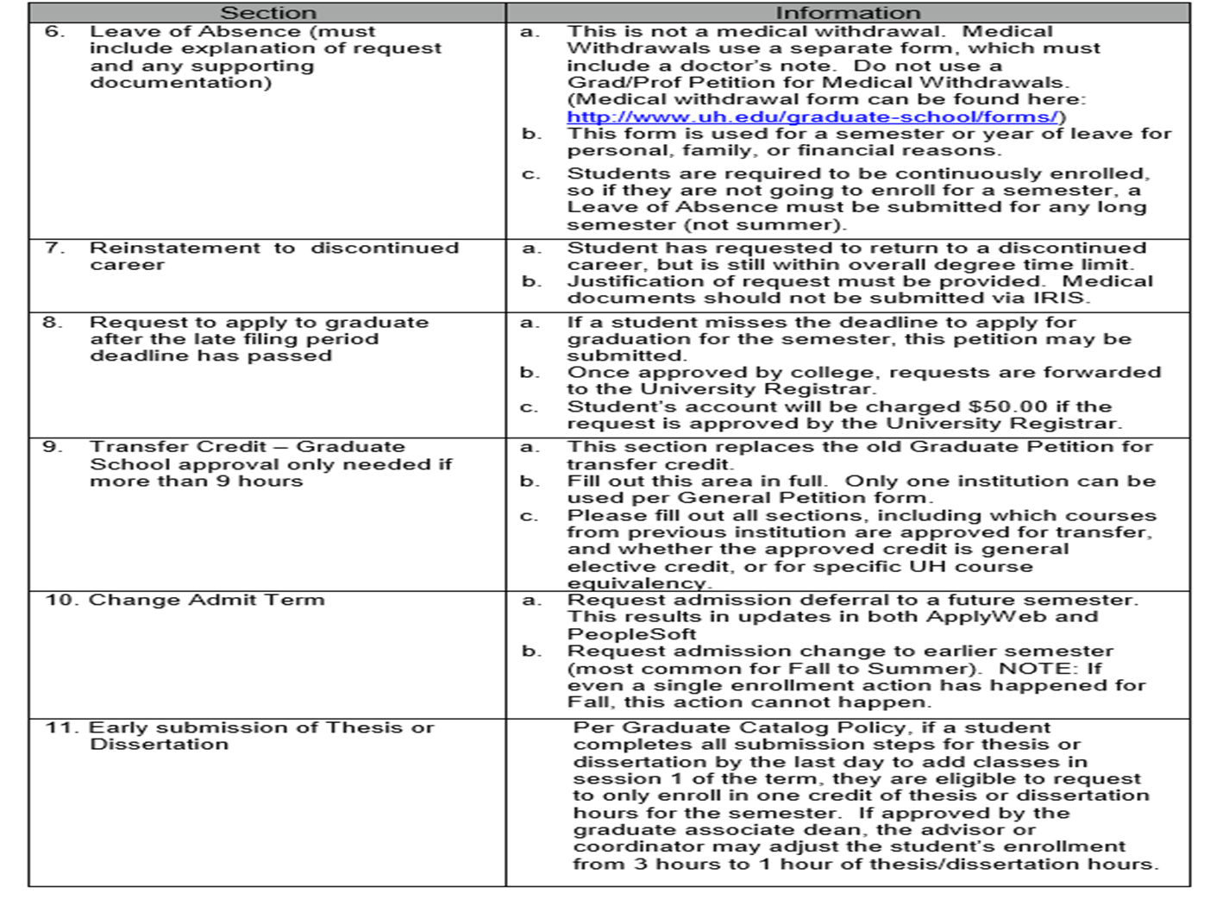
Notes:
New Staff/Transitional

Slide 22
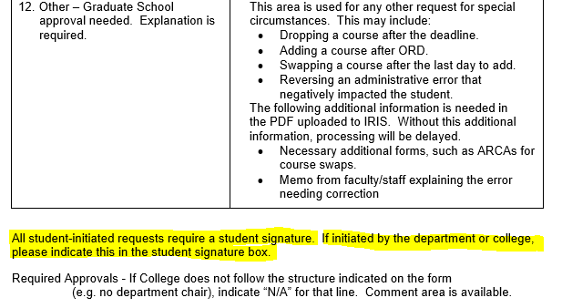

Slide 23
Deferrals
You cannot defer after ORD.
At that point, they are now students who were admitted and Discontinued for No-Show in PS.
This is needed for accurate data processing reasons.
Once ORD has passed, they are now discontinued students and if you want to reactivate them for future enrollment (without a new application), you should submit a petition requesting to “Readmit” the student.
Notes:
New Staff/Transitional

Slide 24
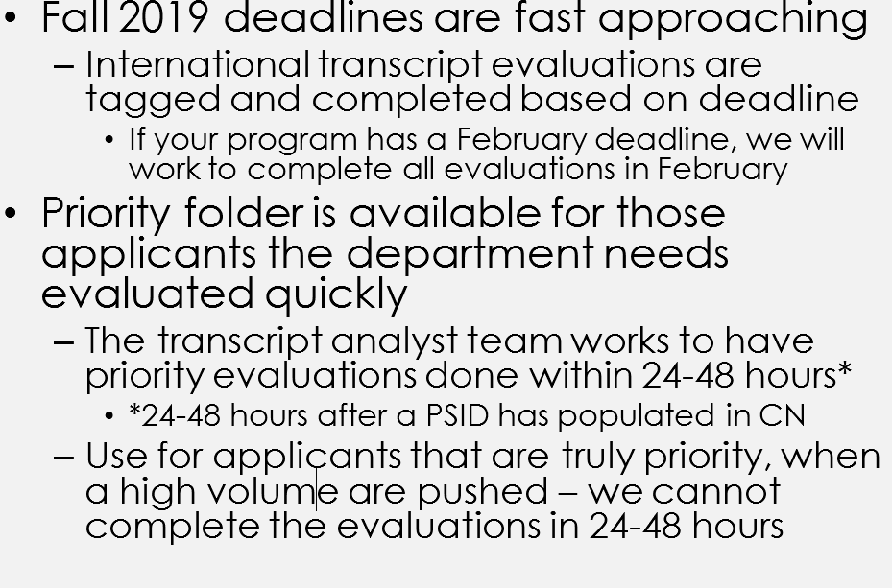
Priority folder - CN

Slide 25
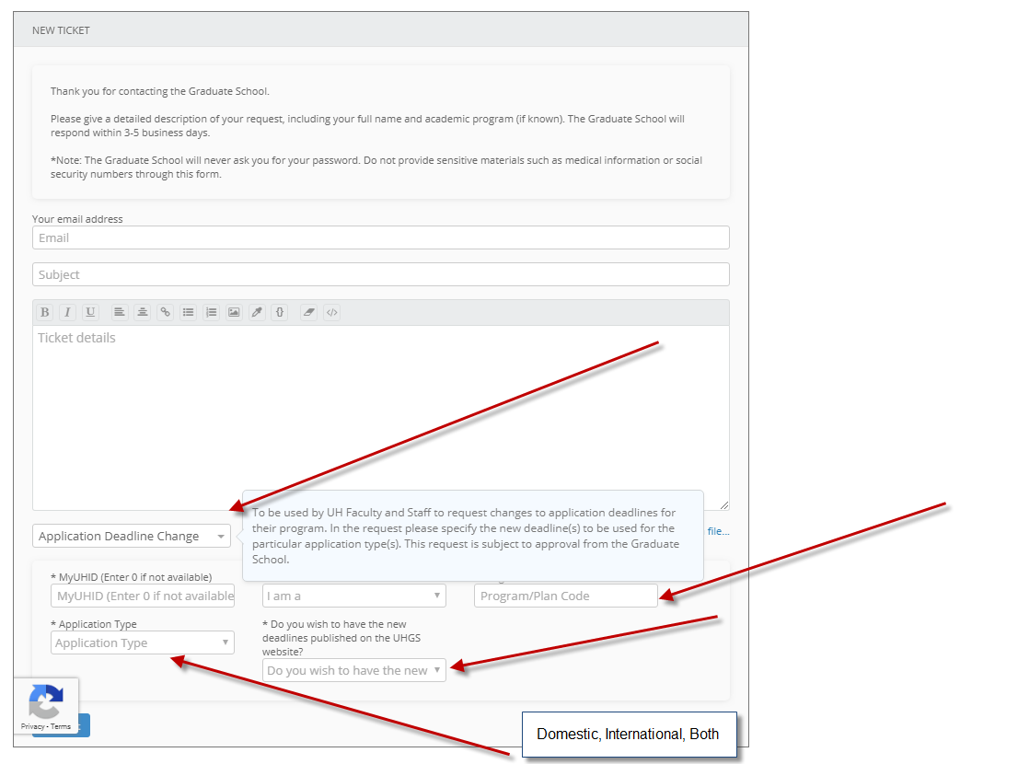
Notes:
Below a screenshot of the application deadline change form that is located as a category in helpdesk request submission page here http://www.uh.edu/graduate-school/contact-us/ .
The category is located at the very bottom of the drop down menu under ‘UH Faculty and Staff Requests’.
The form ask for Program/Plan code, Application Type (Dom, Intl or Both) and whether they want to have the deadlines published on the UHGS website.

Slide 26
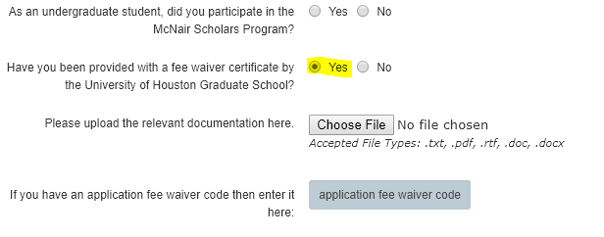

Application, Page 19

Slide 27
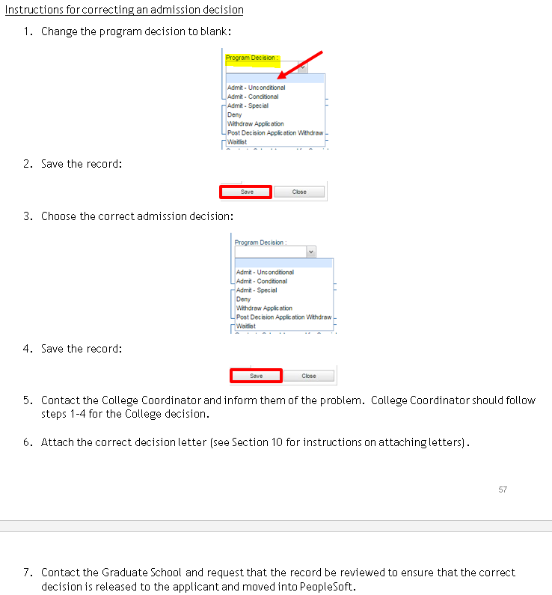
Collegenet

Slide 28
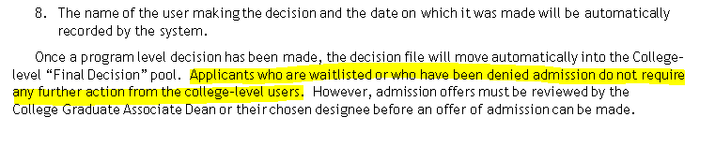
collegenet

Slide 29
Deadlines for Sp2020

Slide 30
Other Reminders
March 1st (Archiving Spring 2019)
Annual Changes (ApplyWeb)
Fee Waivers
Letter of Recommendations (Prospect)
Residency Questionnaire:
http://www.uh.edu/academics/forms/residency-questionnaire.pdf

Slide 31
Recruitment
Recruiting/Out-Reach Committee
- Events
Inquiries/Contacts/Leads
- Hard Copies
- Prospect Folder in CN

Slide 32


Slide 33
Robert Torres-Torres
Coordinator/Graduate Documentation

Slide 34
I-20 processing
Christen Gould
SEVIS Compliance Coordinator

Slide 35
Chastyne Blacklock
[Executive Assistant to Dr. Larsen & Events Coordinator]

Slide 36
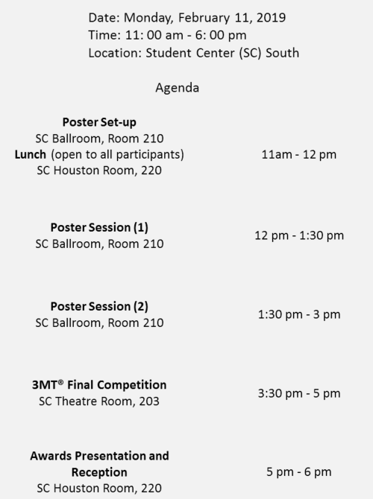
Graduate Research Showcase
Notes:
New Staff/Transitional

Slide 37
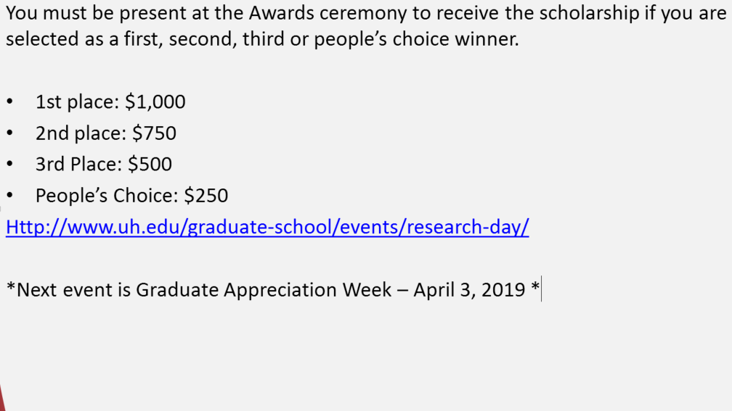
Graduate Research Showcase
You must be present at the Awards ceremony to receive the scholarship if you are selected as a first, second, third or people’s choice winner.
1st place: $1,000
2nd place: $750
3rd Place: $500
People’s Choice: $250
Http://www.uh.edu/graduate-school/events/research-day/
*Next event is Graduate Appreciation Week – April 3, 2019 *
Notes:
New Staff/Transitional

