Slide 1
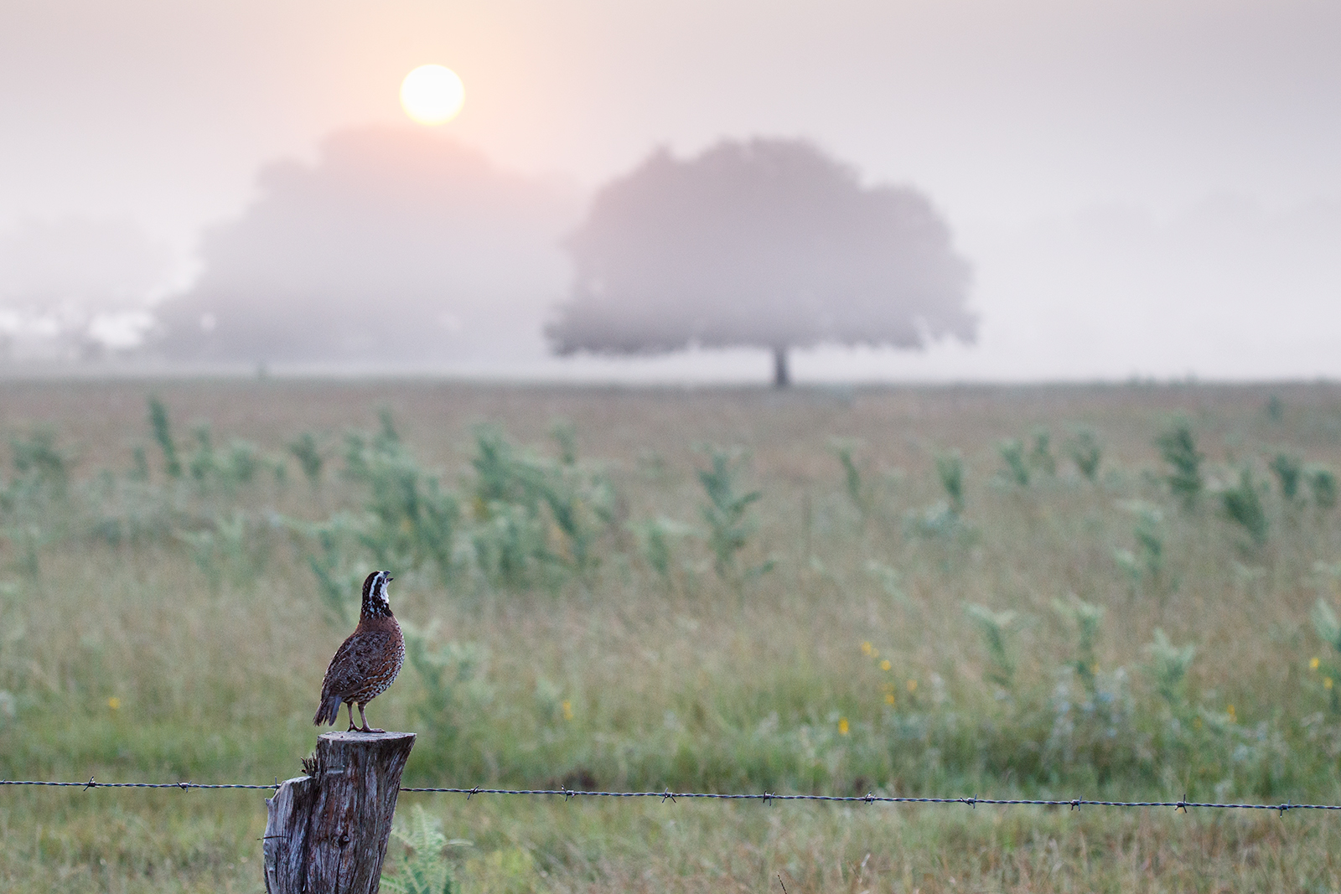
Coastal Grassland Restoration Incentive Program: C-GRIP
Shannon Barron
TPWD Biologist
Victoria & Calhoun Counties
©Trey Barron

Slide 2
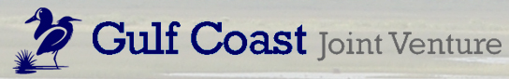
Grassland Restoration Incentive Program
Financial incentive program to encourage grasslands
Set payment rate to landowners for accepted practices
Managed by Gulf Coast Joint Venture
Notes:
We understand that implementing habitat practices on your property is expensive. These programs exist to help offset costs and offer an incentive to make the land better for wildlife
GRIP since 2013 and C-GRIP since 2018

Slide 3
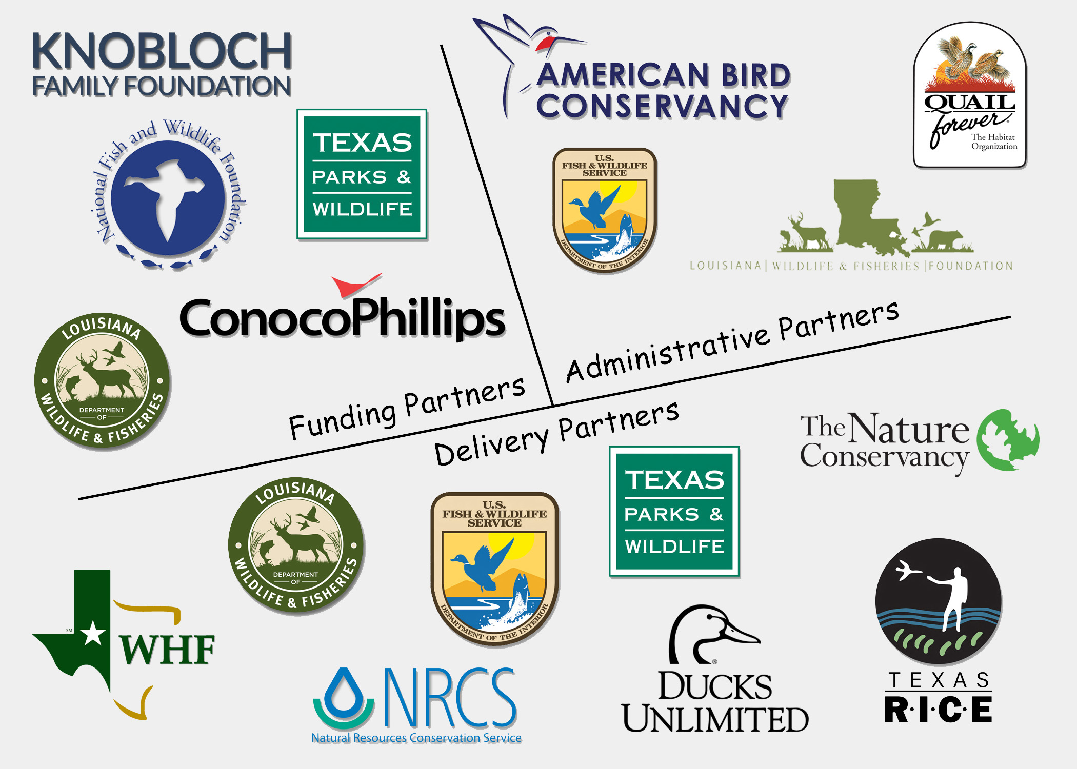
C-GRIP Partners

Slide 4
Who is this for?
Private landowners (public land does not qualify)
Property must be partially in a focal area
People that are interested in wildlife habitat
People that are committed to keeping the improvement for 5 years (or have a conservation easement)
Minimum treatment area 25 ac
Agree to bird and veg. data collected in treatment area
Max. payment for individual projects- $50,000
Notes:
Minimum trmt area- 25 ac GRIP- landholding of at least 50 ac
We ask that you allow vegetation and bird data to be collected on your property

Slide 5
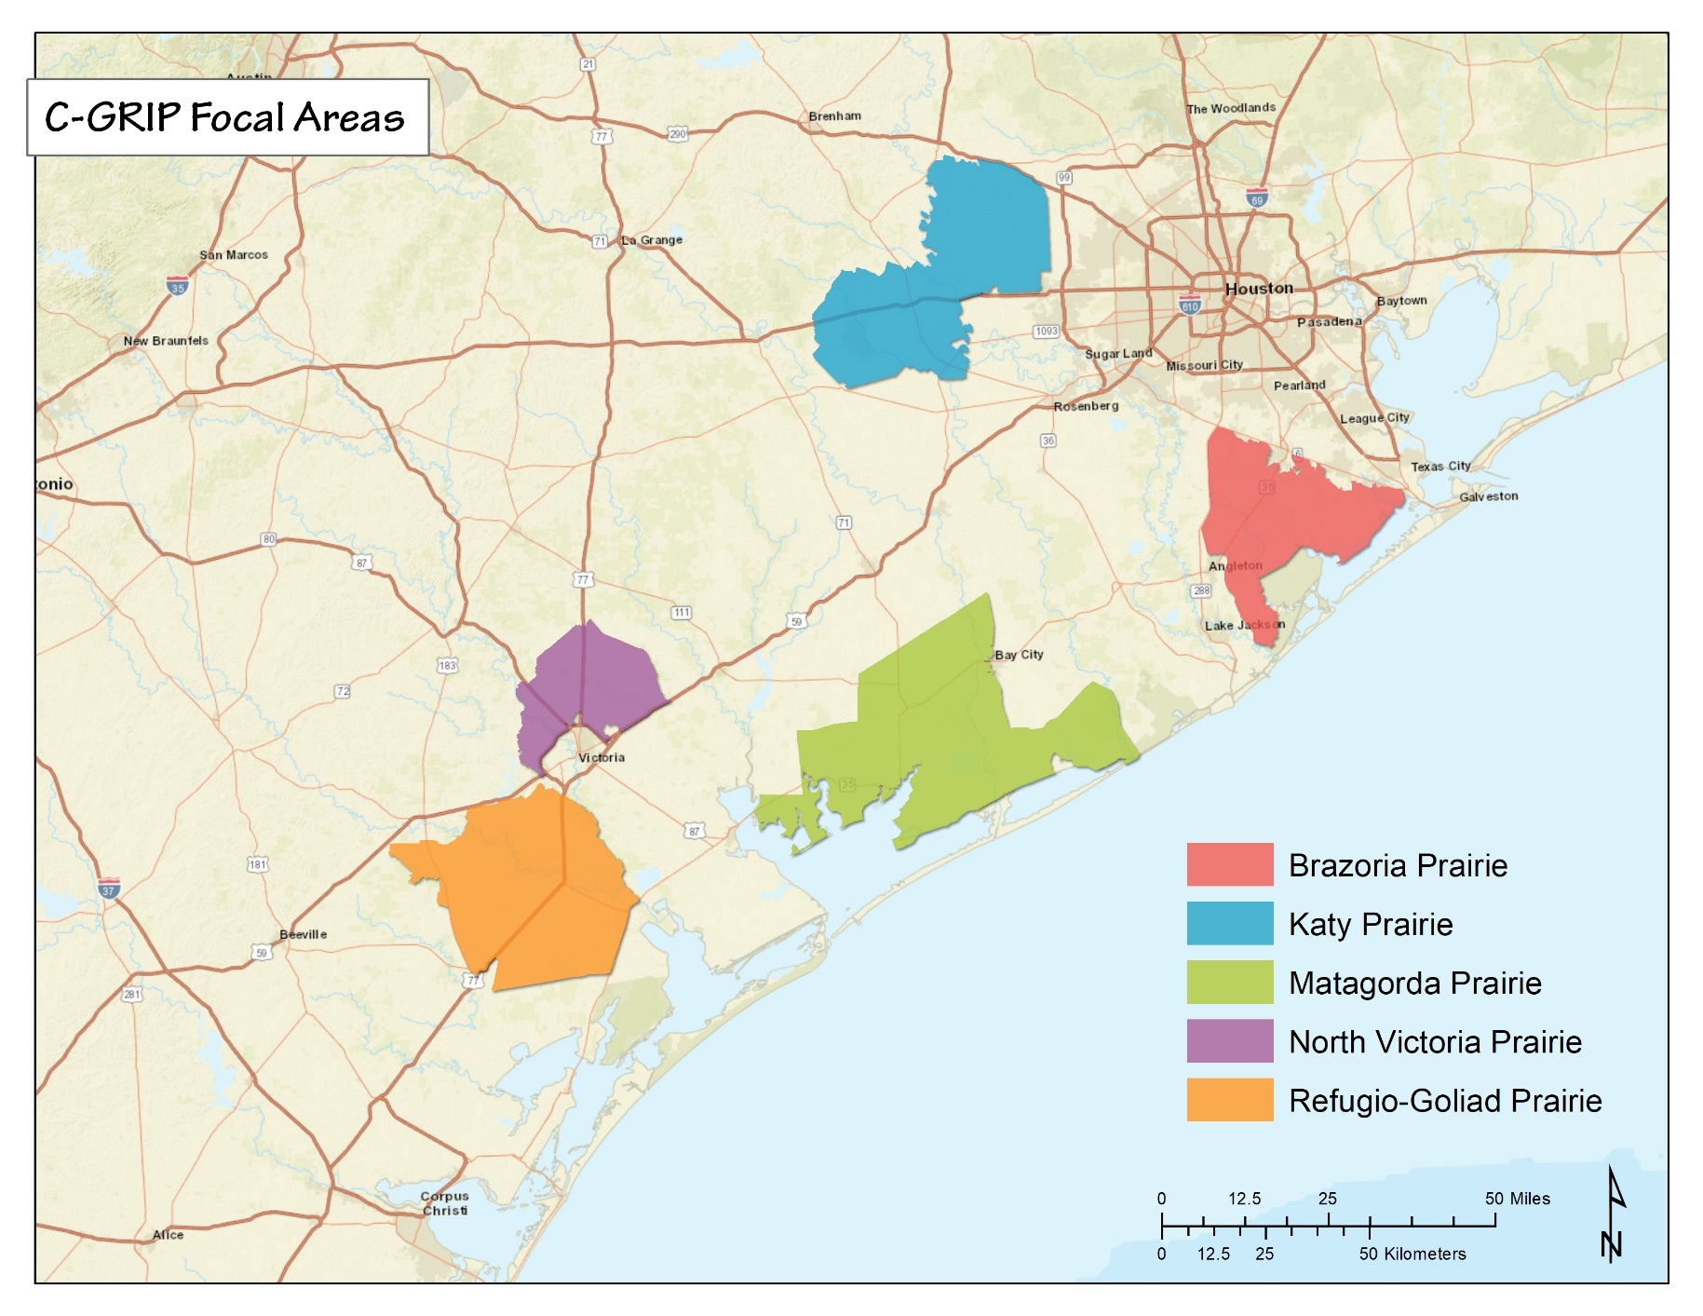
C-GRIP Focal Areas
Katy Prairie
Brazoria Prairie
Matagorda Prairie
North Victoria Prairie
Refugio-Goliad Prairie
www.cgrip.org

Slide 6
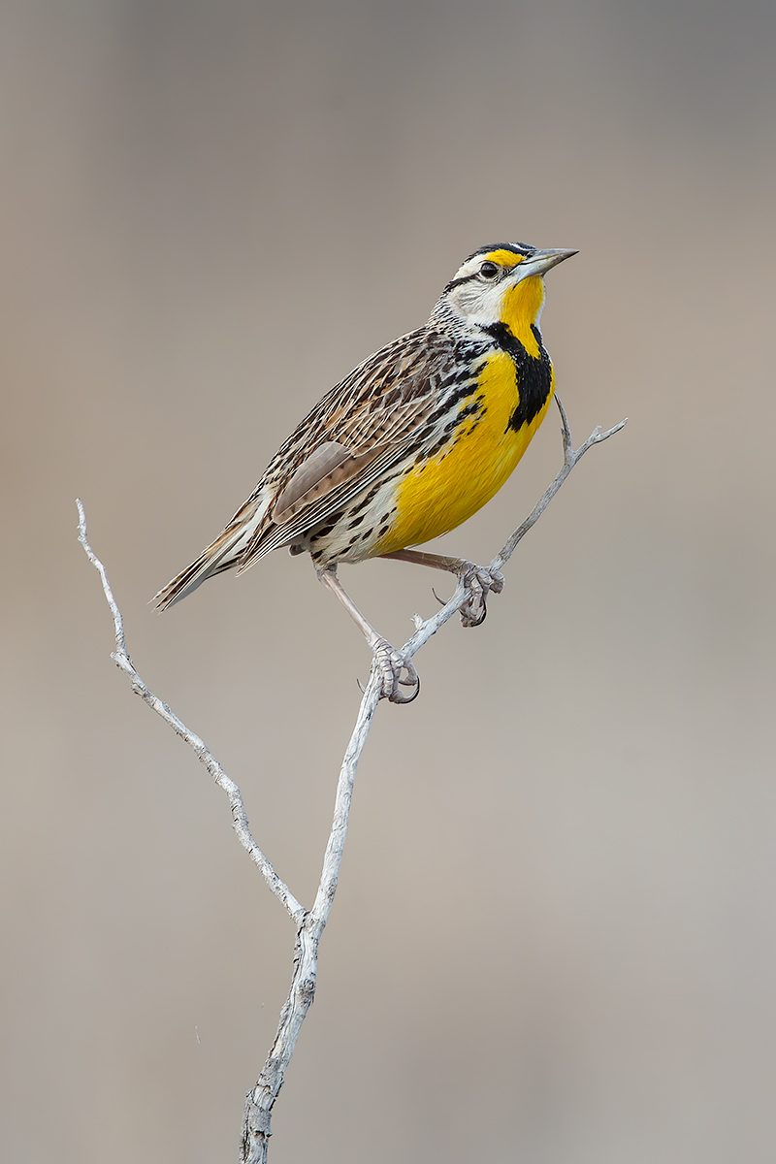
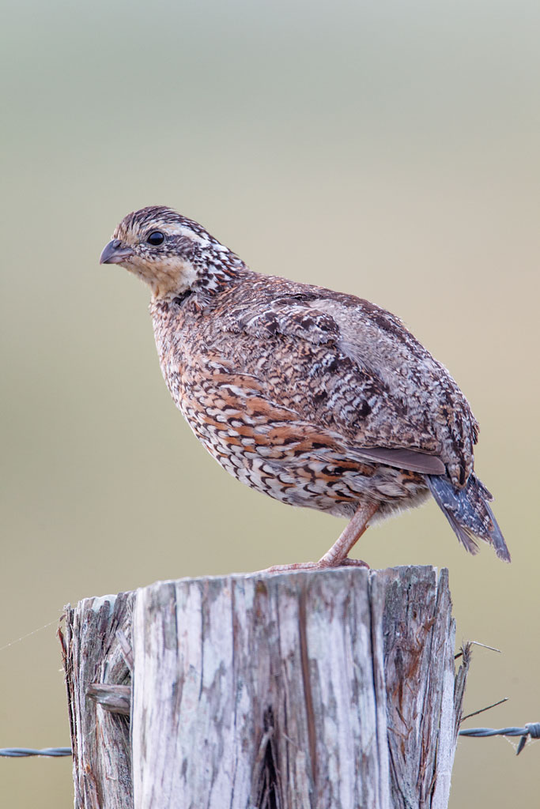
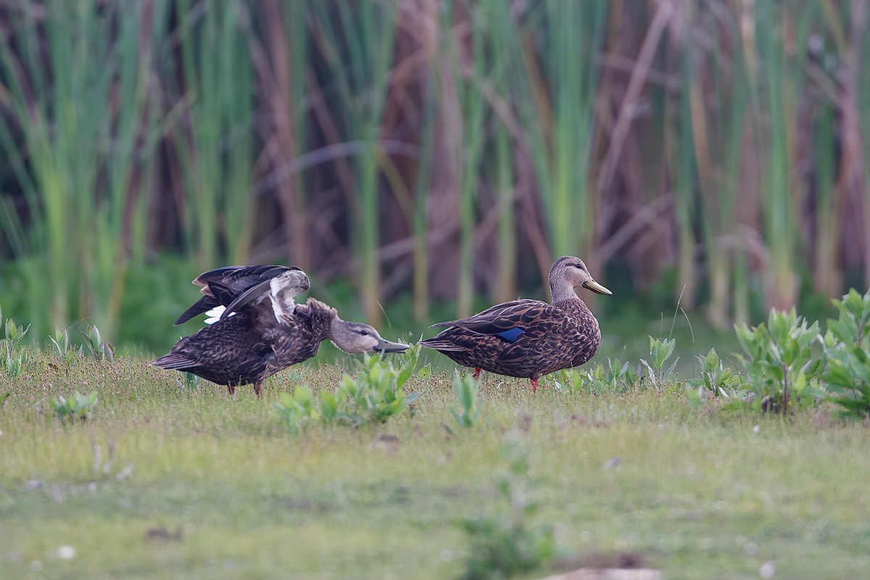
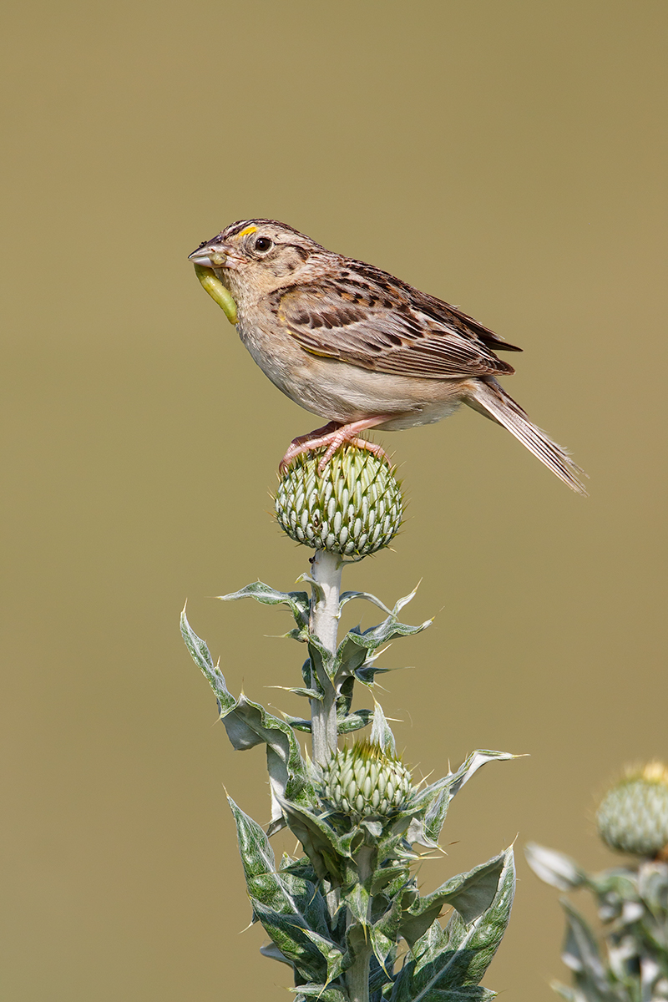
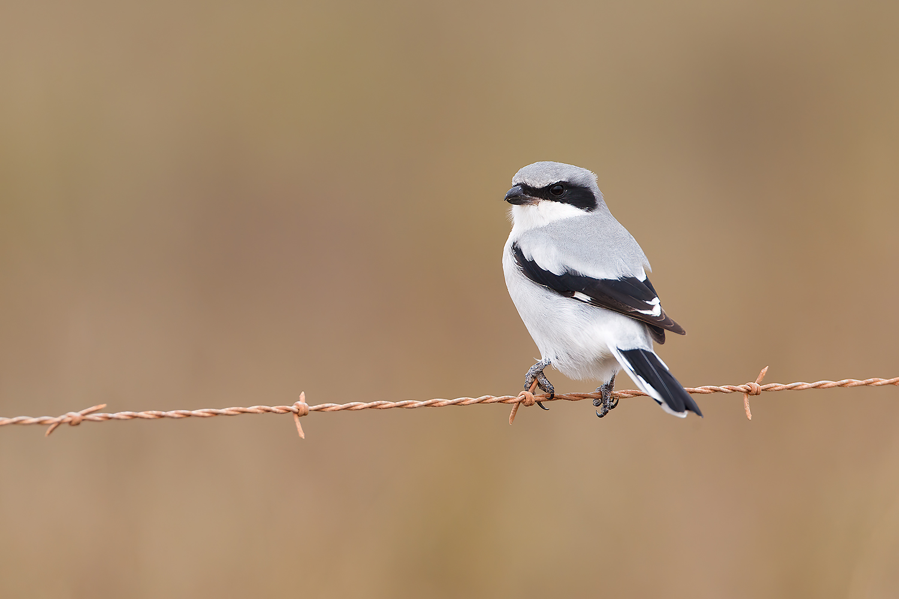
It’s for the Birds!
E. Meadowlark
Mottled duck
Northern Bobwhite Quail
Grasshopper sparrow
Loggerhead shrike

Slide 7
What practices count?
Brush management (mechanical or chemical)
Invasive herbaceous plant control
Range planting
Fences to aid in grazing management
Prescribed burning
Firebreak creation
Prescribed grazing
Disking for early successional plant growth

Slide 8
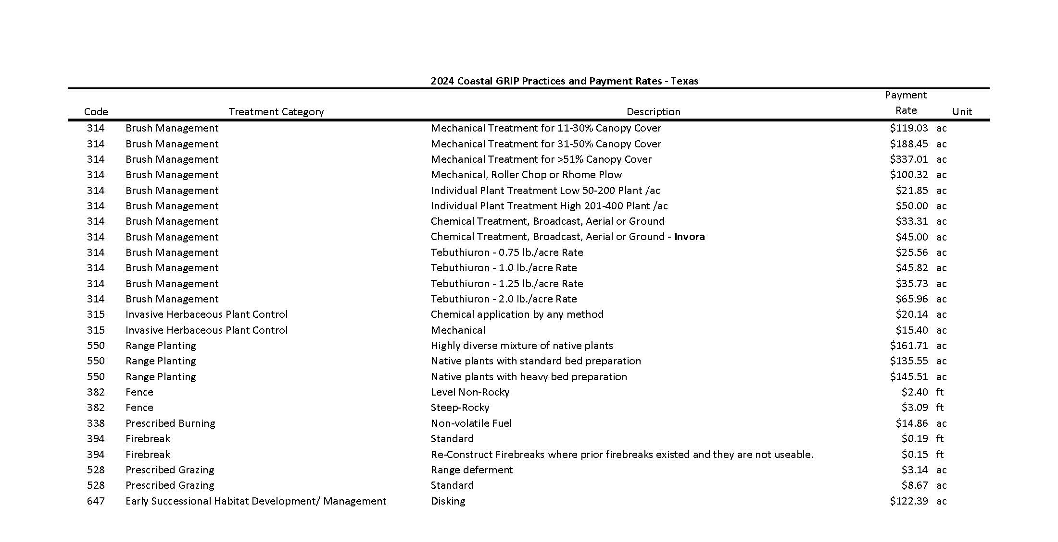

Slide 9
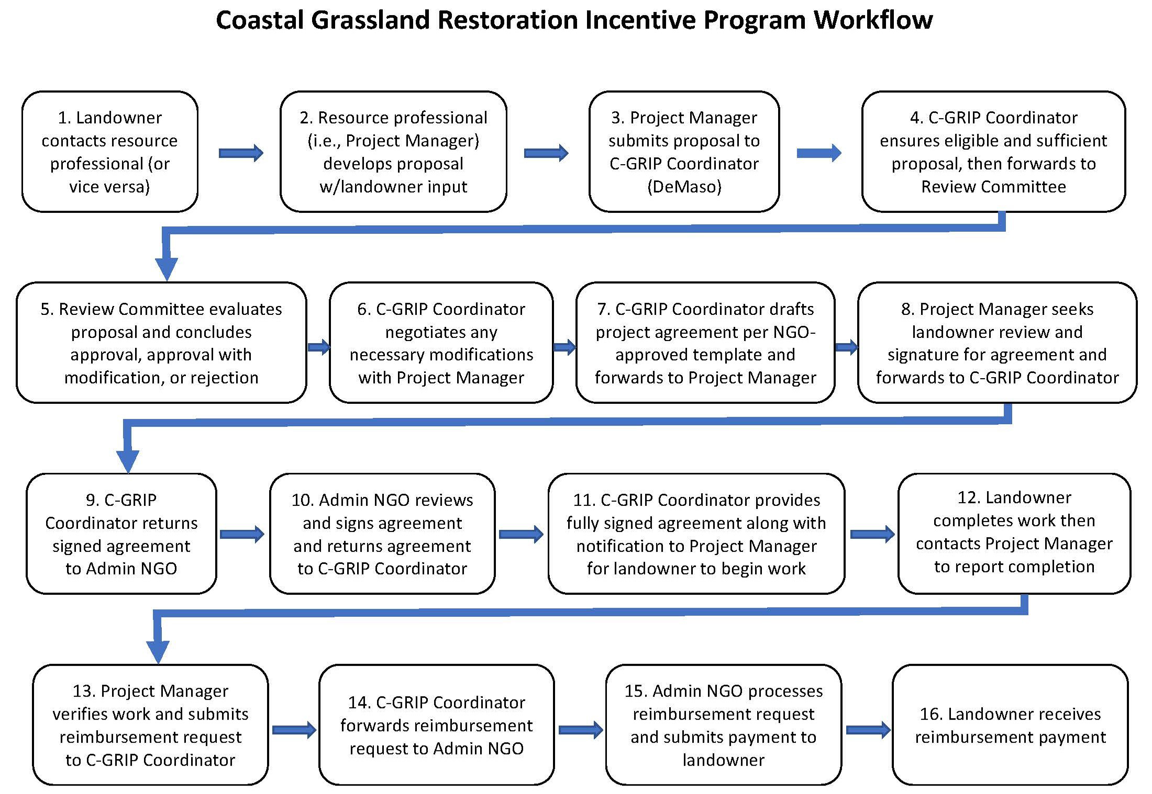

Slide 10
C-GRIP Annual Funding Cycle
1 September- 31 August
  Projects need to be completed by July 15
Annual amount for Projects:
~$222,000

Slide 11
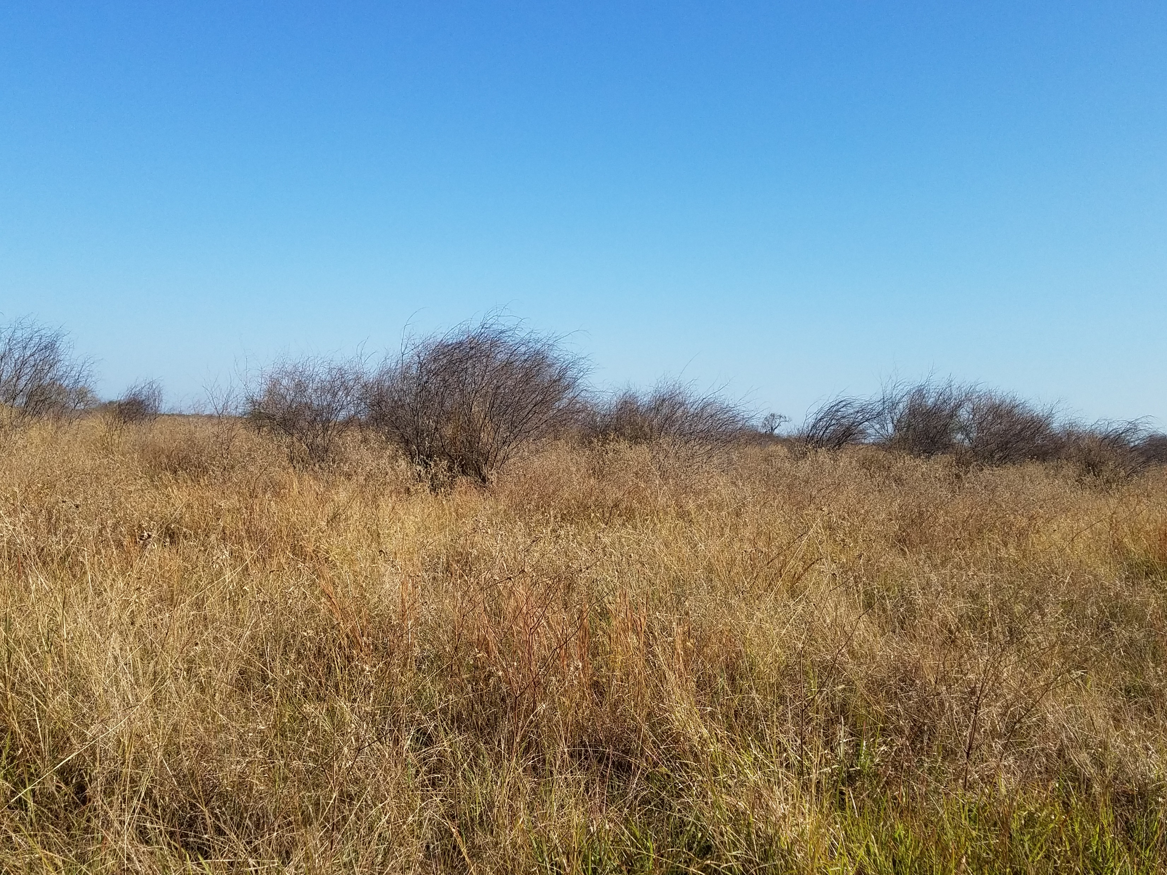
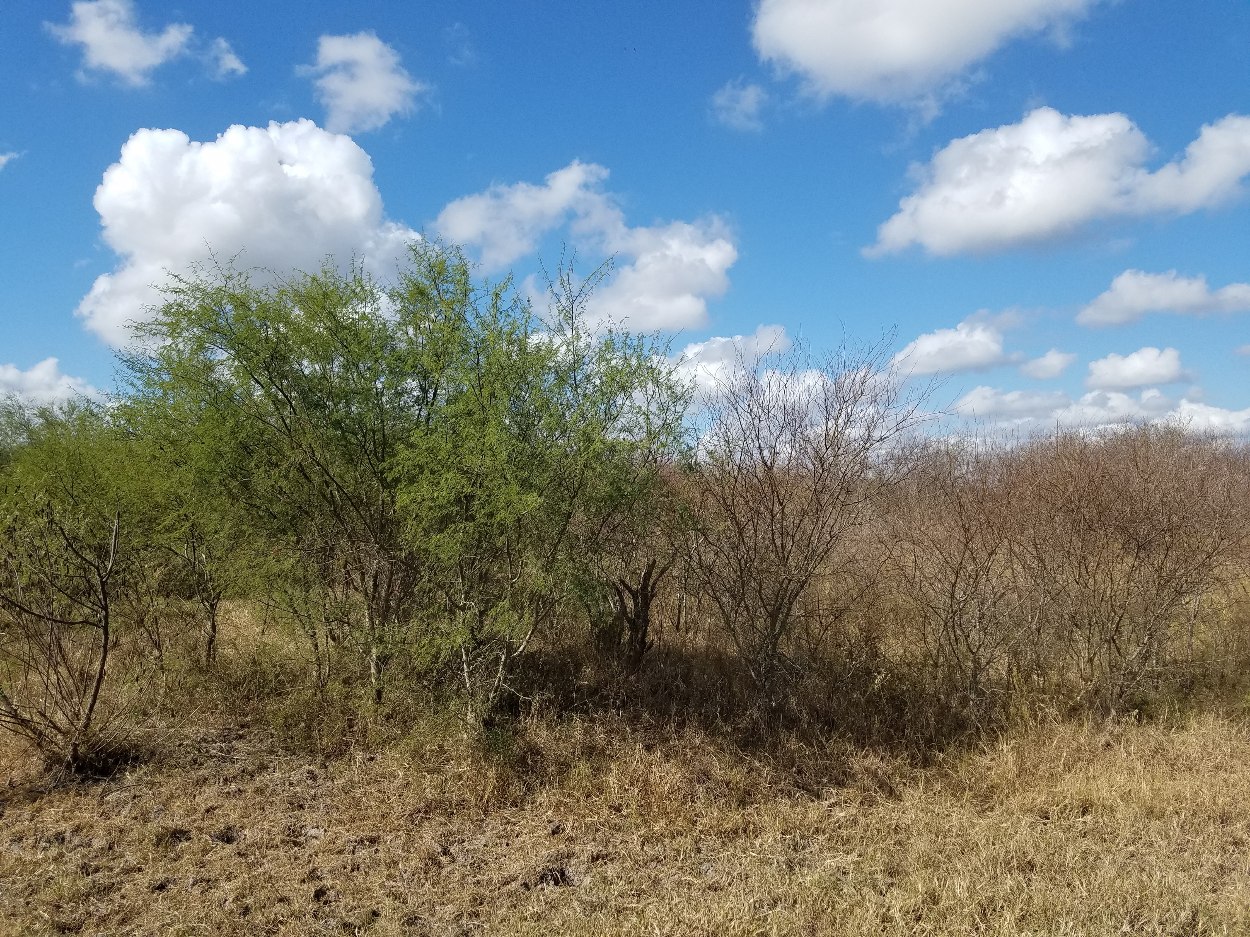
Brush Management – Aerial spraying
Notes:
Second photo shows distinct line of treated vs non-treated huisache

Slide 12
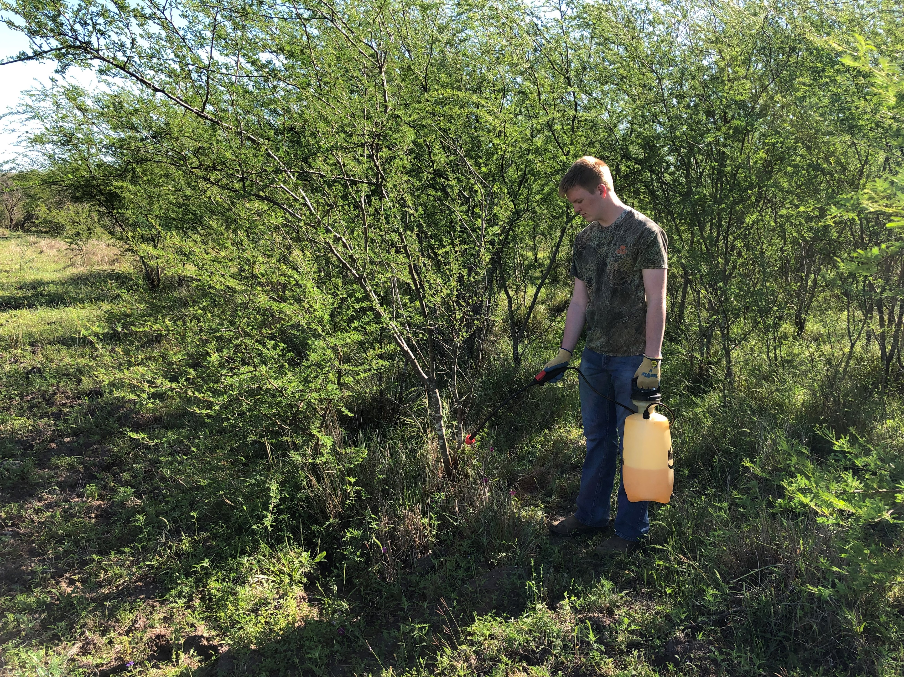
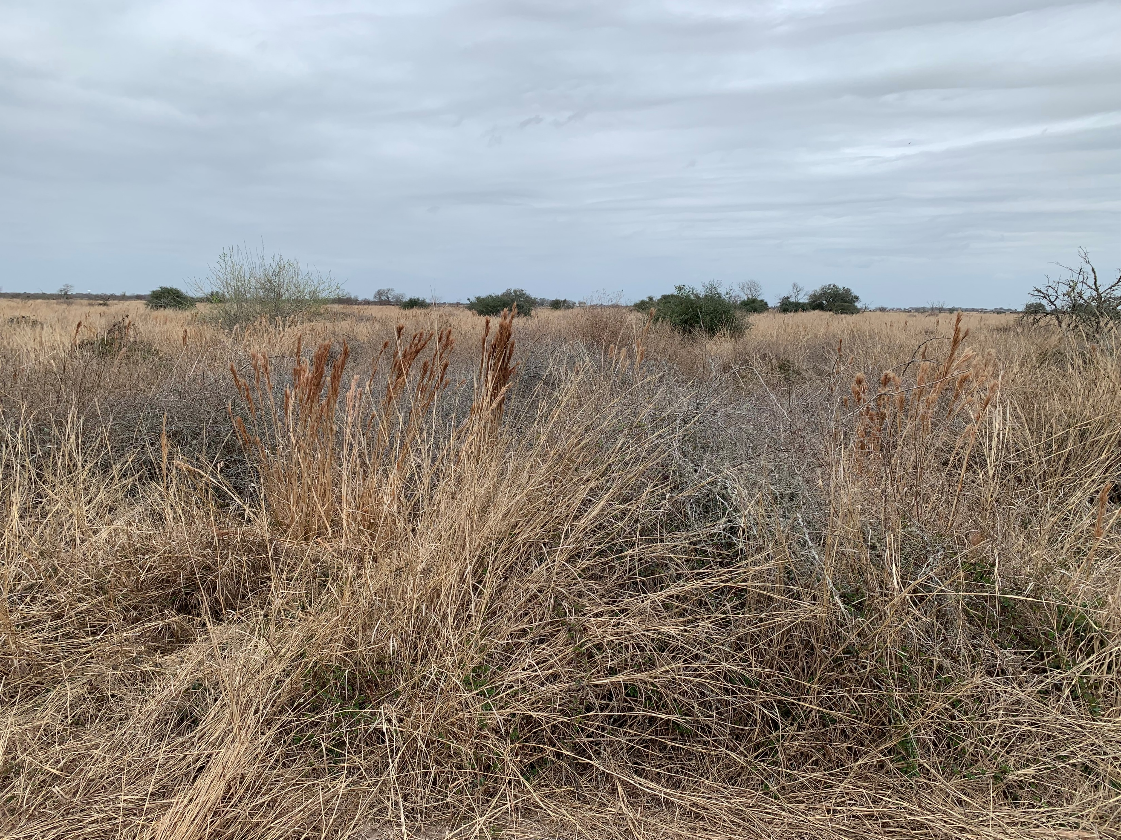
Brush Management – IPT
Notes:
IPT of huisache (first photo) and KR/ rose (second photo)

Slide 13
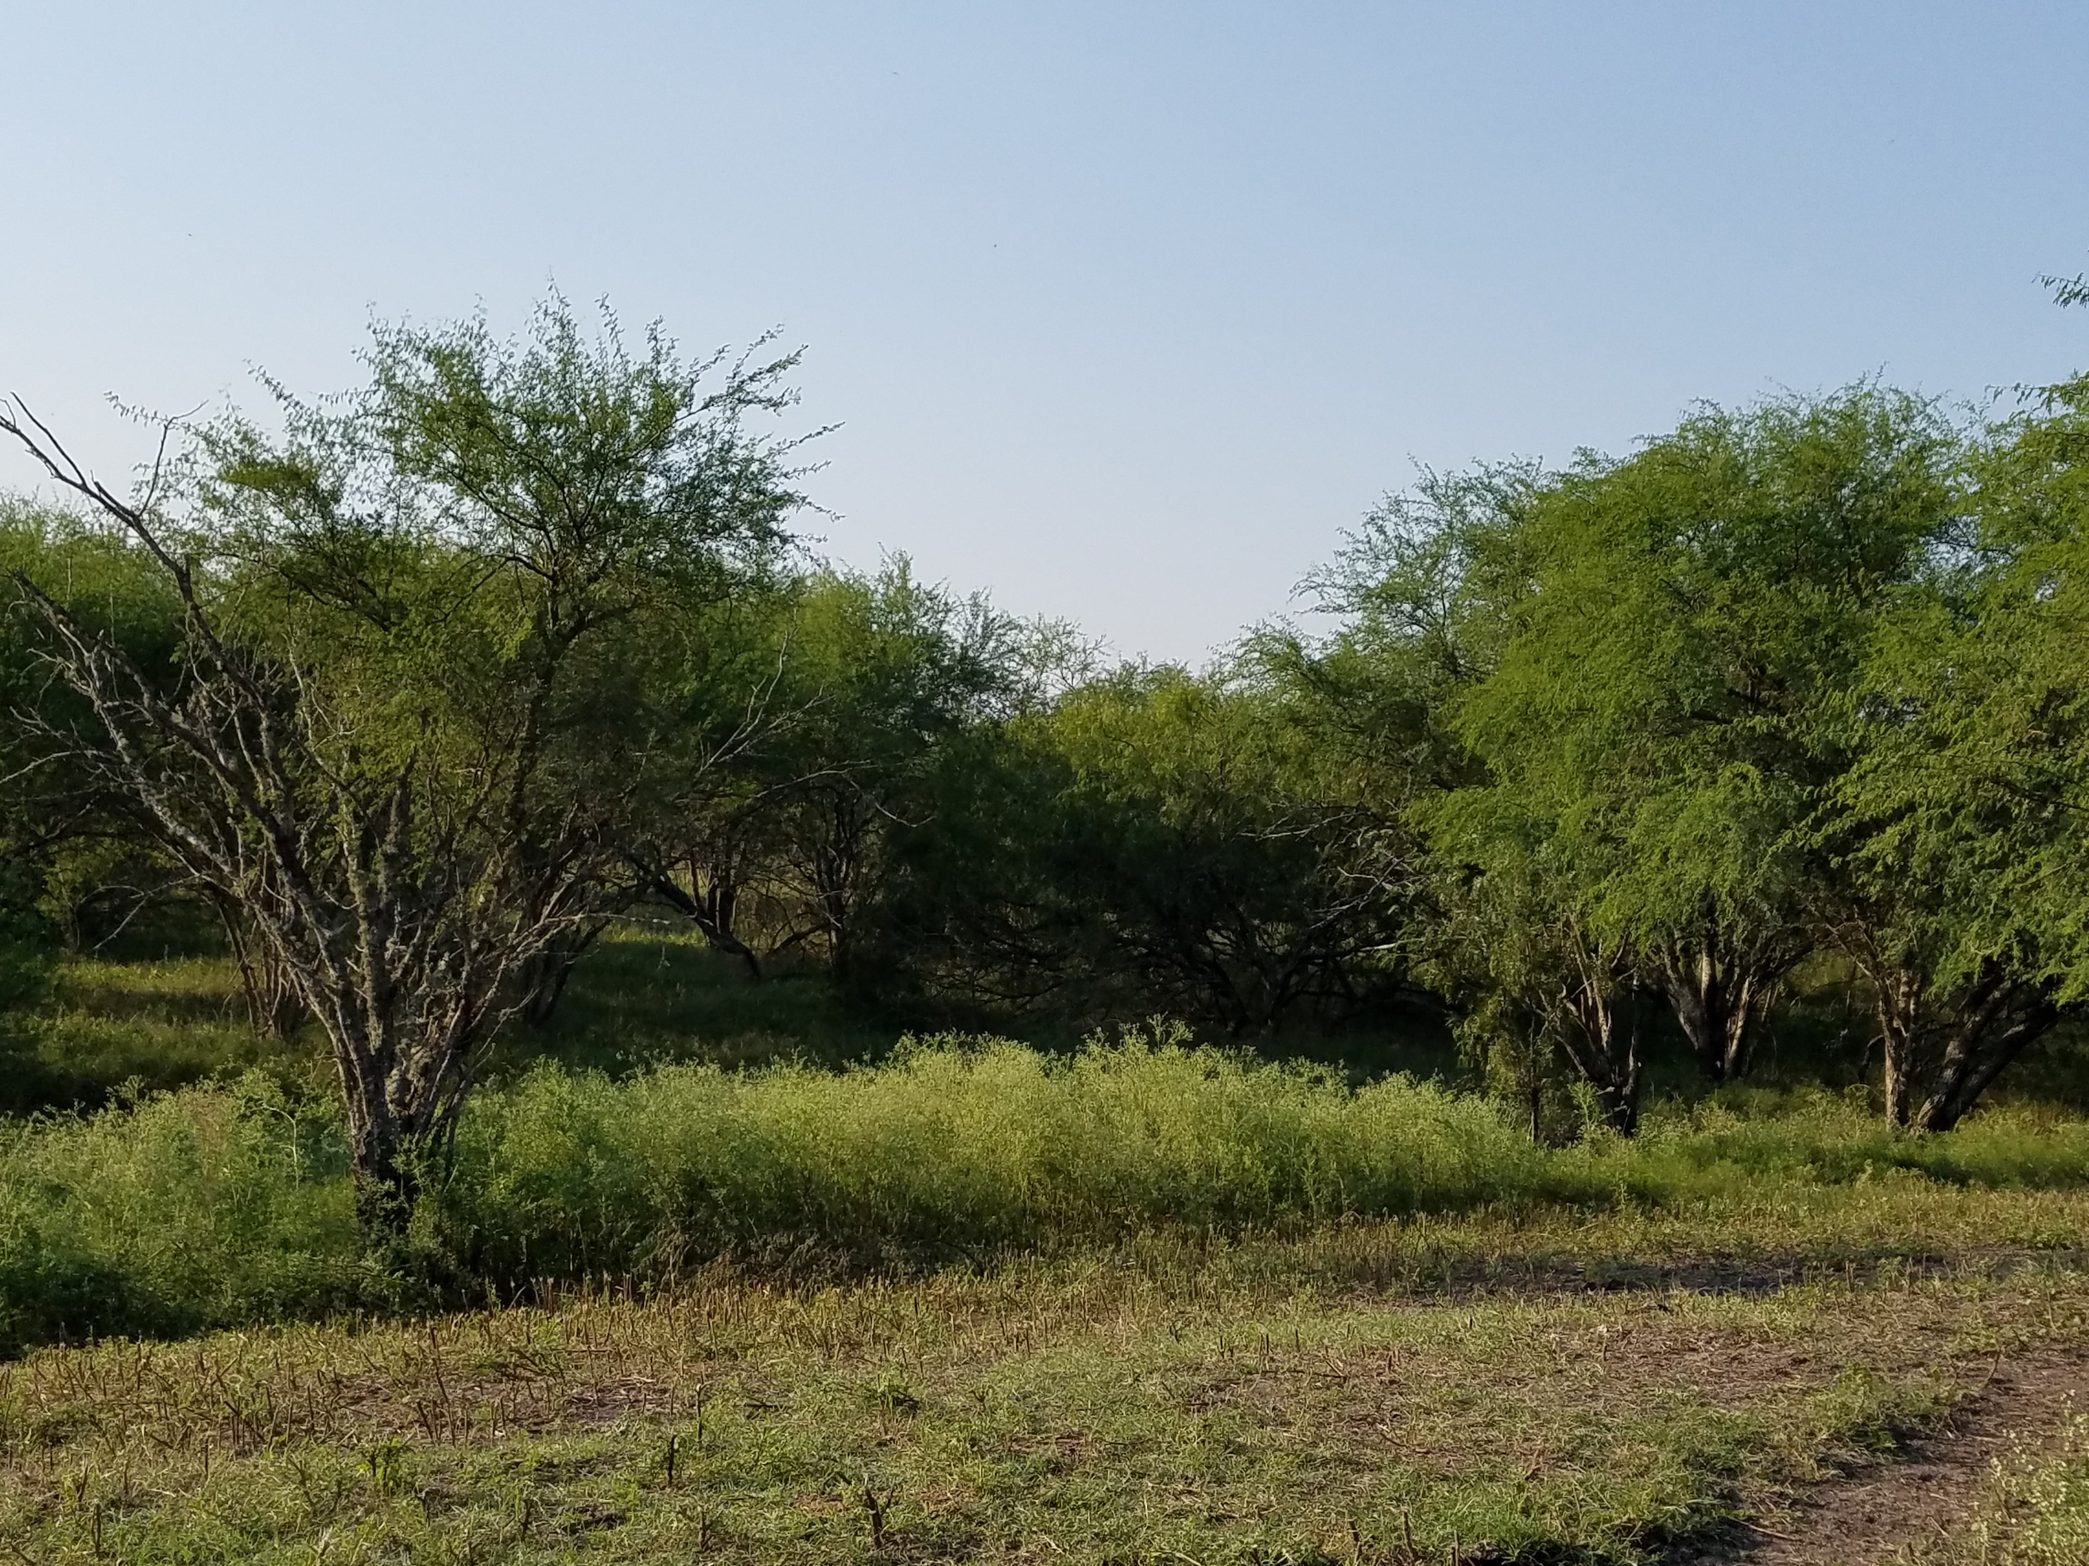
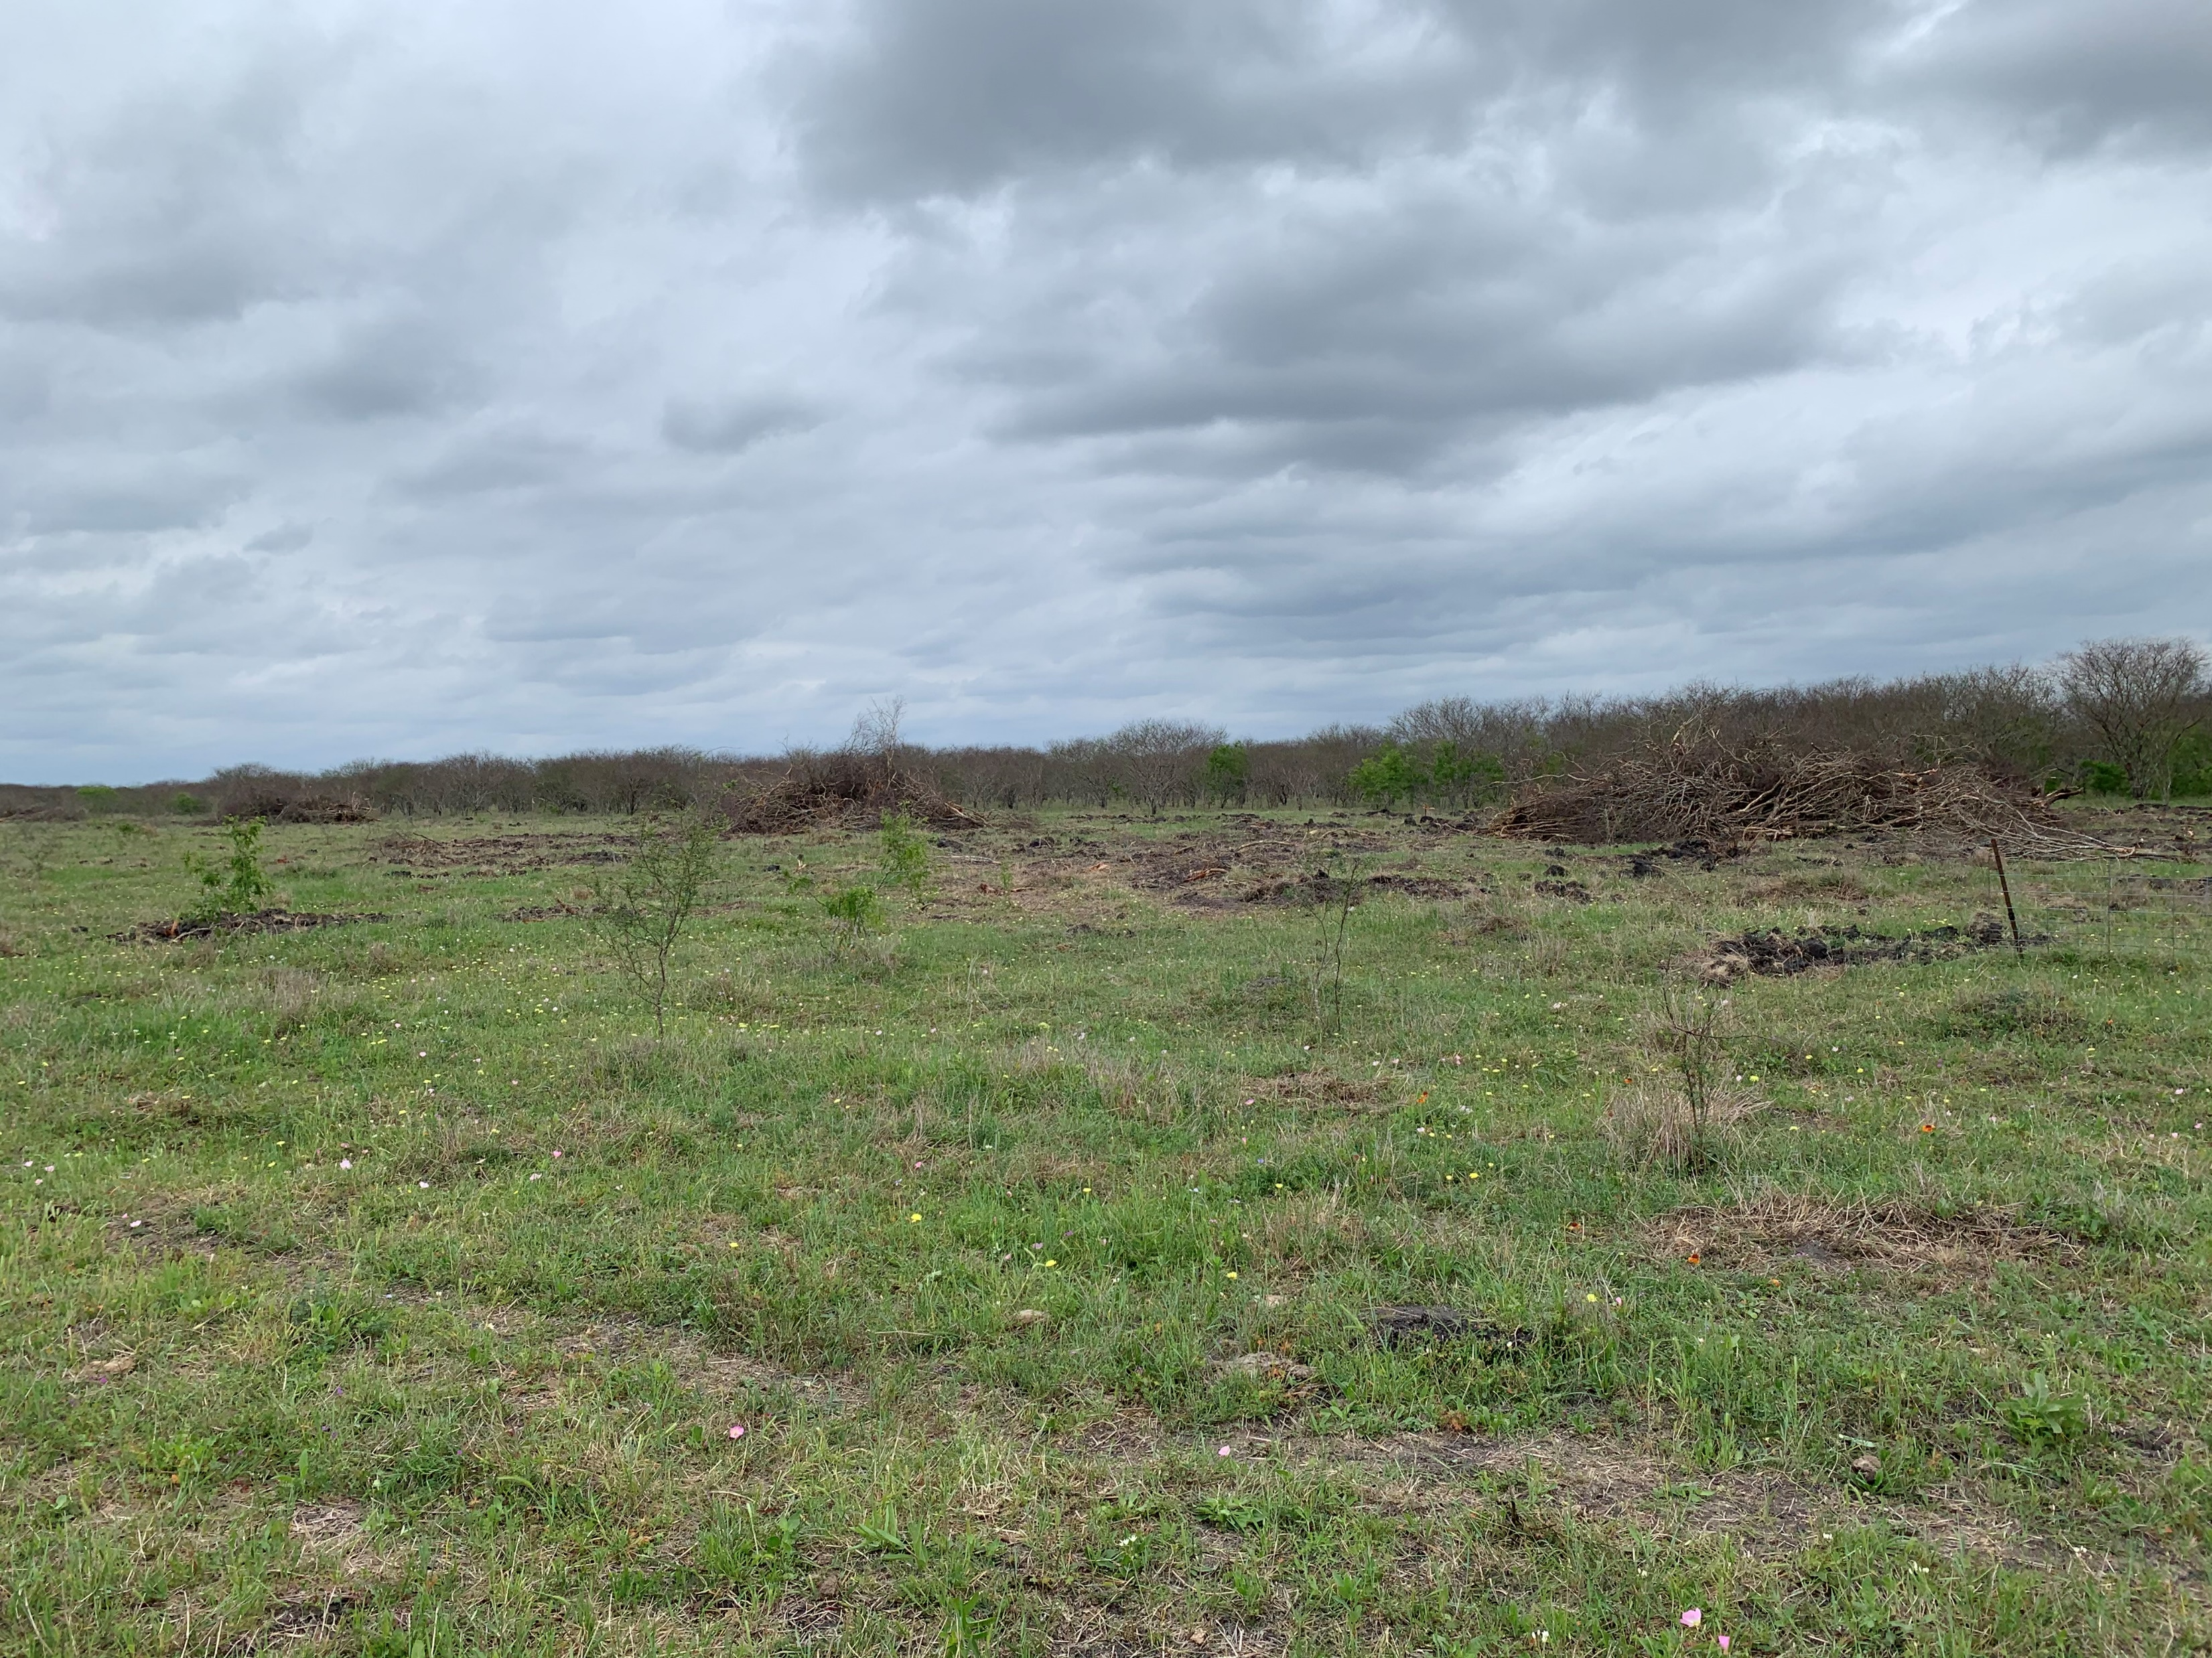
Brush Management- Mechanical
Notes:
Huisache infestation. Grubber used for larger plants

Slide 14
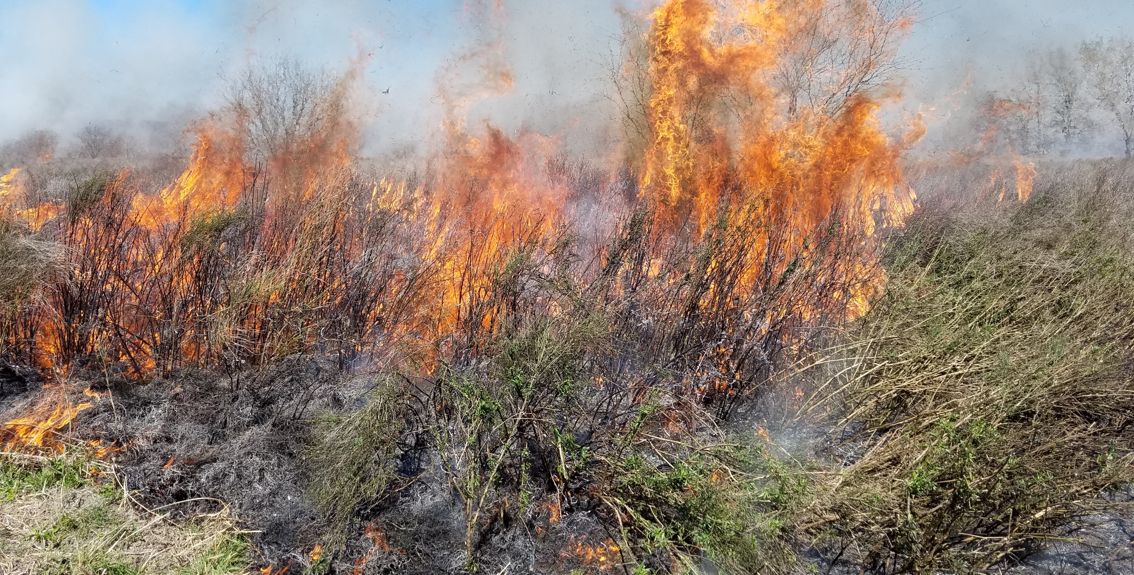
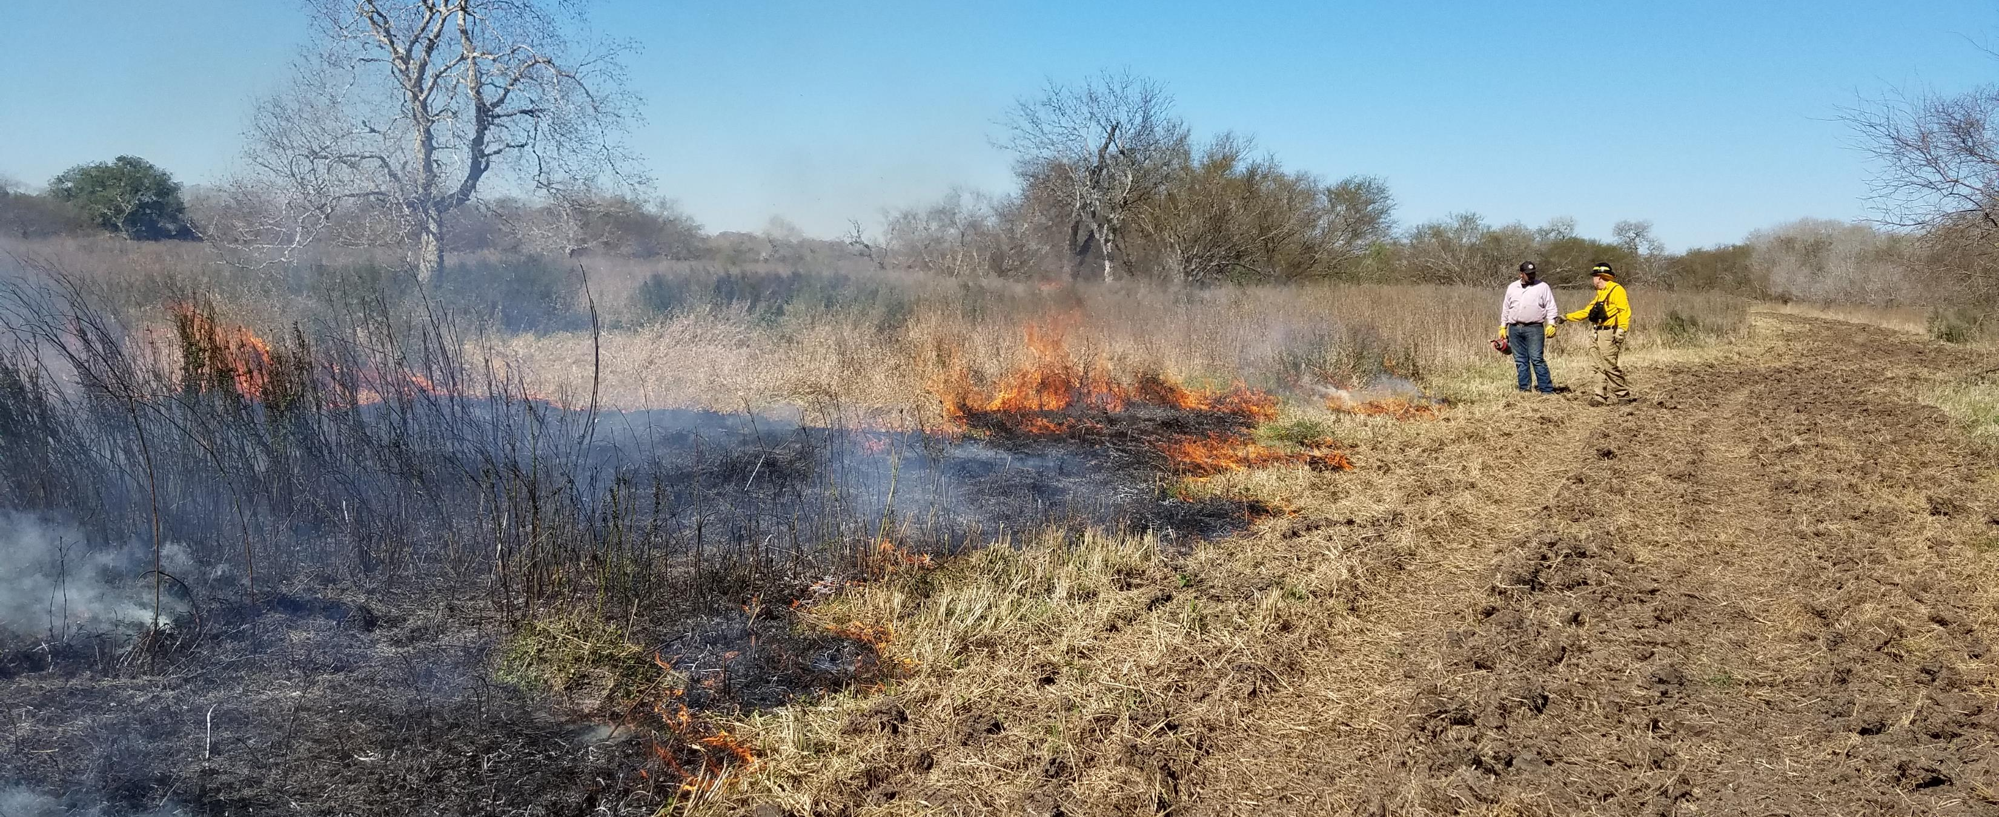
Prescribed Fire
Stack firebreak creation and prescribed fire payment rates

Slide 15
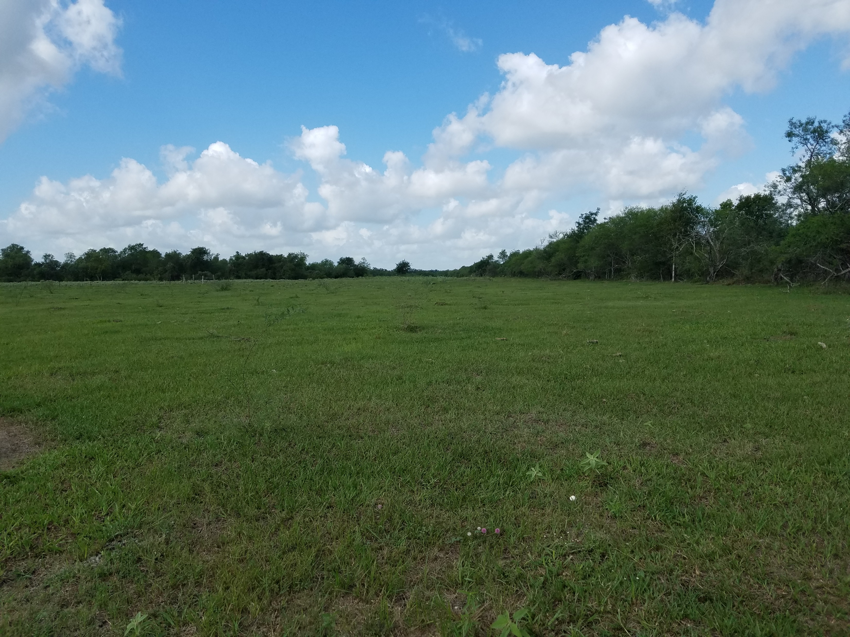
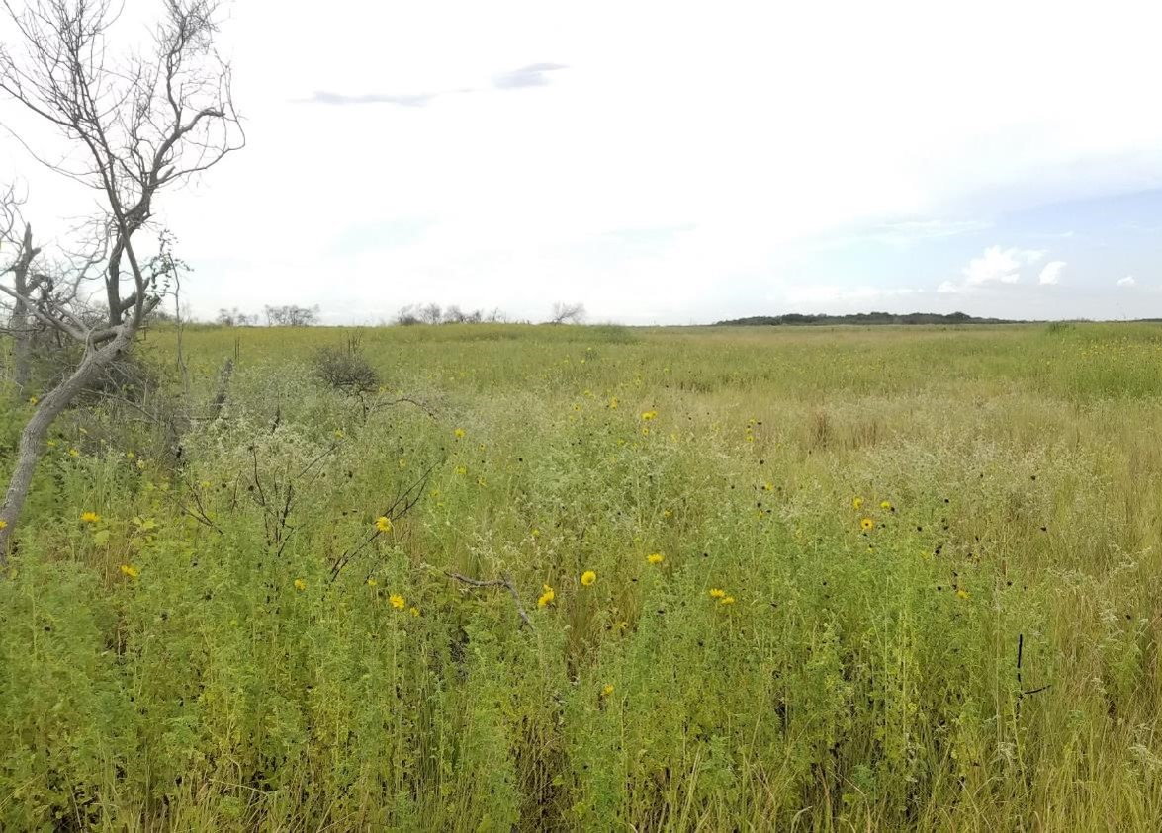
Promoting healthy grasslands
Prescribed grazing, Cross fencing
Notes:
We’d much rather see the land look like the second photo rather than the first

Slide 16
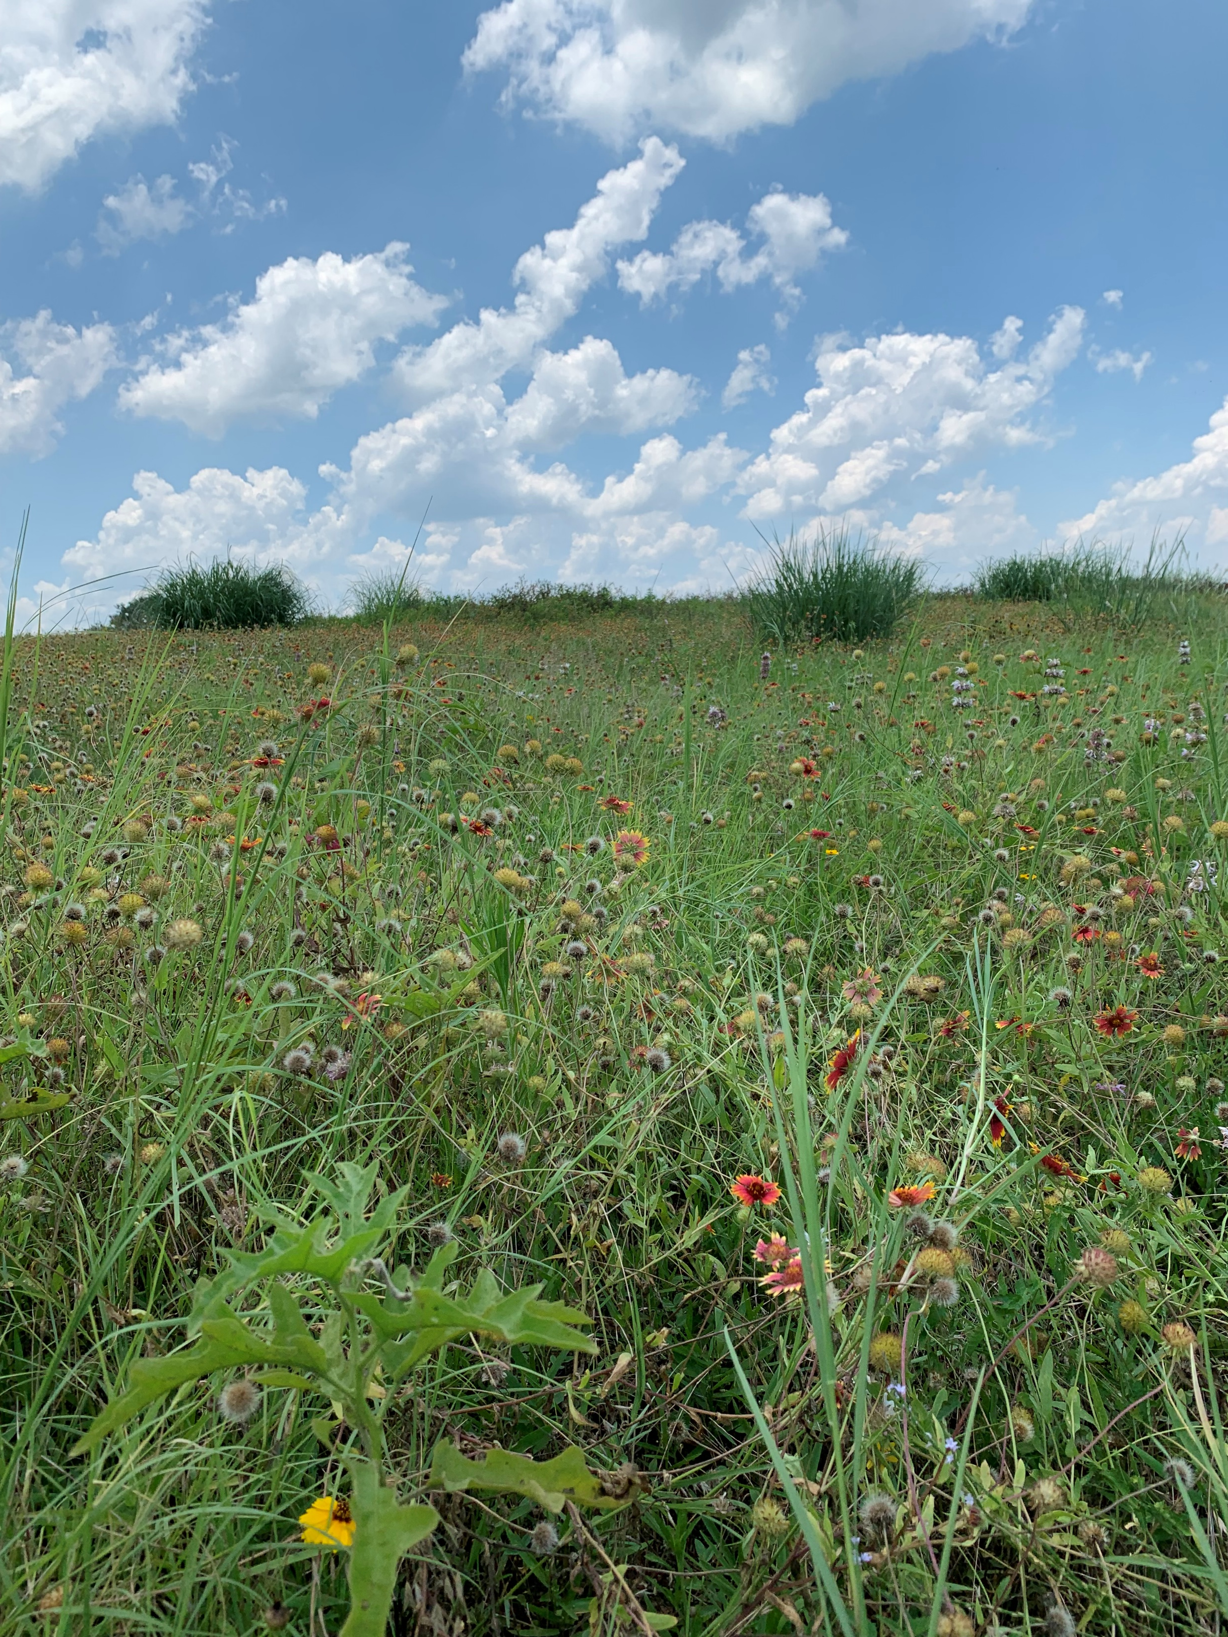
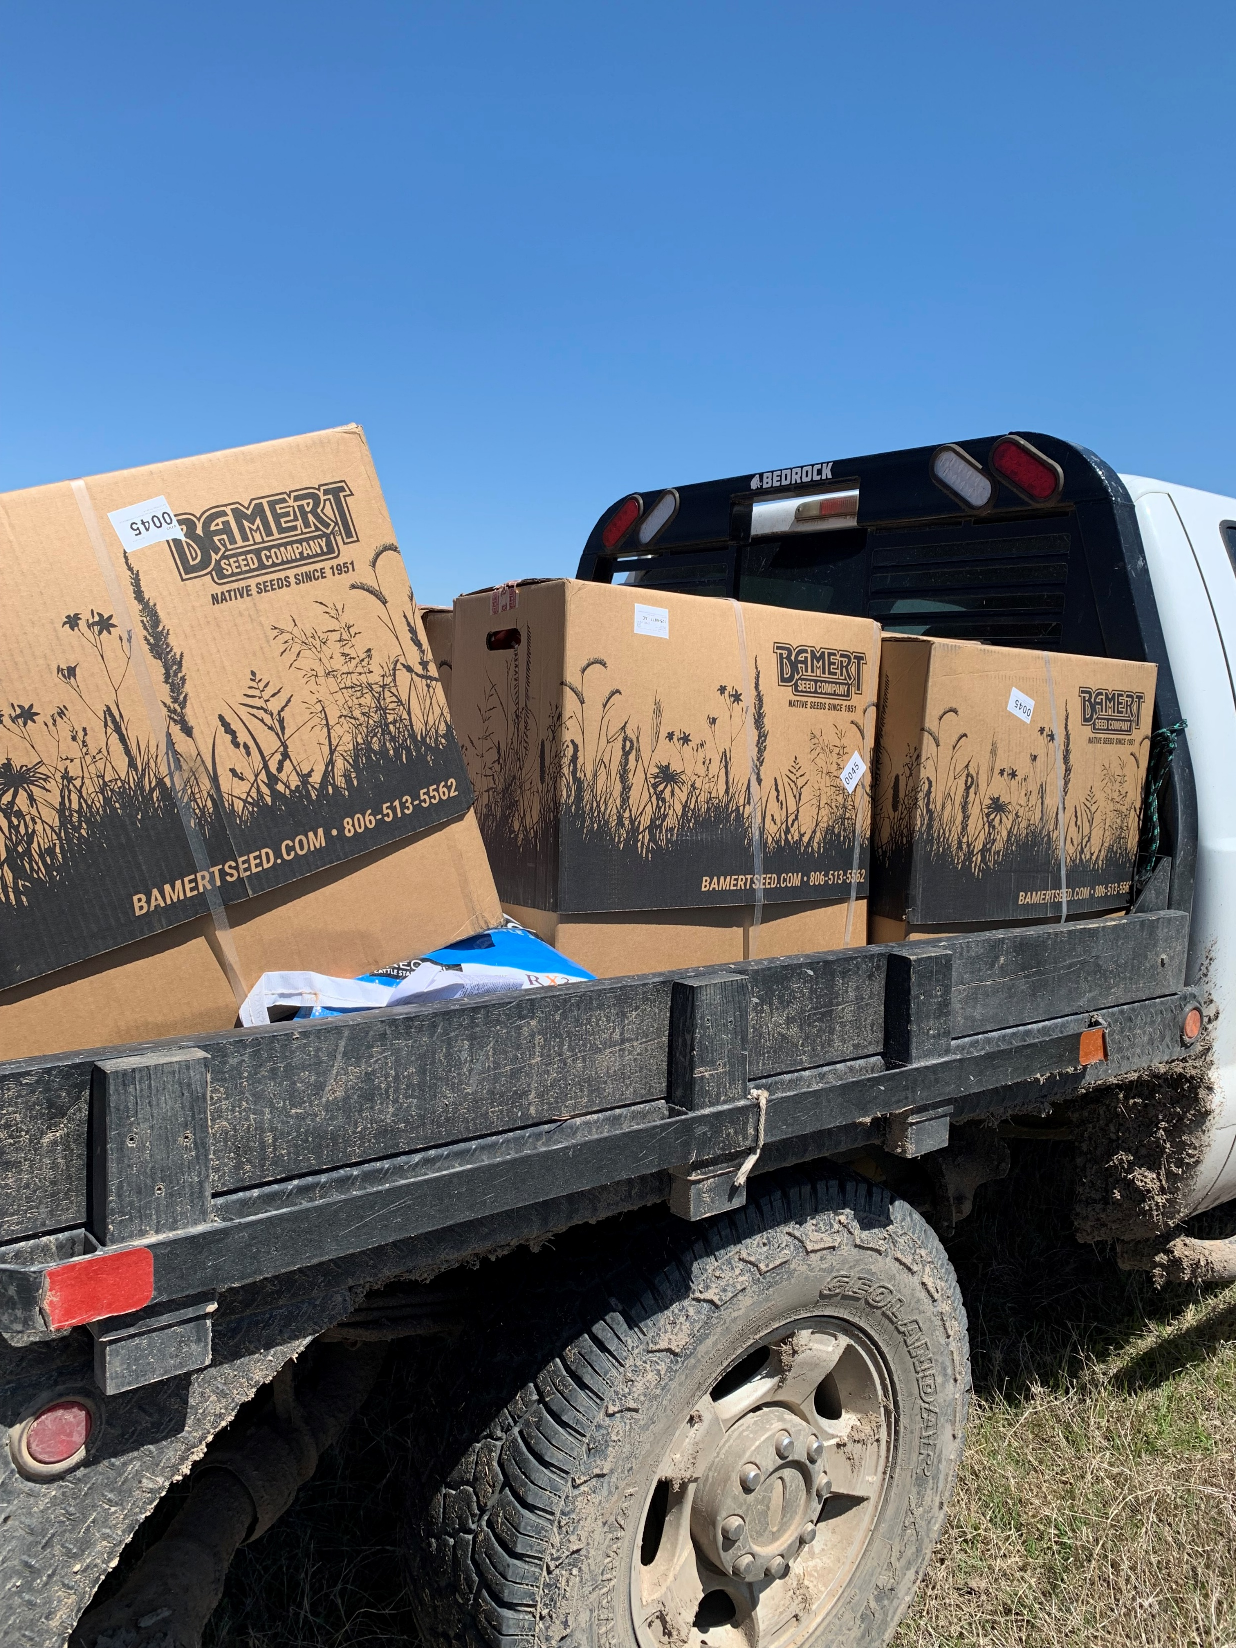
Range planting with native seed

Slide 17
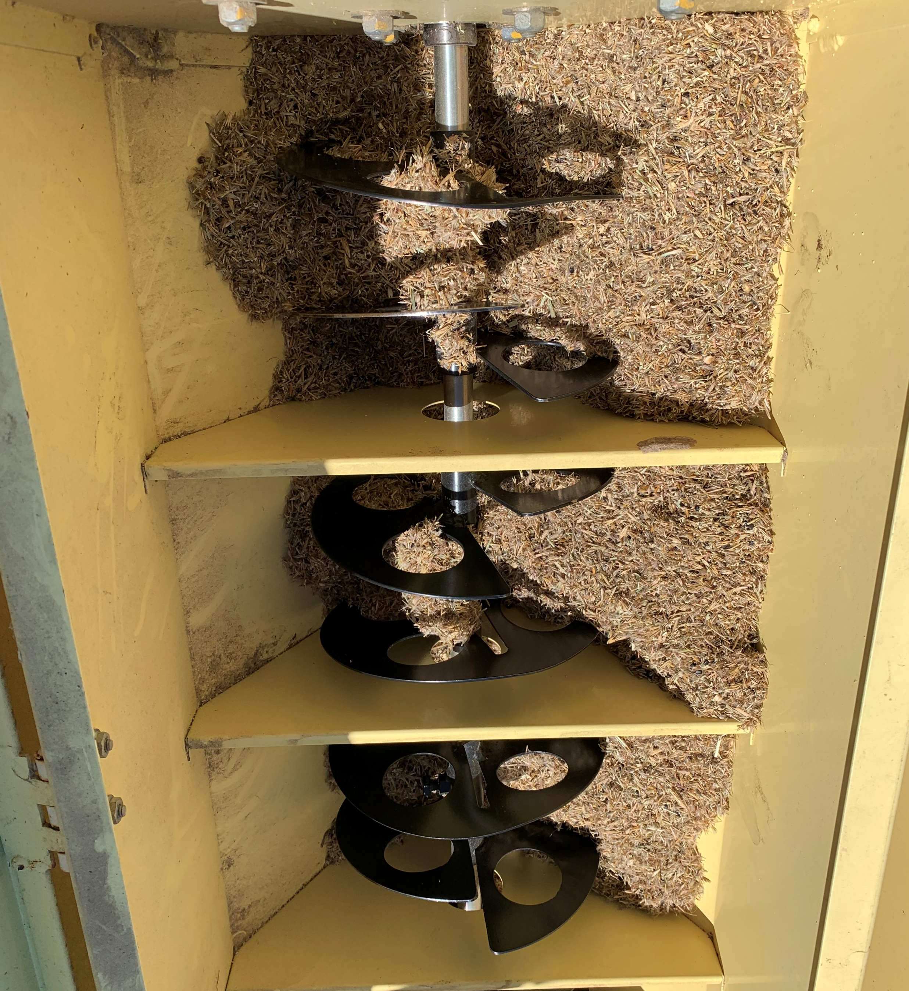
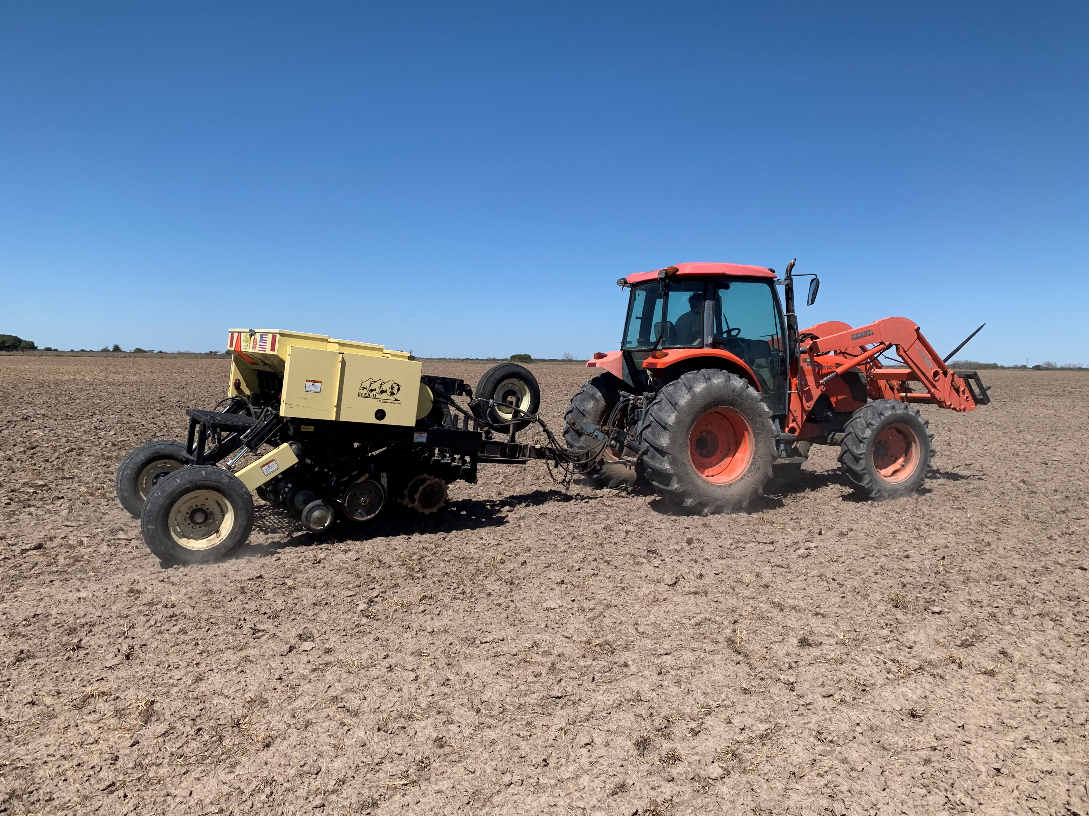
Native seed drill

Slide 18
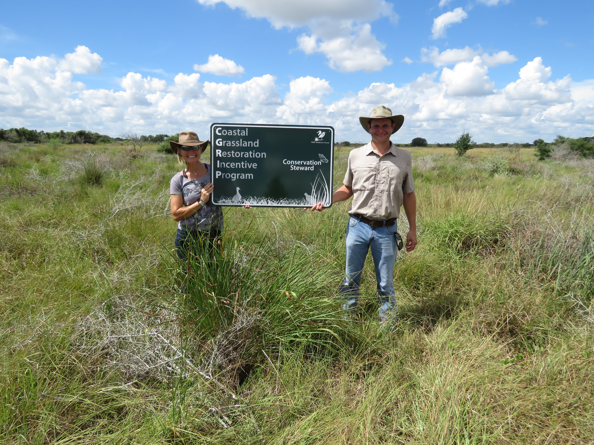
Questions?
C-GRIP website:
www.cgrip.org

