Slide 1
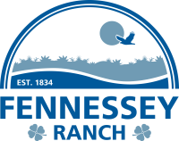

Mission Aransas National
Estuarine Research Reserve
Fennessey Ranch
Katie Swanson
Reserve/Ranch Manager
April 9, 2025

Slide 2
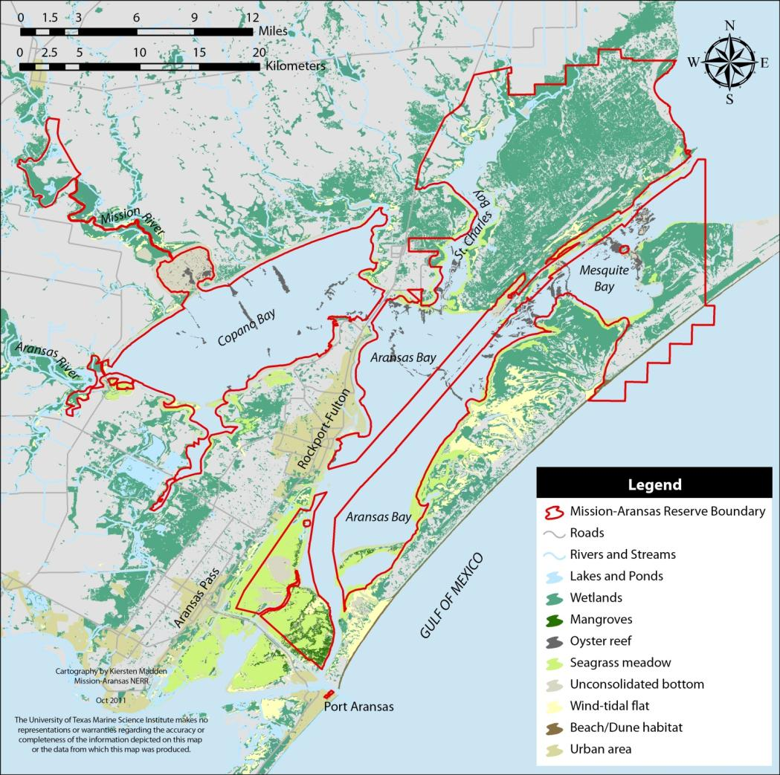
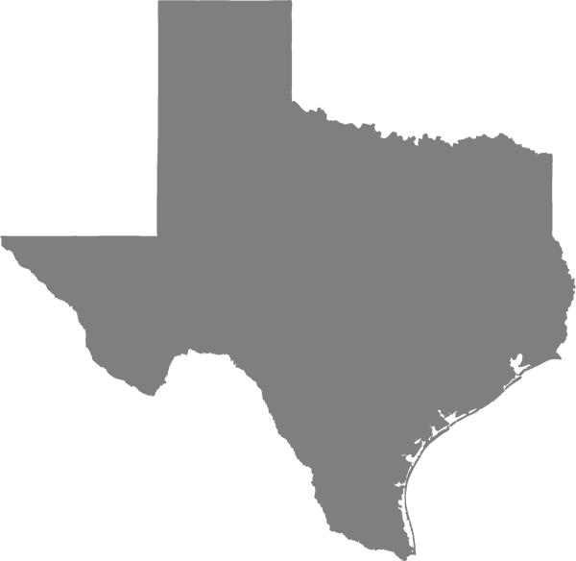
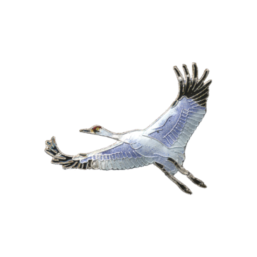
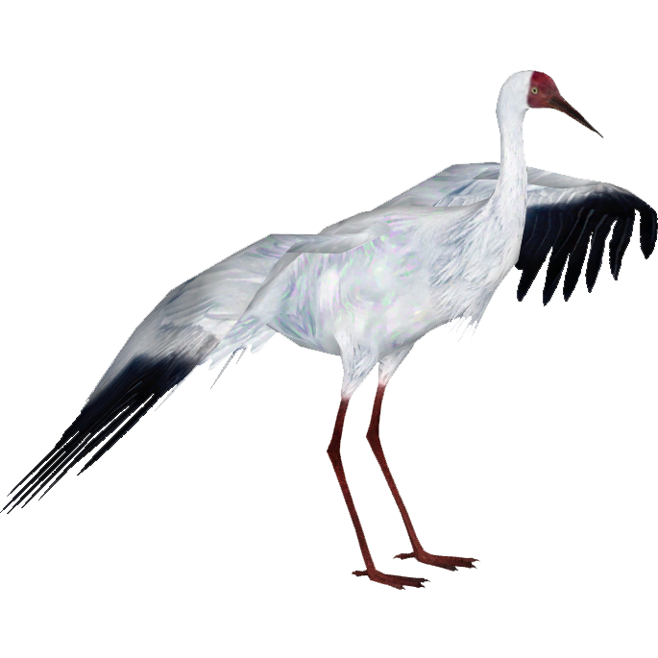
Water = 145,462 acres
Land = 40,727 acres
TOTAL = 186,189 acres
#MissionAransas
Notes:
We are the 3rd largest NERR at 186,189 acres
The only NERR in Texas
The only NERR west of the Mississippi in the Gulf of Mexico

Slide 3
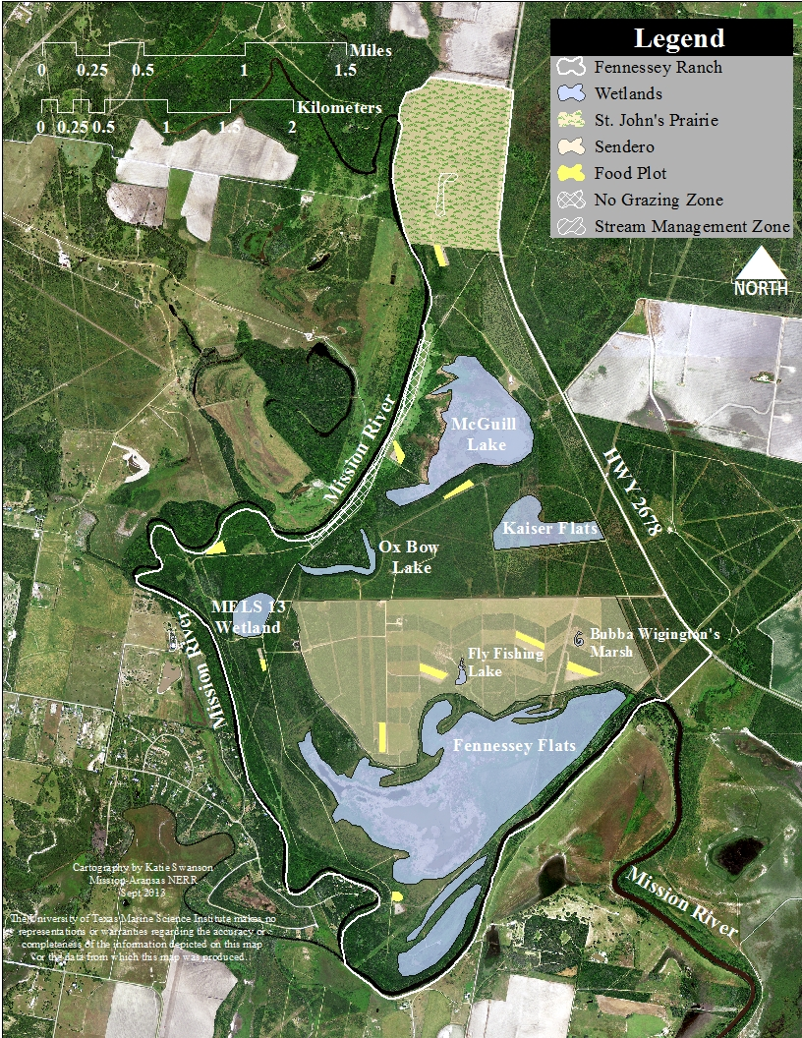
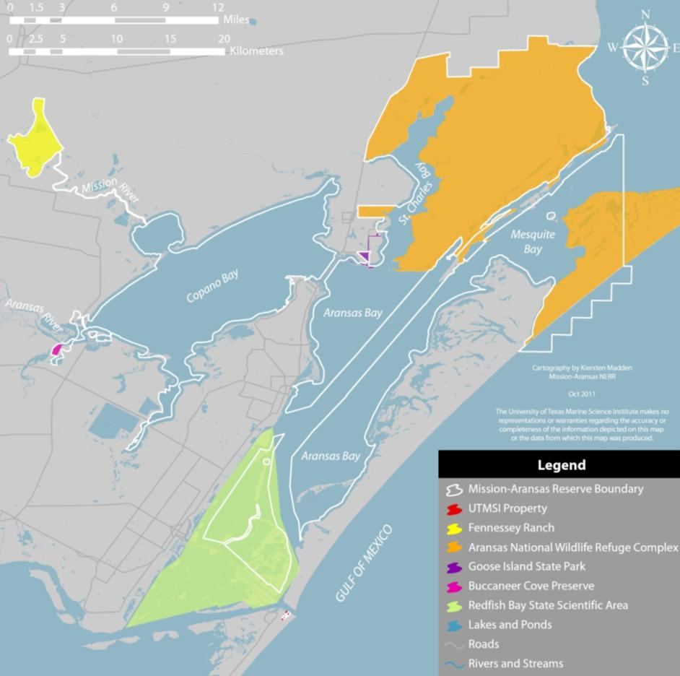
Fennessey Ranch
3,261 acre Fennessey Ranch

Slide 4
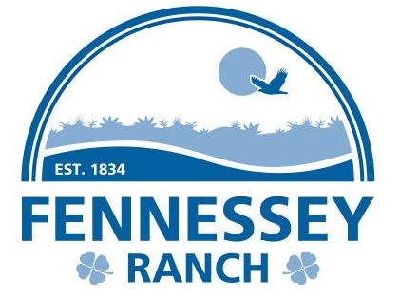
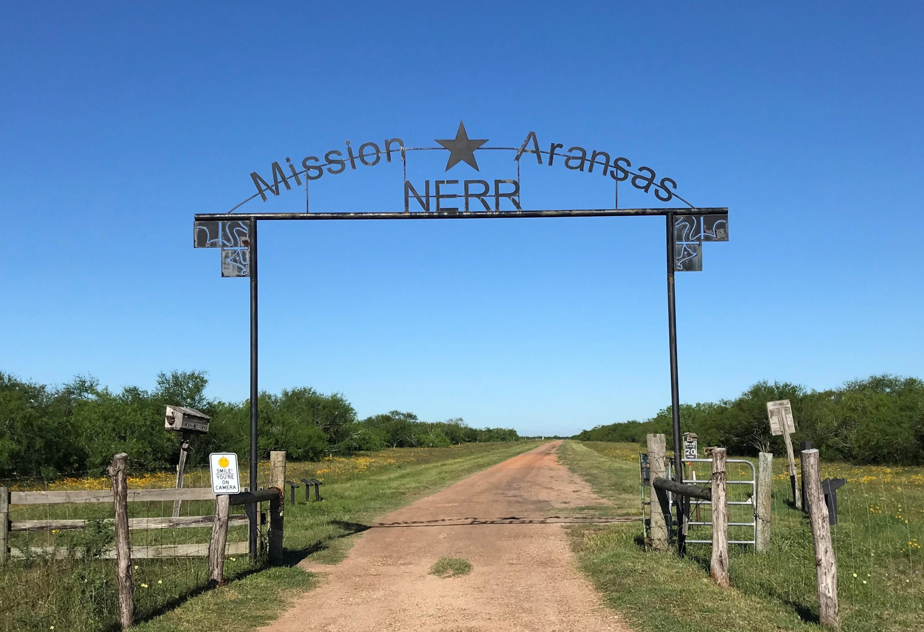
Notes:
The Fennessey Ranch is part of a legendary 750,000 acre Texas land empire that has remained in the same family for 171 years. The ranch consists of approx. 3,300 acres of abundant wetlands, meadows, natural lakes, riparian woods and brush land and bordered on three sides by the Mission River. The Fennessey is located in the heart of the Central Flyway along a region of the Texas coastline known as the "Coastal Bend." The Fennessey has opened its gates for a wide array of unique recreational opportunities.

Slide 5
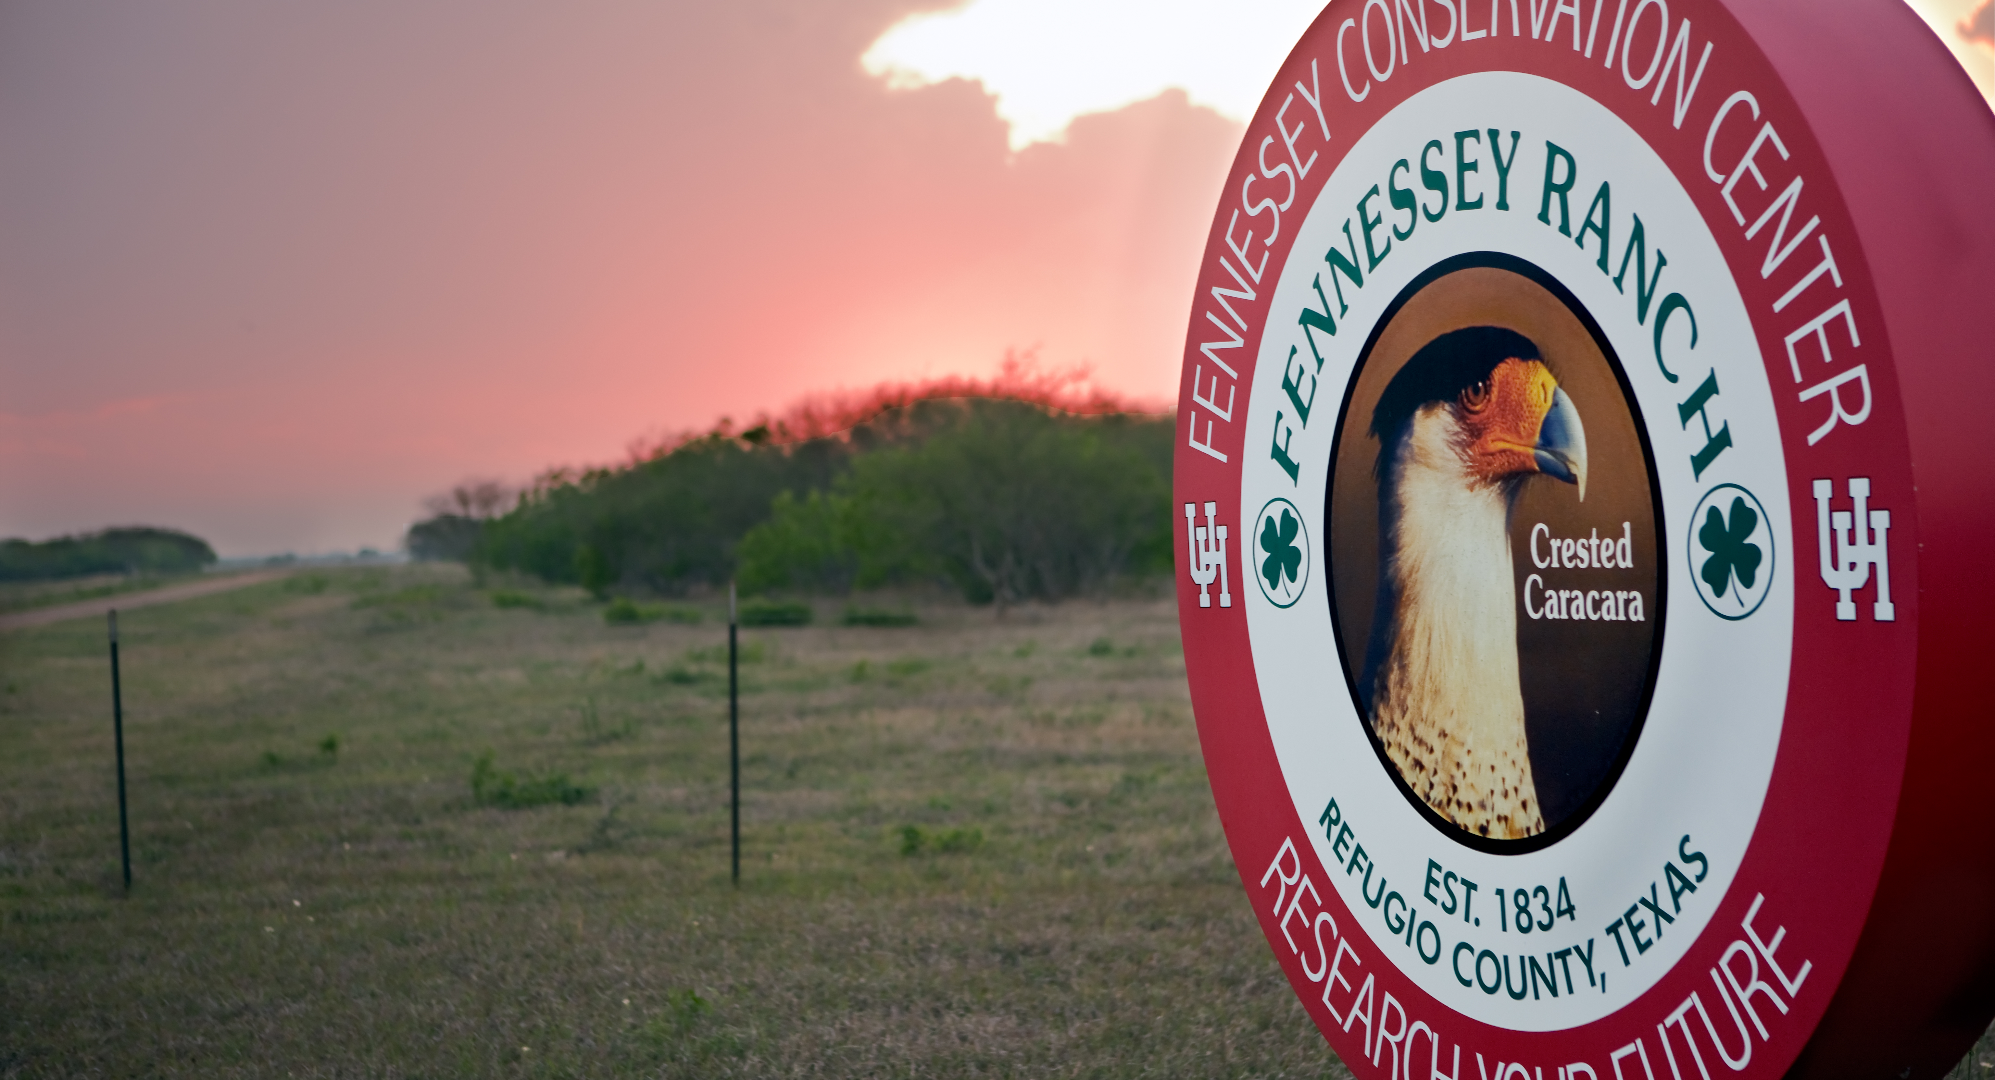
Fennessey Ranch- History
Notes:
The Fennessey Ranch is part of a legendary 750,000 acre Texas land empire that has remained in the same family for 171 years. The ranch consists of approx. 3,300 acres of abundant wetlands, meadows, natural lakes, riparian woods and brush land and bordered on three sides by the Mission River. The Fennessey is located in the heart of the Central Flyway along a region of the Texas coastline known as the "Coastal Bend." The Fennessey has opened its gates for a wide array of unique recreational opportunities.

Slide 6
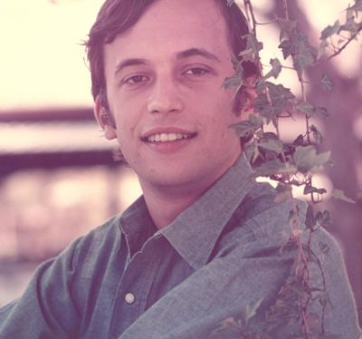
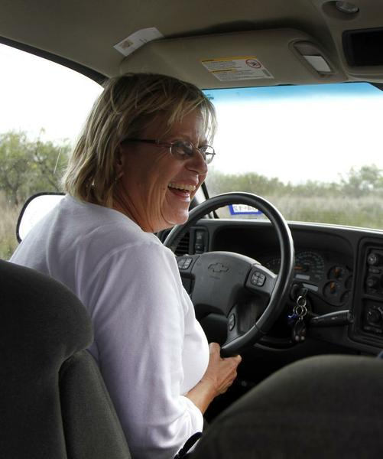
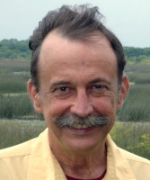
Brien O’Connor Dunn
Sally Crofutt
Owner, 1950-2016
"What I'm trying to achieve here is a for-profit renewable resource plan to keep landowners on their land; to bring the urban dollar to the countryside in the form of bird watchers."
Ranch Manager, 1992-2019
Notes:
Fennessey Ranch is part of the vast O’Connor family land empire in South Texas. In 1834, fifteen-year-old Thomas O’Connor came to South Texas from County Wexford, Ireland. In a fortune of fate, Thomas’s uncle, James Power, was an empresario, entrepreneurs who operated as land agents for the Republic of Mexico to bring in settlers who would develop the country’s unpopulated northern reaches. In exchange, the settlers would receive title to land. Thomas’s land grant was for 4,428 acres. He received an additional 1,280 acres as a reward for military service on behalf of the Texas Republic (he fought at the Battle of San Jacinto and signed the Goliad Declaration of Independence). Thomas was one of the first Texans to fence his land, along with Richard King and Mifflin Kenedy (founders of the King Ranch). At the time of his death in 1887, Thomas had accrued more than 500,000 acres and an estate worth about $4.5 million – reportedly the largest individual land and cattle owner in Texas. Thomas’s descendants acquired additional land, culminating in 750,000 acres.
Brien O’Connor Dunn, a sixth generation Texan and descendant of Thomas O’Connor, created and pioneered conservation projects on the Fennessey Ranch. He was awarded the 1992 Outstanding Wildlife Conservationist award from the Copano Bay Soil and Water Conservation District, the 1997 National Wetland Award for Land Stewardship and Development from the Environmental Law Institute in Washington D.C., the 2006 Conservation and Environmental Stewardship Award from the Coastal Bend Bays Foundation, and the 2008-2009 Outstanding Lone Star Land Steward Award from Texas Parks and Wildlife. Brien passed away in 2016. The Ranch is now owned by the Brien O’Connor Dunn estate.

Slide 7
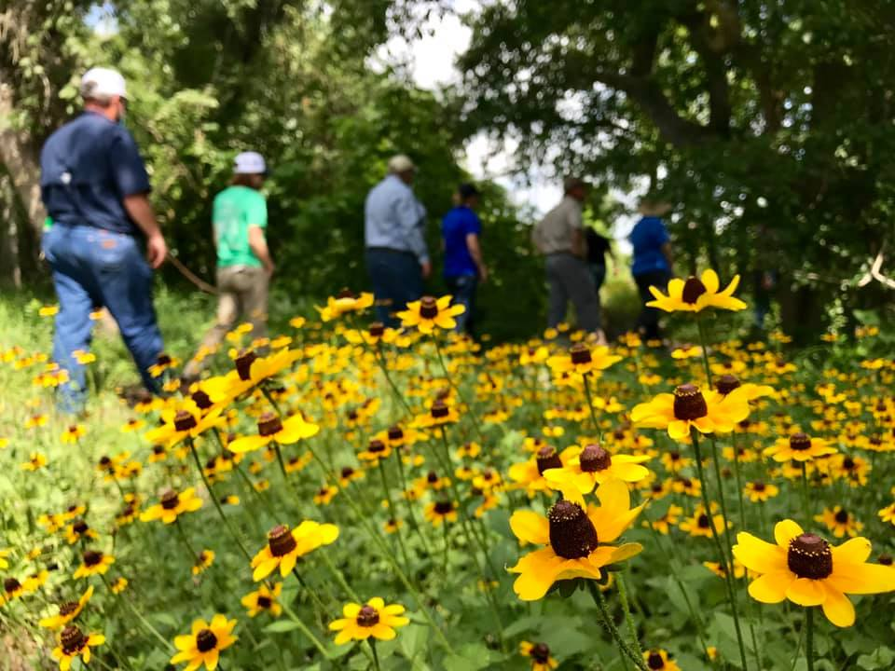
Current Goal: To maintain the Ranch.

Slide 8
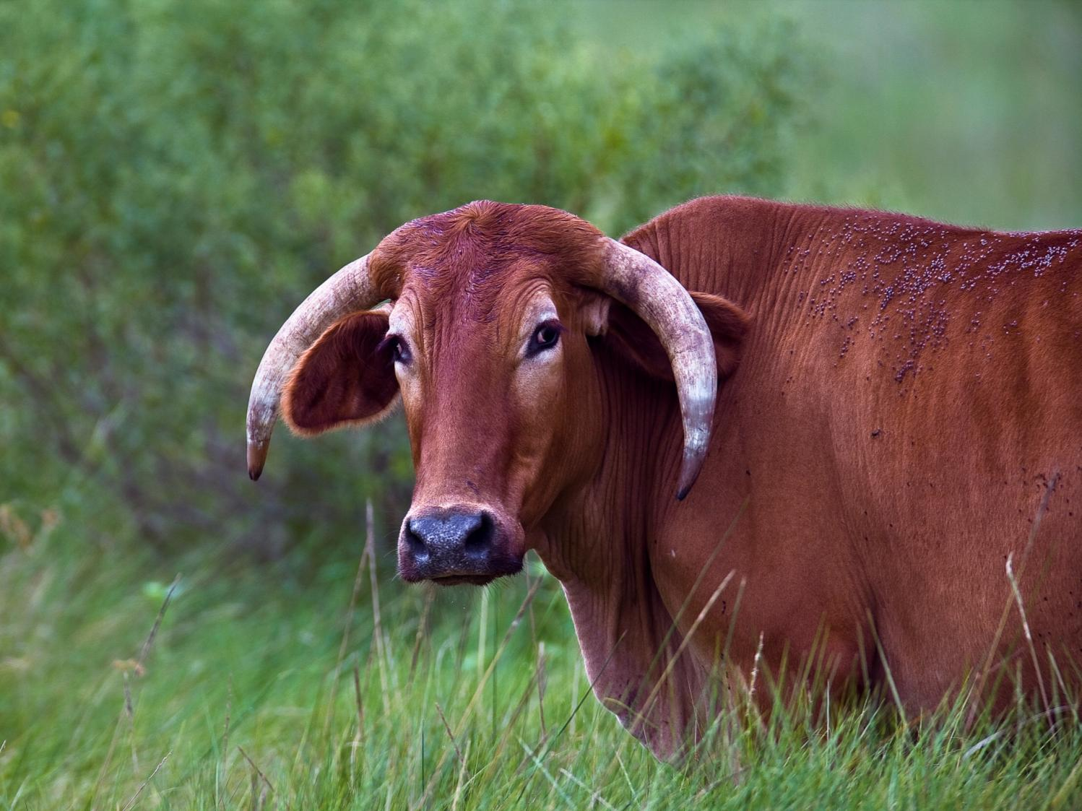
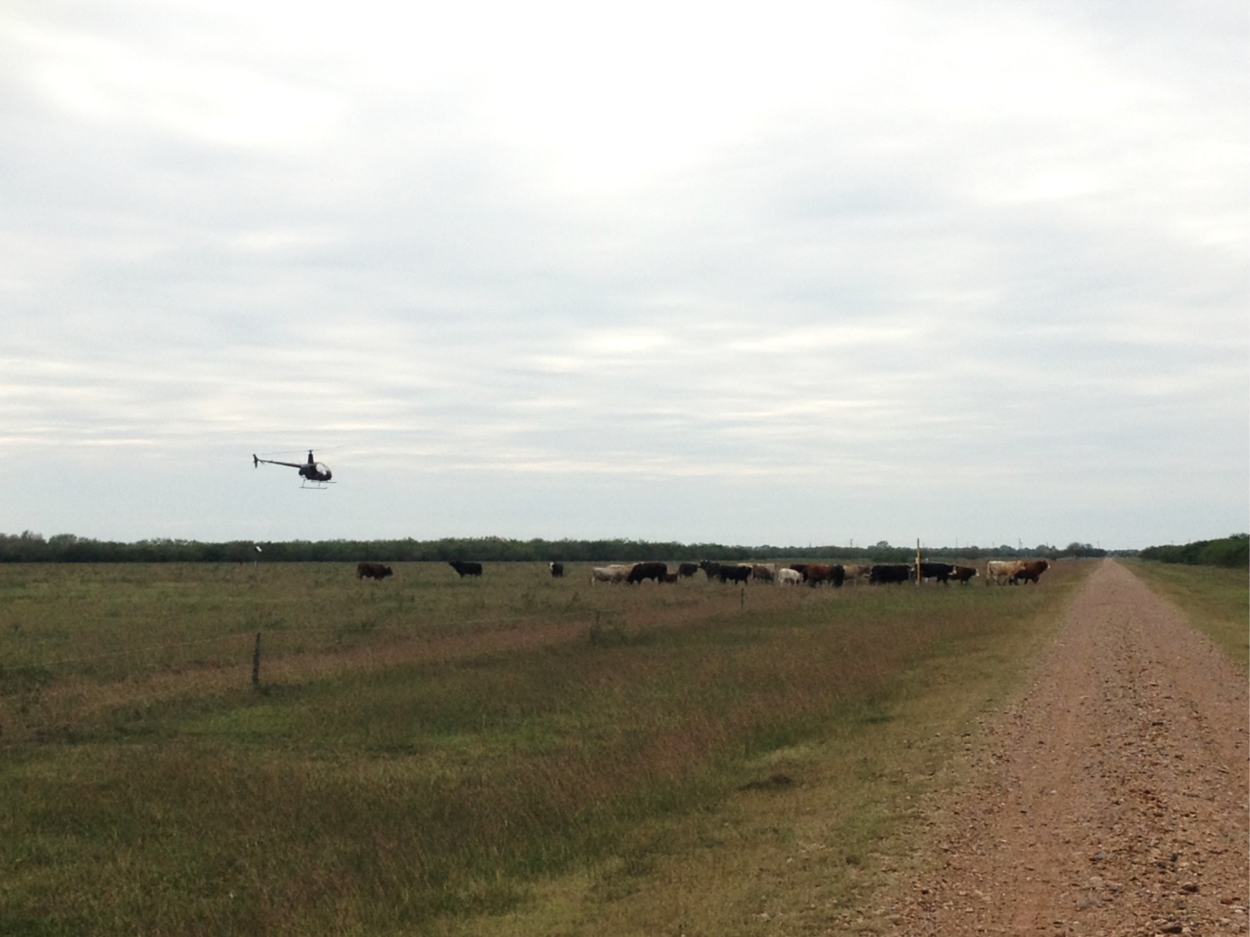
A Working Ranch
Cattle
Photo courtesy of Todd Steele

Slide 9
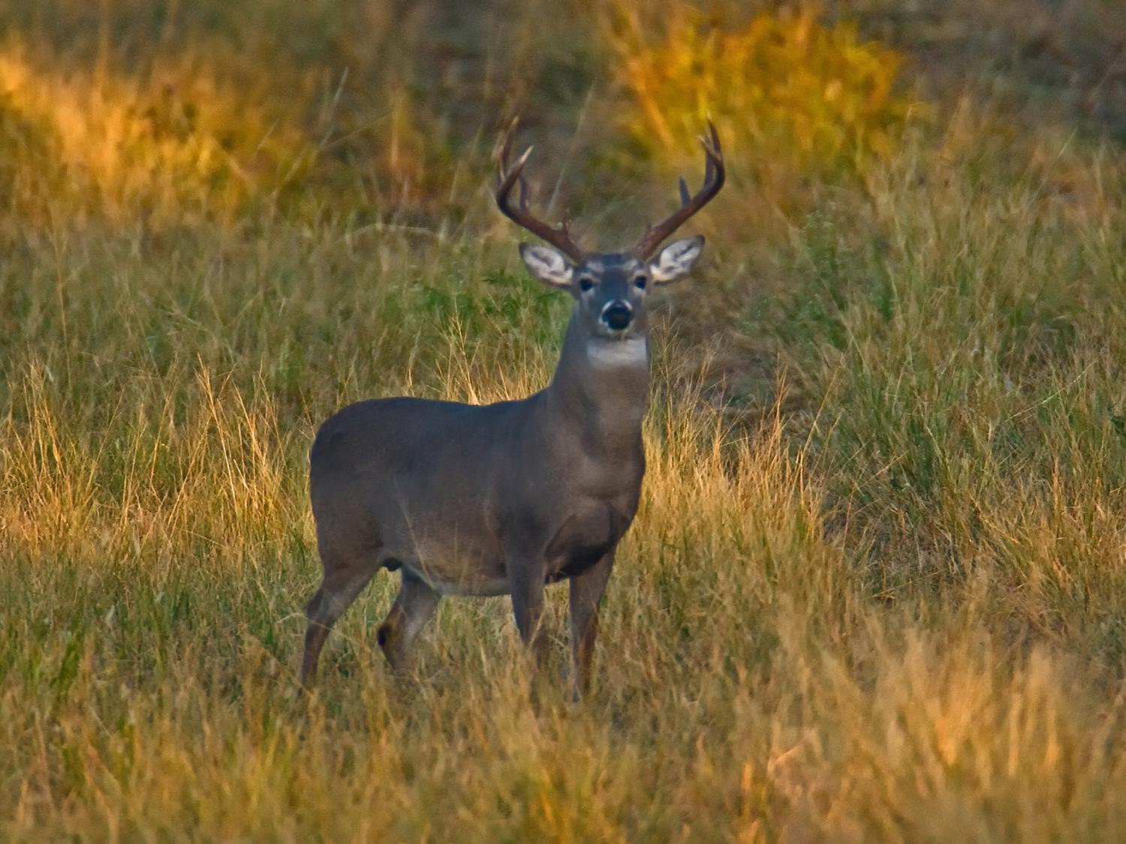
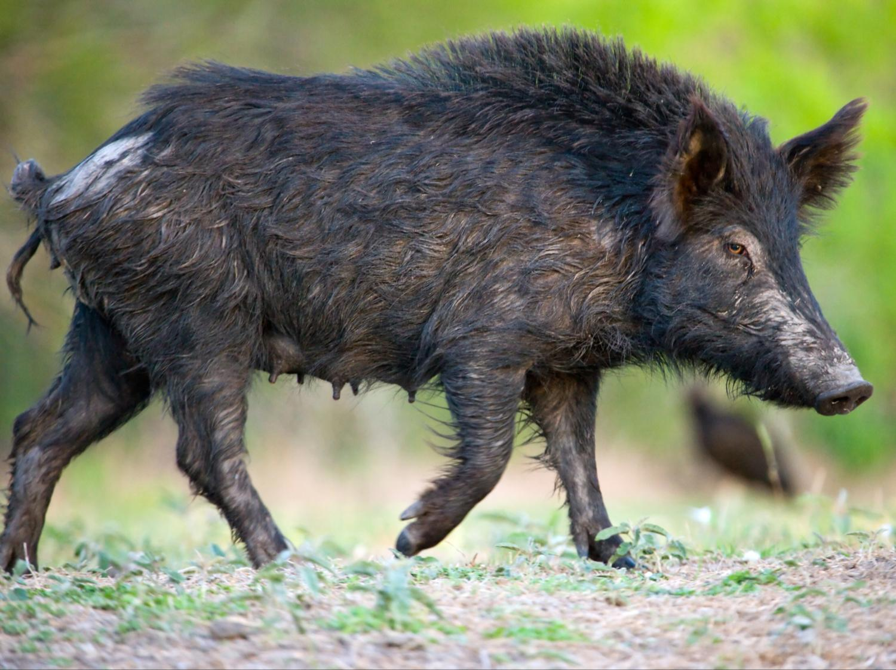
A Working Ranch
Hunting
Photo courtesy of Todd Steele

Slide 10
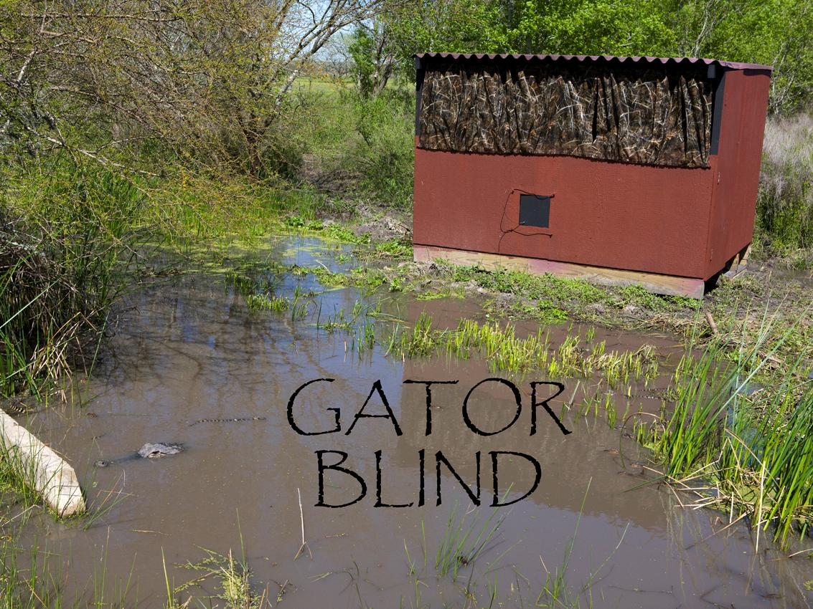
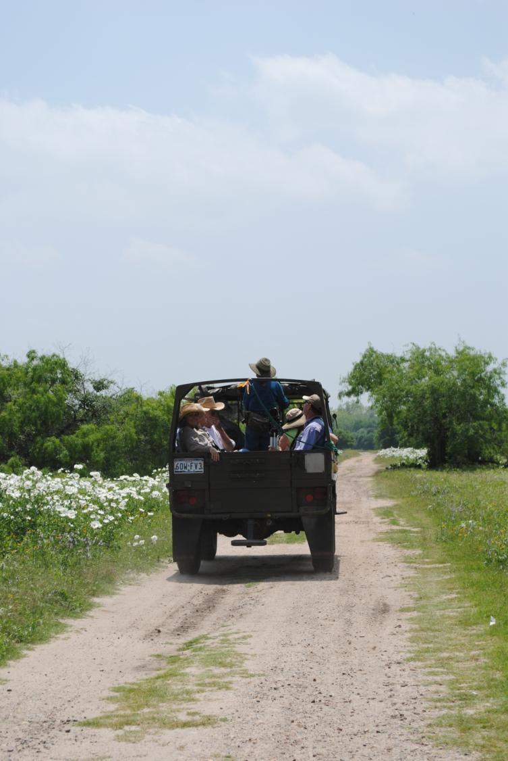
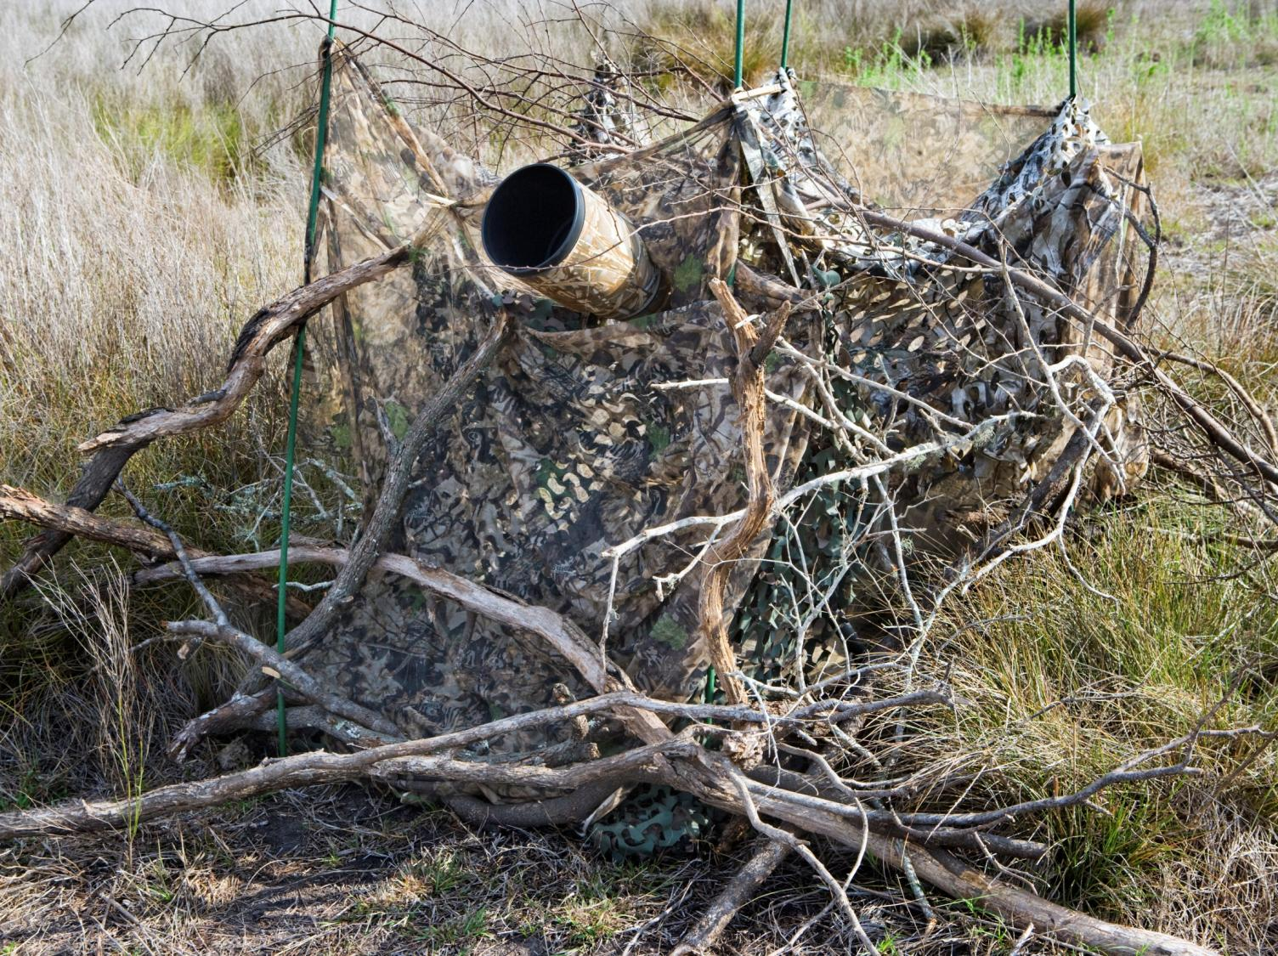

A Working Ranch
A Working Ranch
Eco-tourism
Eco-tourism
Photo courtesy of Todd Steele

Slide 11
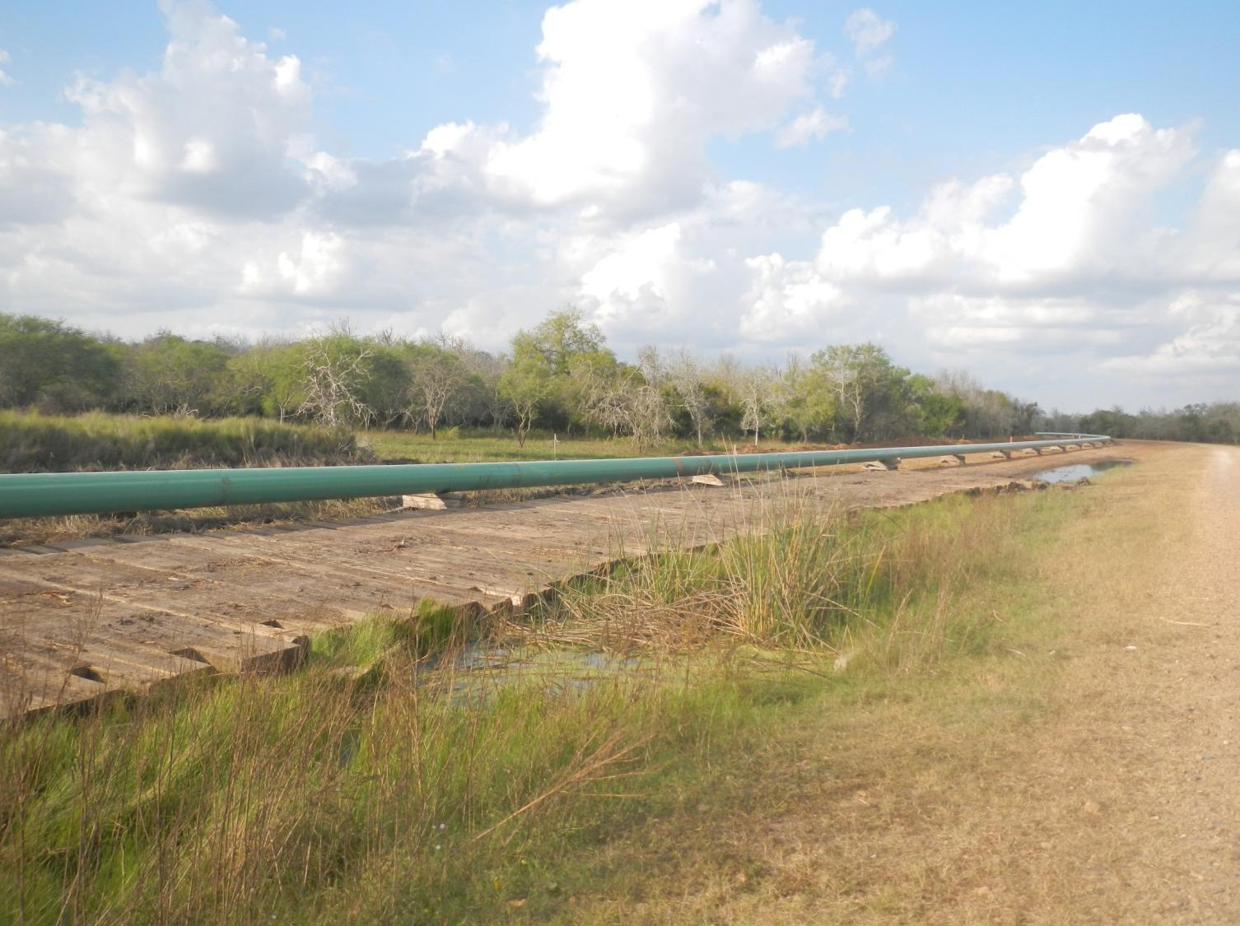
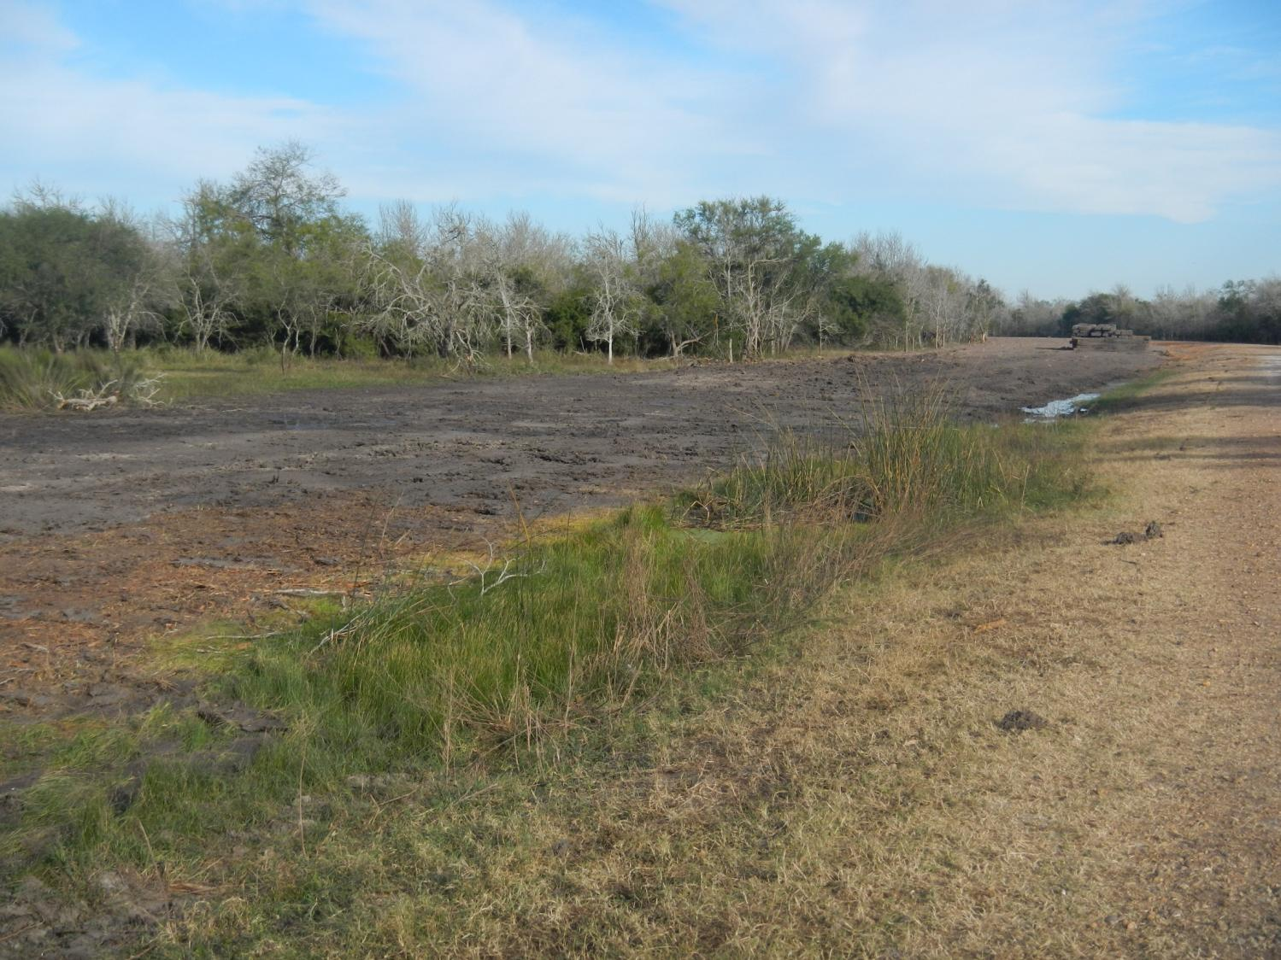
A Working Ranch
Oil and Gas

Slide 12
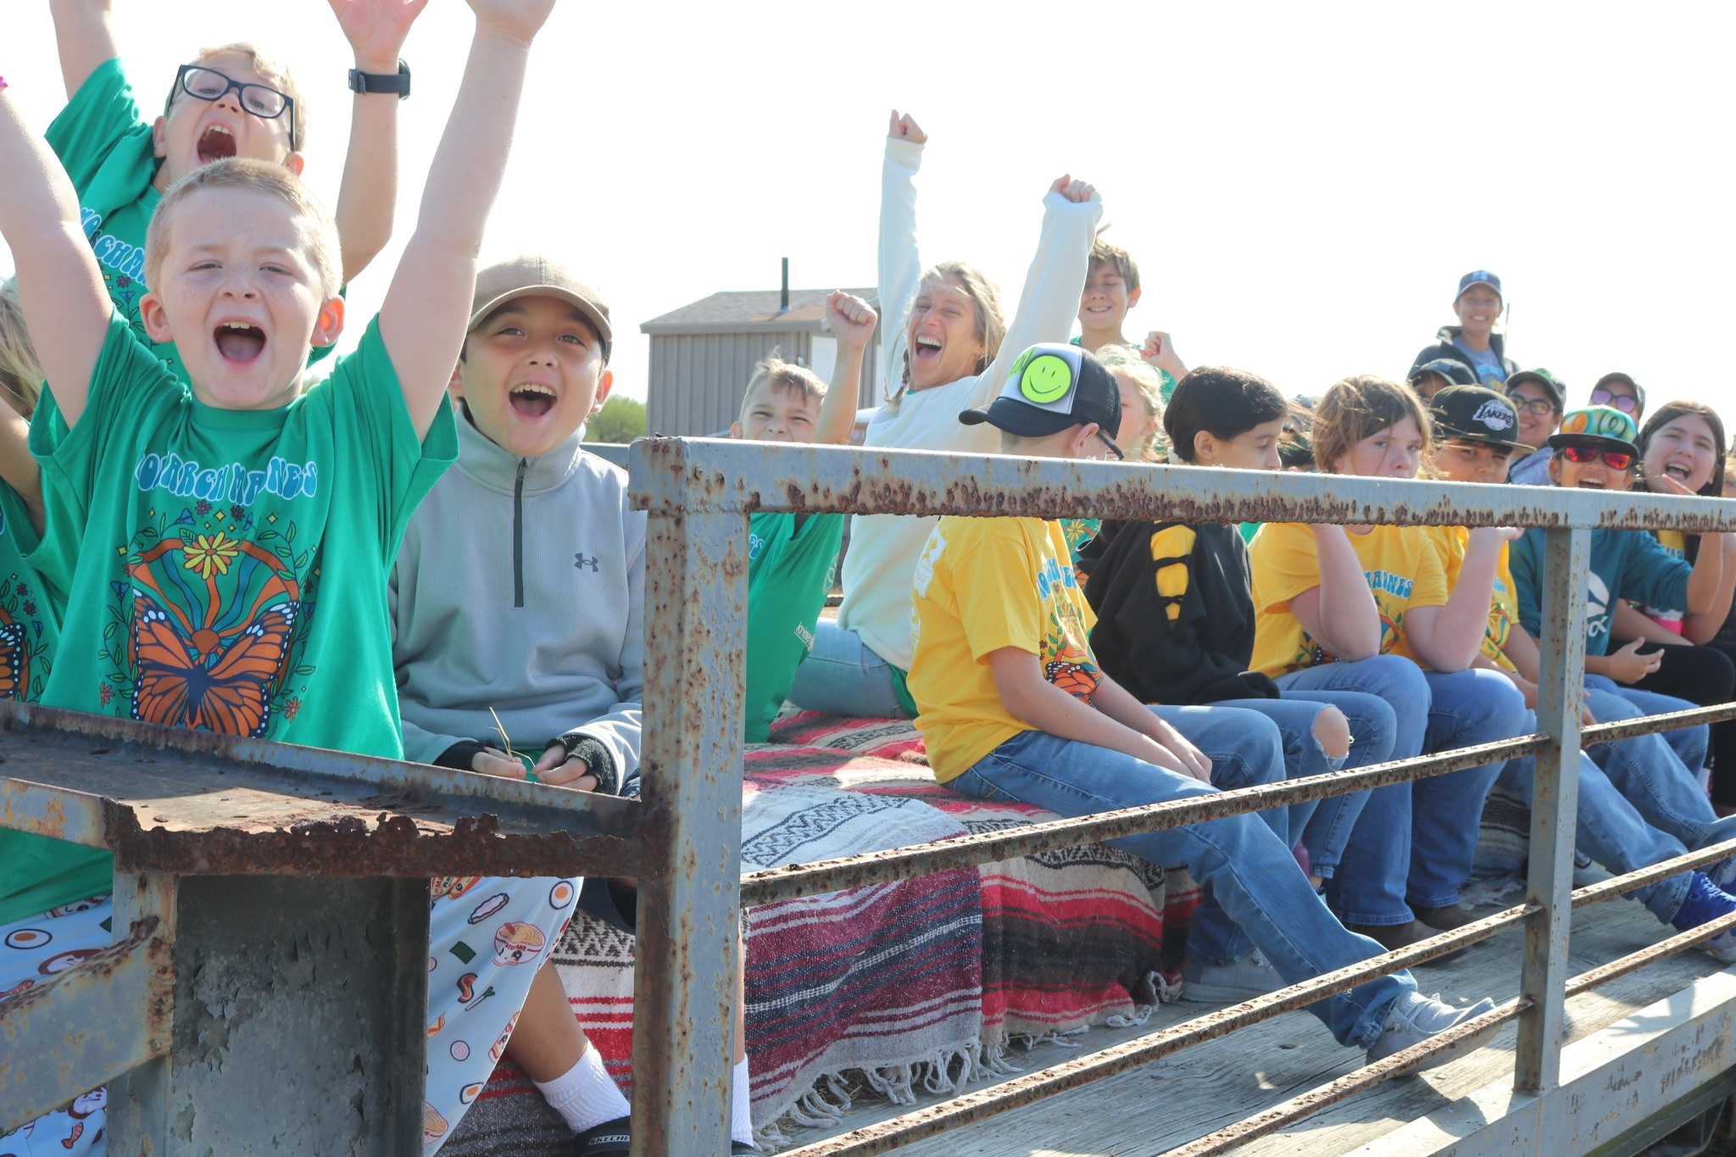
A Working Ranch
Outreach and Education

Slide 13
Ranch Income Revenues
Total net average revenue: $78,300

Slide 14
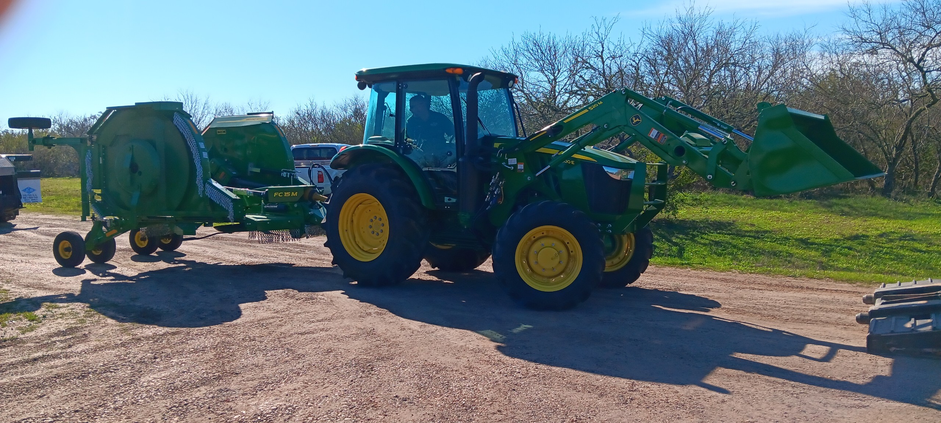
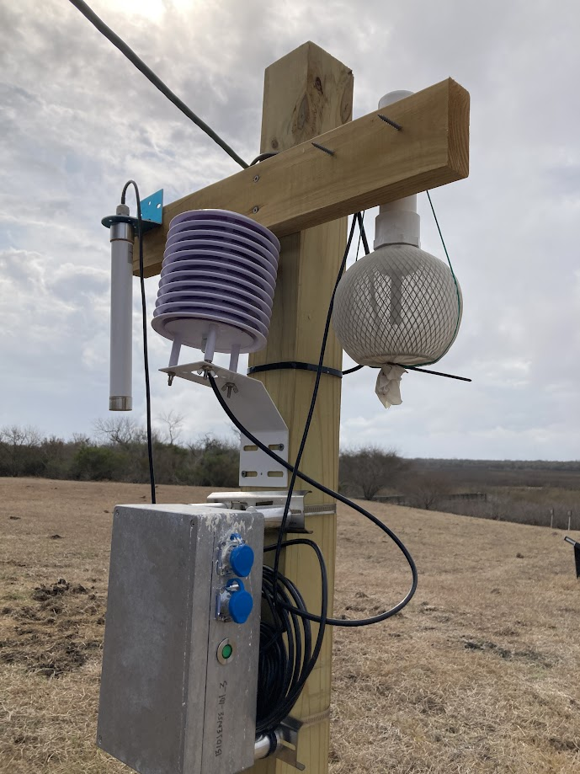
Conservation Easement Benefits
Equipment & Facility Upgrades
Funding & Research Opportunities

Slide 15
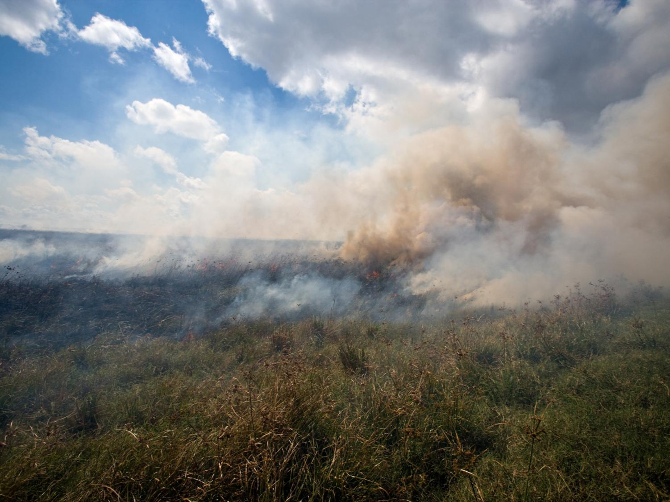
Managing the Ranch
Controlled Burns
Photo courtesy of Todd Steele

Slide 16
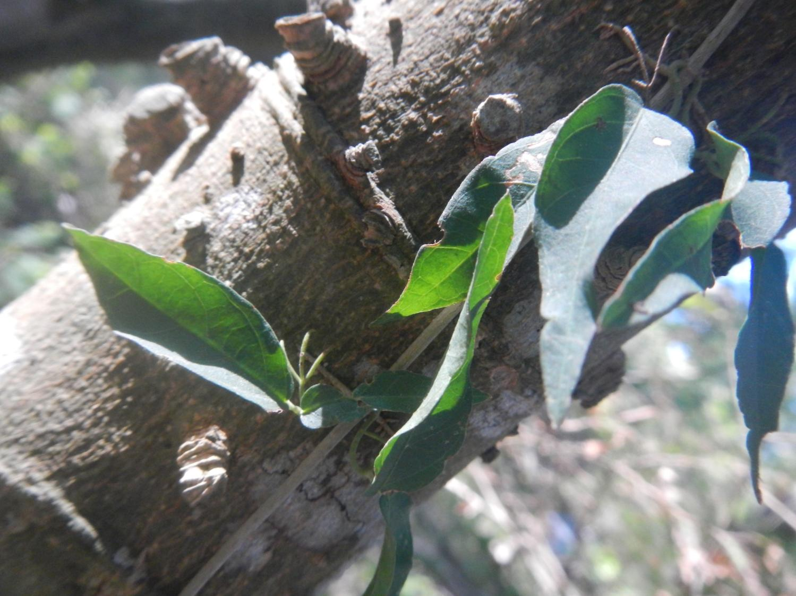
Managing the Ranch
Invasive Species
Photo courtesy of Todd Steele

Slide 17
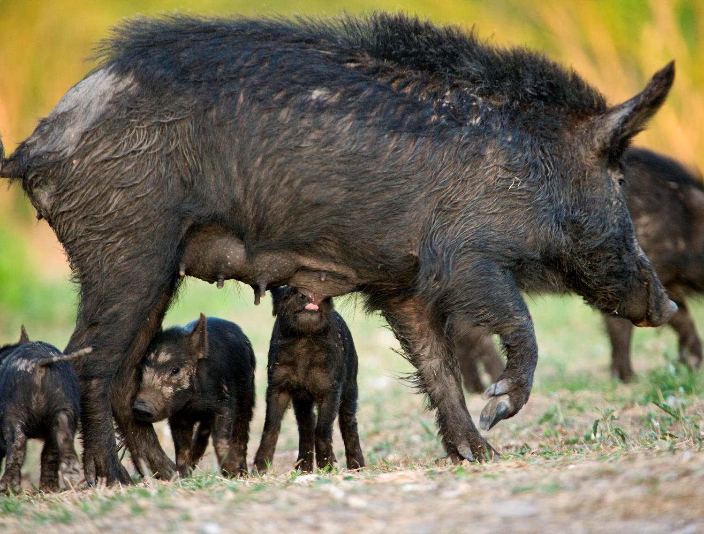
Managing the Ranch
Invasive Species
Photo courtesy of Todd Steele

Slide 18
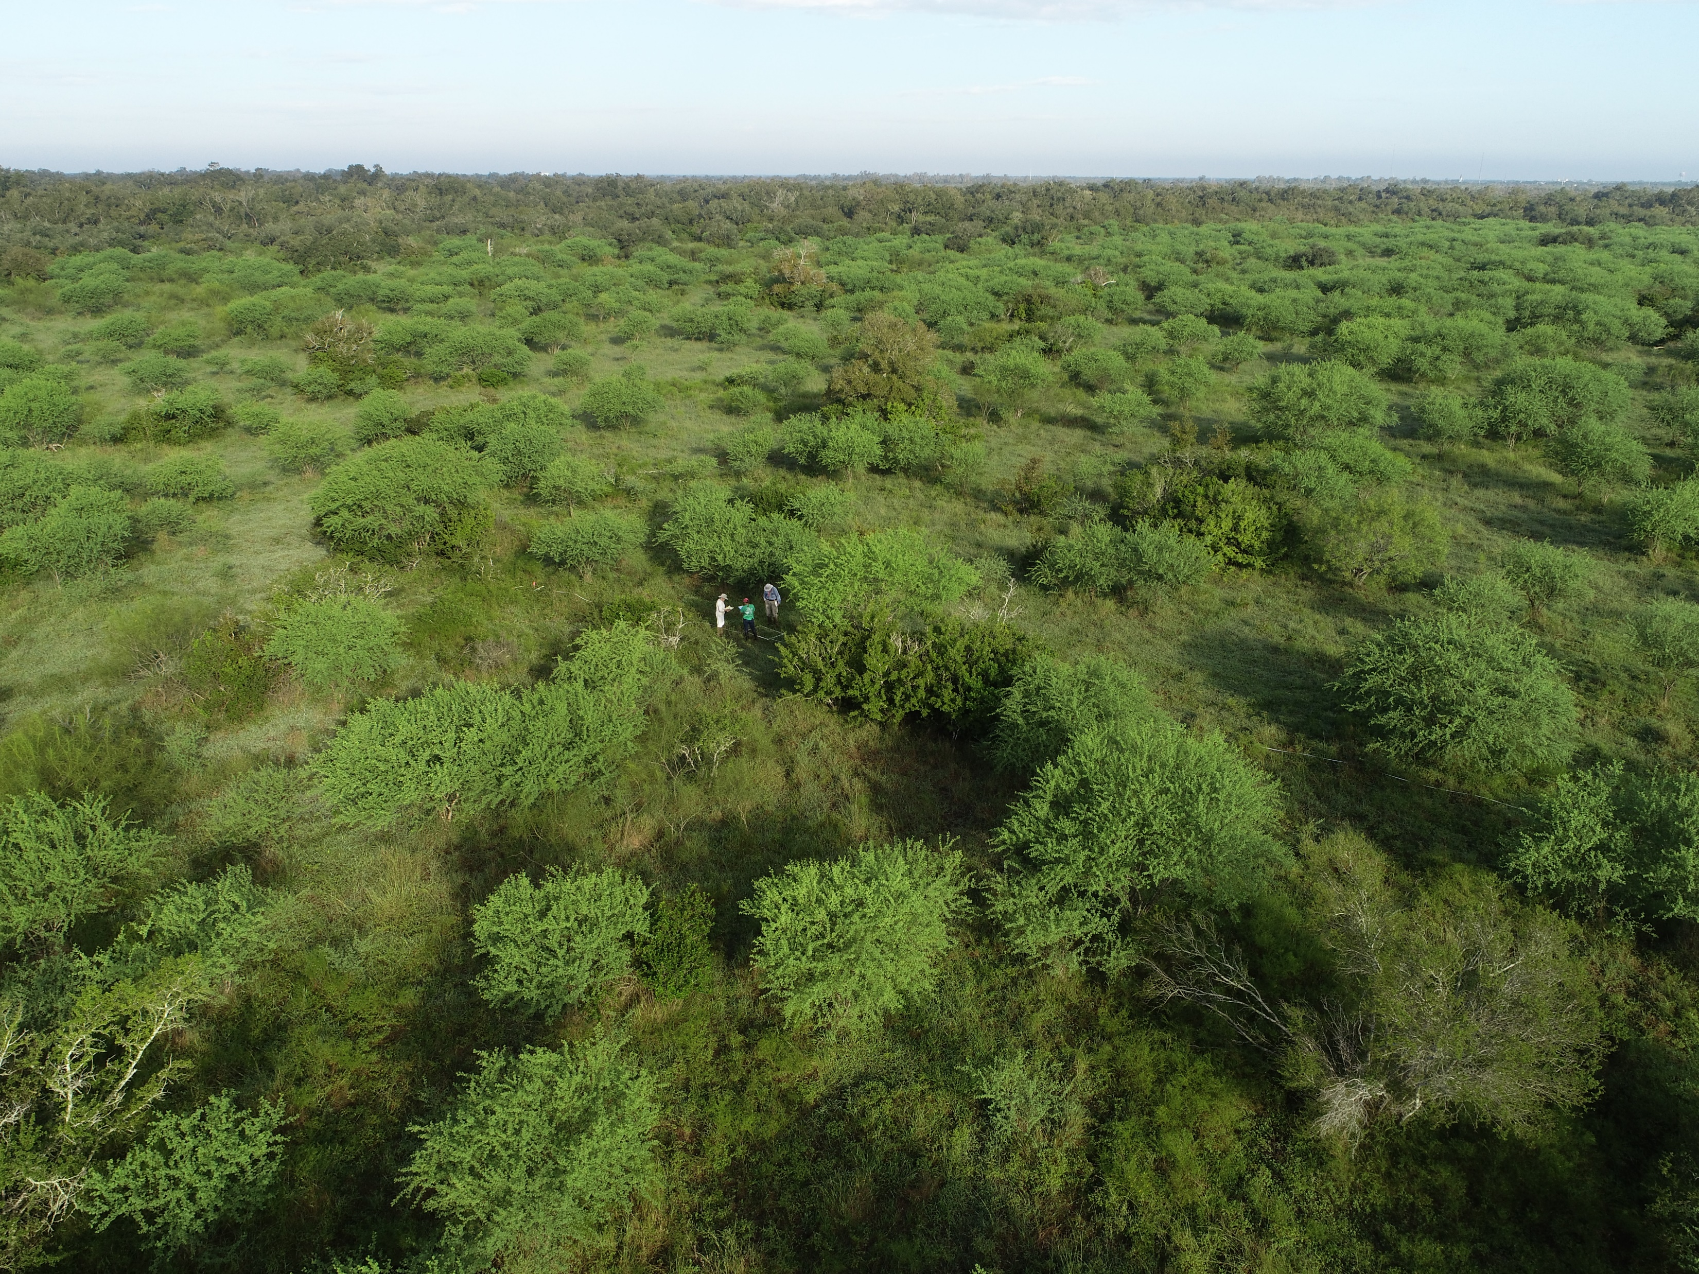
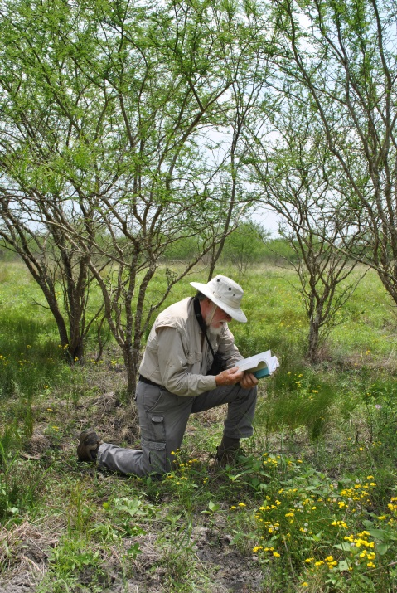
Managing the Ranch
Vegetation Monitoring/Research

Slide 19
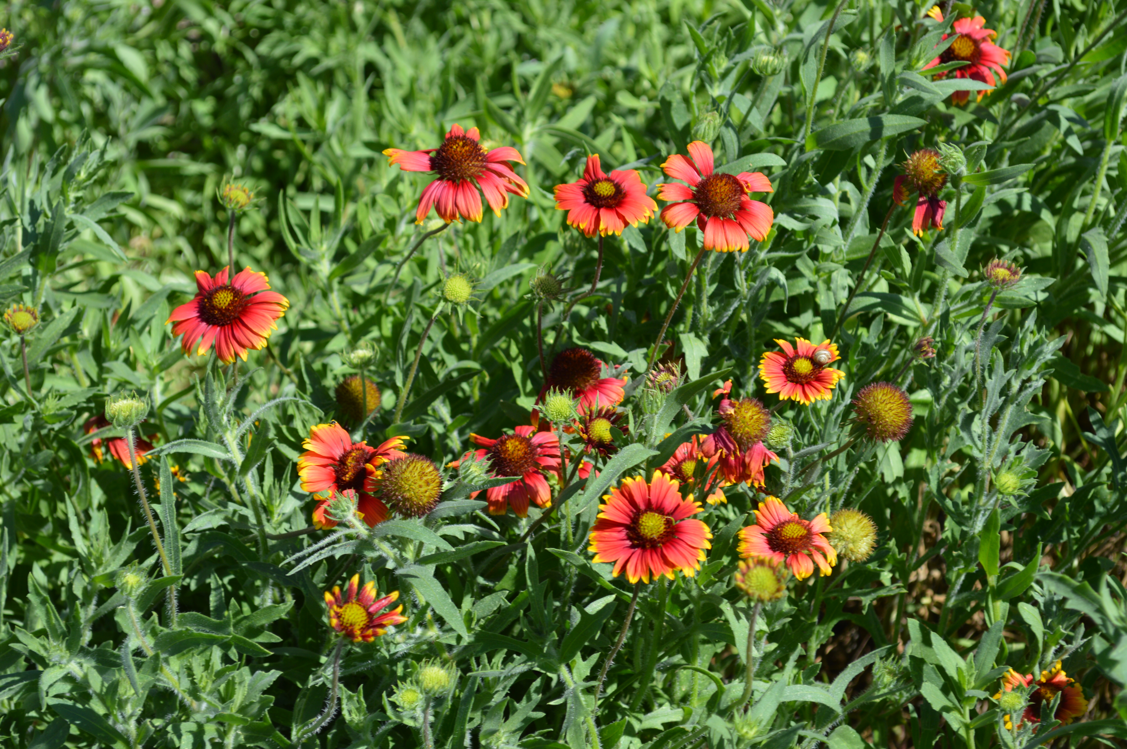

Mission Aransas Reserve
THANK YOU.
Katie Swanson
Katie.Swanson@utexa.edu
www.missionaransas.org
www.fennesseyranch.net

Slide 20
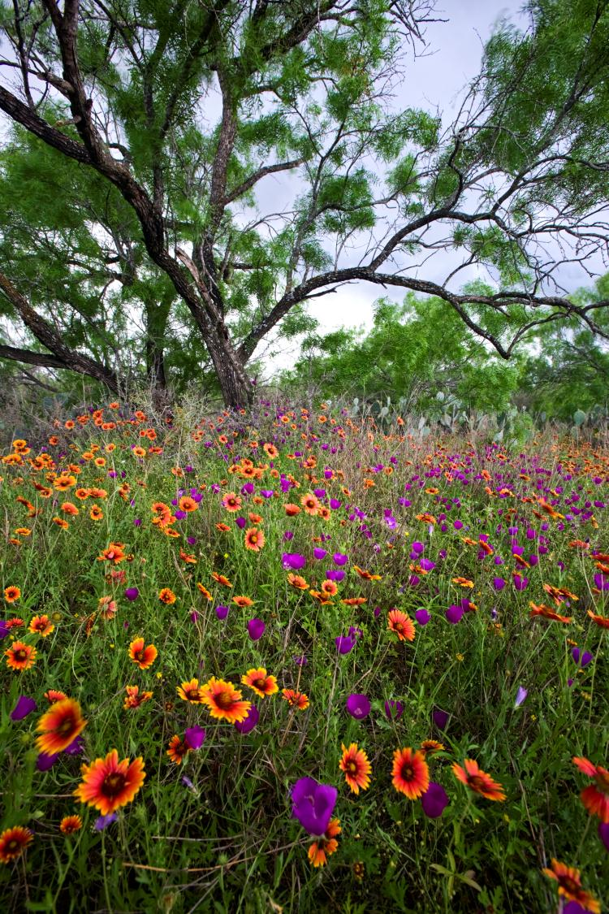
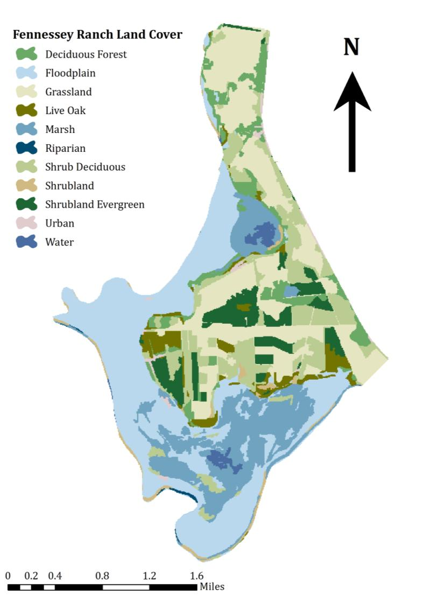
Fennessey Ranch Habitats
In addition to its more than 400 species of birds, Fennessey Ranch is also home to 16 plant communities, 50 kinds of amphibians and reptiles, 70 types of moths and butterflies, alligators, armadillo, deer, wild boar, coyotes, bobcats, and cougars.

Slide 21
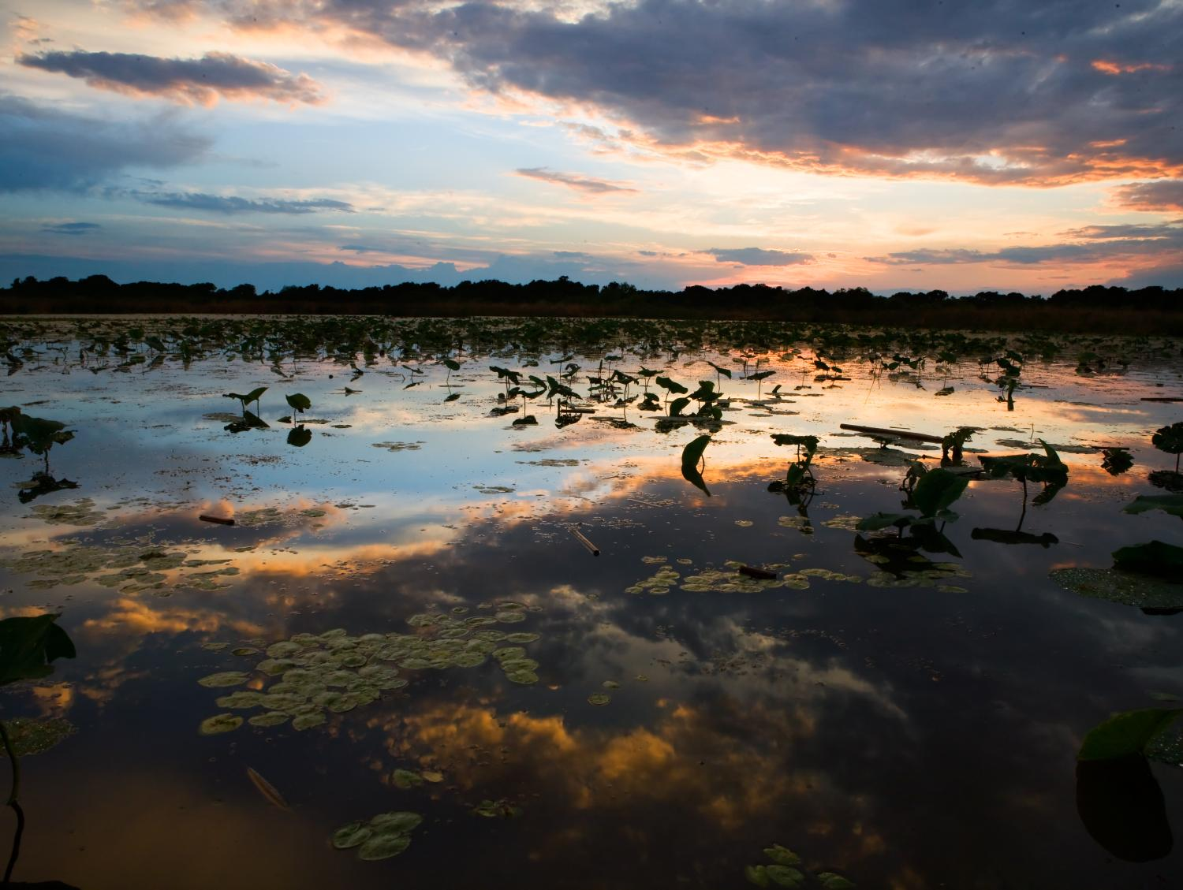
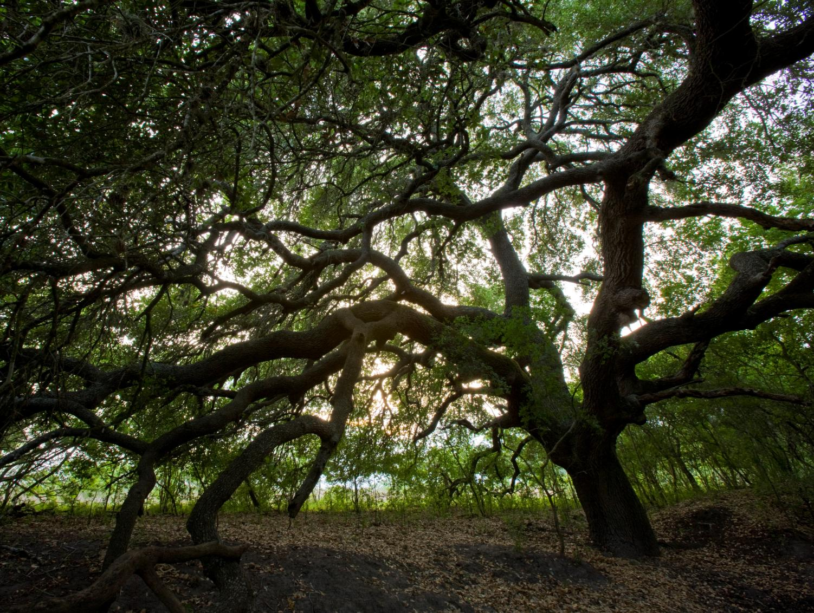
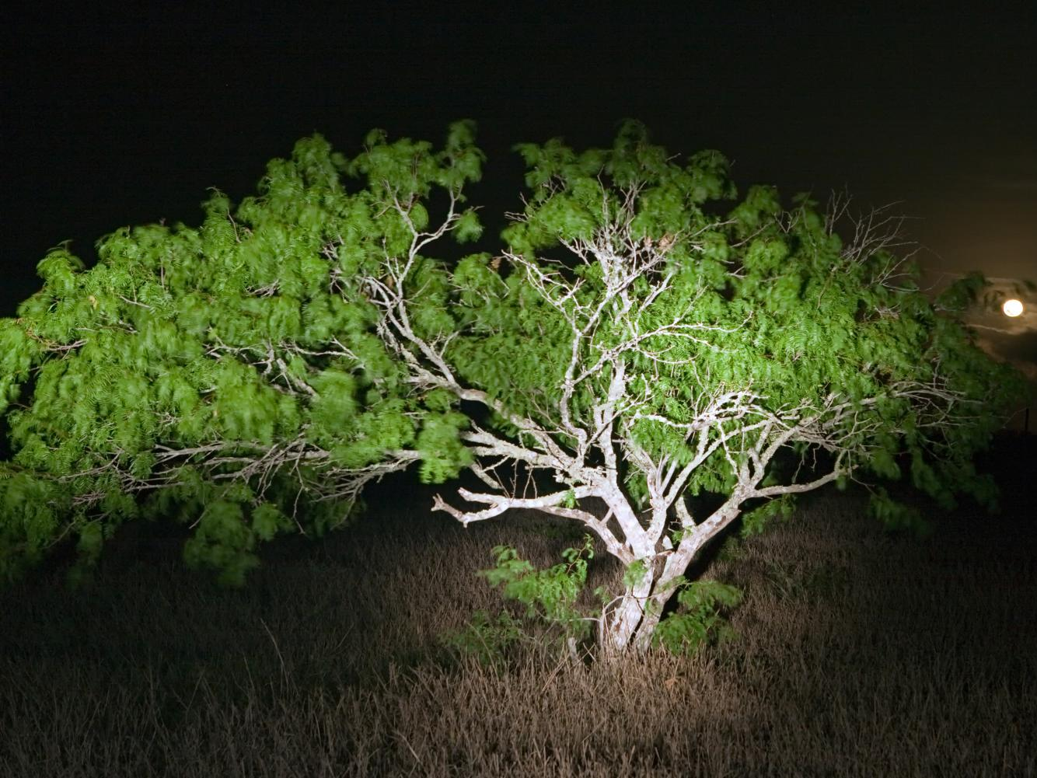
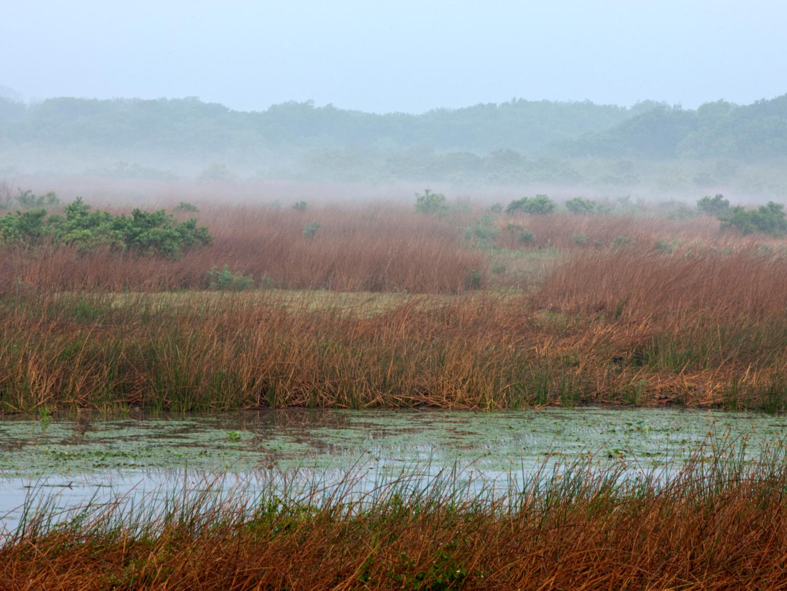
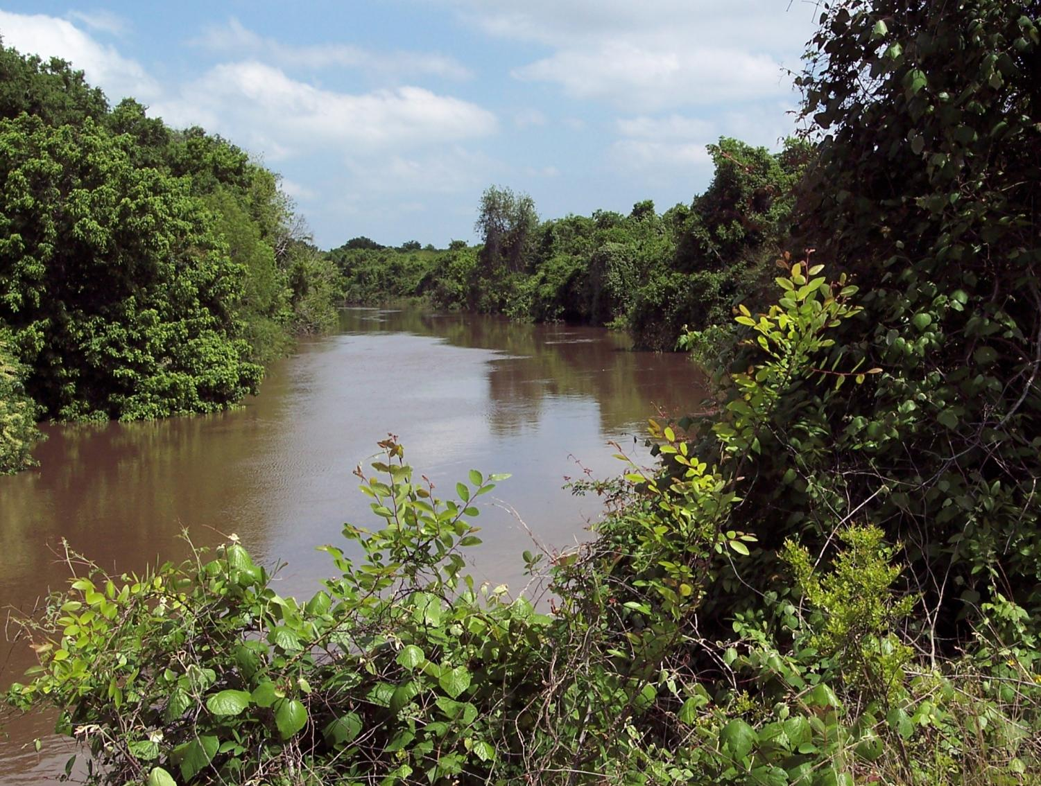
Photo courtesy of Todd Steele
Photo courtesy of Todd Steele
Notes:
The Fennessey Ranch is part of a legendary 750,000 acre Texas land empire that has remained in the same family for 171 years. The ranch consists of 4,000 acres of abundant wetlands, meadows, natural lakes, riparian woods and brush land and bordered on three sides by the Mission River. The Fennessey is located in the heart of the Central Flyway along a region of the Texas coastline known as the "Coastal Bend." The Fennessey has opened its gates for a wide array of unique recreational opportunities.

