Slide 1
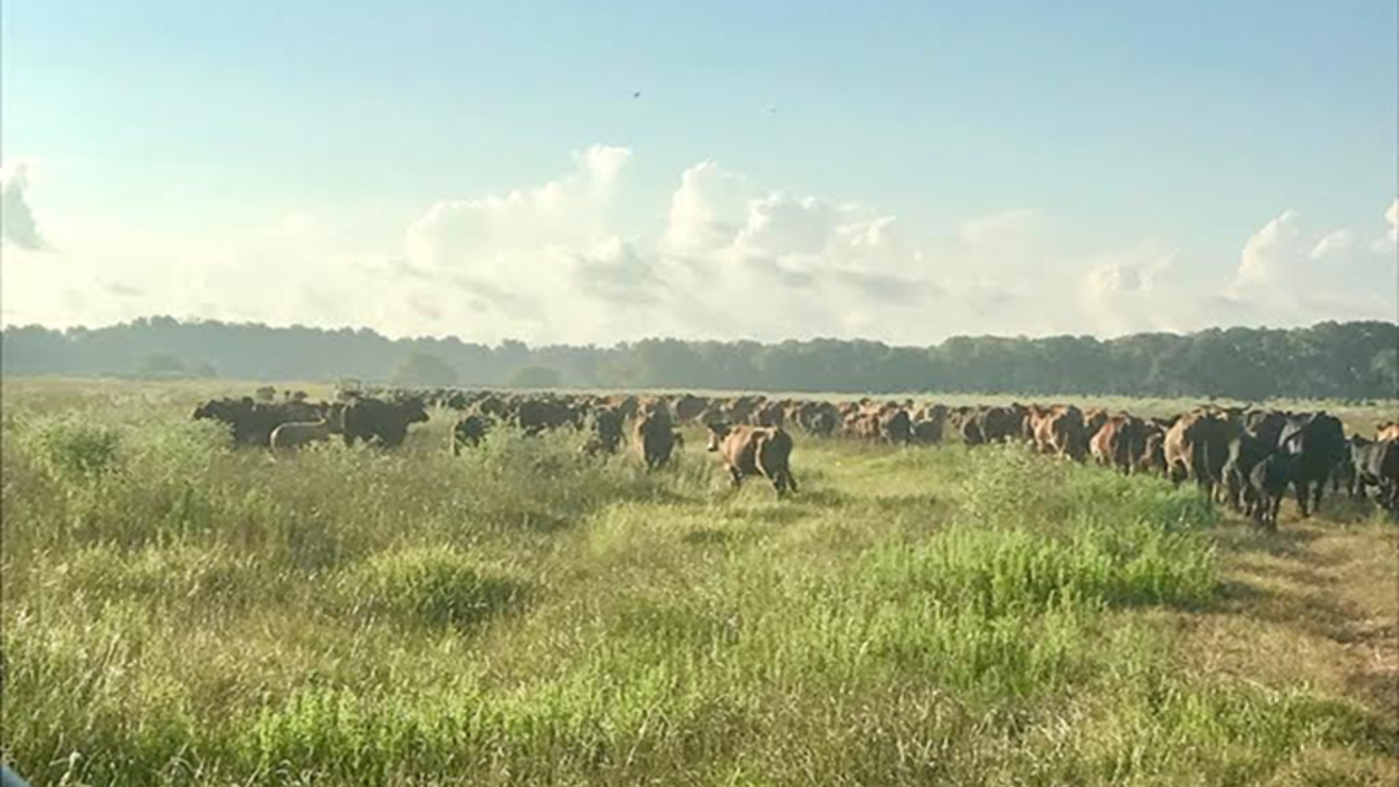
Strategic Grazing: Increasing Carrying Capacity and Improving Soil Health

Slide 2
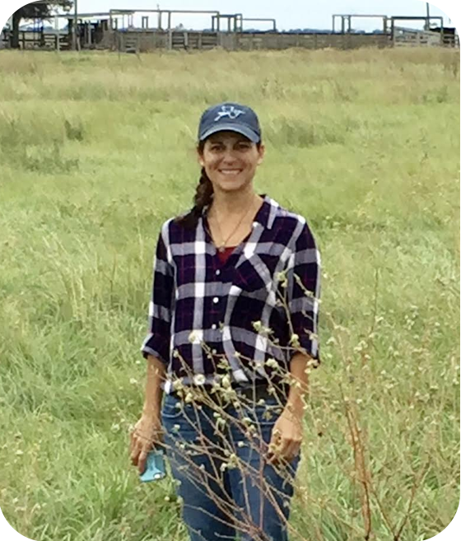
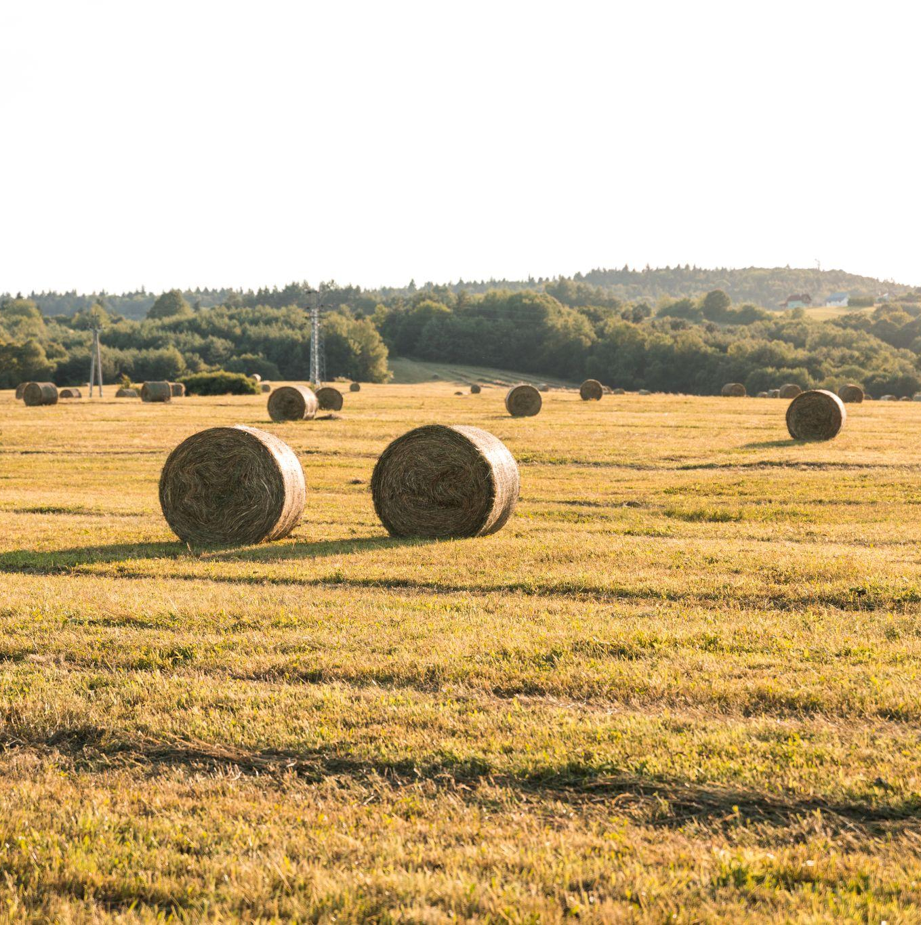
“The Flower Among the Thorns”
Iliana Pena, Consultant
- Knobloch Family Foundation
- Horizon Foundation
- TPWD Foundation

Slide 3
Adaptive High Stock Density Grazing (AHSD)
Purpose : Improve, enhance environmentally-sustainable livestock grazing lands through an adaptive method of high stock density rotational grazing.
Goal: Improve soil health = improved profitability, enhance water quality, wildlife habitat and carbon sequestration.

Slide 4
Results/Benifits
All cattle observed daily & quality family time
Reduced costs: herbicides, fertilizer, intensive mowing, parasite control, labor
Increased income/acre.
Drought protection by improved soil health, microbial population & organic matter (OM)
Increased plant complexity/diversity by tapping into latent seed bank + “natural” fertilizer.
Anticipated improvement within 4 years: Organic Matter and water retention increased 4X Dry Matter 3X

Slide 5
Keys to Success
01
02
03
04
05
Easy access to water is critical !!!
Stock densities adjust to changes in: climate, forage dry matter (DM) production, animal performance, soil health objectives and lifestyle priorities.
Quality mapping system
PastureMap.com
Daily cattle moves
Portable fencing

Slide 6
- Began with 38,000#/acre (32 AU/Ac.)…Now: 83,000#/acre (69 AU/Ac.)
- Ultimate goal: 250,000 pounds per acre at least once annually (208 AU/Ac)
Followed by long rest periods, to rapidly build soil organic matter (OM)
Best Practices
Livestock consume no more than 30-50% of available forage DM before moving to fresh paddock.
- Cattle walk no more than 800’ - 1000’ to water

Slide 7

Don’t start before you have the water figured out!!

Slide 8
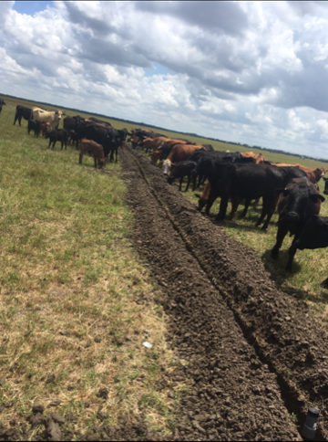
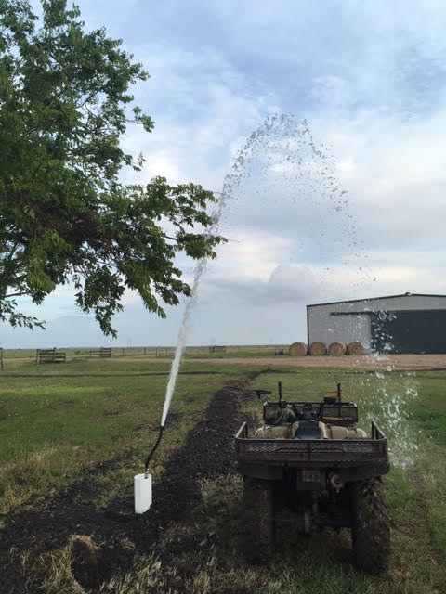
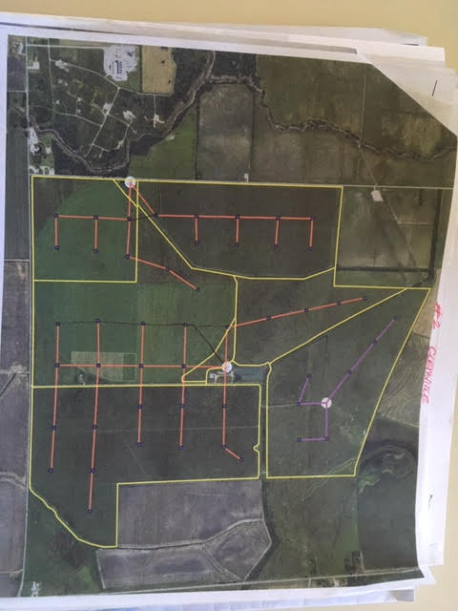
Pipe: 12 miles - 2” HDR 11 Poly underground Wells: 5- 2 H.P. Risers: 800’ – 1000’ Flow: 35 GPM

Slide 9
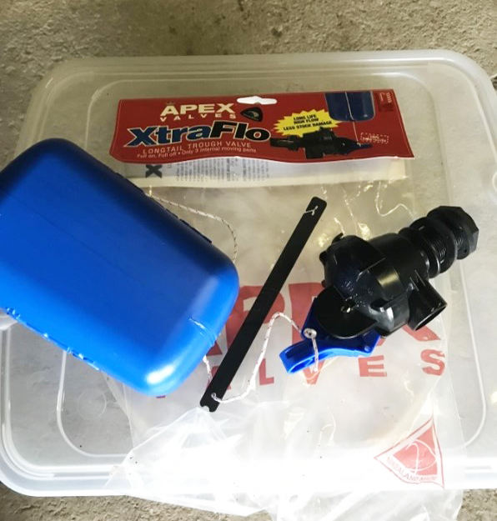
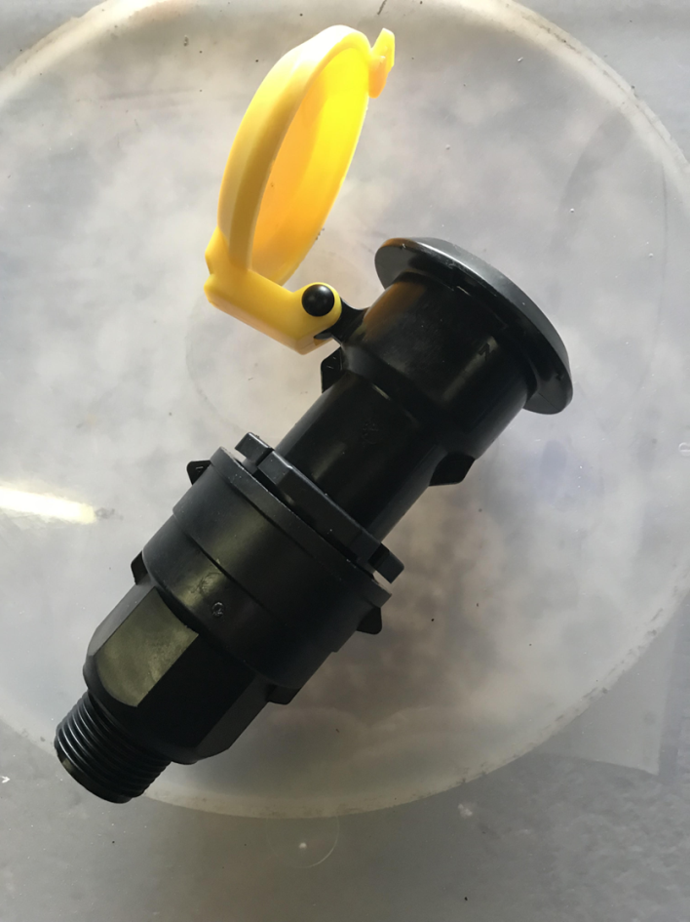
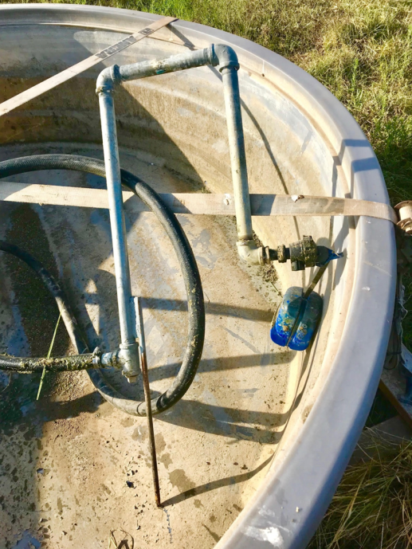
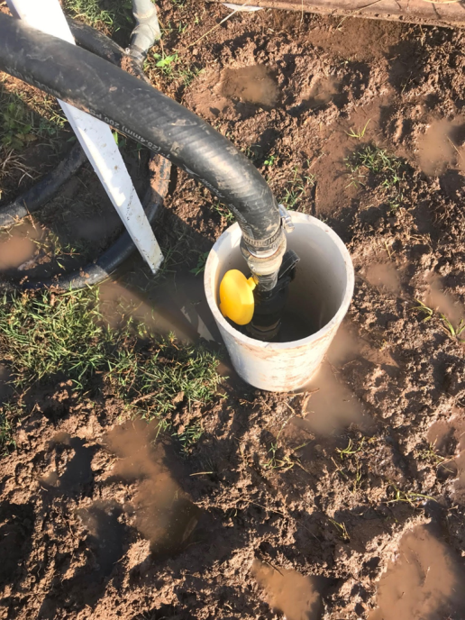
Watering Tools
Apex float valve
Plasson quick connect water valve

Slide 10
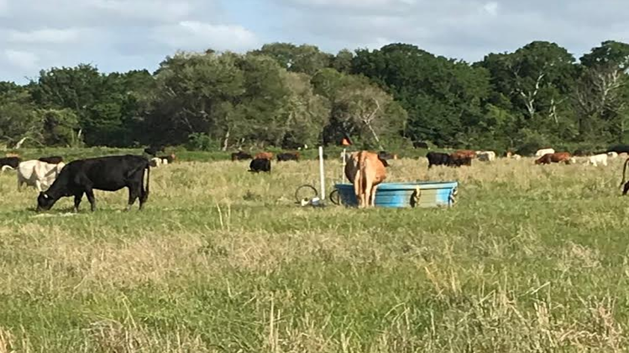
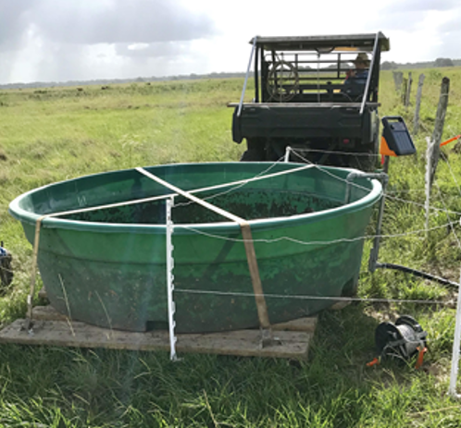
Watering Point for 600 head

Slide 11
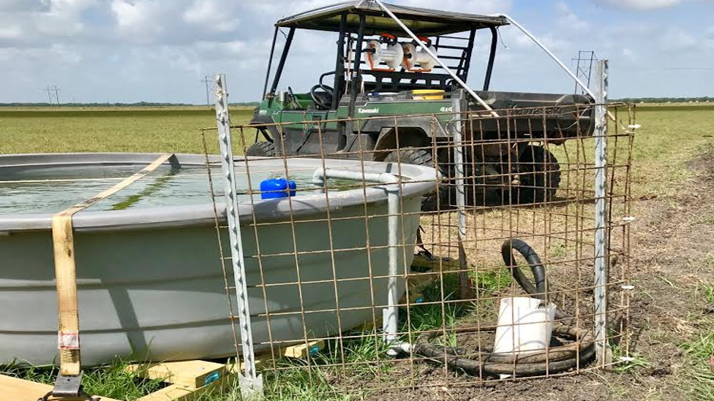
Apex Valve and Plasson Quick Connect

Slide 12

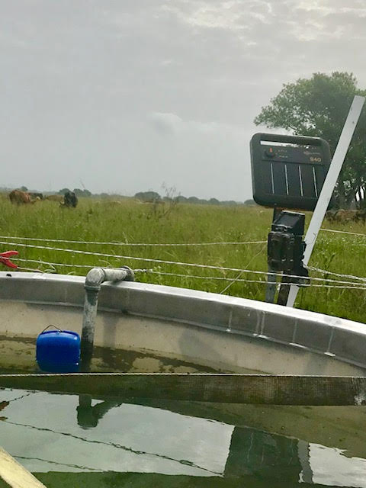

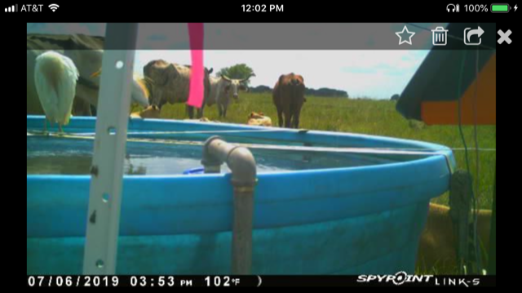

Slide 13

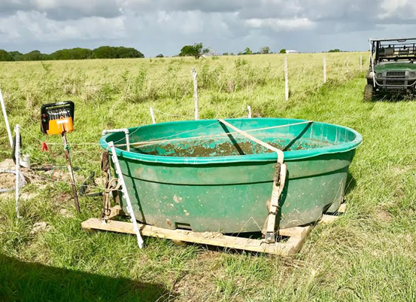
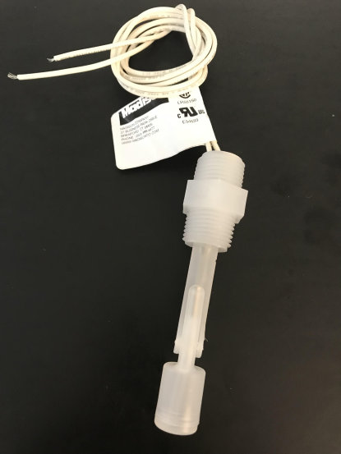
Monitor Water Level
Liquid level switch by Madison
xProxy by Net Irrigate

Slide 14
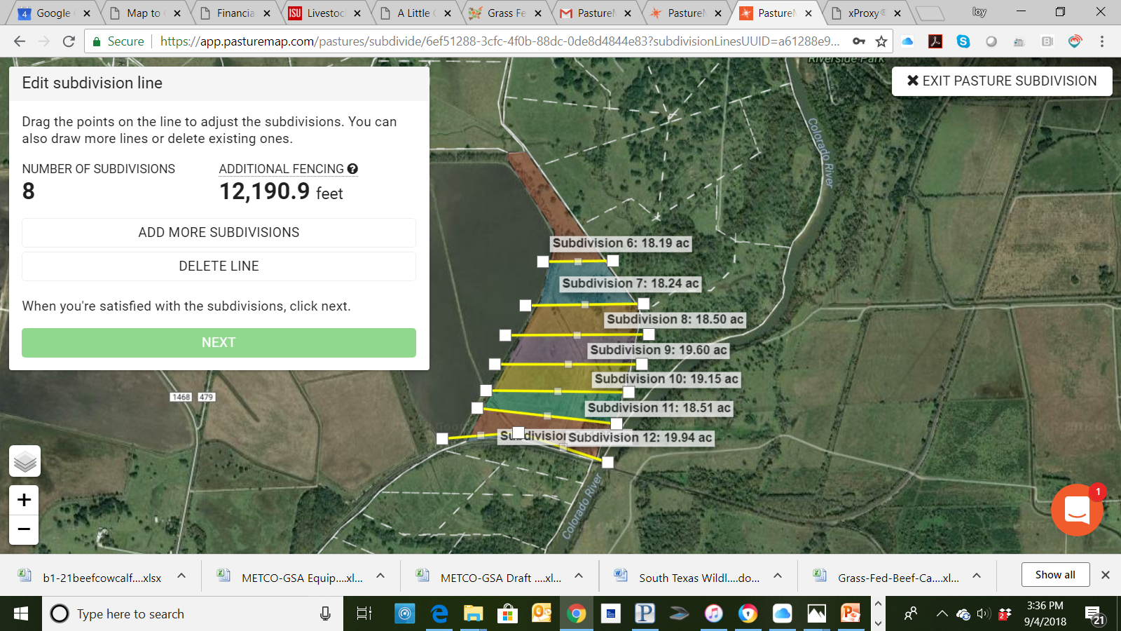
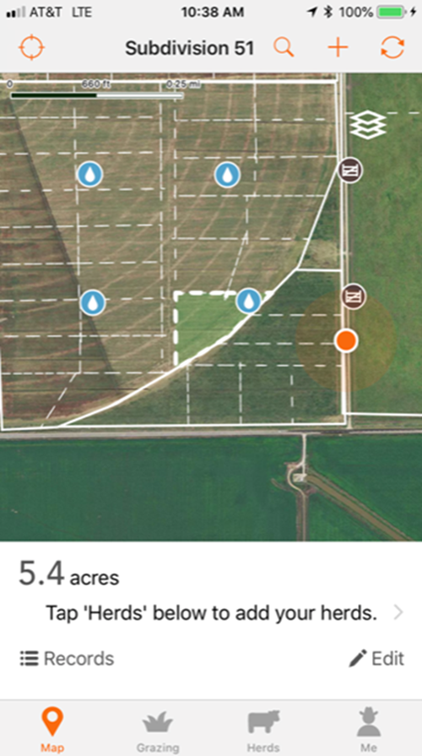
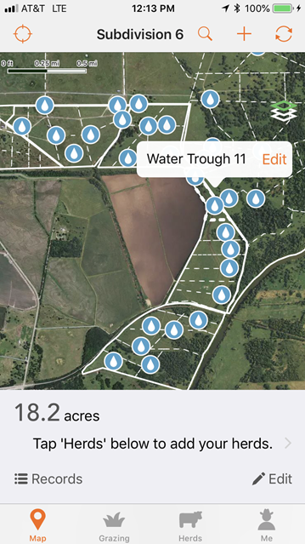
PastureMap is a “Must Have”

Slide 15
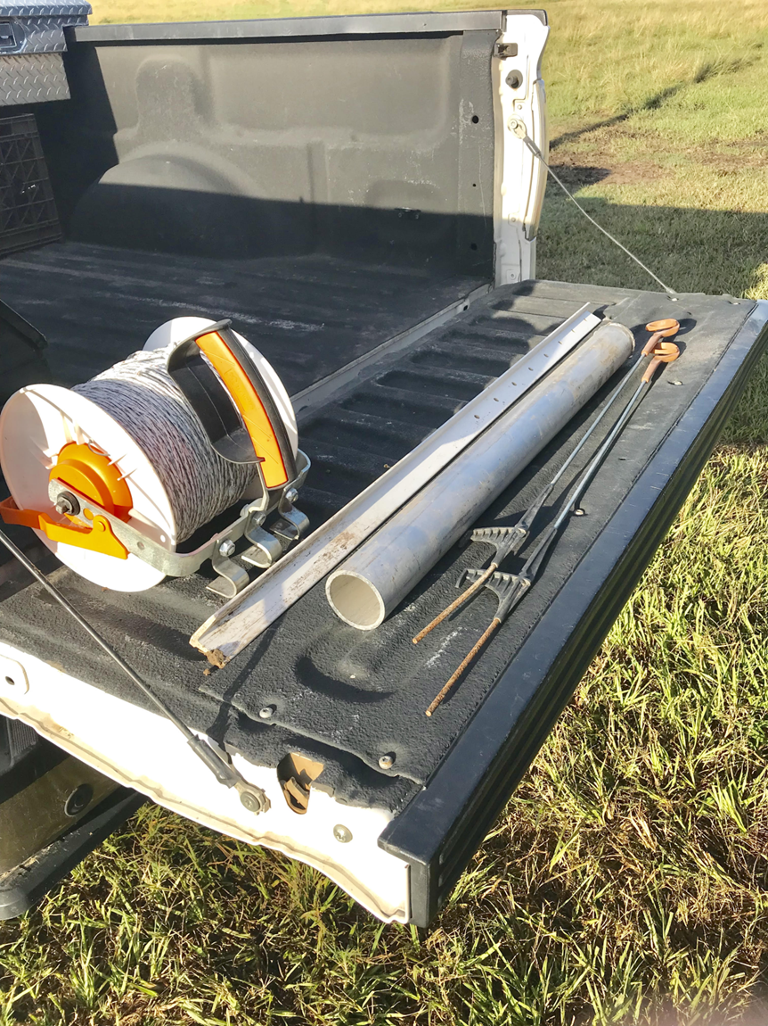
Portable Fencing

Slide 16
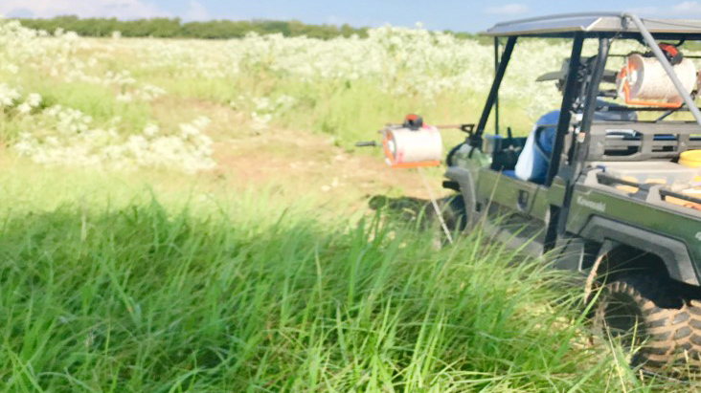
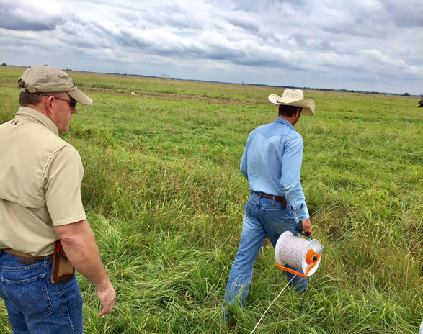
Unrolling Polly Wire
Unrolling Polly Wire With Coach Allen Williams

Slide 17
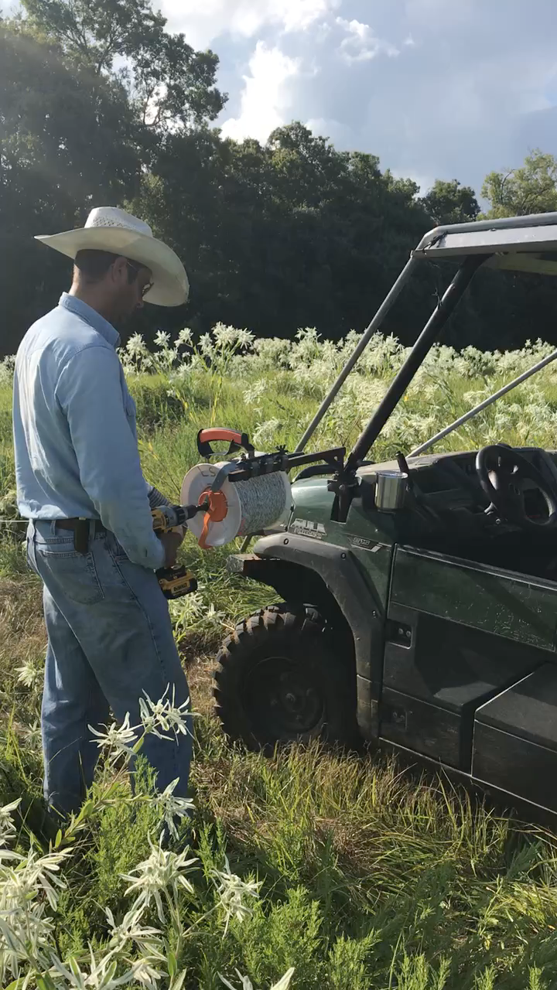
Spooling up wire

Slide 18
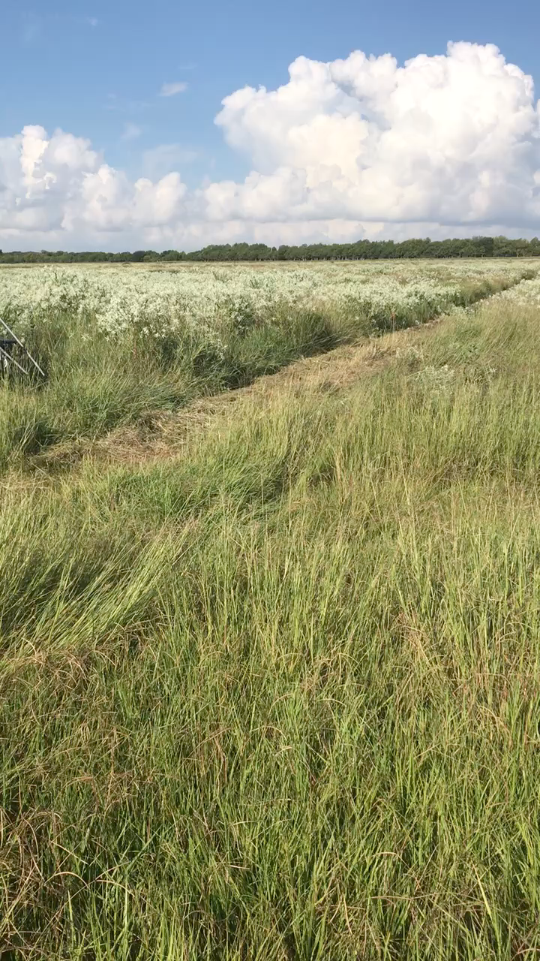
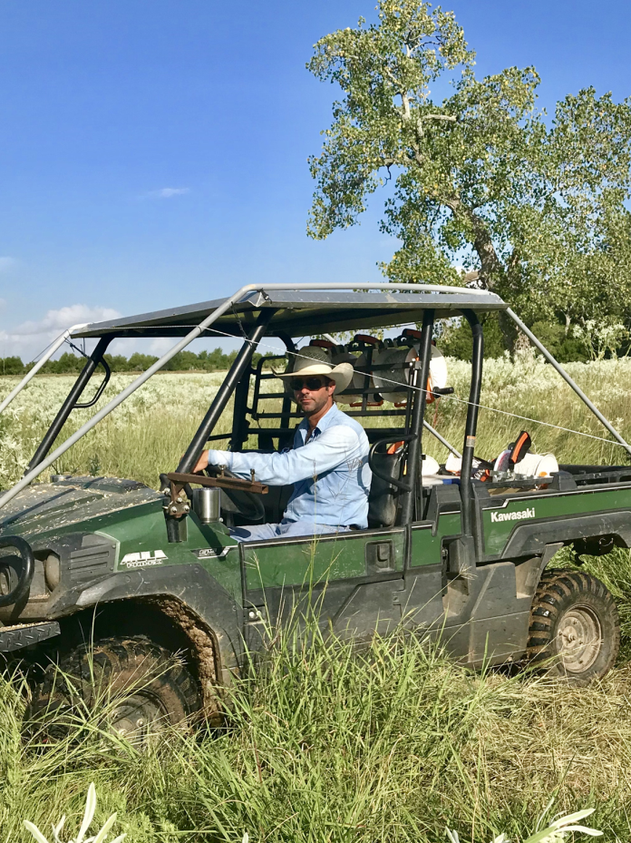
Driving under poly wire

Slide 19

Moving 400 AU

Slide 20
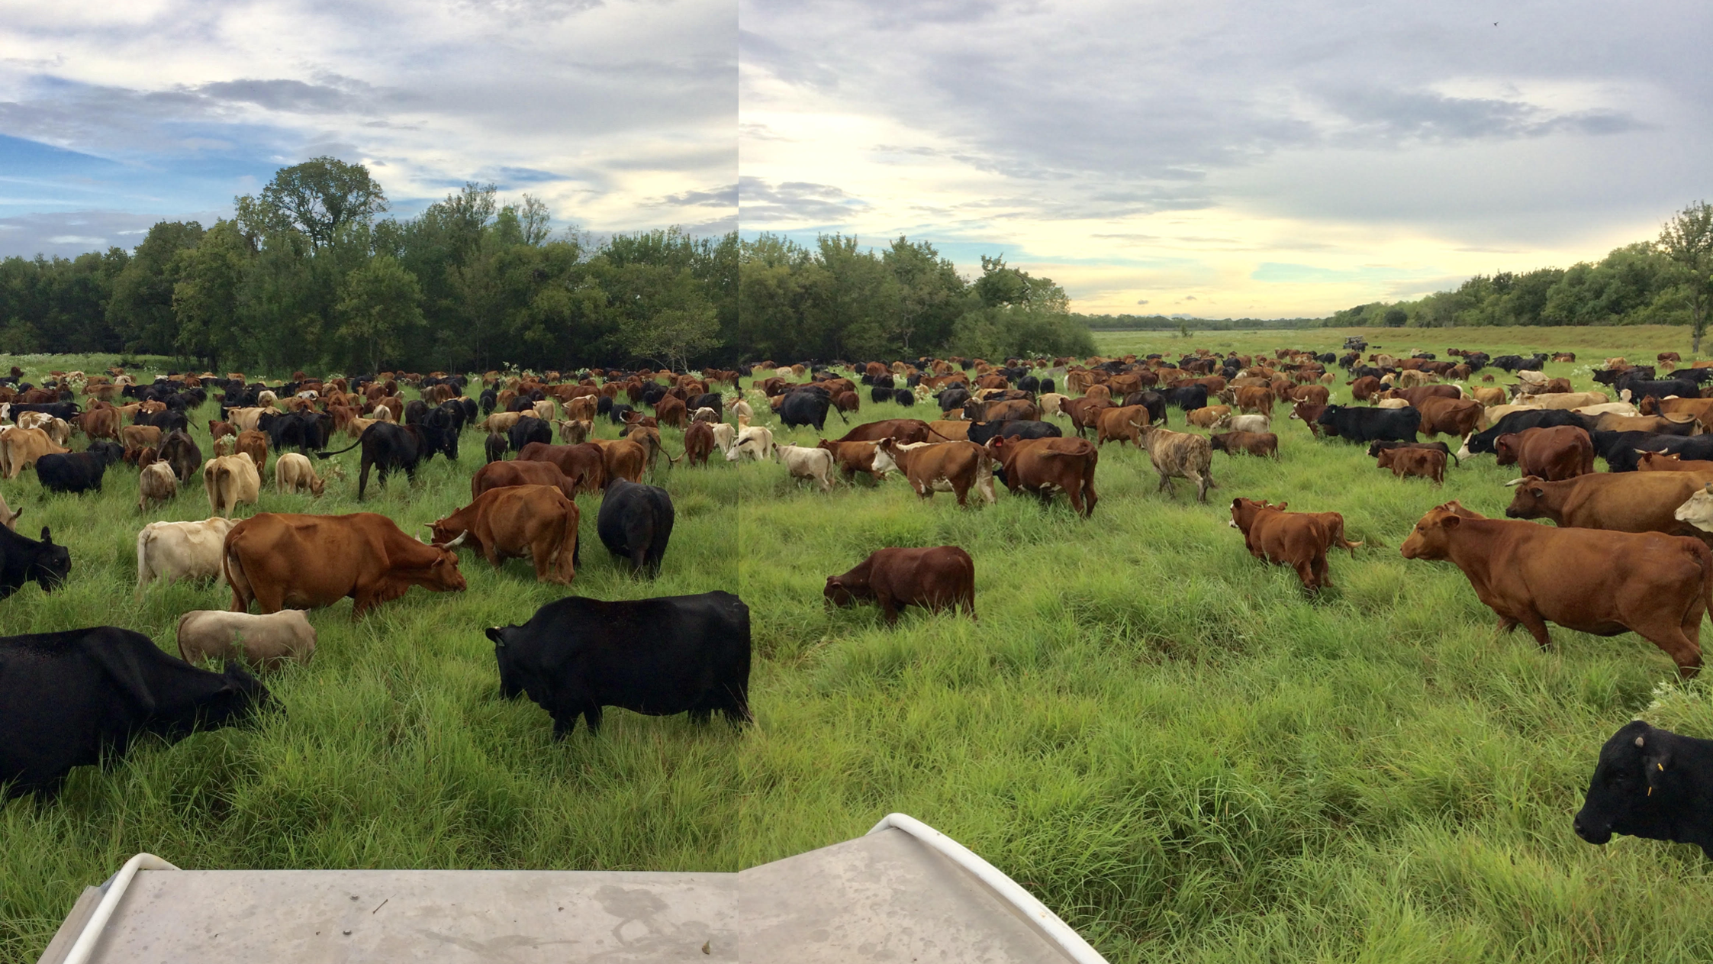
Daily Observation = Better Management
628 AU on 18Ac. = 42,000#/Ac.

Slide 21
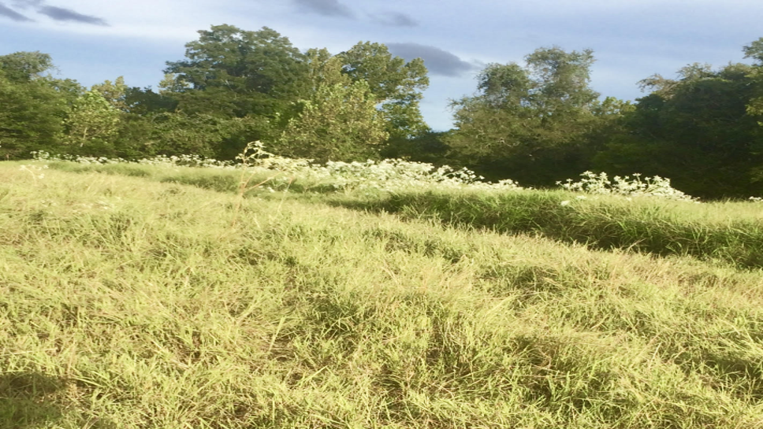
Trample and Weed Control

Slide 22
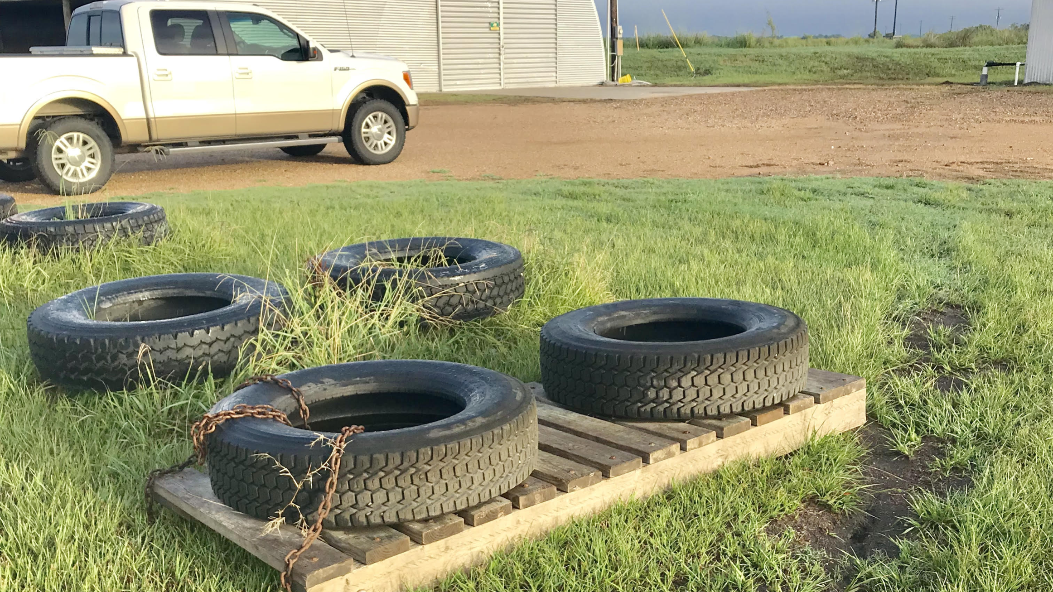
Mineral troughs

Slide 23
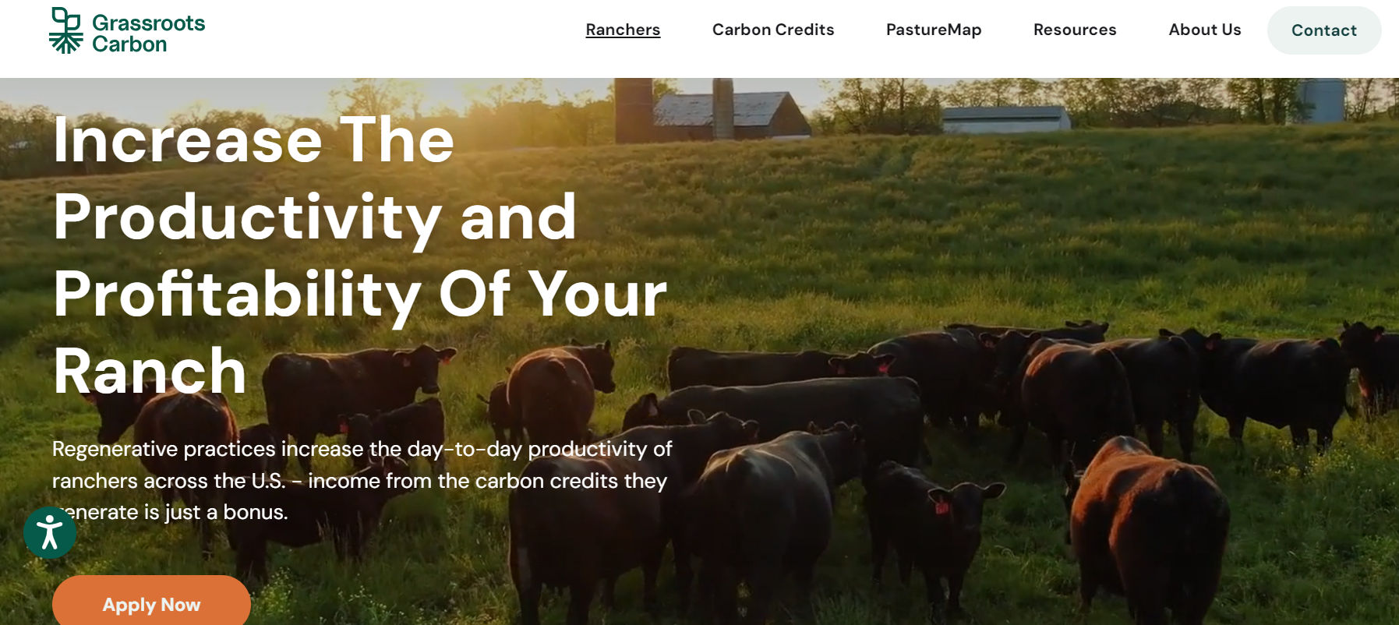
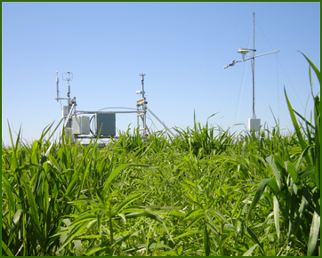
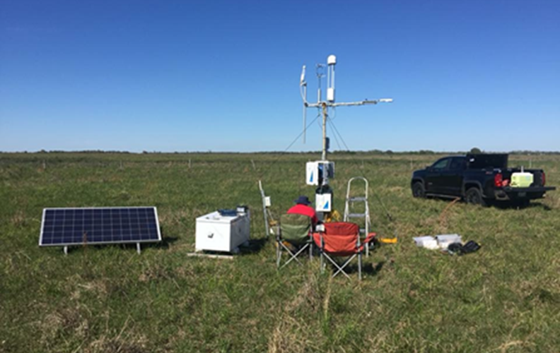


GrassRootsCarbon.com
1. Evaluate Net Carbon uptake for AHSD grazing
2. Quantify net CH4 flux with and without cattle present to understand overall carbon benefit

Slide 24
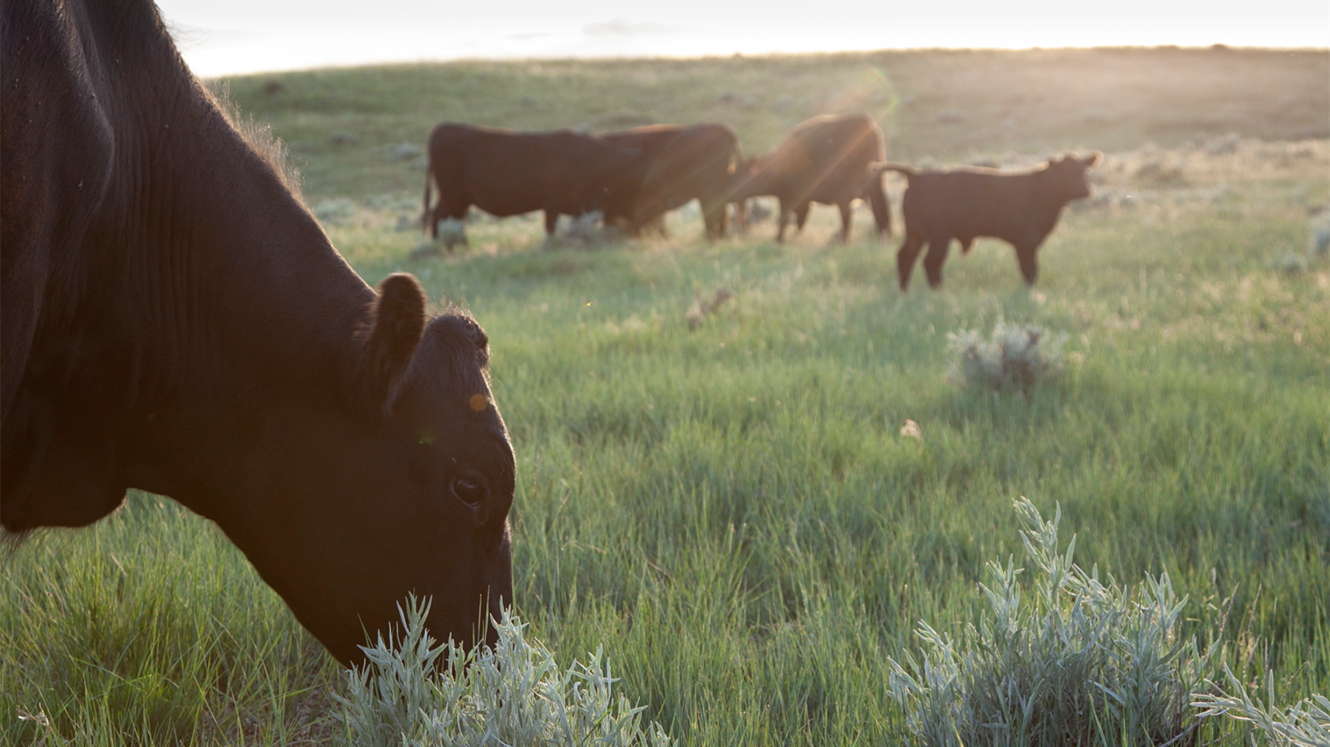


Audubon Conservation Ranching Program
Purpose: create market-based incentives for grassland
bird habitat conservation on ranchlands

Slide 25
https://content.jwplatform.com/previews/LMjLGCZi

Slide 26
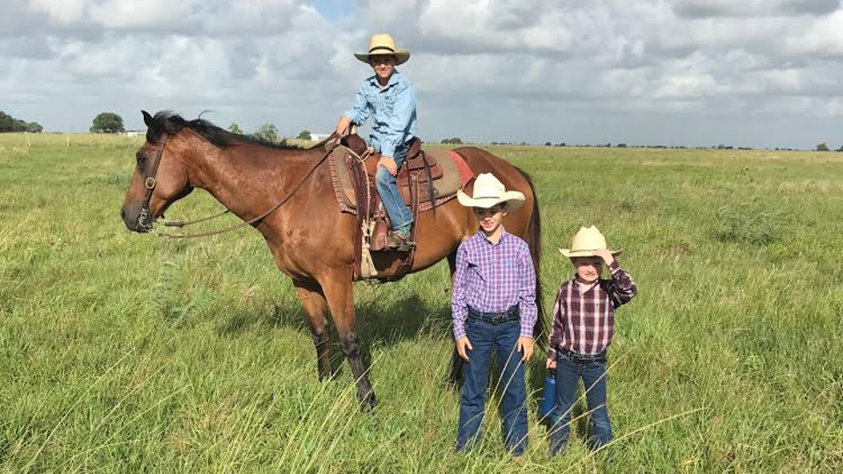
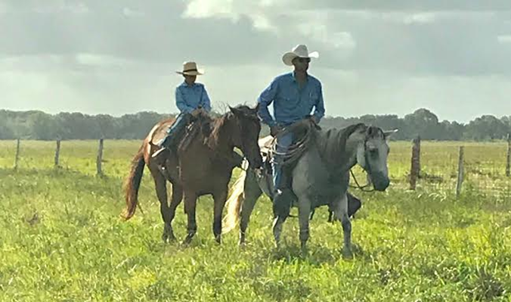
Quality Family Time

Slide 27
Resources
- Adaptive High Stock Density (AHSD): pastureproject.org/pasture-management
- Audubon Conservation Ranching: audubon.org/conservation/ranching
Thomas Schroeder
Conservation Ranching Program Manager
Texas/Oklahoma
tschroeder@audubon.org
c: 512.663.2944
Grass Roots Carbon
Hunter Jones
Hunter.jones@buildinggrassroots.com
PastureMap
Molly Faught
Molly.fault@buildinggrassroots.com

Slide 28
Contact
Loy Sneary 979.240.3512 loy@gcgenergy.com www.windmillhayfarms.com www.loysneary.com

