Slide 1
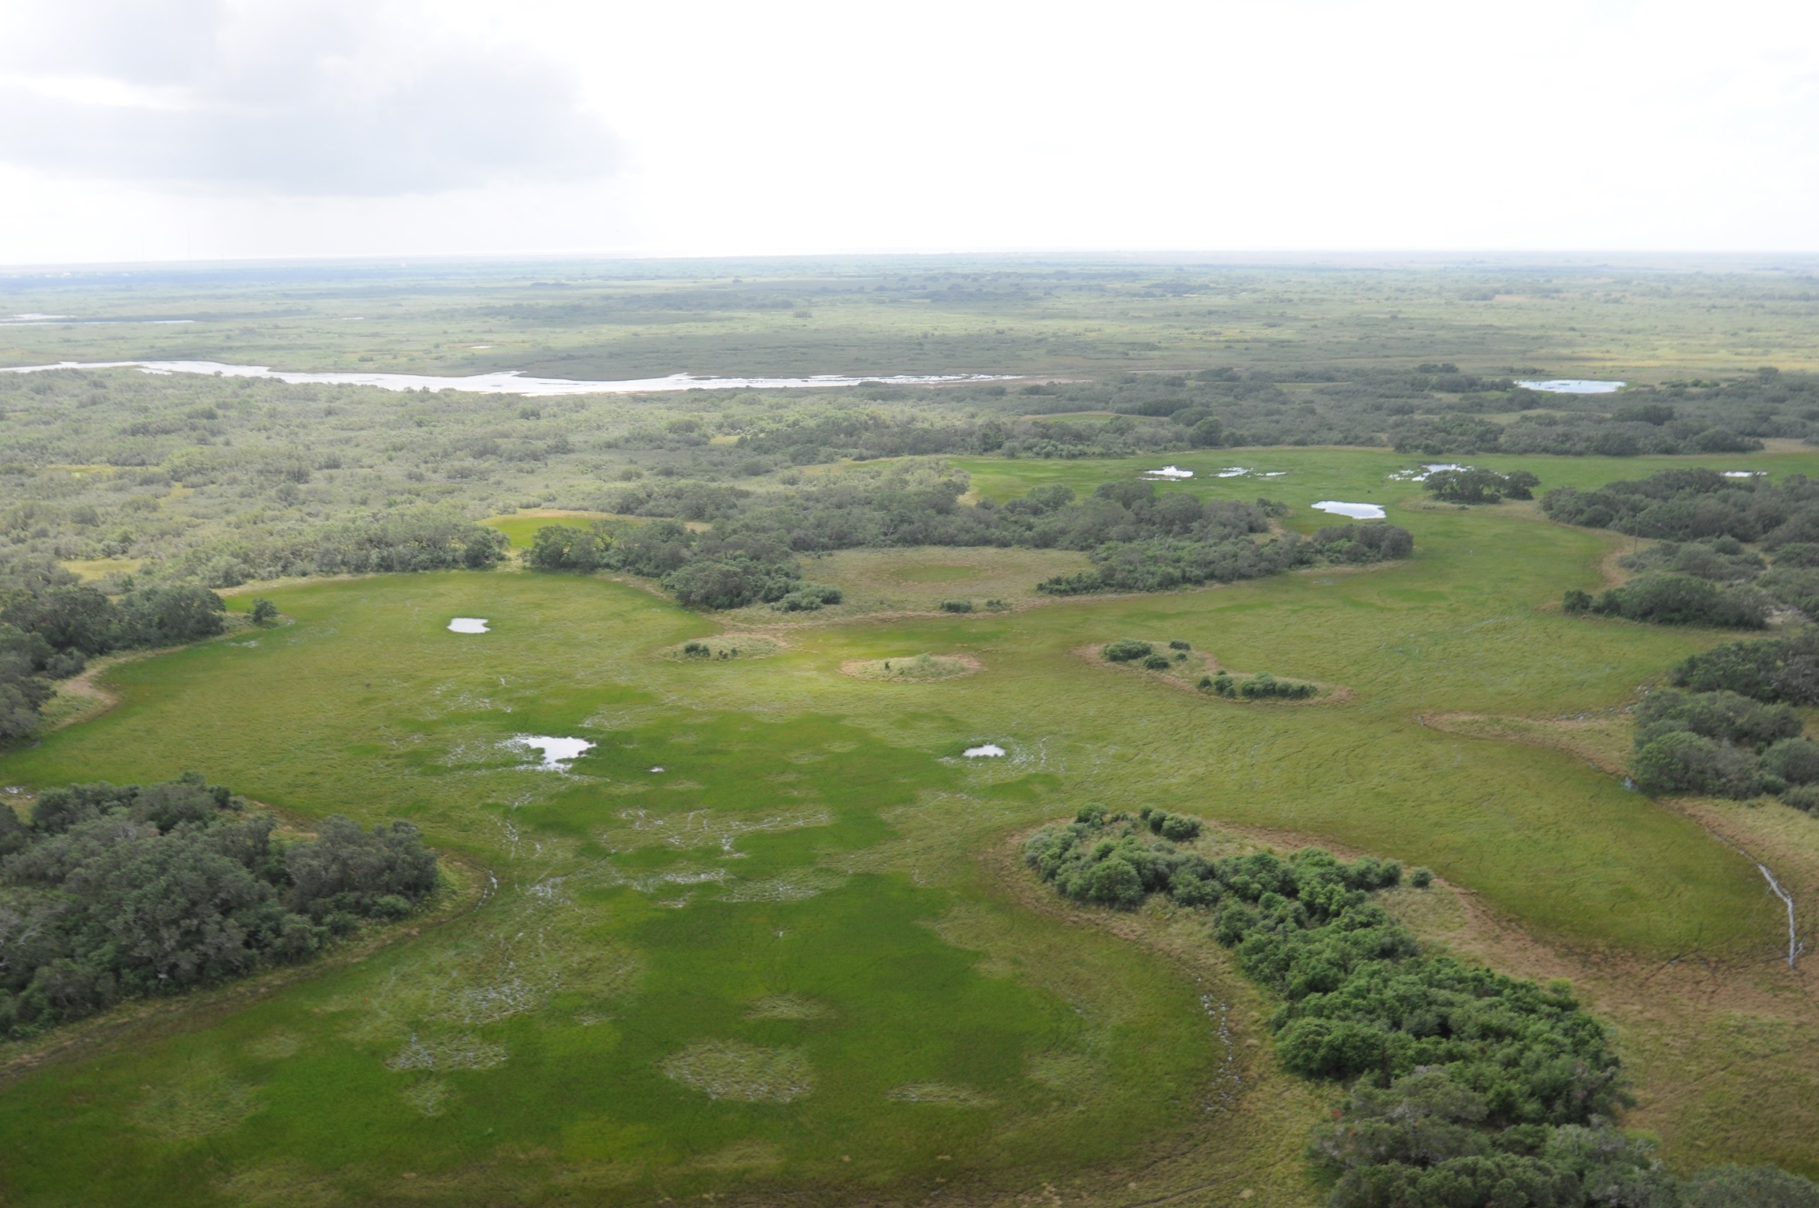
Powderhorn WMA
Calhoun County
17,351 acres
Cattle ranch

Slide 2
Acquisition
Purchased with funds resulting from the BP Horizon oil spill
Multi agency effort
Texas Parks and Wildlife Foundation
Texas Parks and Wildlife Department
The Nature Conservancy
The Conservation Fund
National Fish and Wildlife Foundation
TPWF donated the property in October 2018

Slide 3
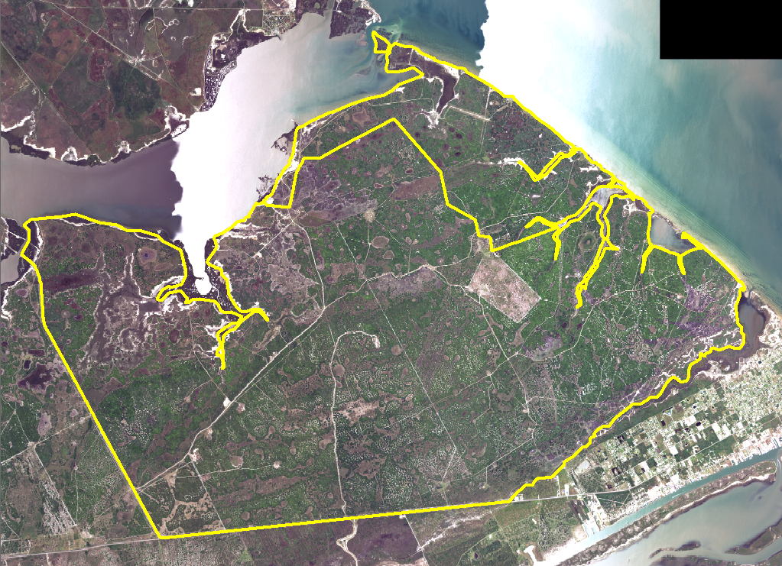

Slide 4
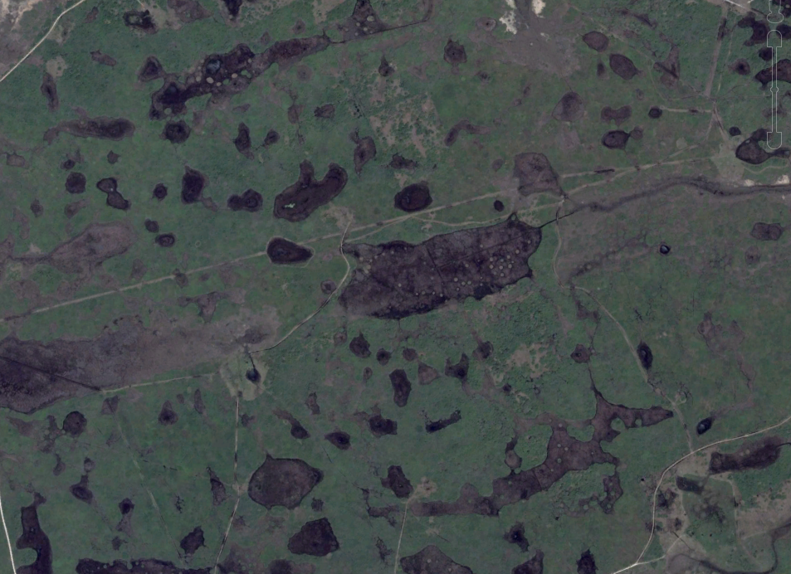

Slide 5
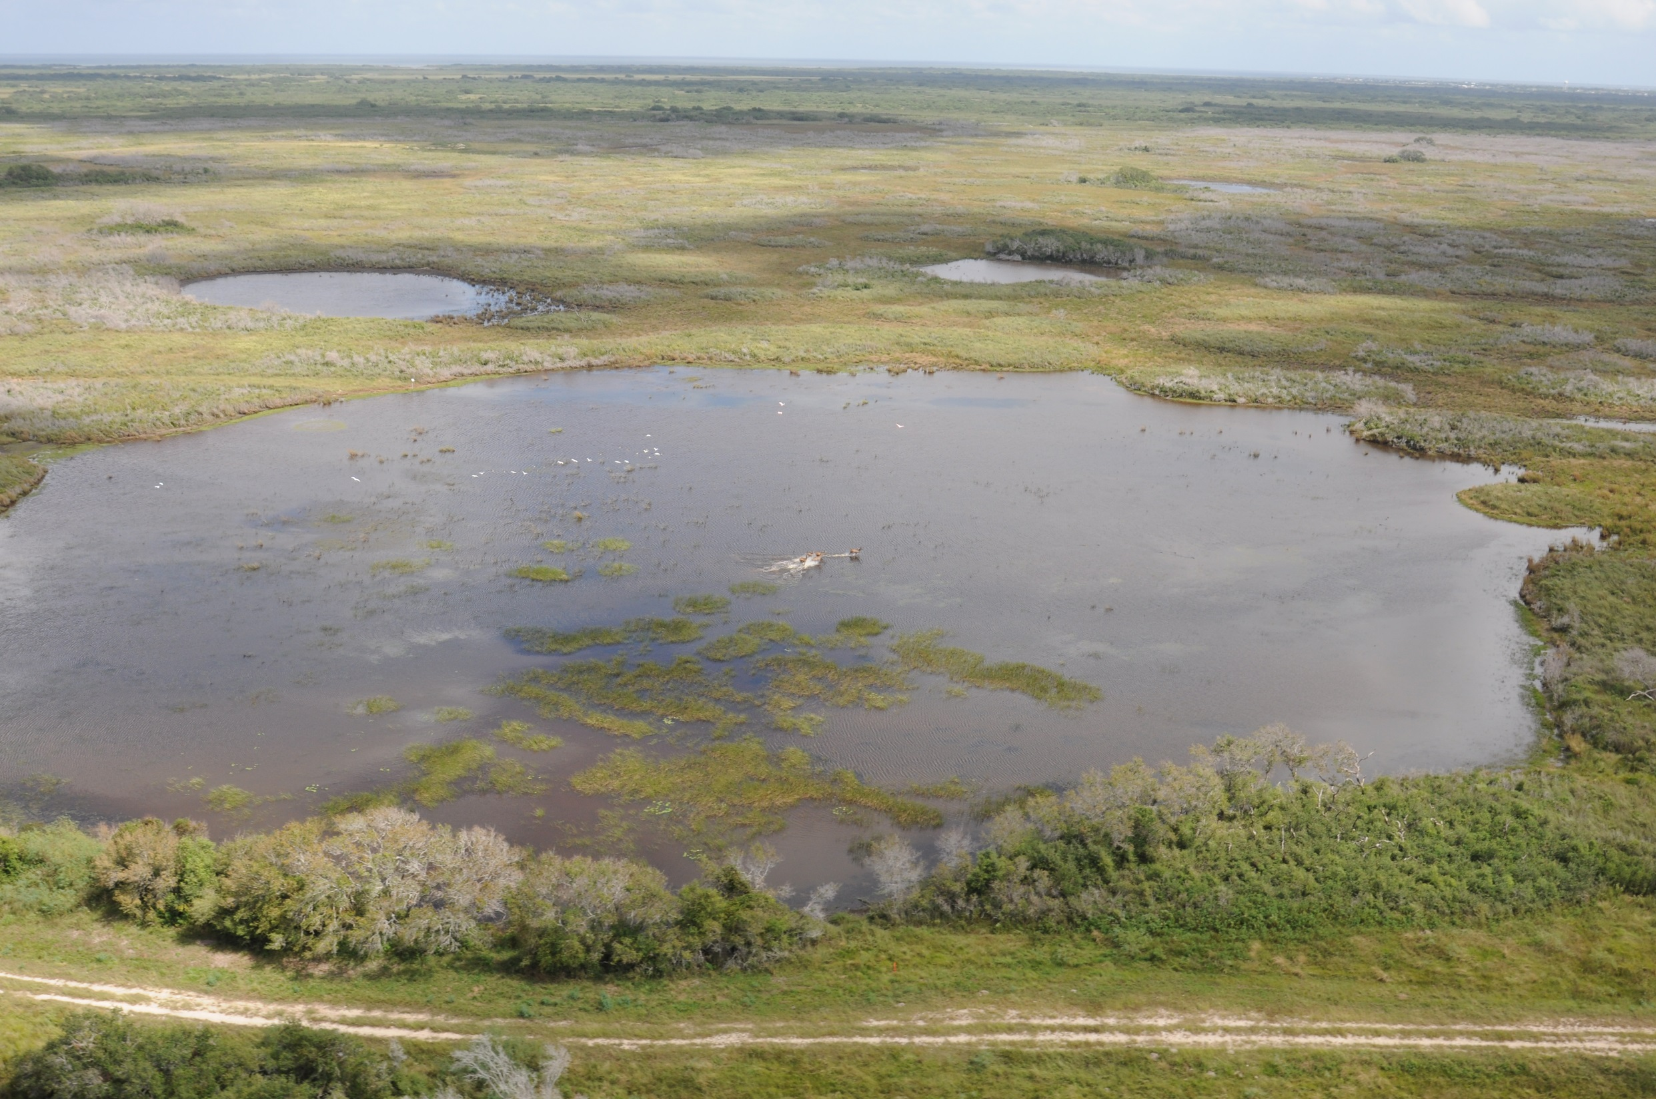

Slide 6
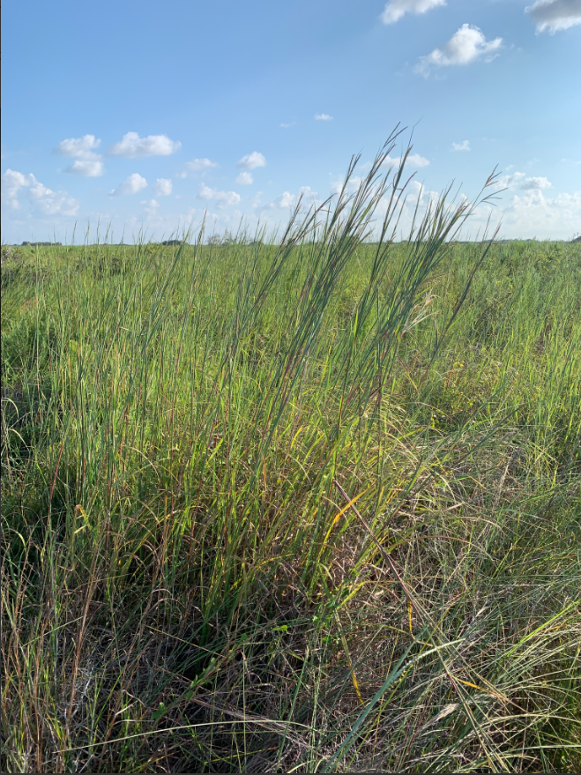
Habitat
Historically coastal prairie
Interspersed wetlands
Brush encroachment
Suppression of fire
Over 500 plant species

Slide 7
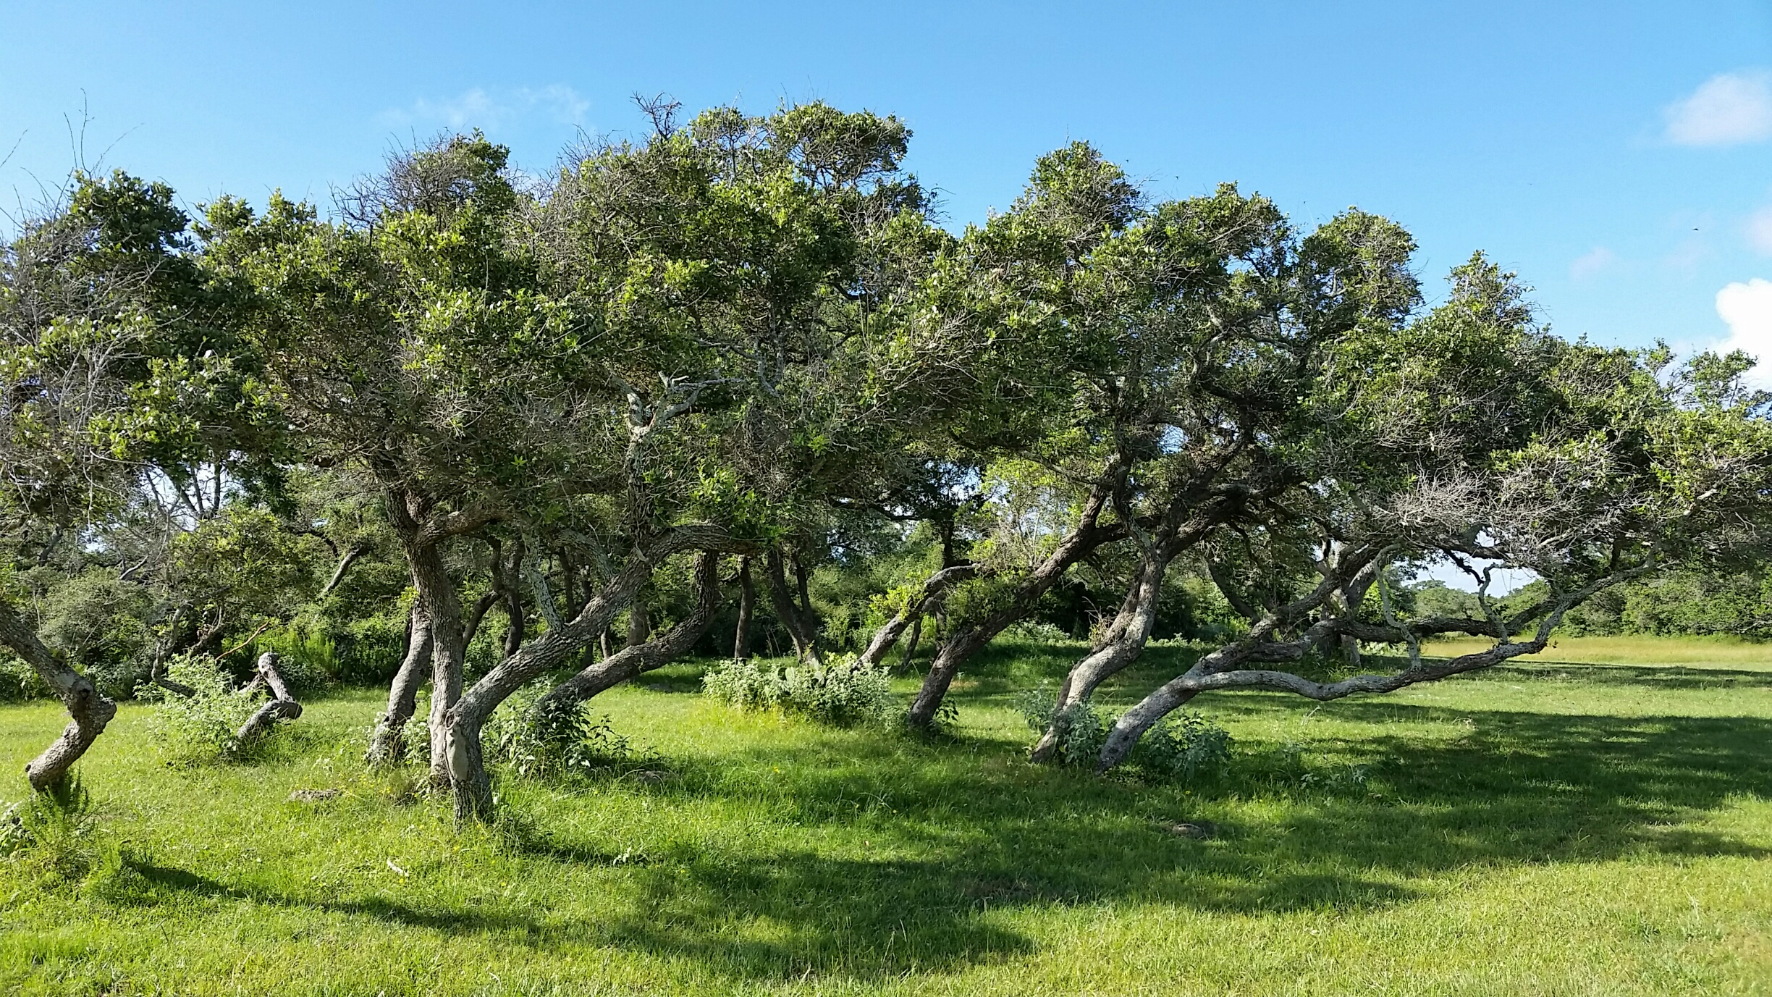

Slide 8
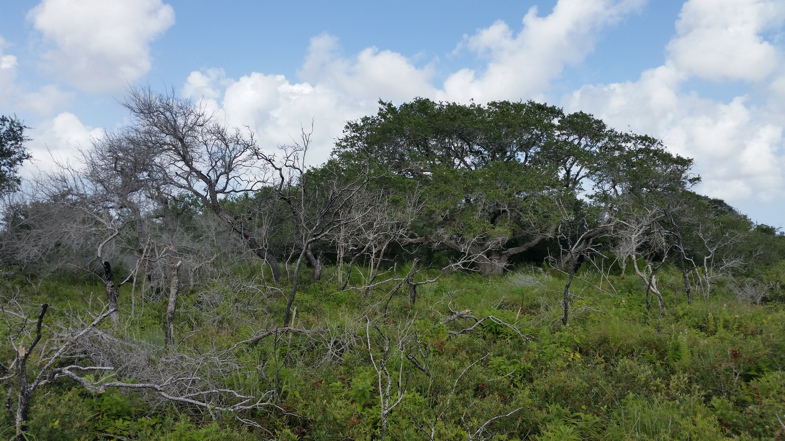

Slide 9
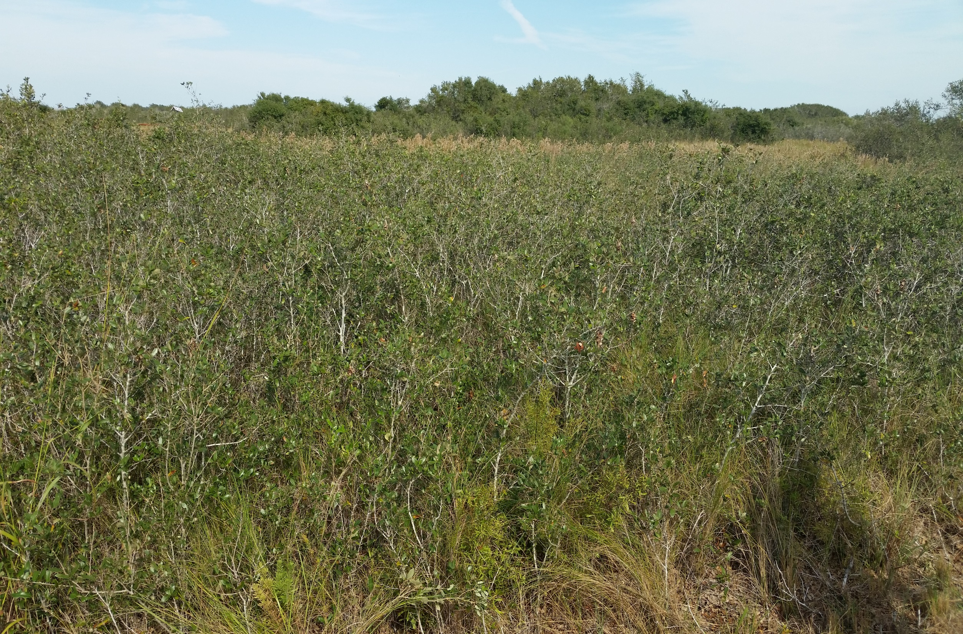
Running Live Oak

Slide 10
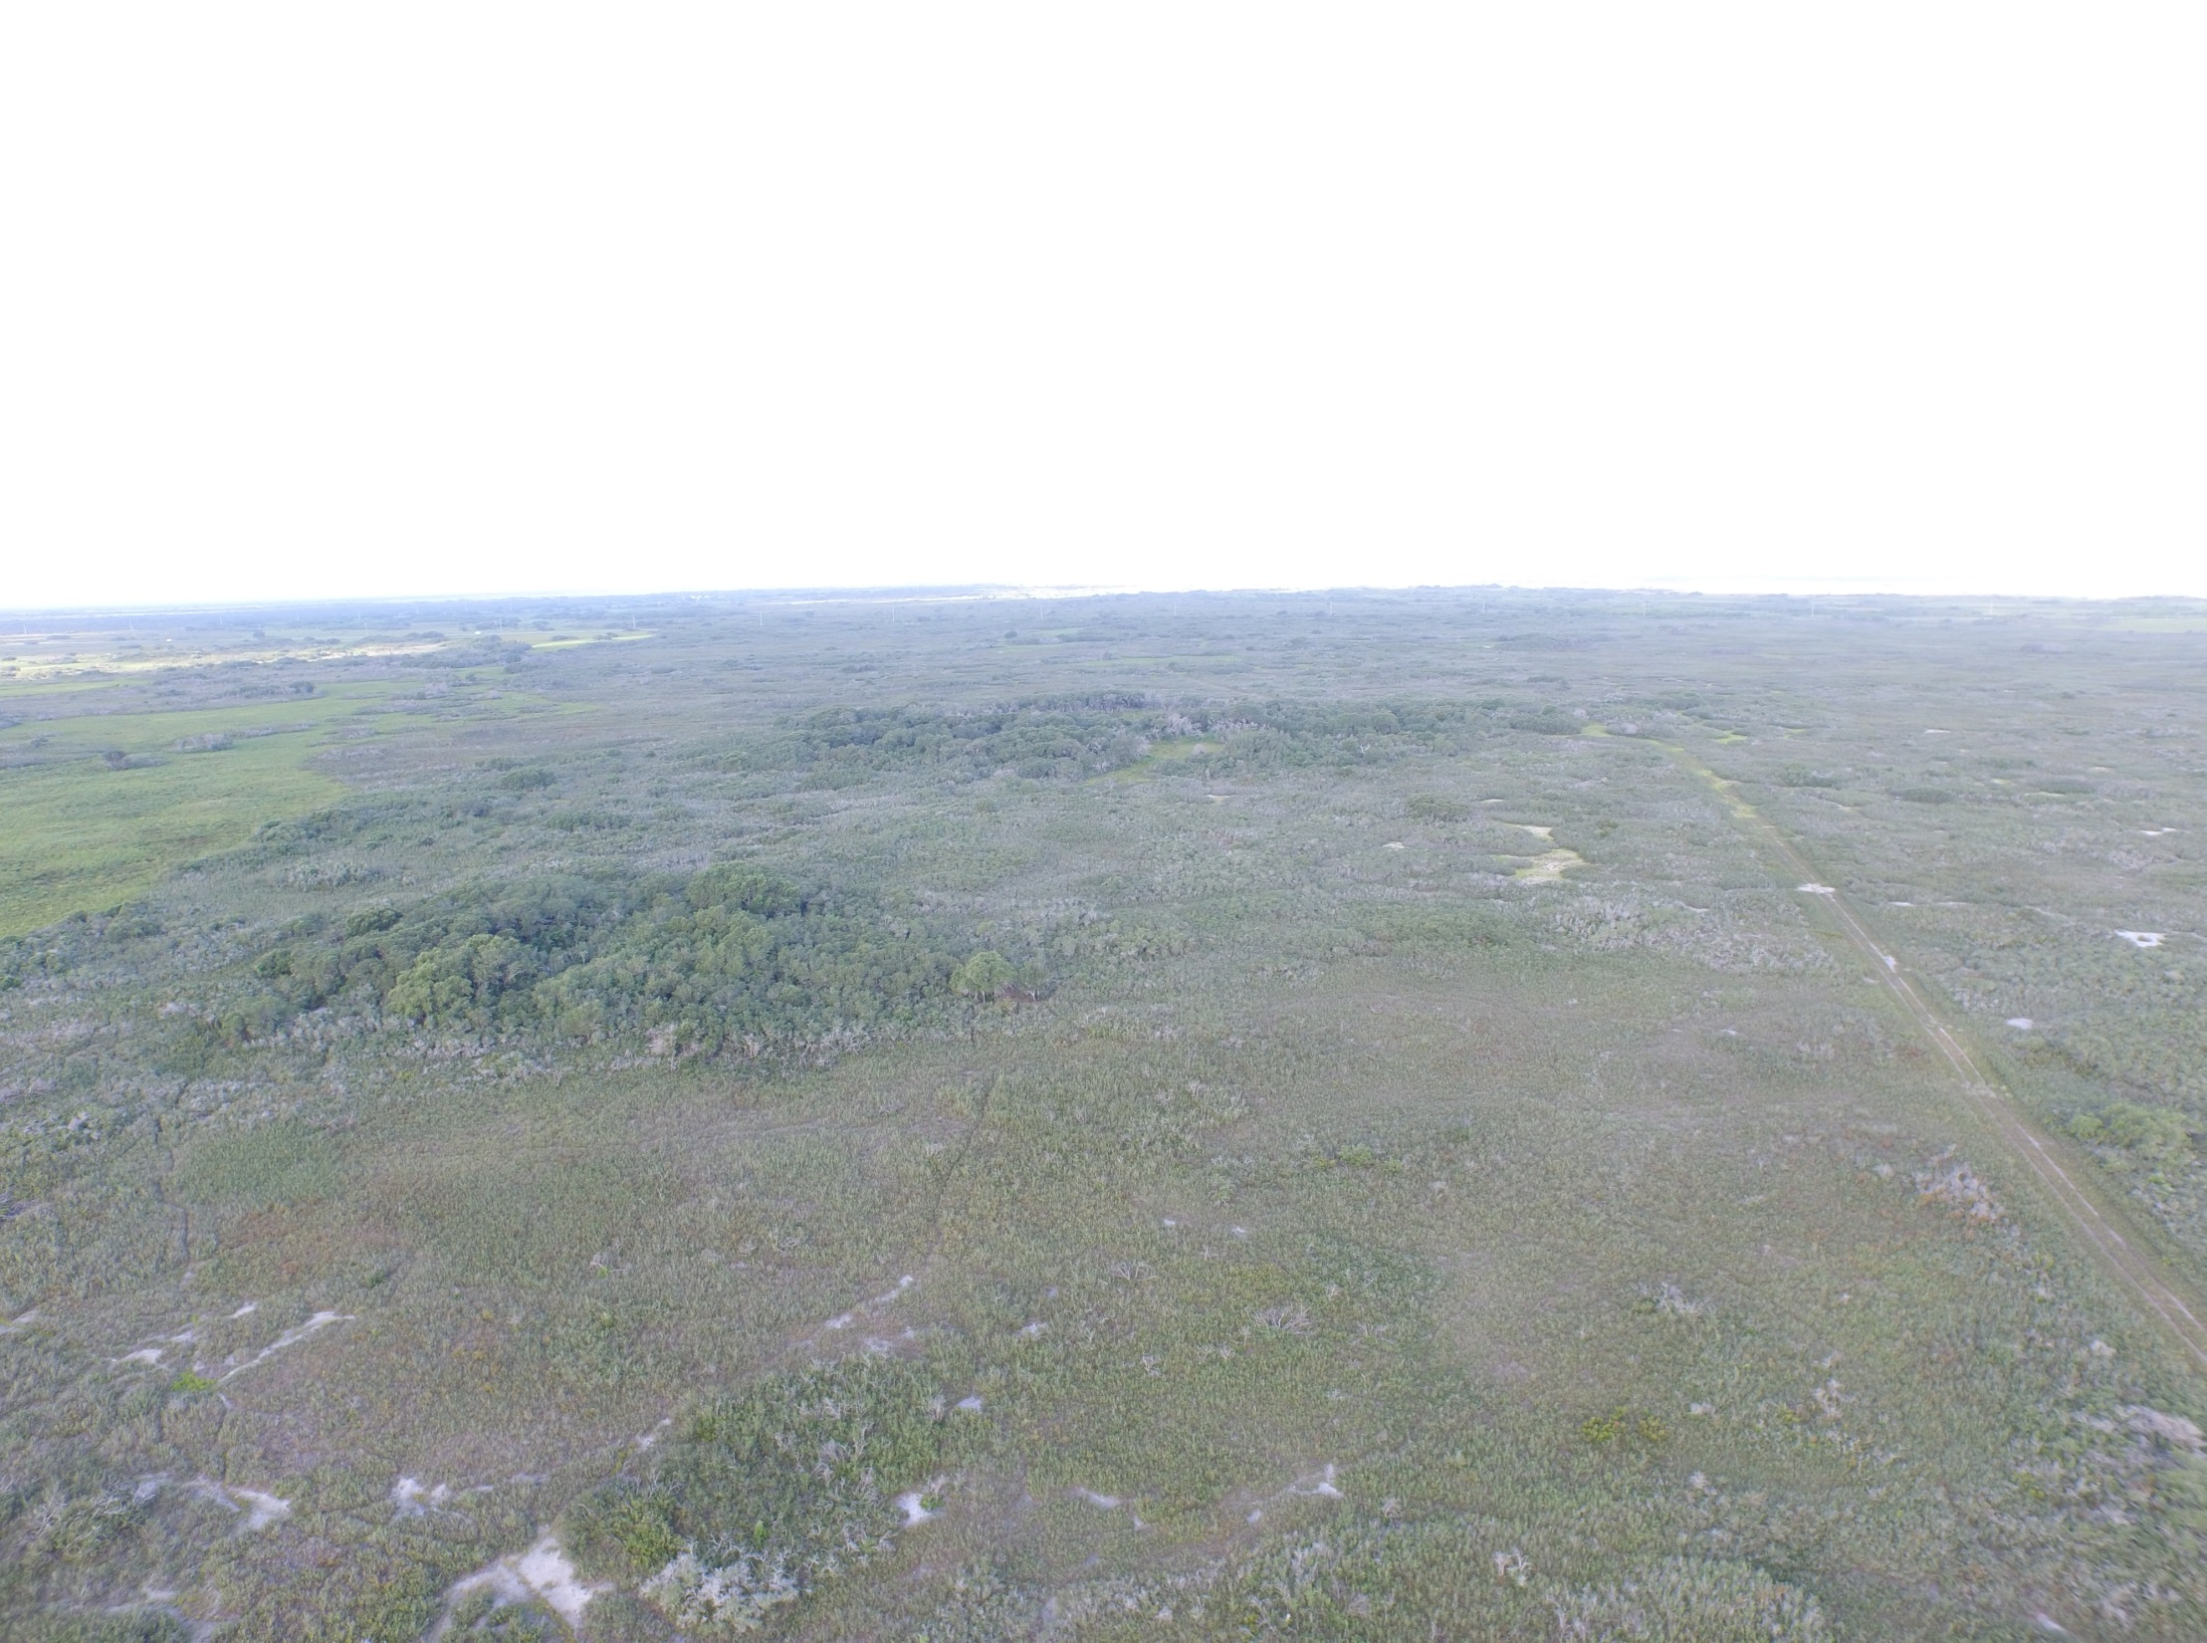

Slide 11
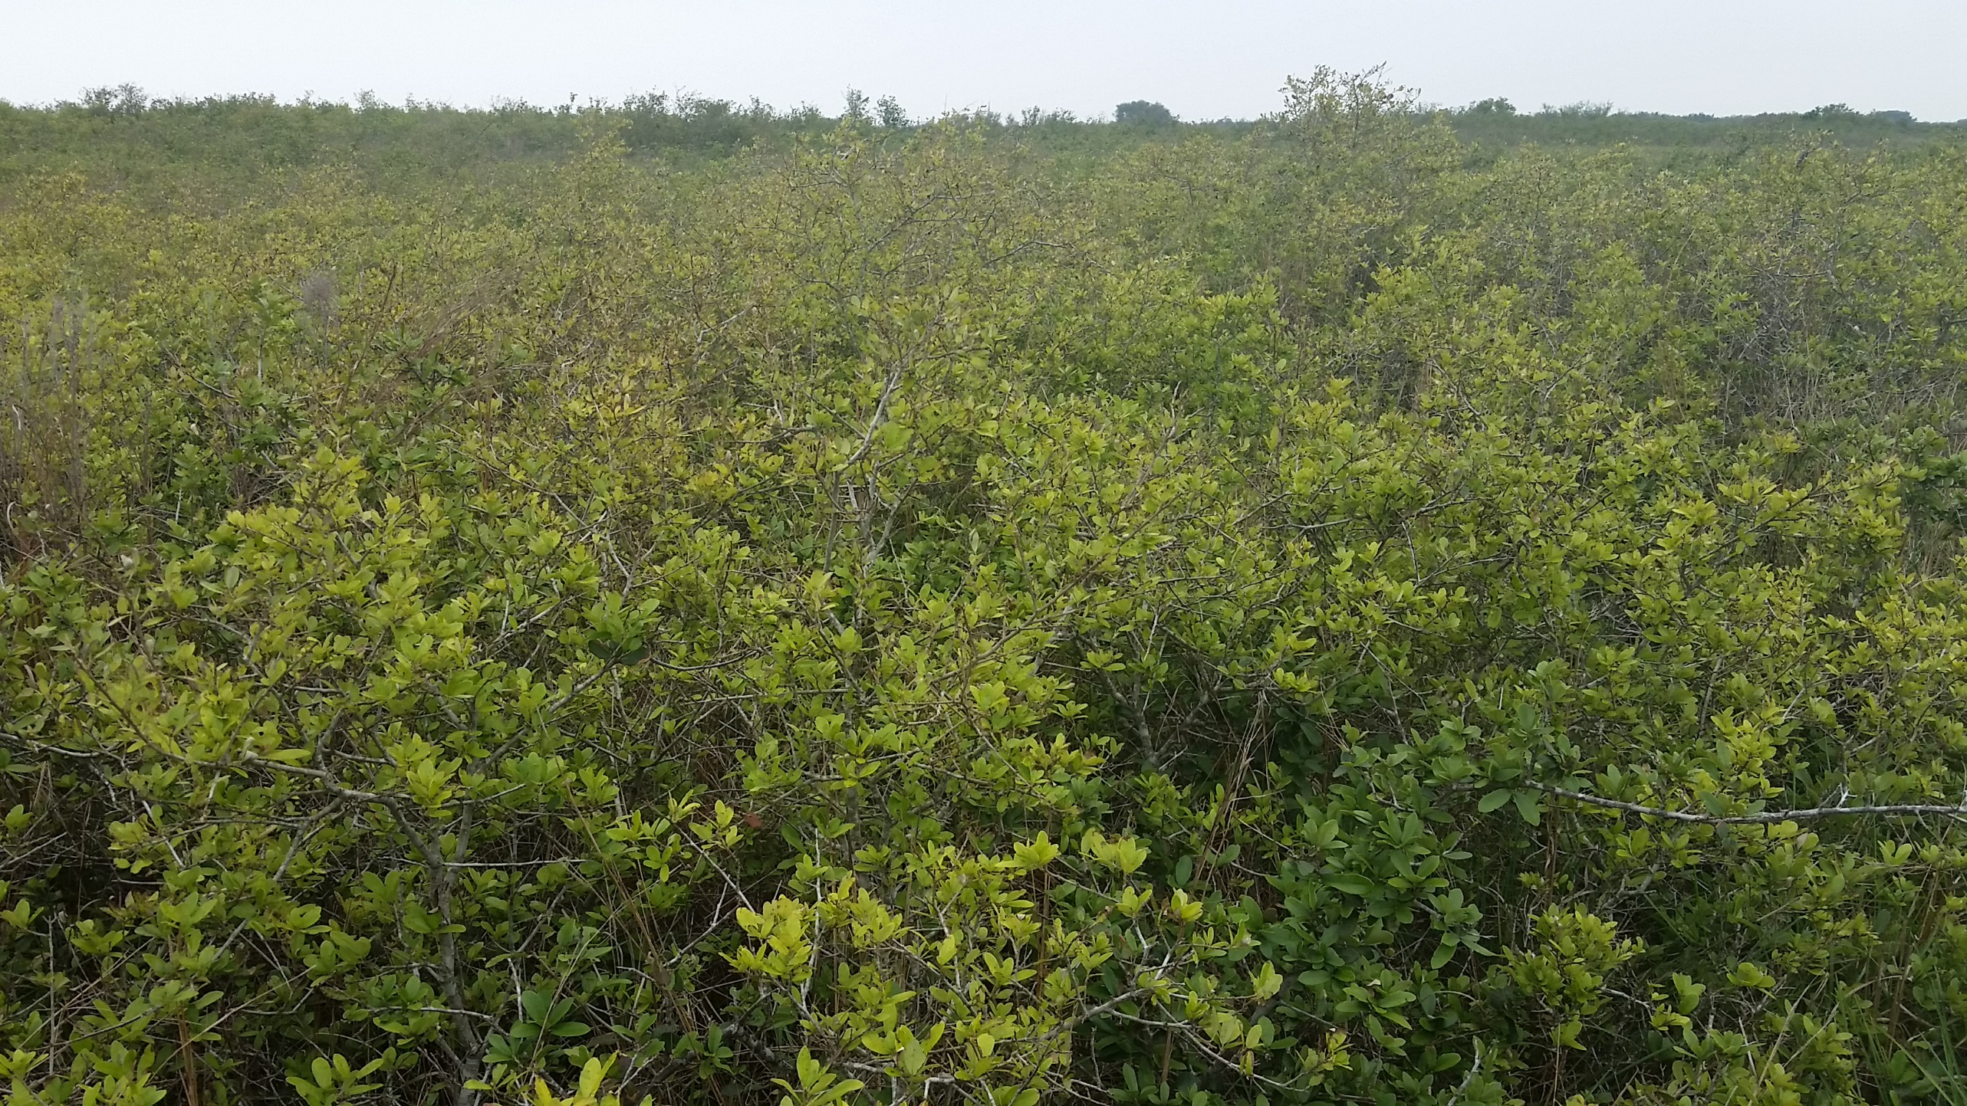

Slide 12
Herbicide Application
Not enough fine fuel to set back brush through prescribed fire
Herbicide used to open up brush and let grasses grow
Spike (Tebuthiuron)
20p – pelleted form
80df – granular, mixed with water before applying
Both are absorbed through roots
Don’t want excessive rain washing chemical away

Slide 13
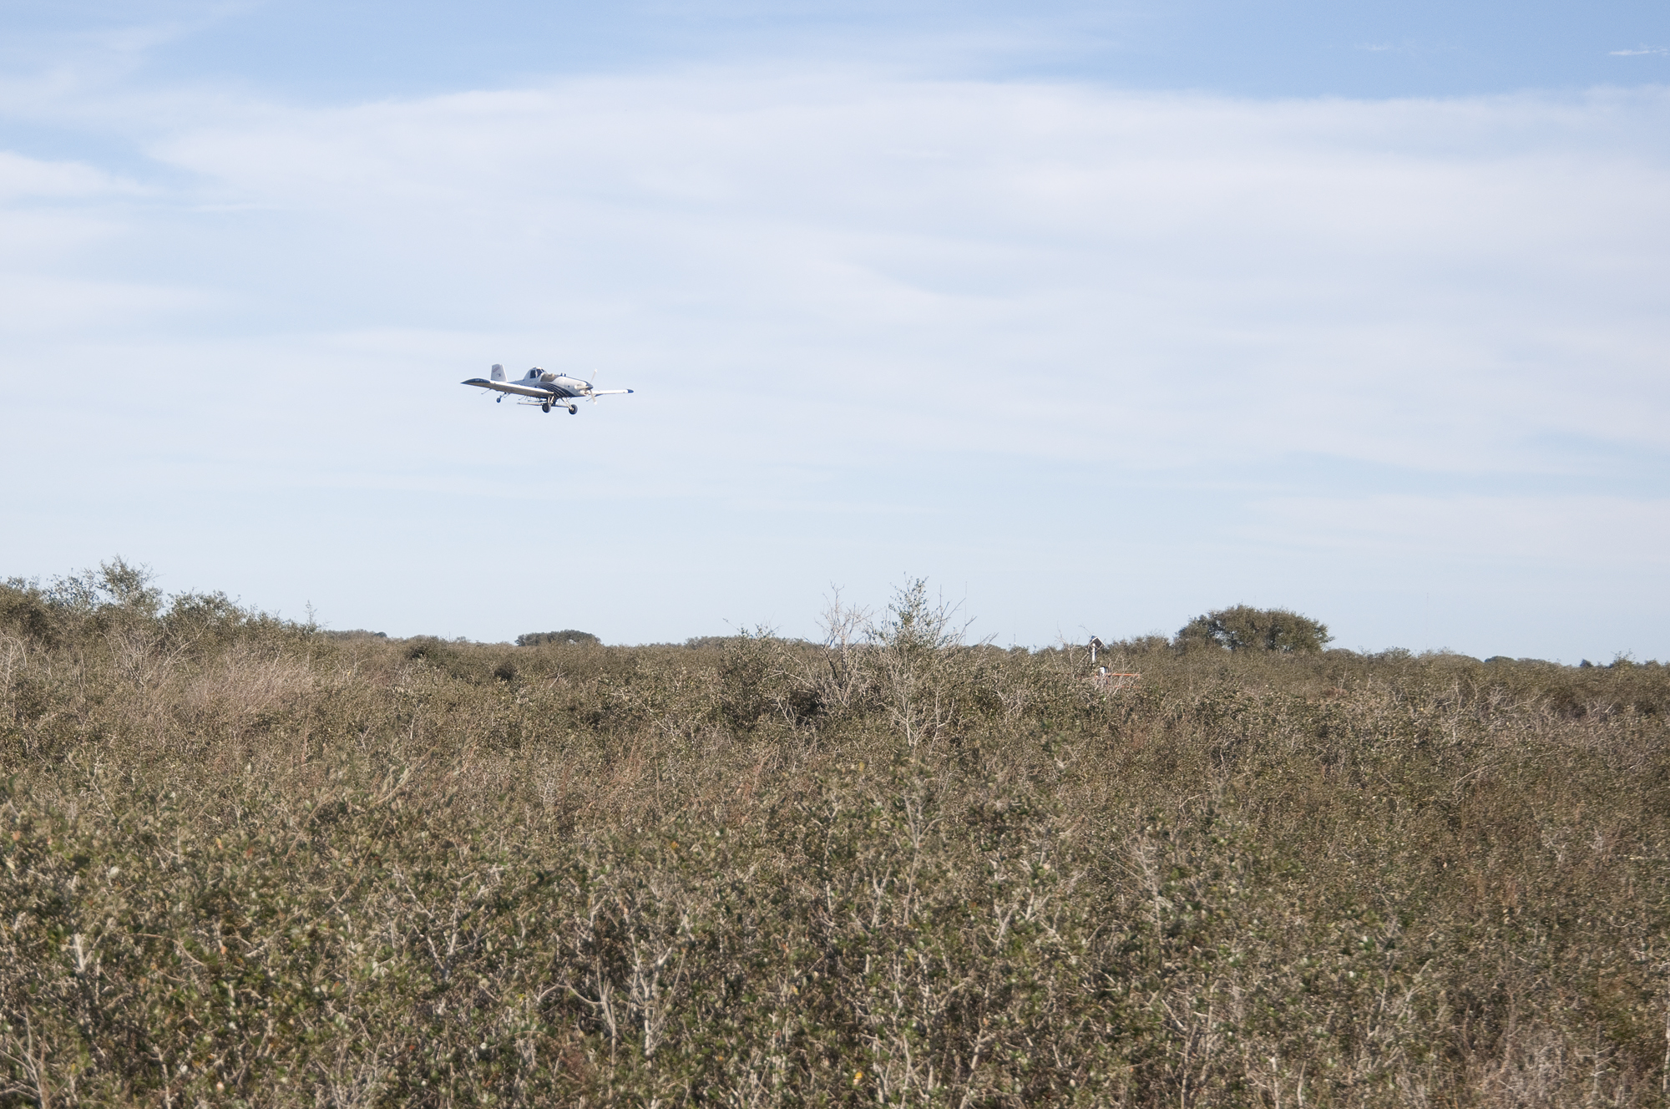

Slide 14
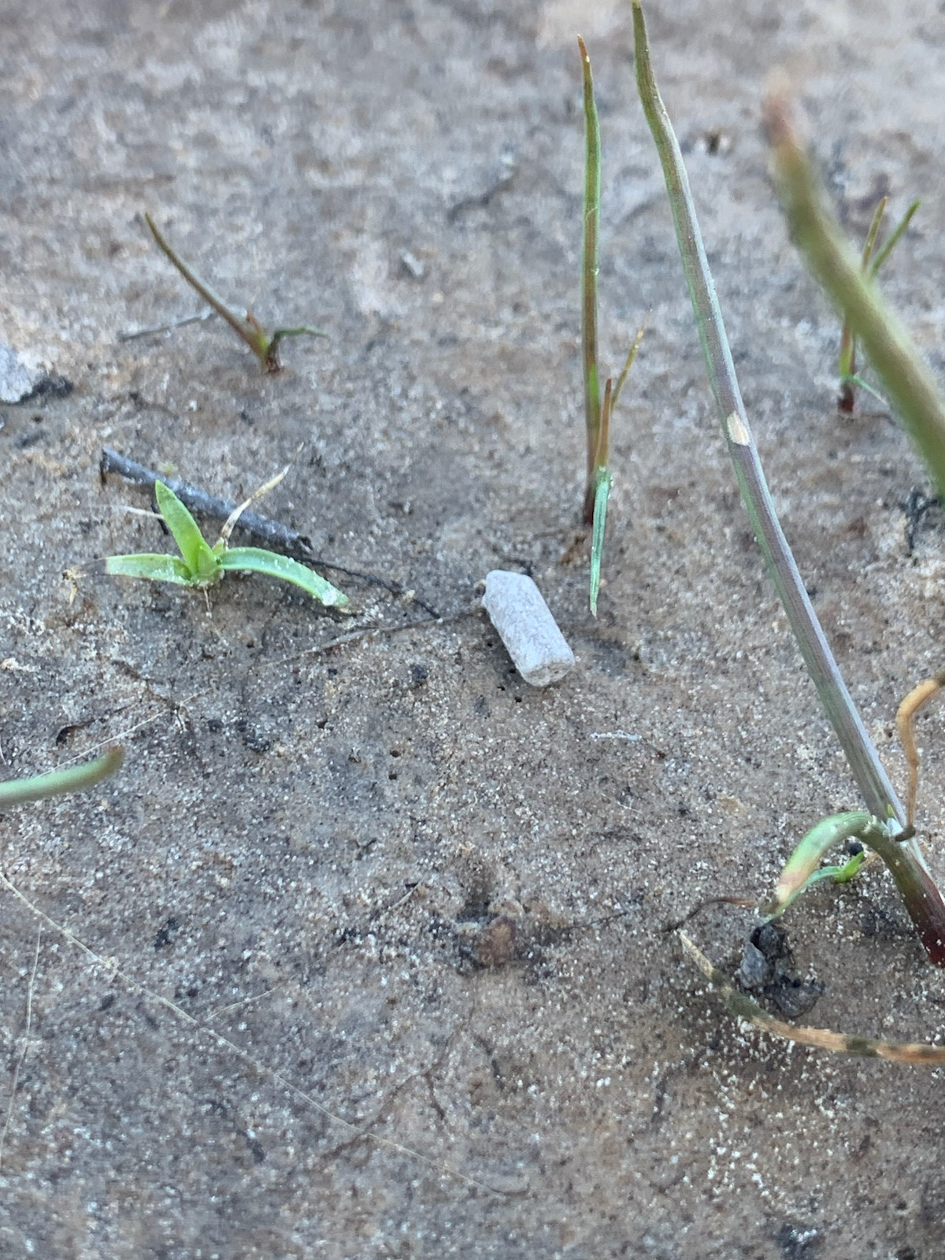
Spike 20p on Powderhorn WMA
Applied to 7200 acres
Dec 2015 – 2900 ac
Dec 2016 – 1200 ac
Jan 2023 – 1700 ac
Jan 2025 – 1400 ac
Fix-winged aircraft
10 lbs/ac
Follow up with prescribed fire
2 years to let plants die
Allow grasses to grow

Slide 15
Post-Treatment Precipitation
Treatment | January | February | March | April | May | June
2015 (Dec) | 4.00 | 0.75 | 2.25 | 0.20 | 9.5 | 5.89
2016 (Dec) | 0.23 | 0.19 | 0.38 | 2.97 | 6.00 | 2.91
2023 (Jan) | 1.24 | 0.28 | 0.62 | 6.64 | 3.80 | 0.09
2025 (Jan) | 2.81 | 0.40 | 4.50 | - | - | -

Slide 16
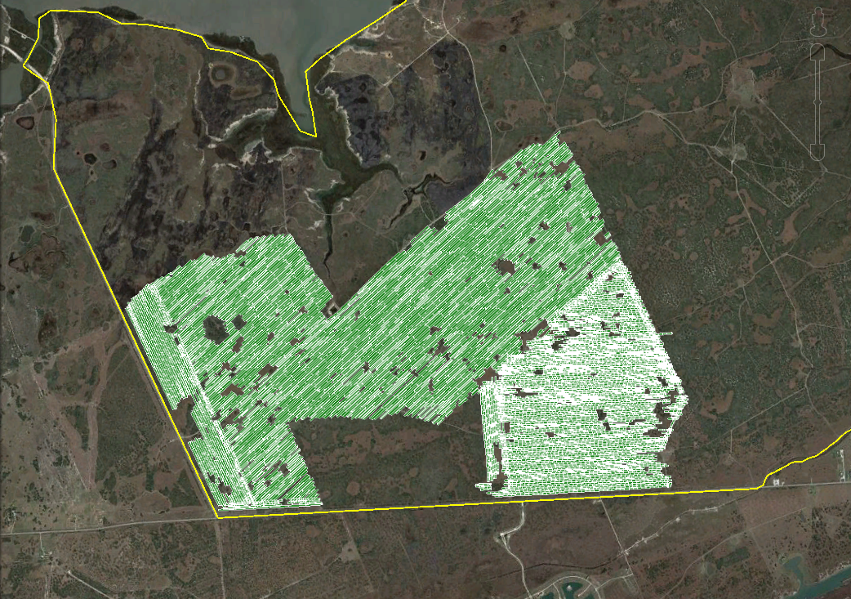

Slide 17
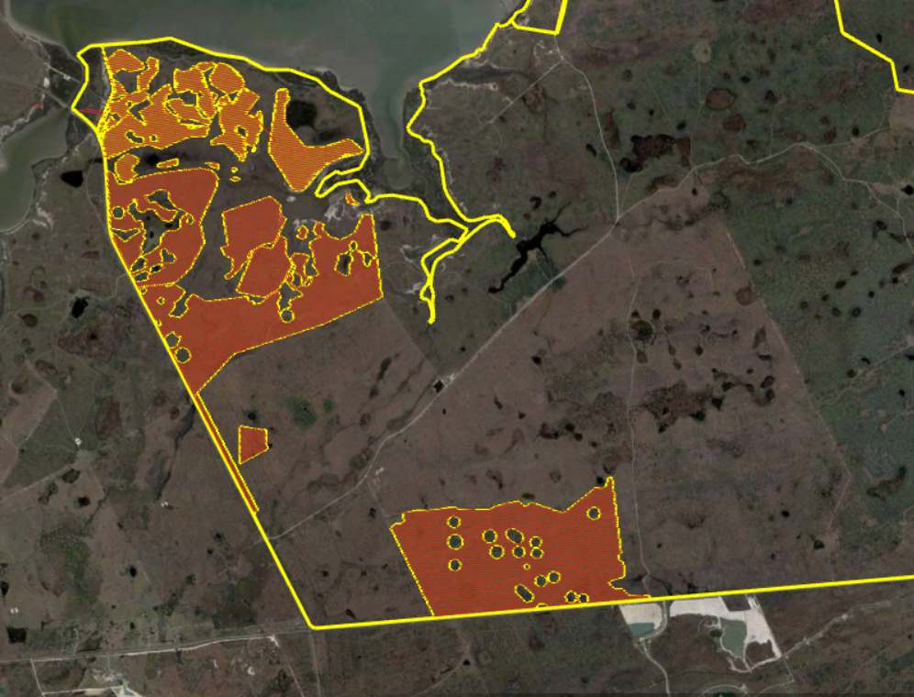

Slide 18
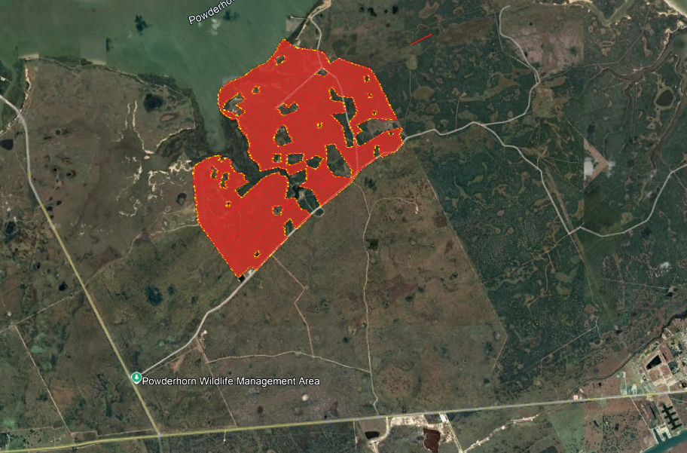

Slide 19
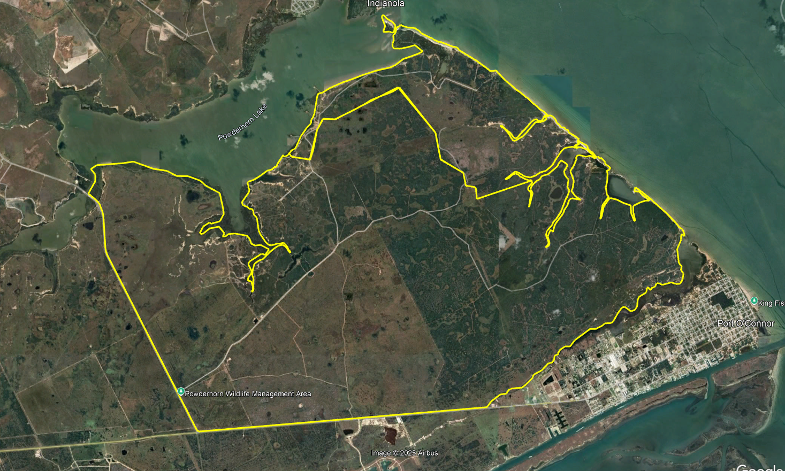

Slide 21
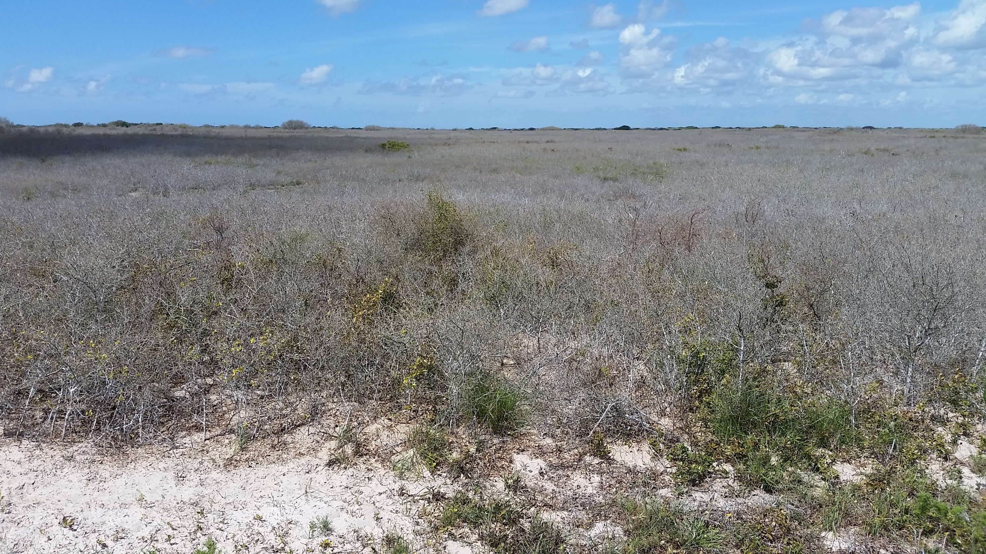

Slide 22
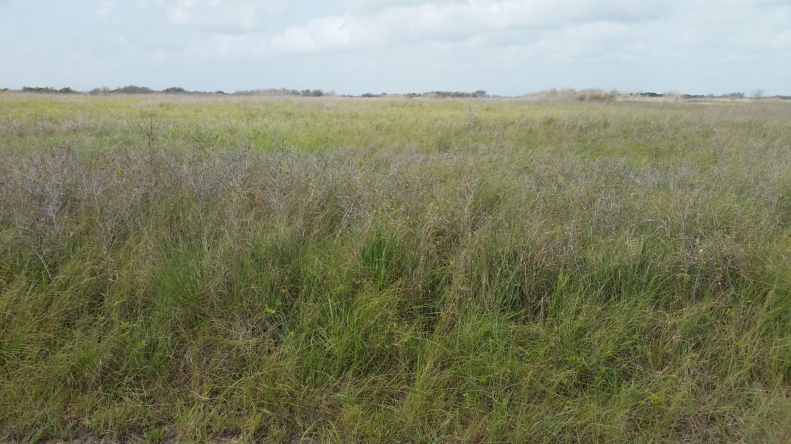

Slide 23
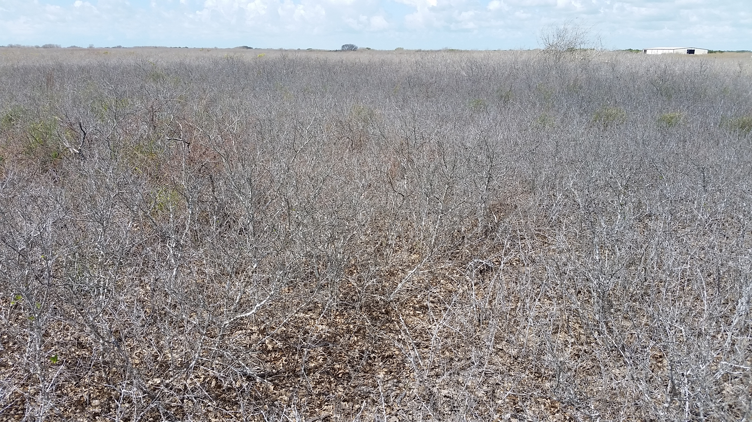

Slide 24
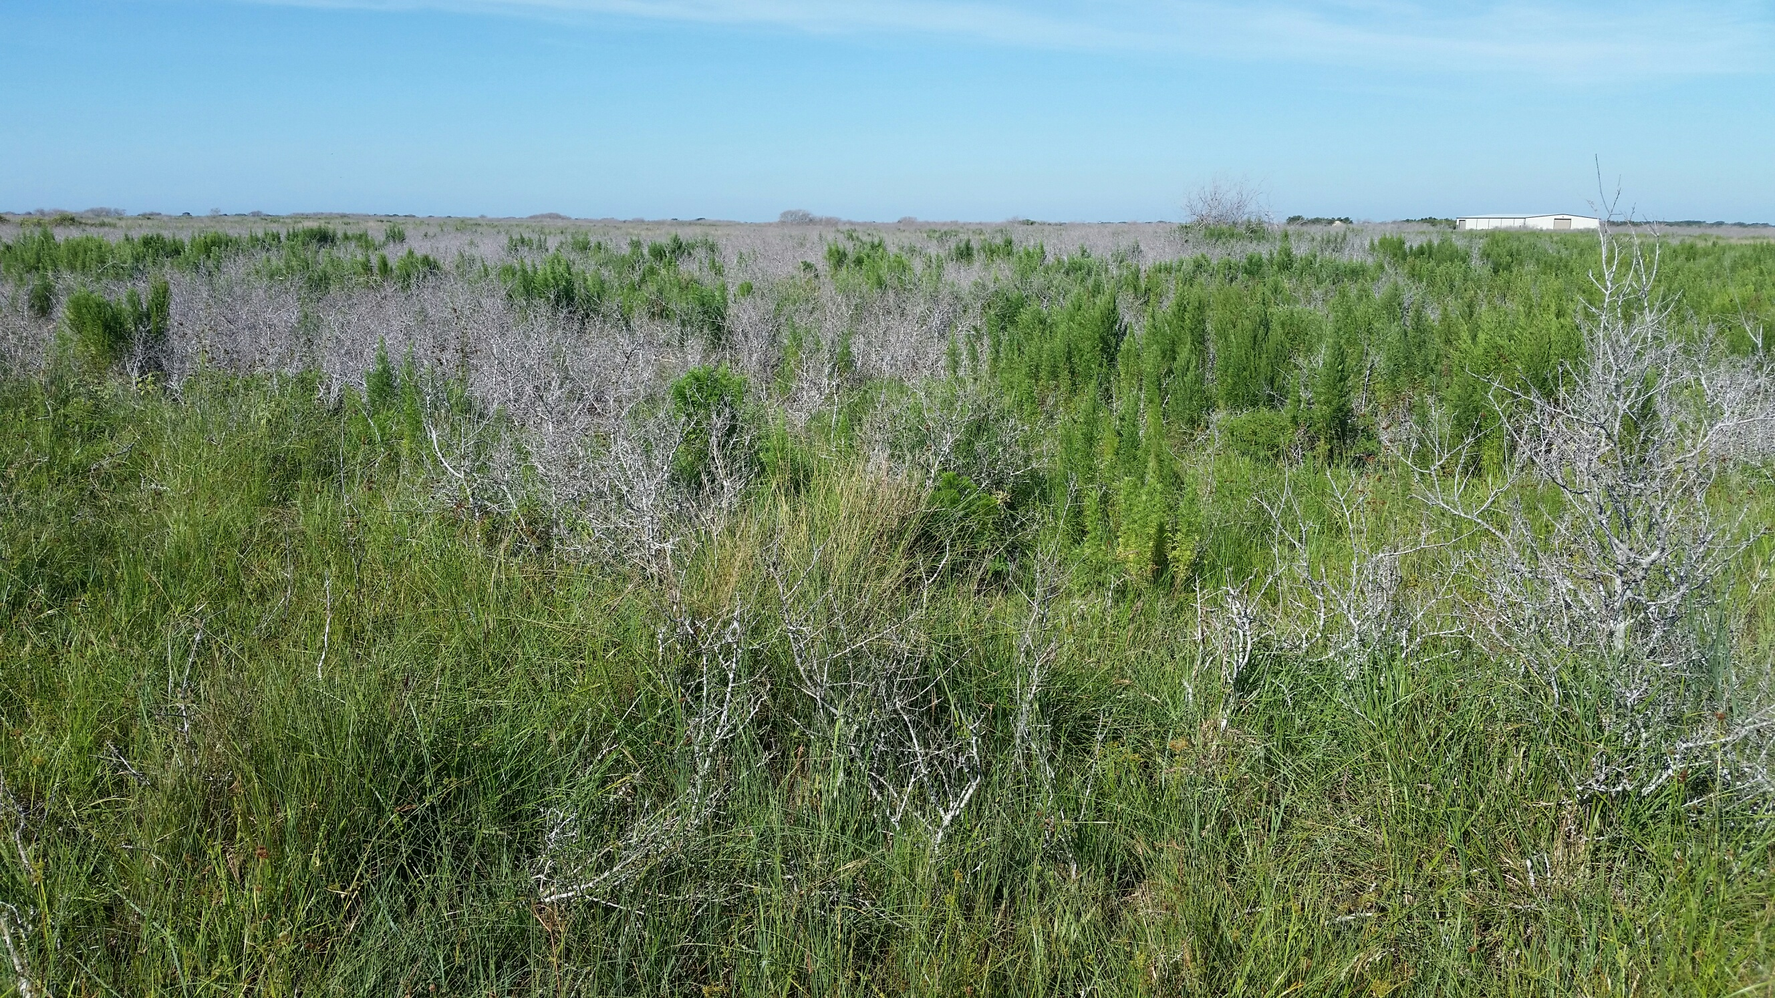

Slide 25
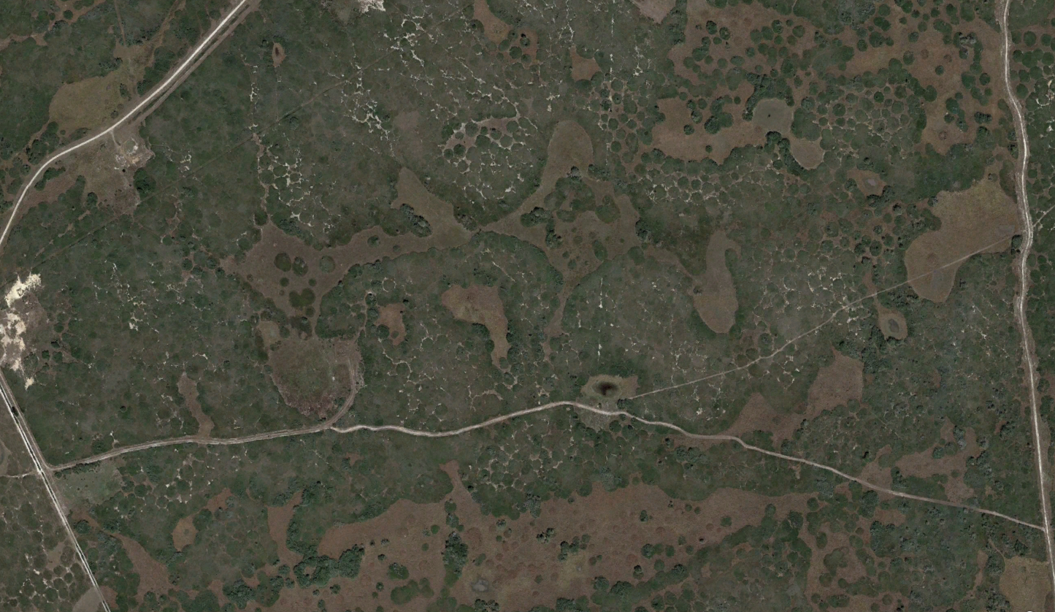

Slide 26
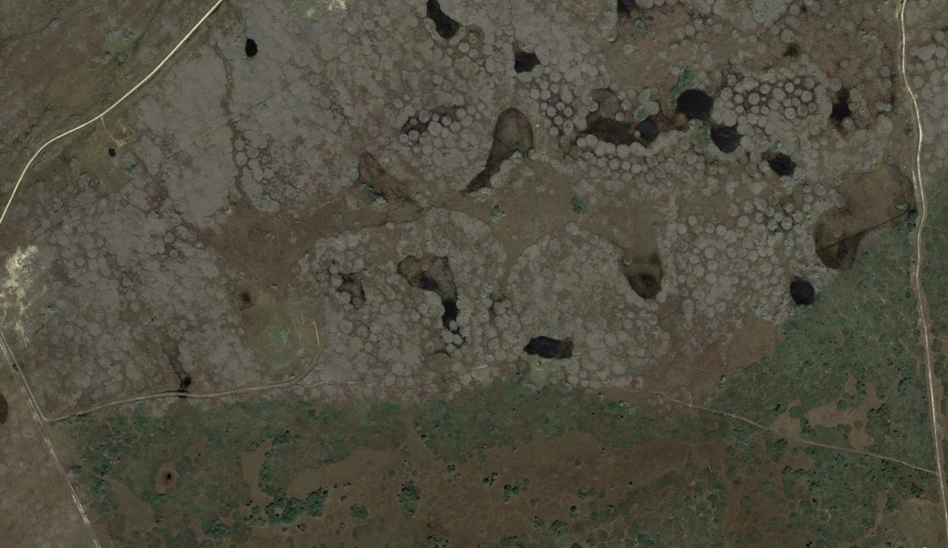

Slide 27
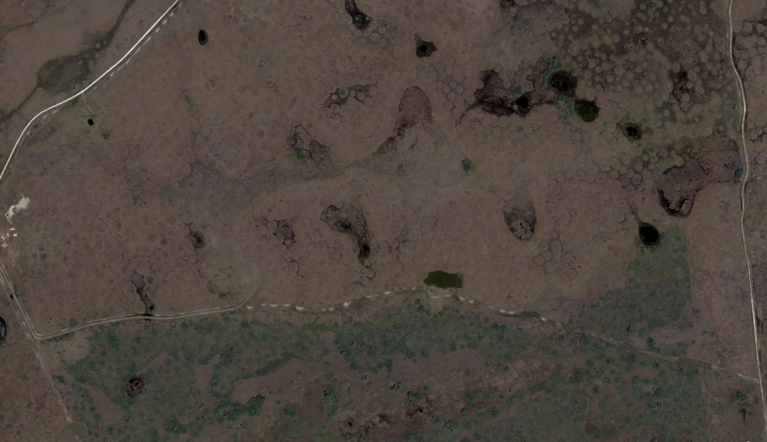

Slide 28
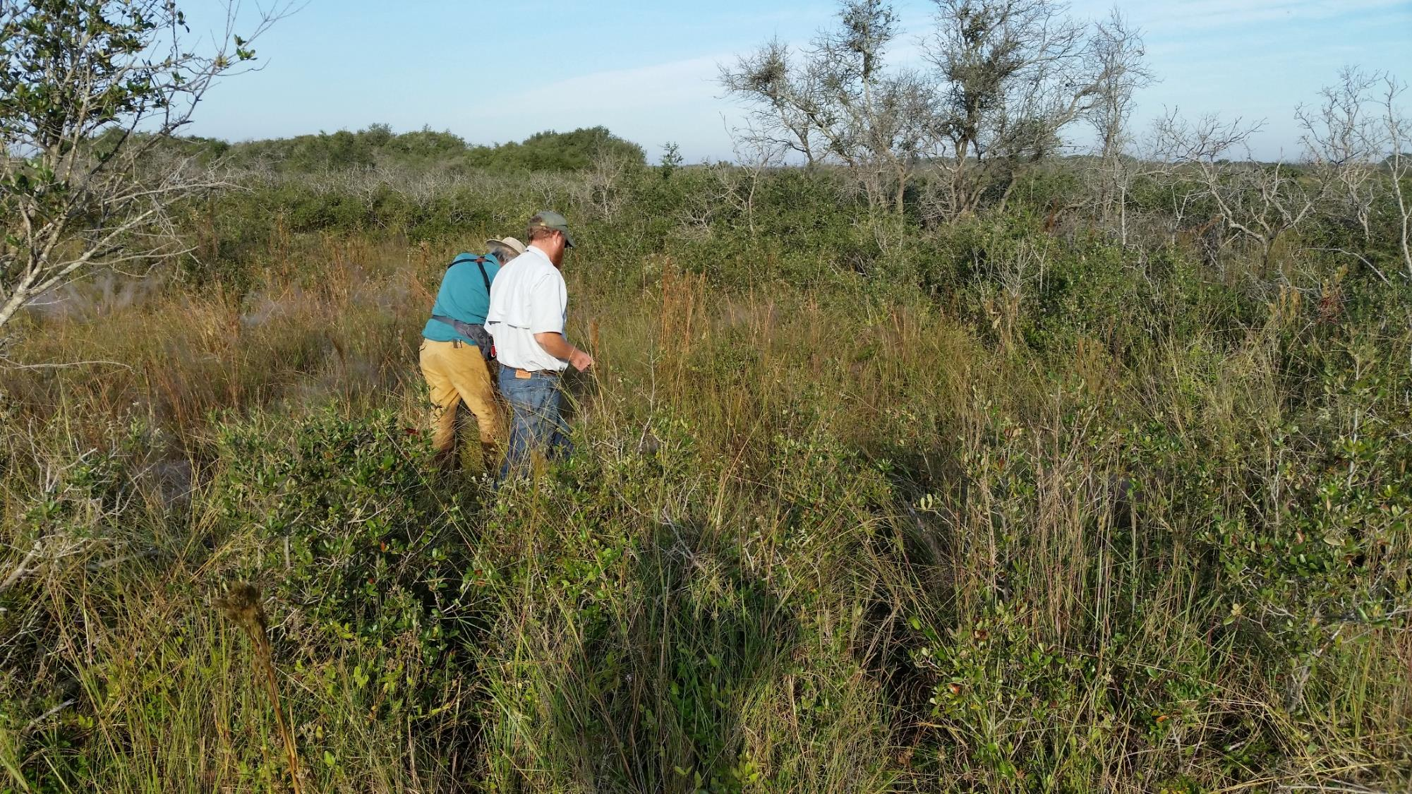
Oct 2015

Slide 29
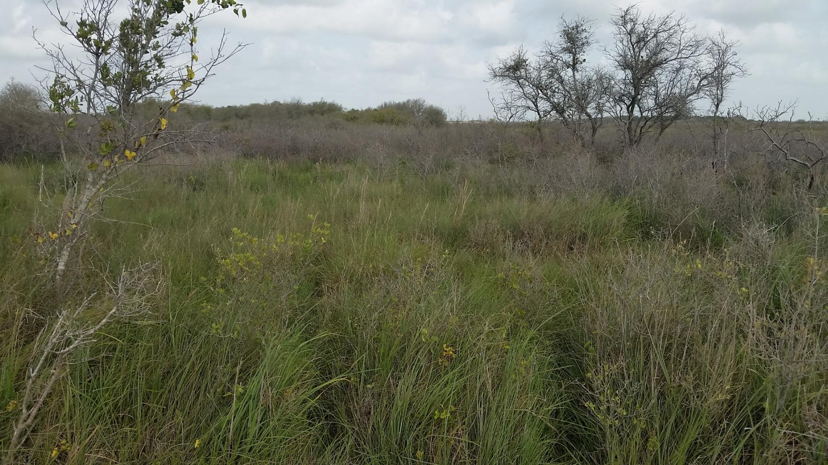
Oct 2016

Slide 30
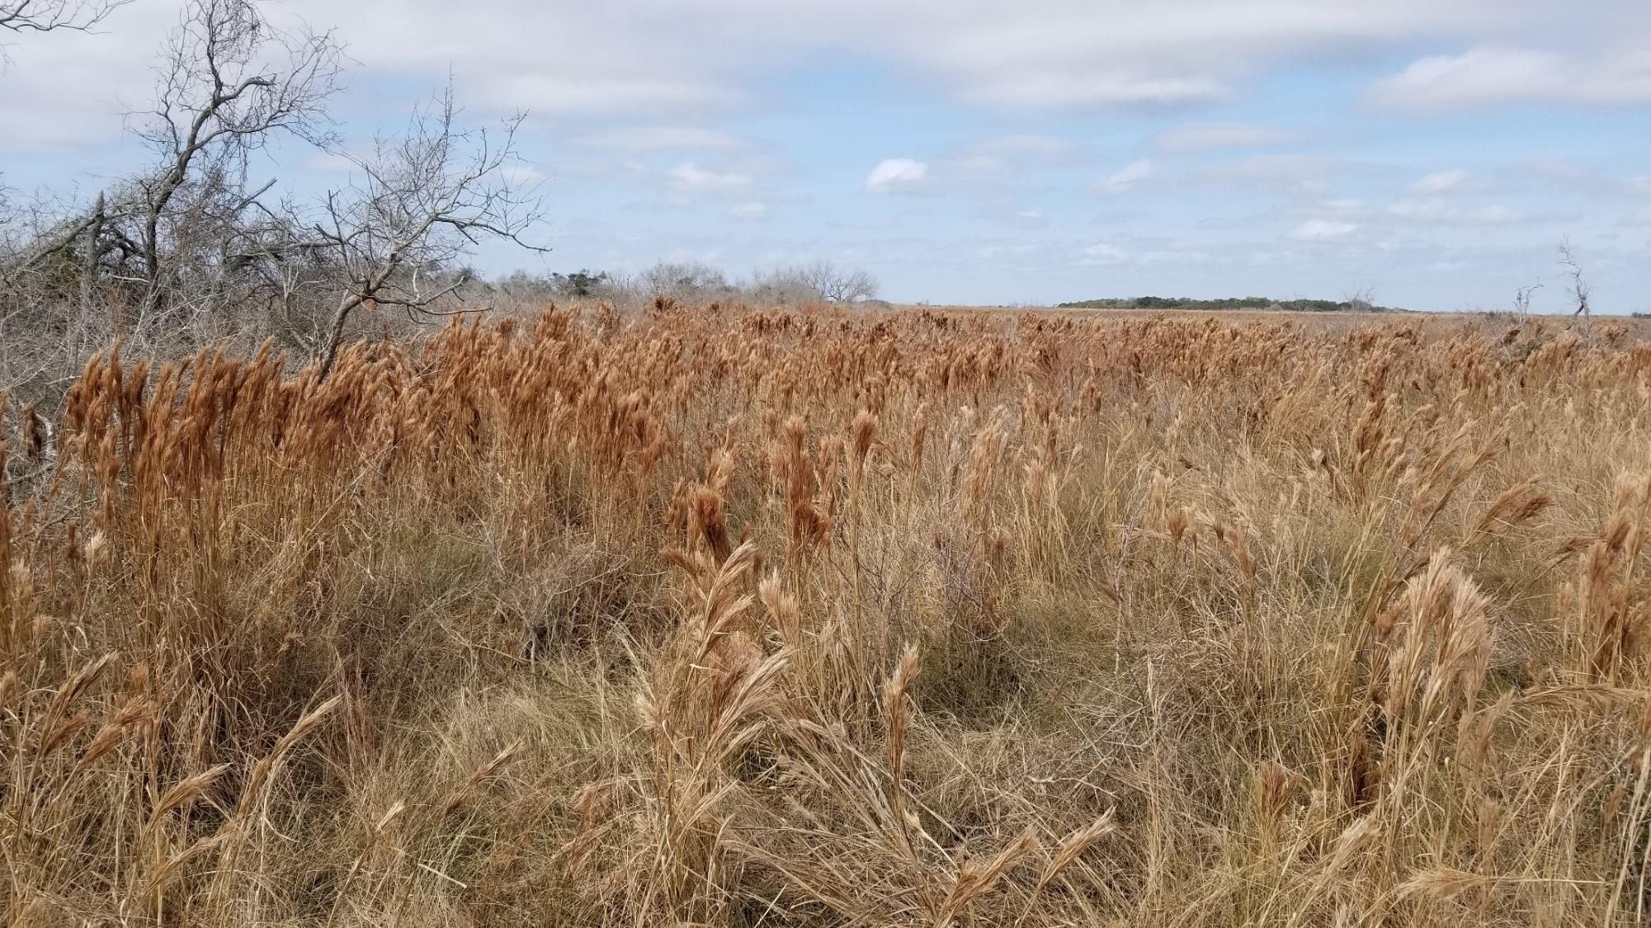
Feb 2018

Slide 31
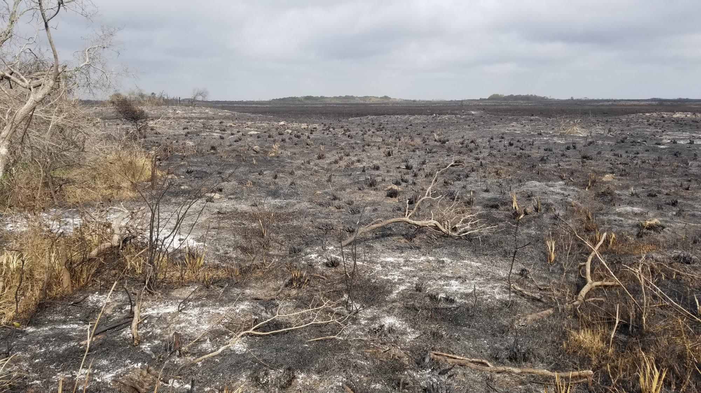
Mar 2018

Slide 32
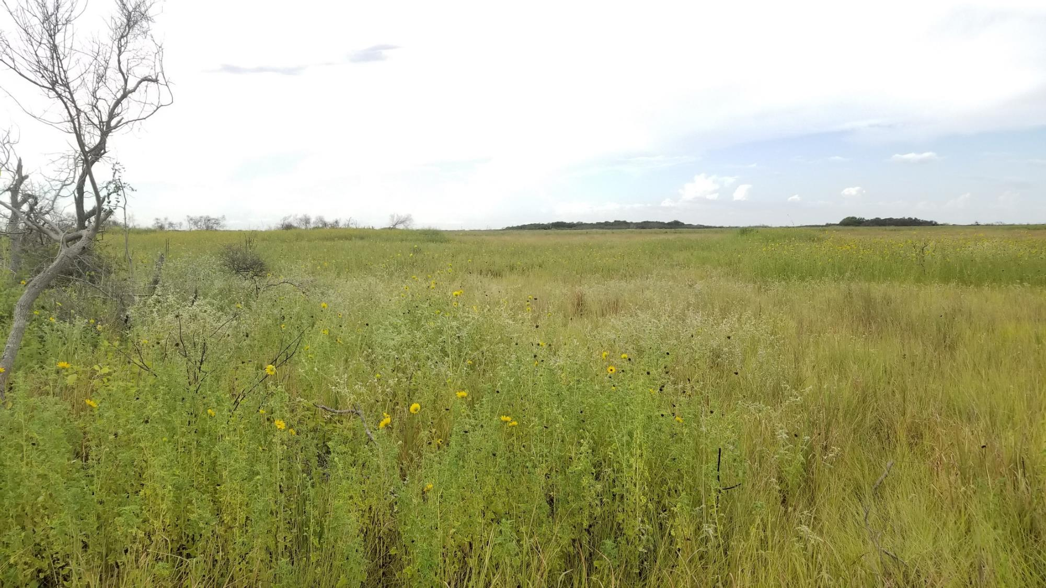
Aug 2018

Slide 33
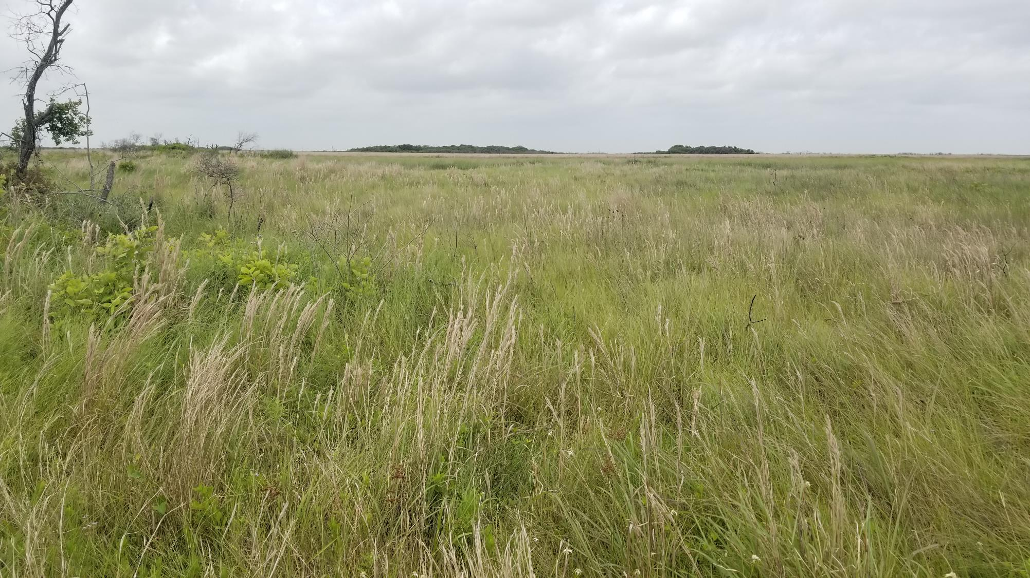
May 2019

Slide 34
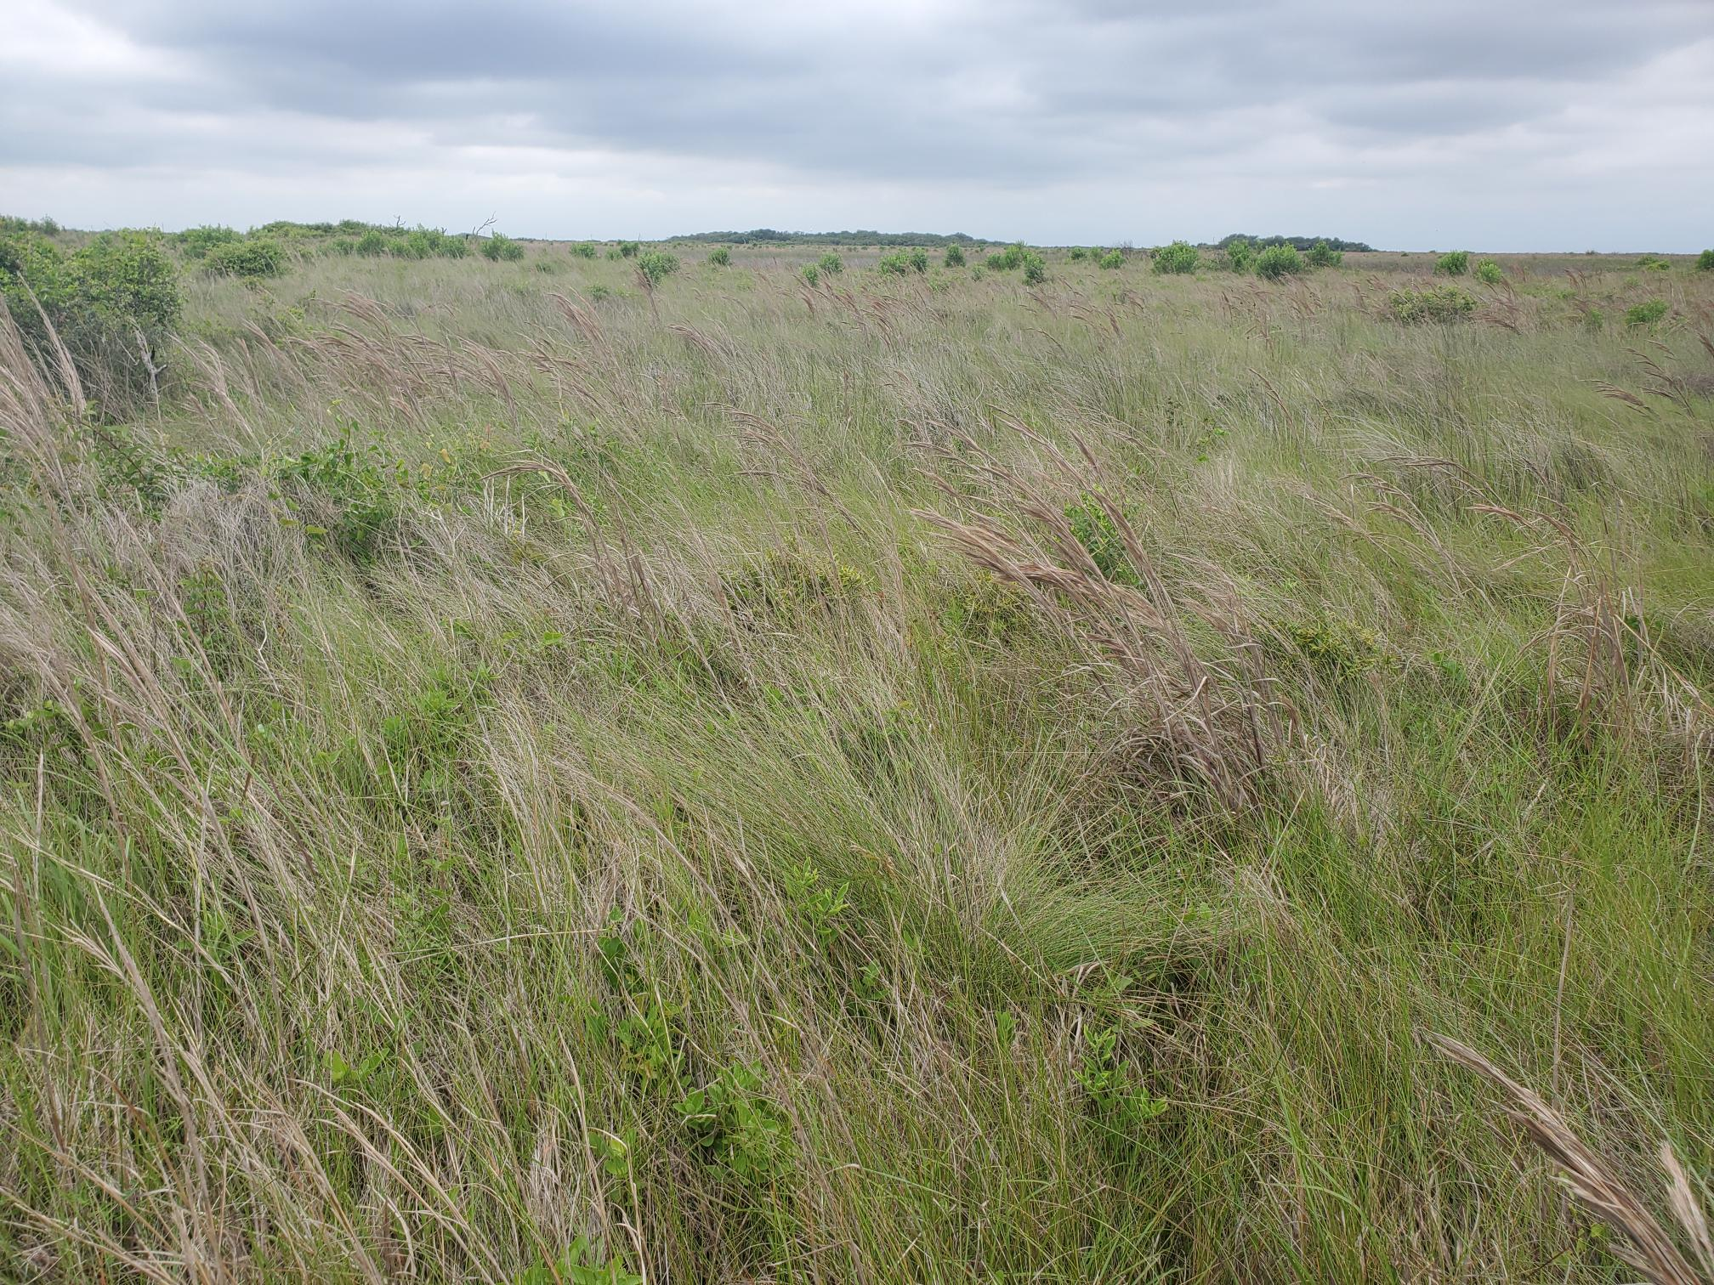
April 2023

Slide 35
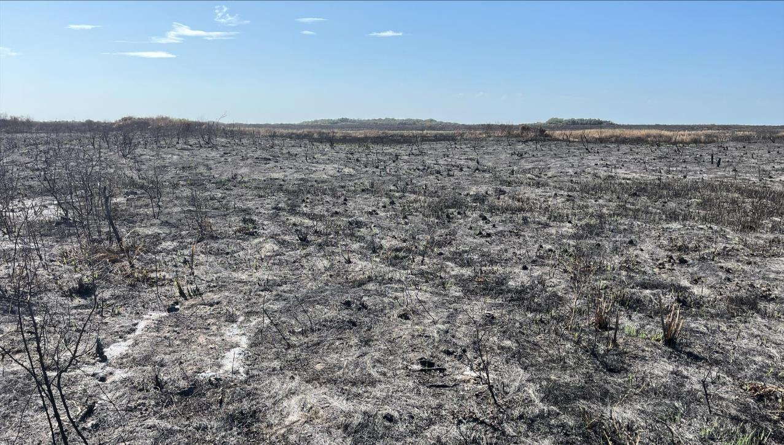
July 2023

Slide 36
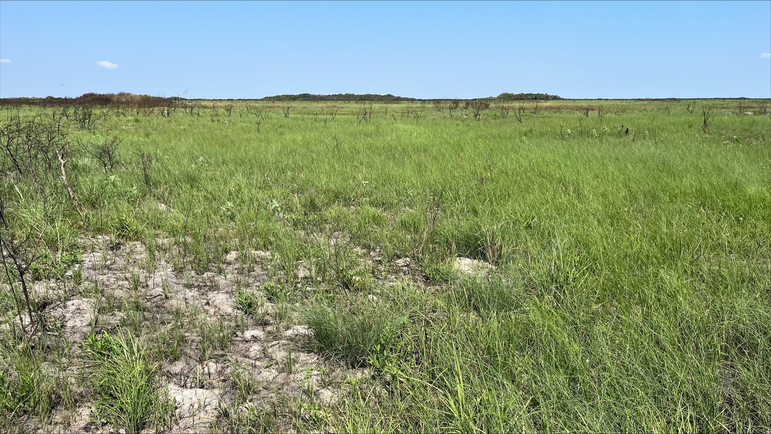
September 2023

Slide 37
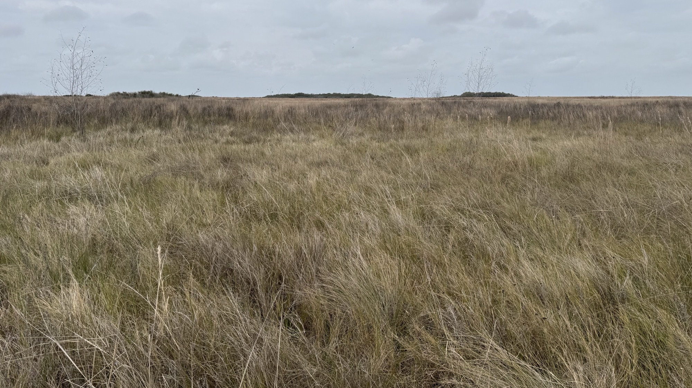
March 2025

Slide 38
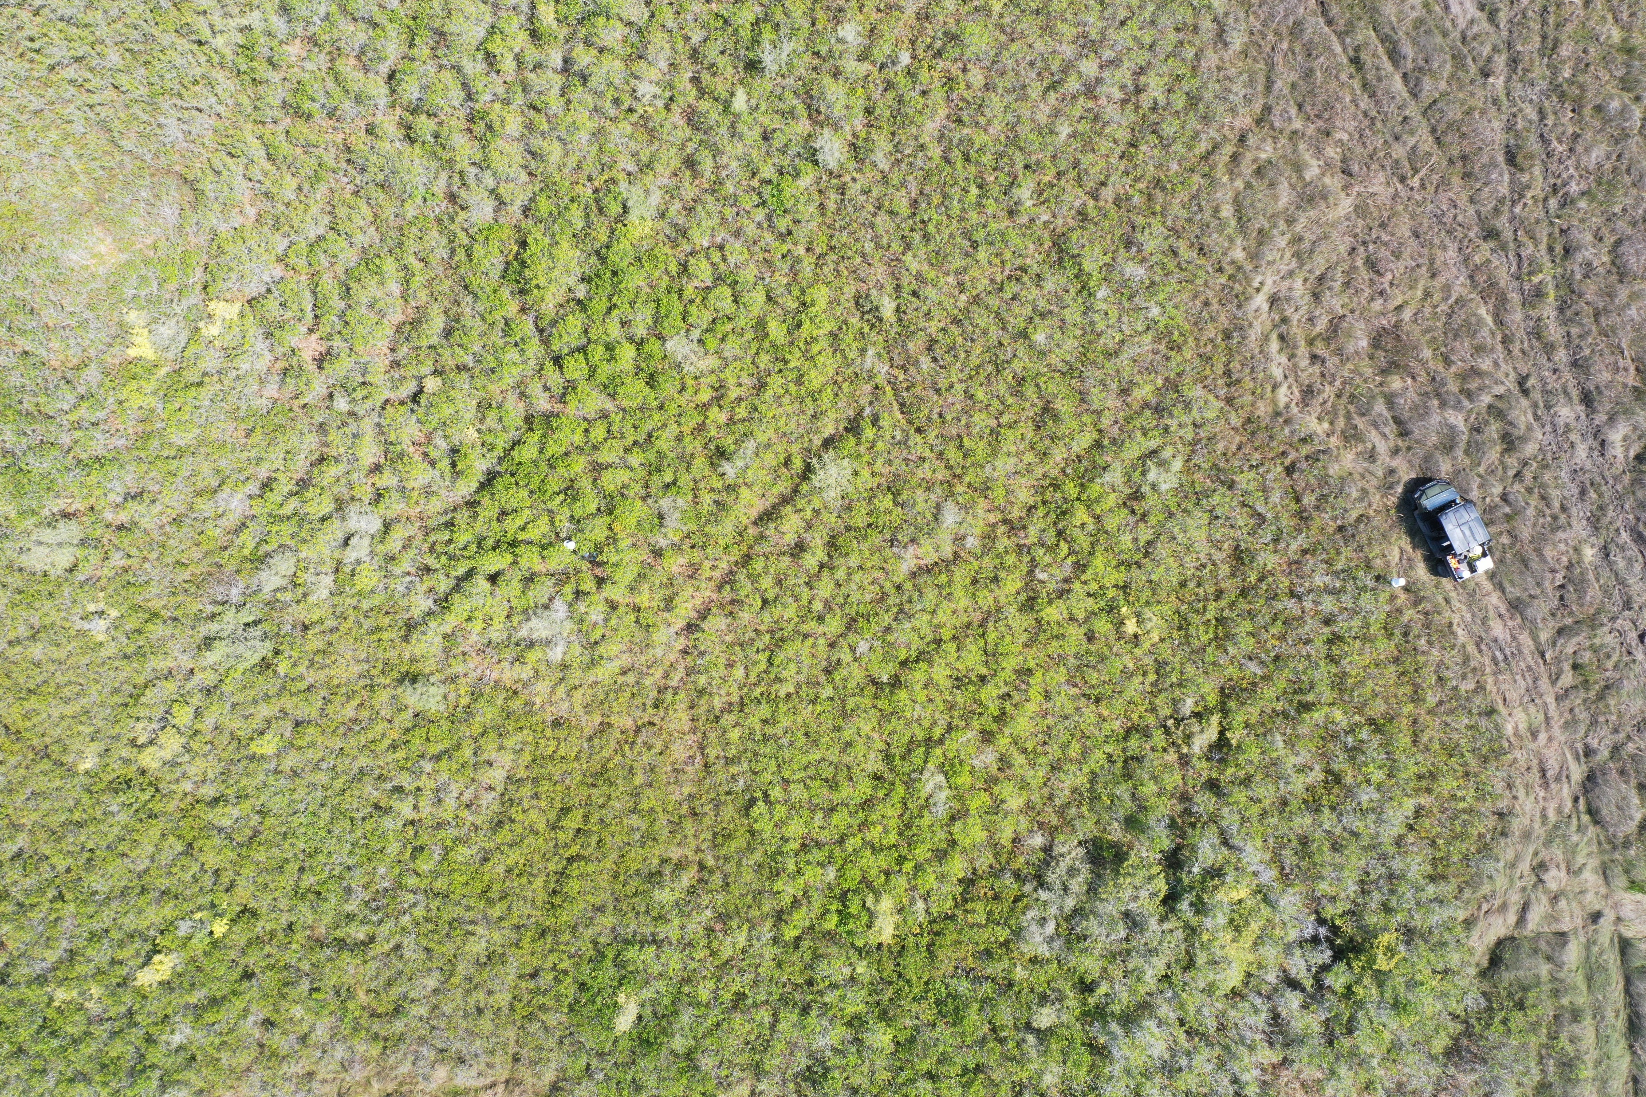
May 2023

Slide 39
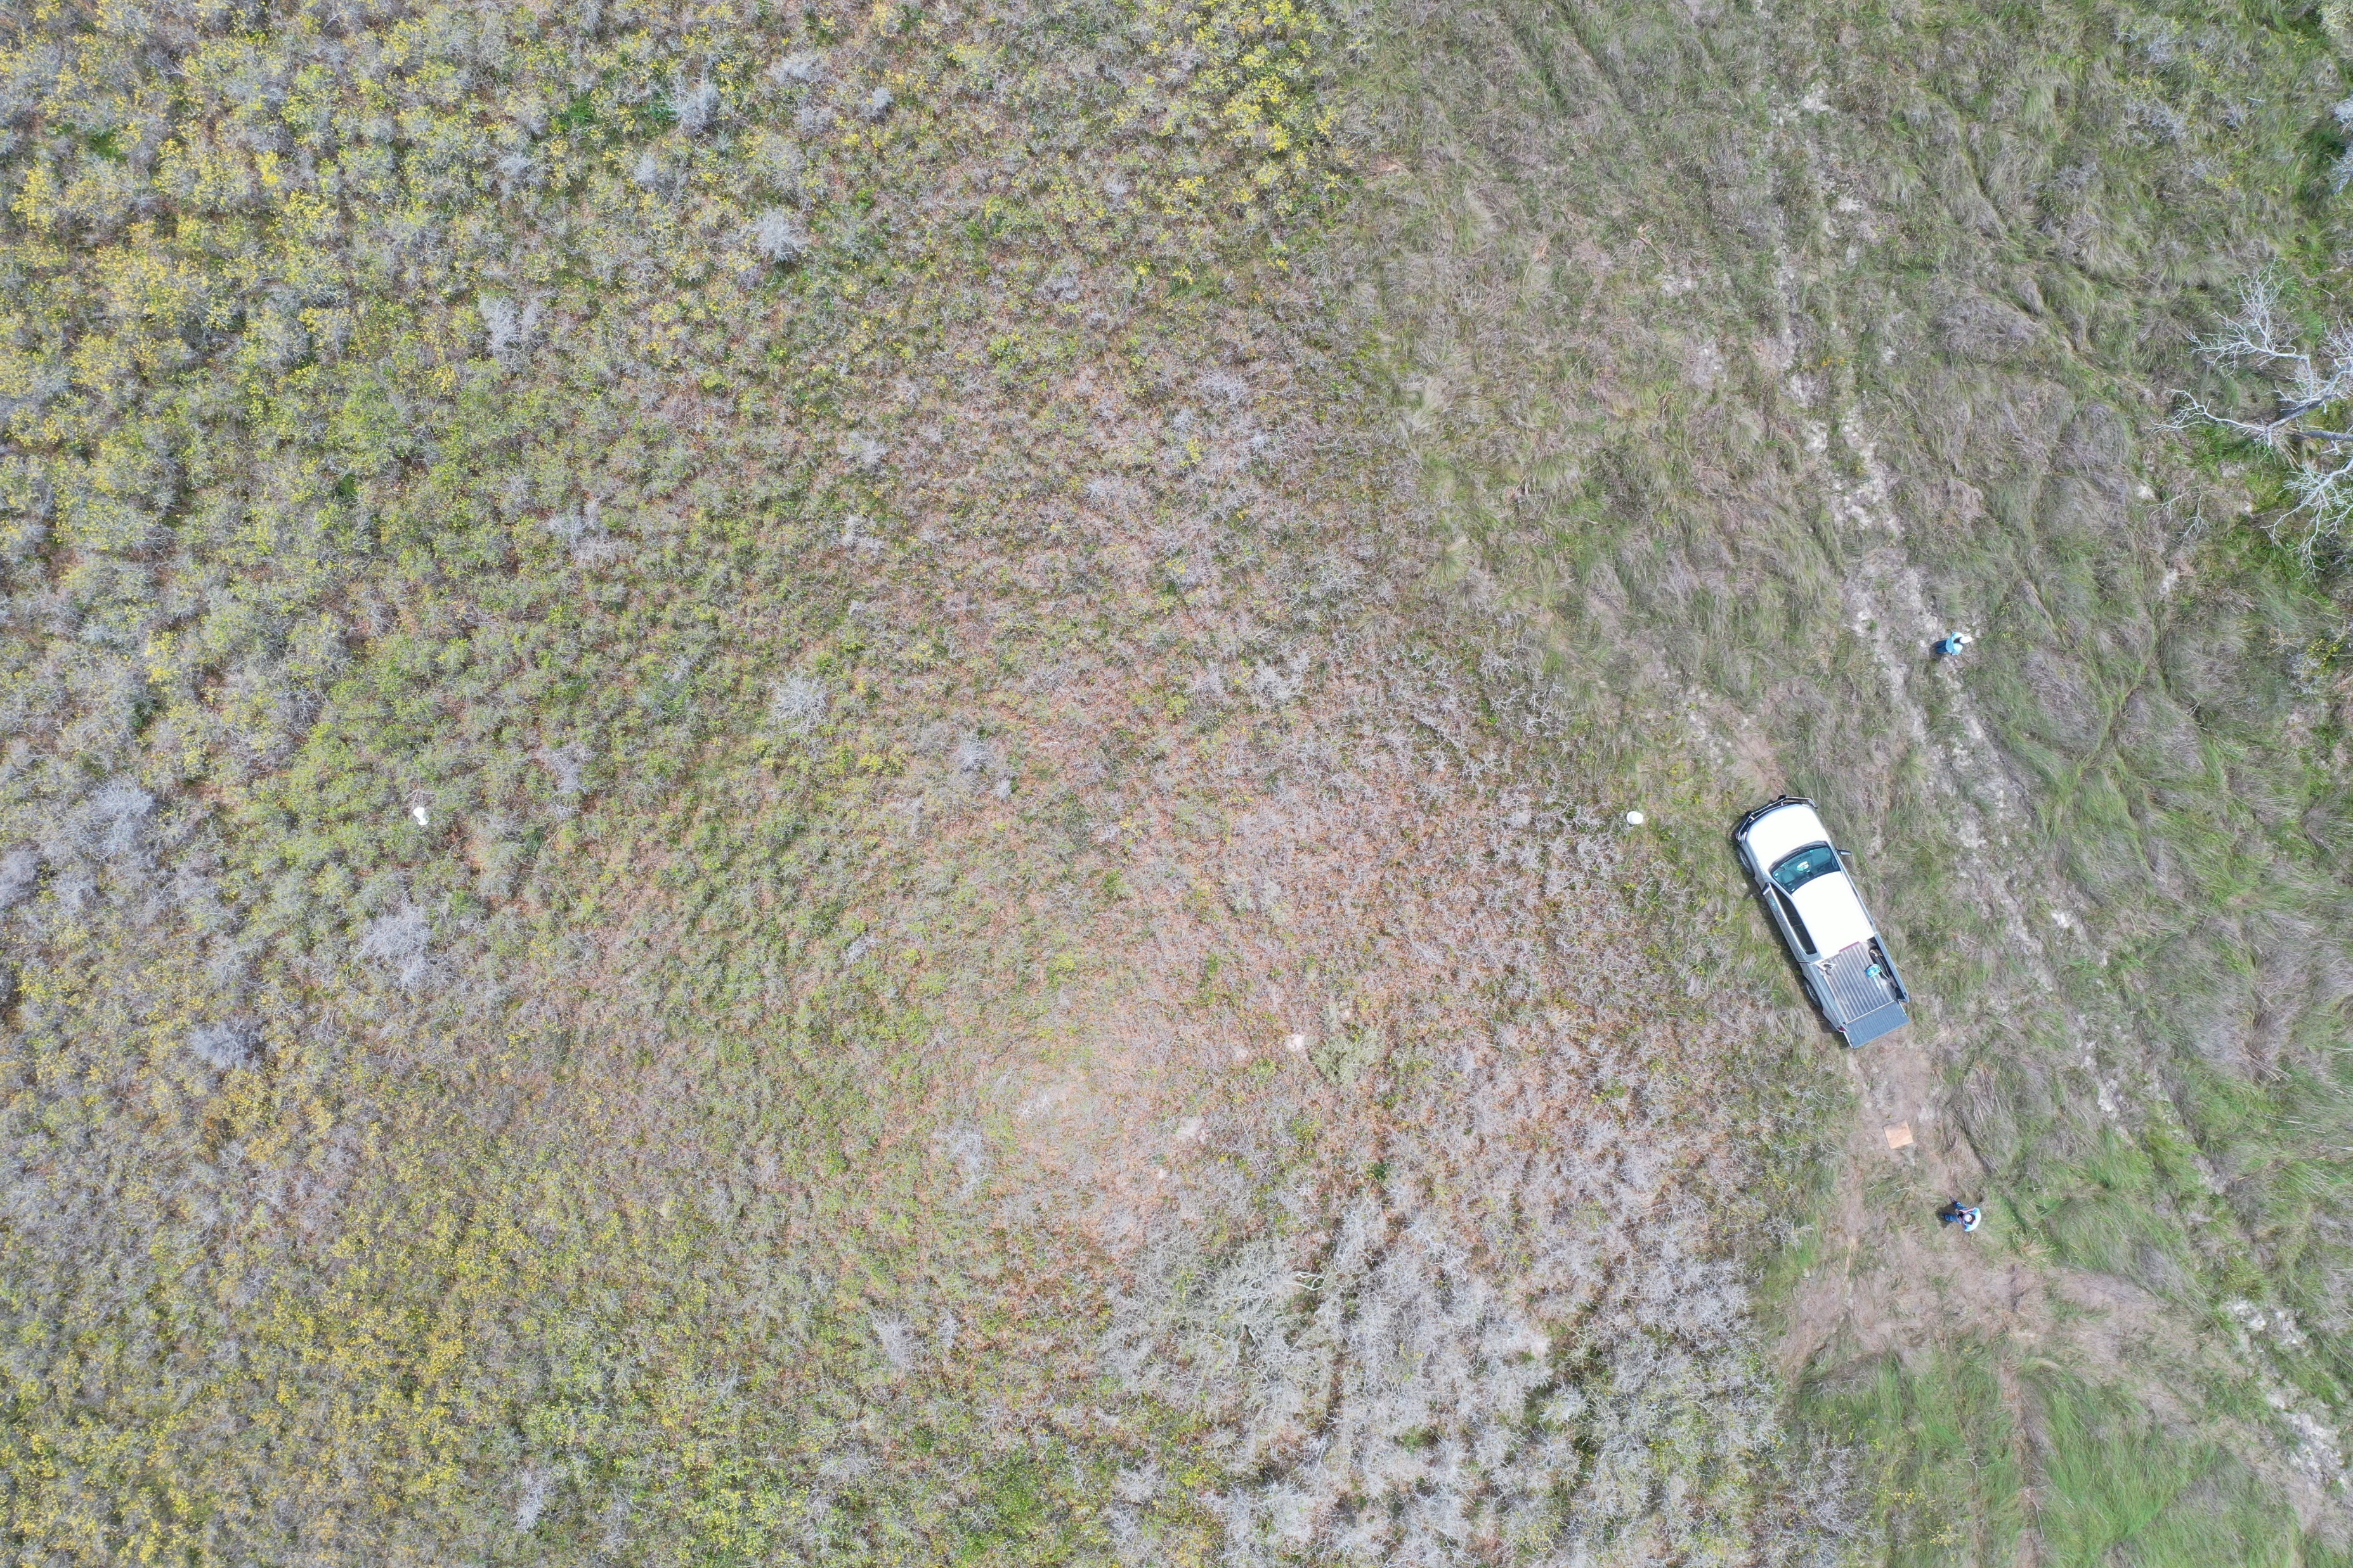
June 2023

Slide 40
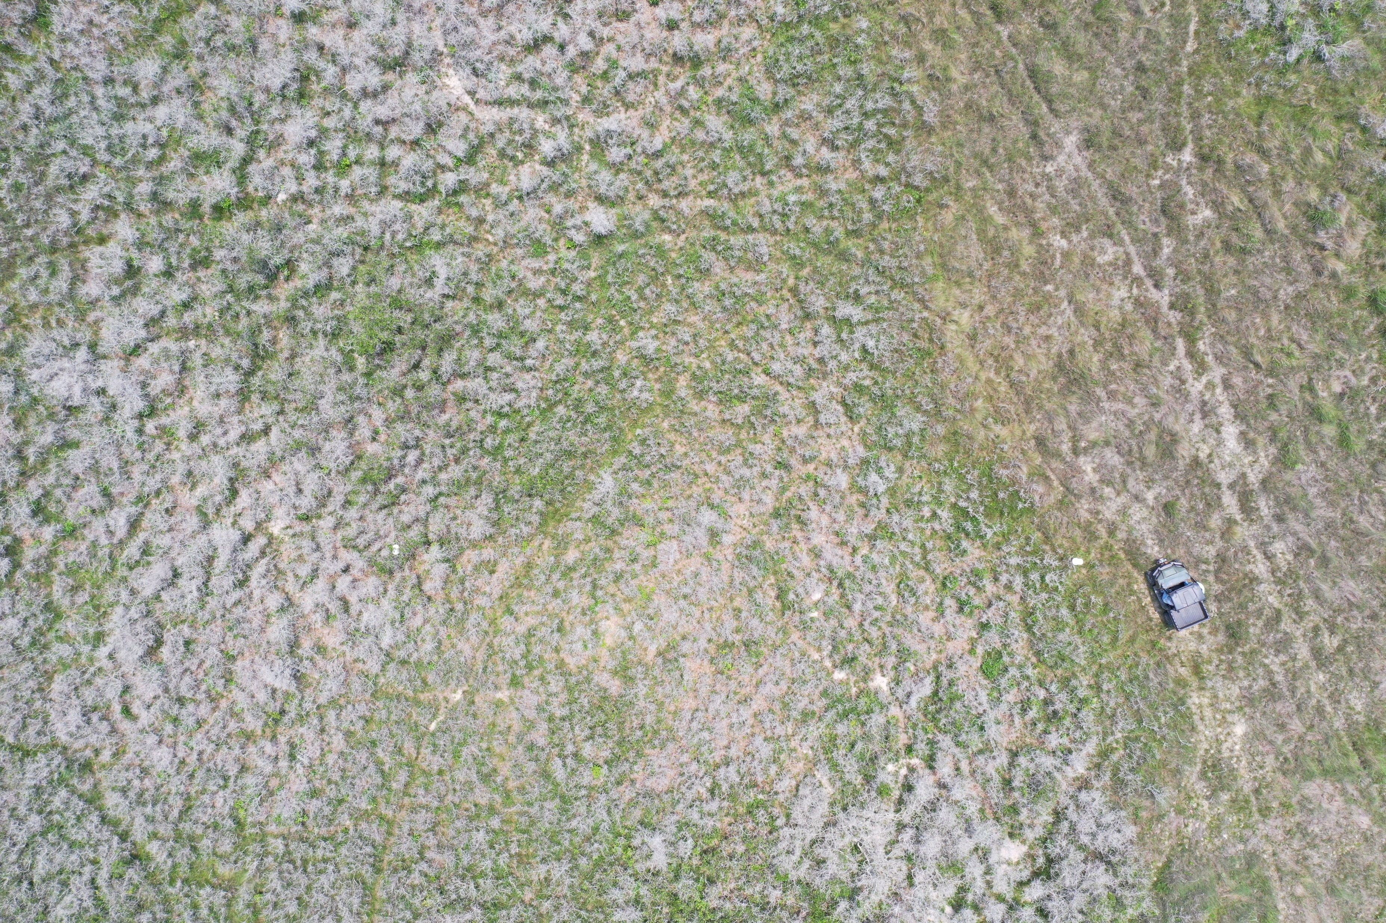
May 2024

Slide 41
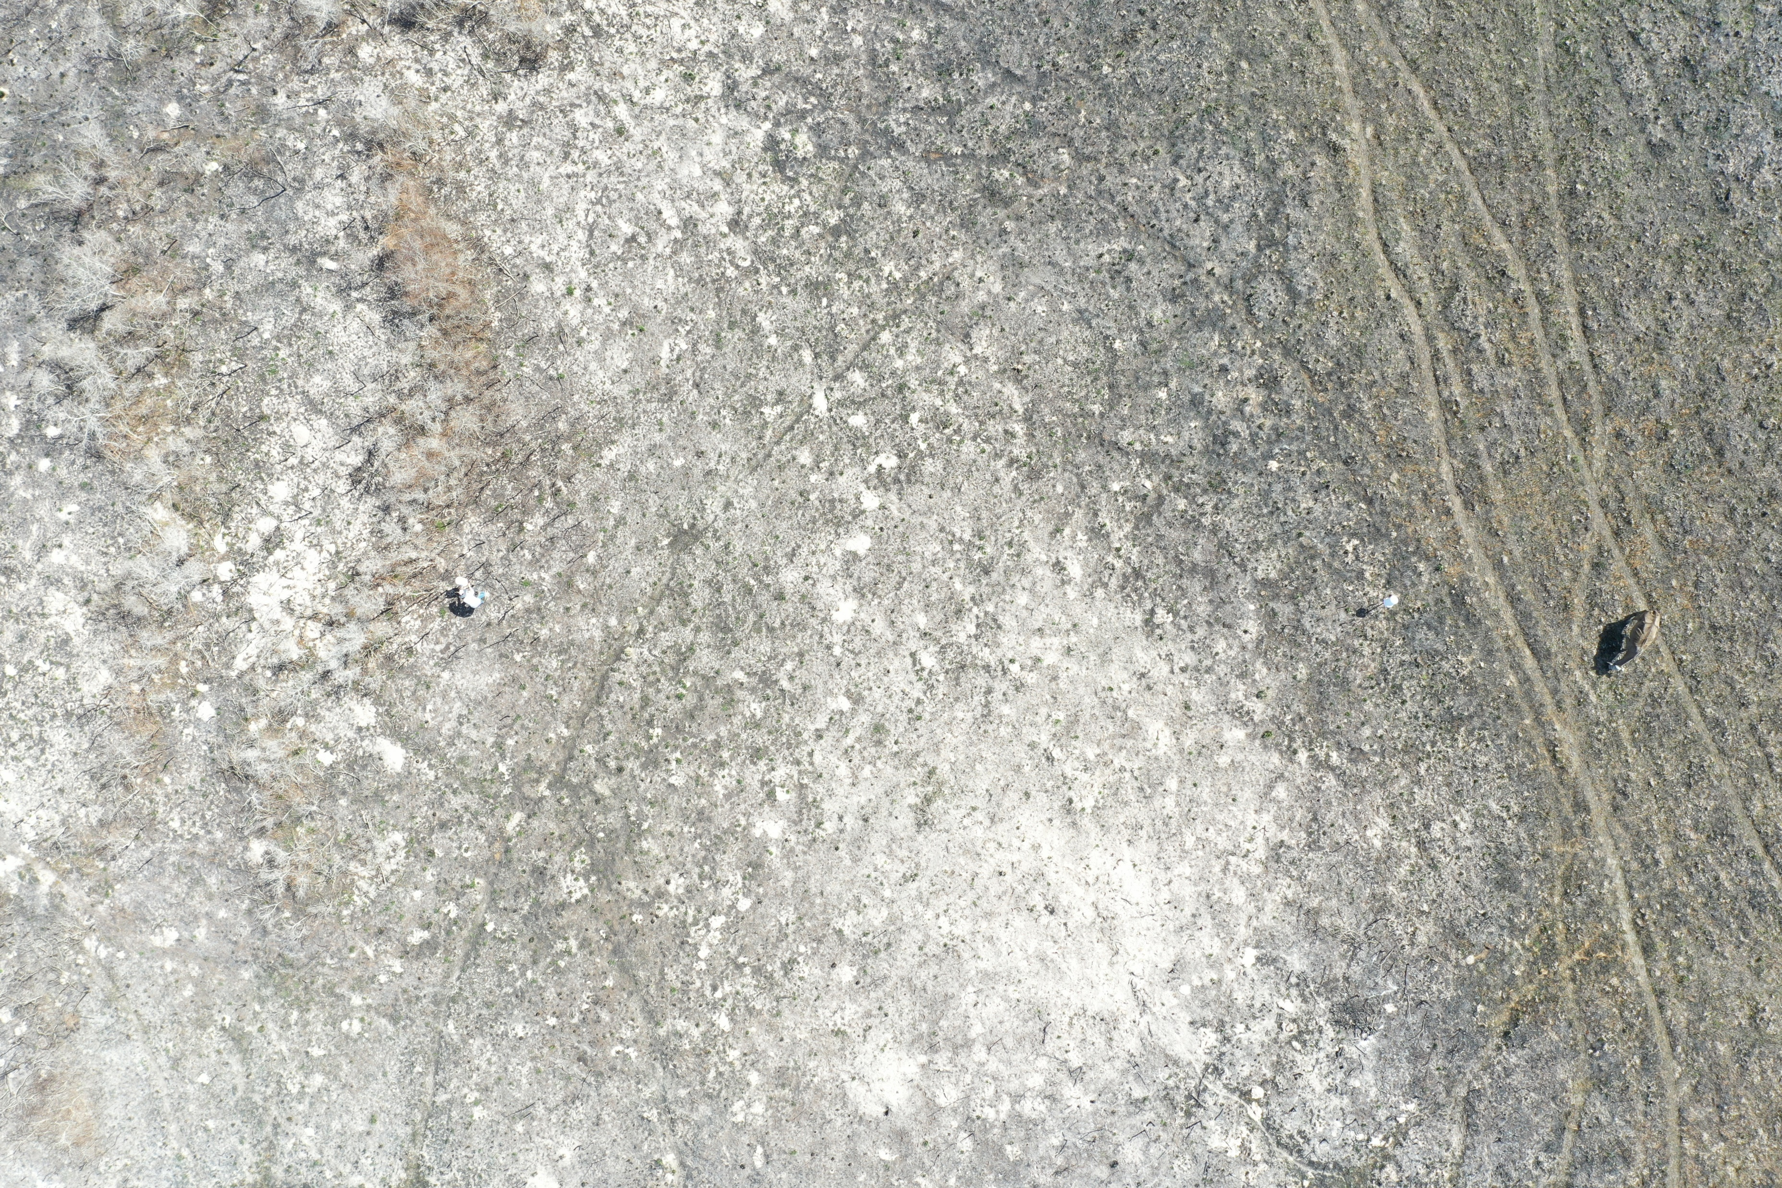
March 2025

Slide 42
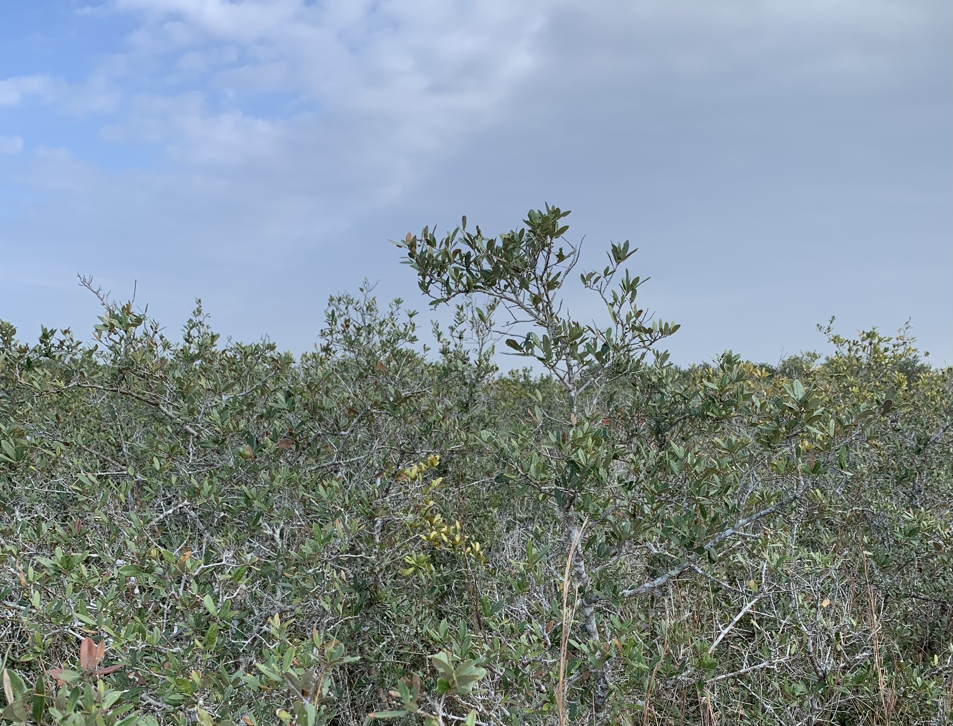

Slide 43
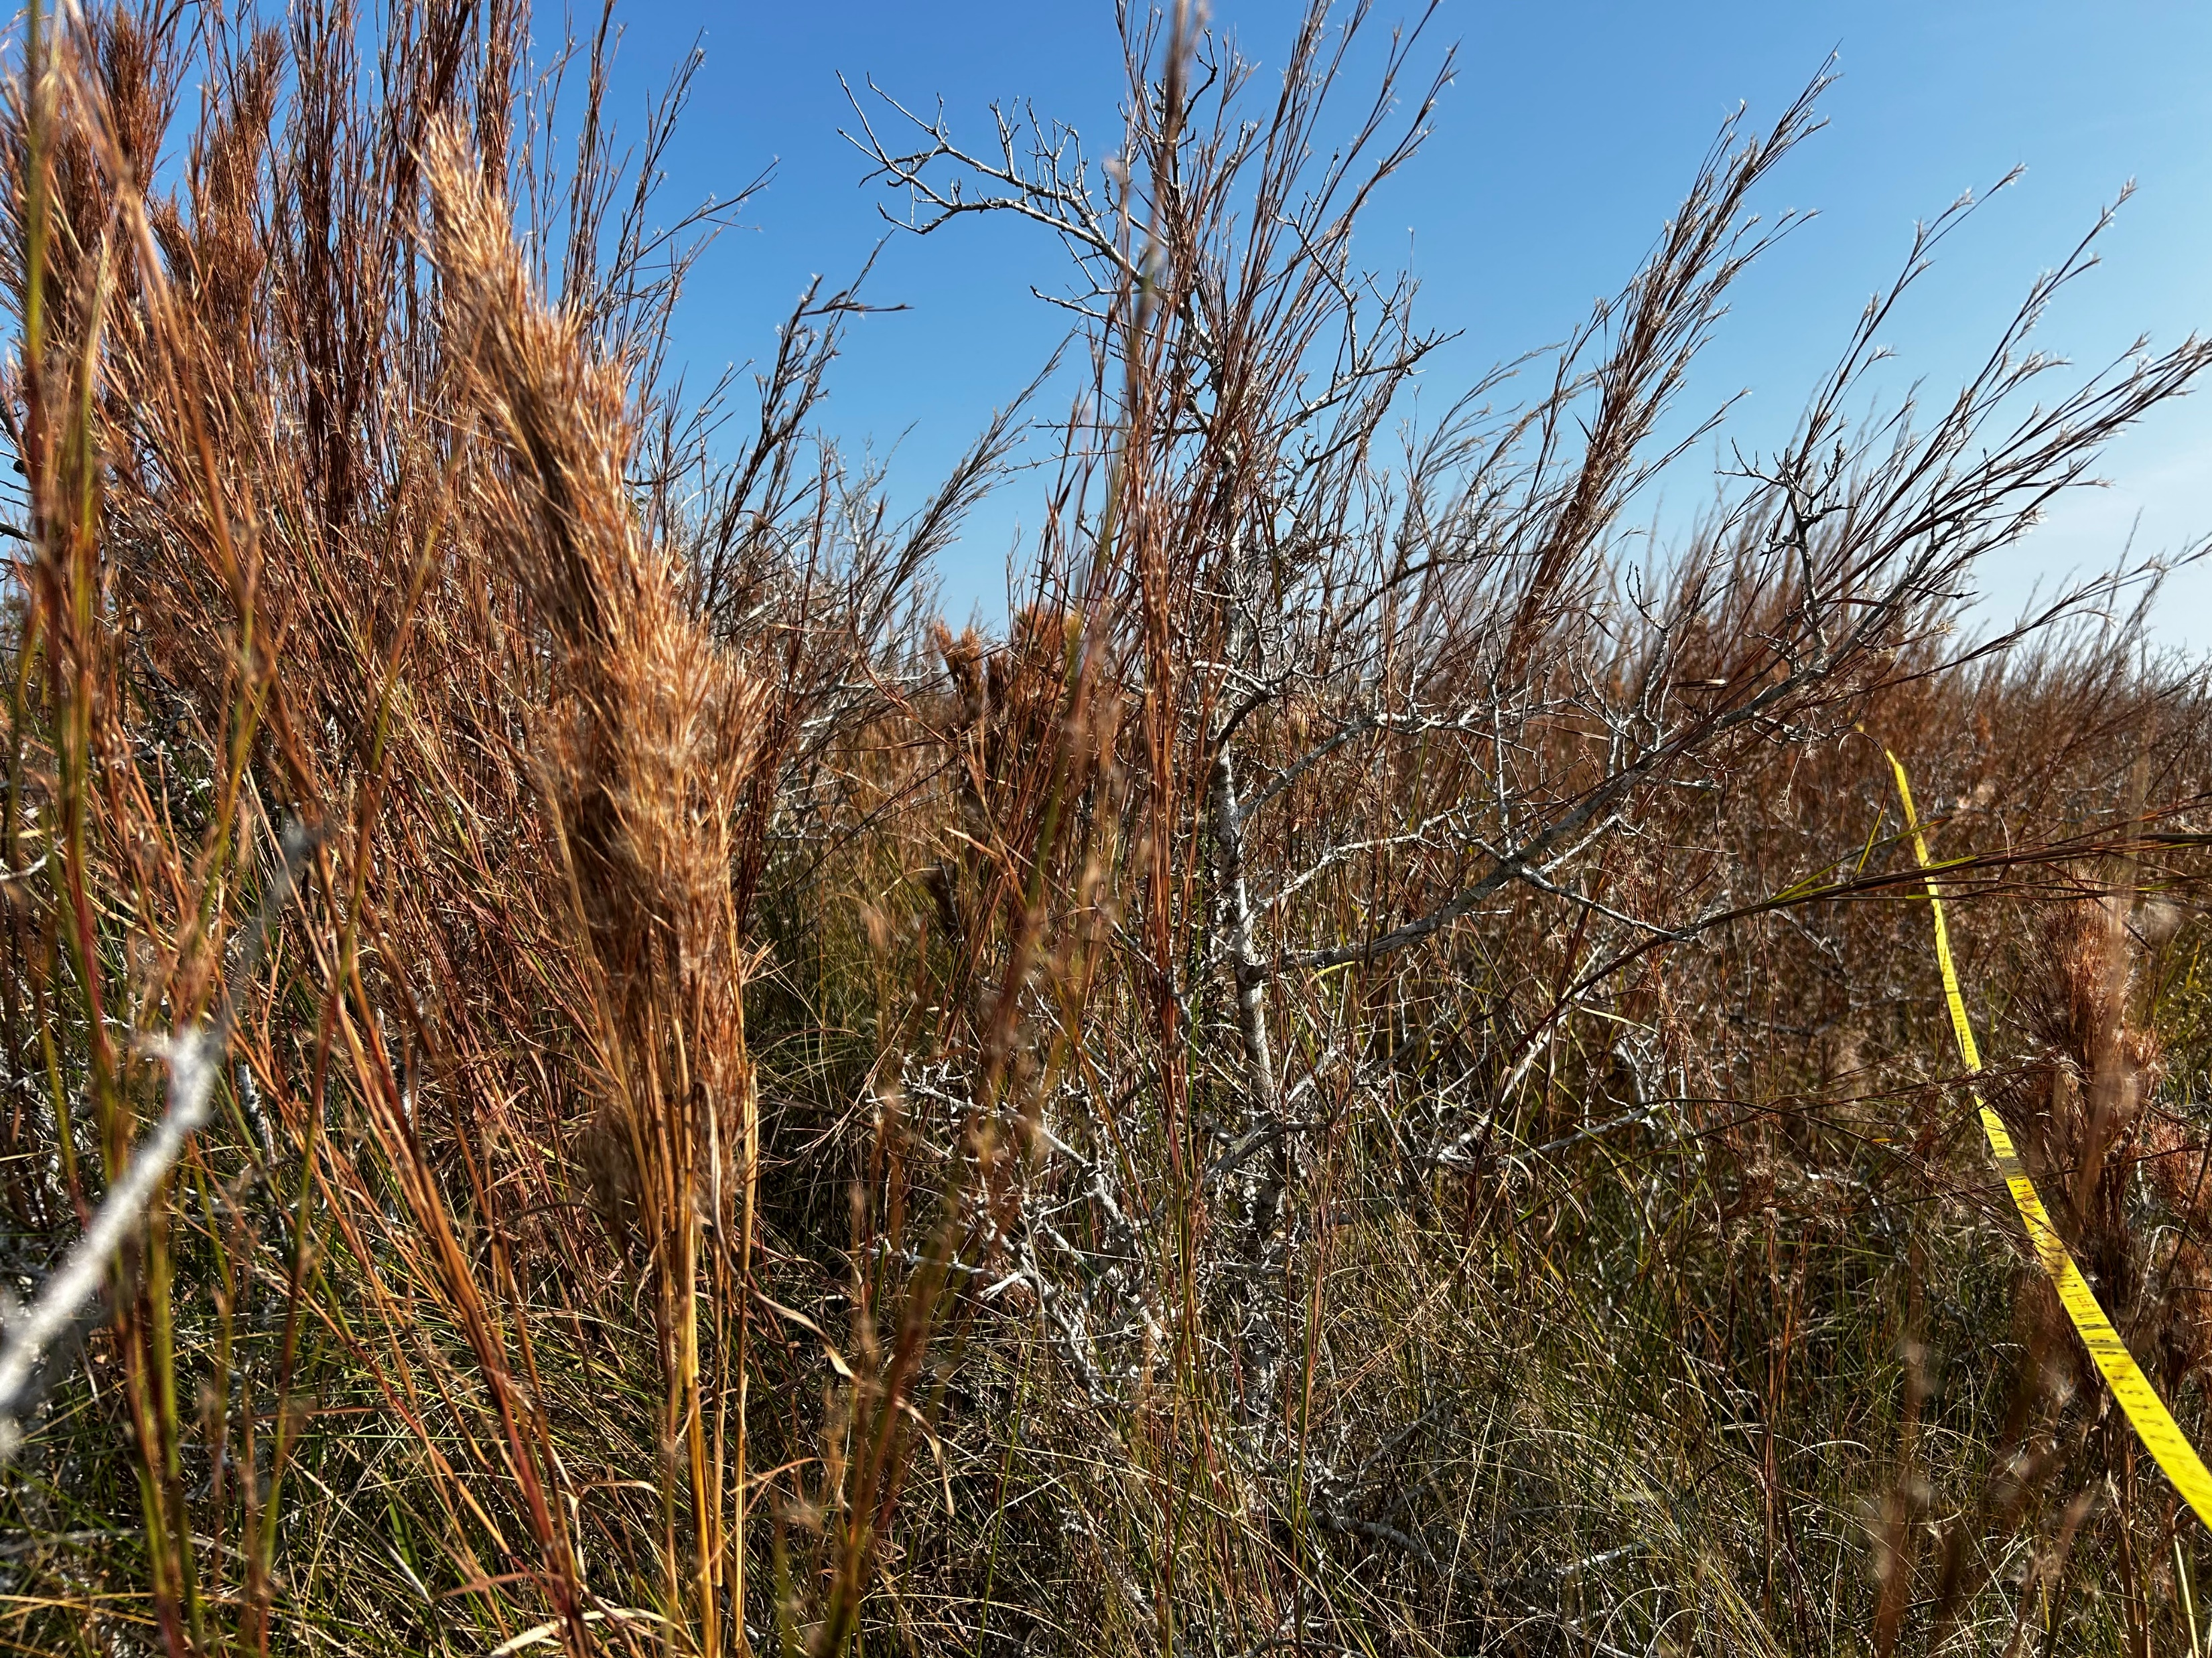

Slide 44
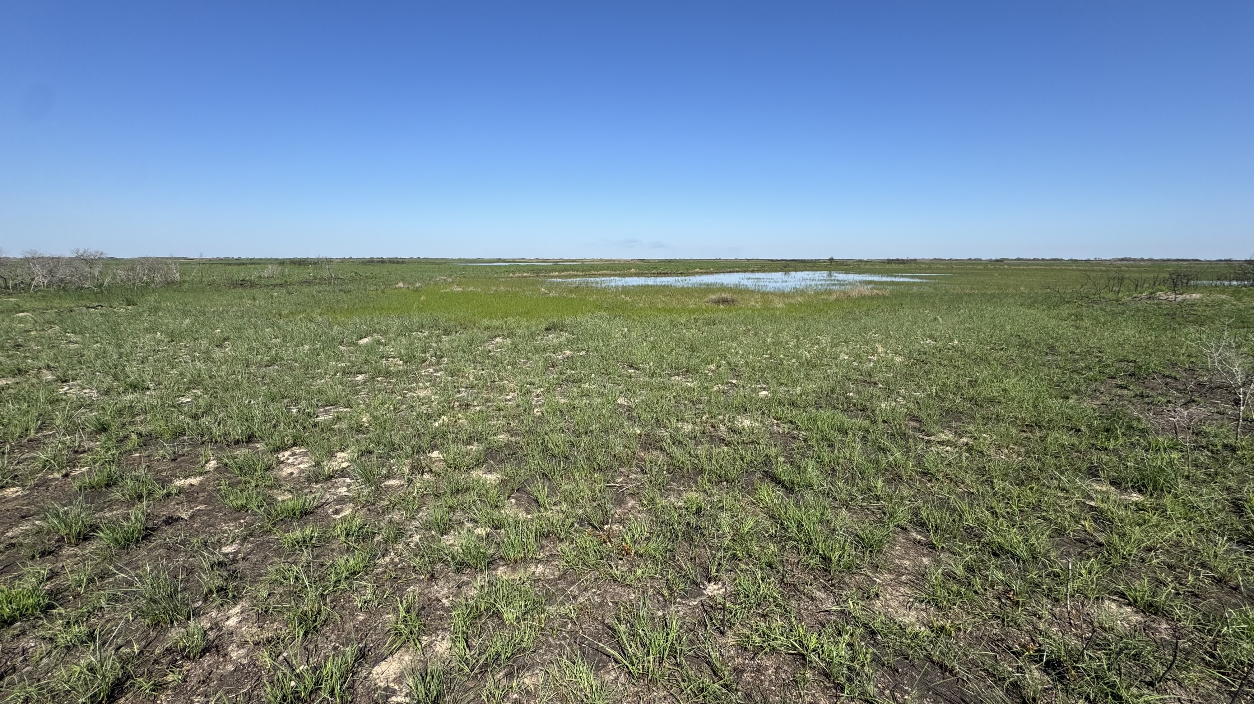

Slide 45
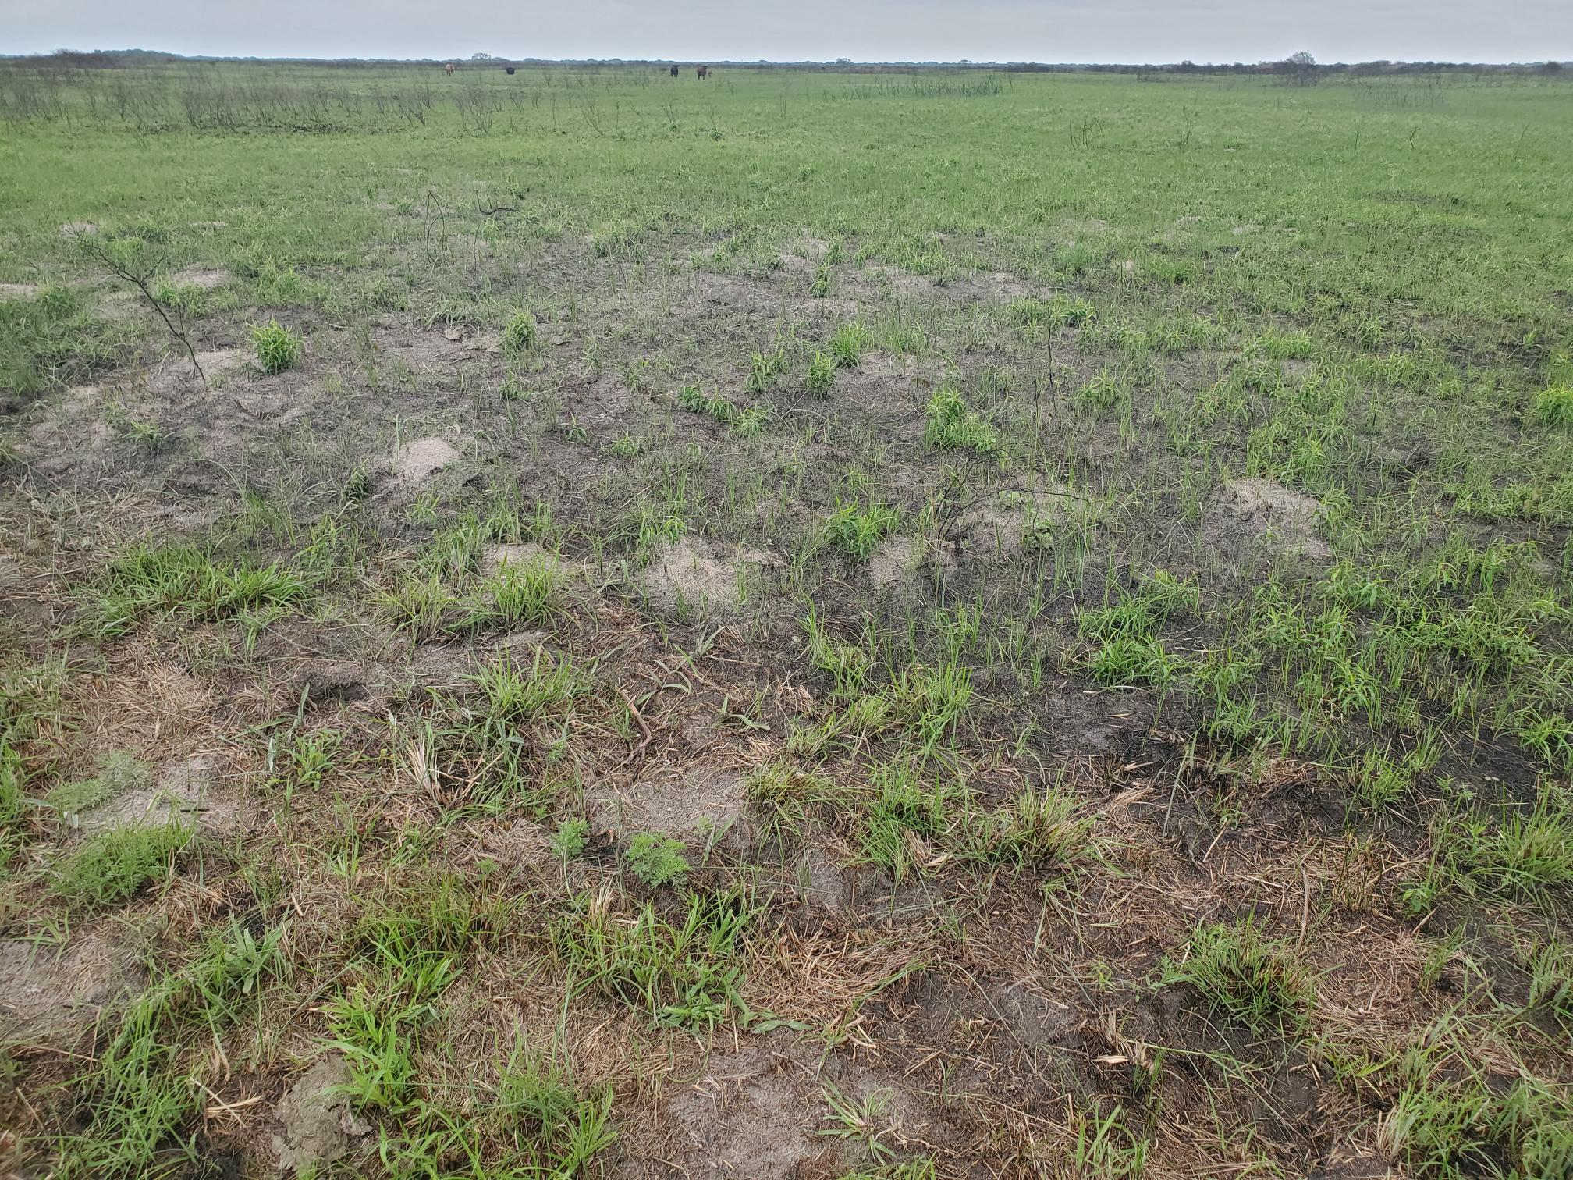

Slide 46
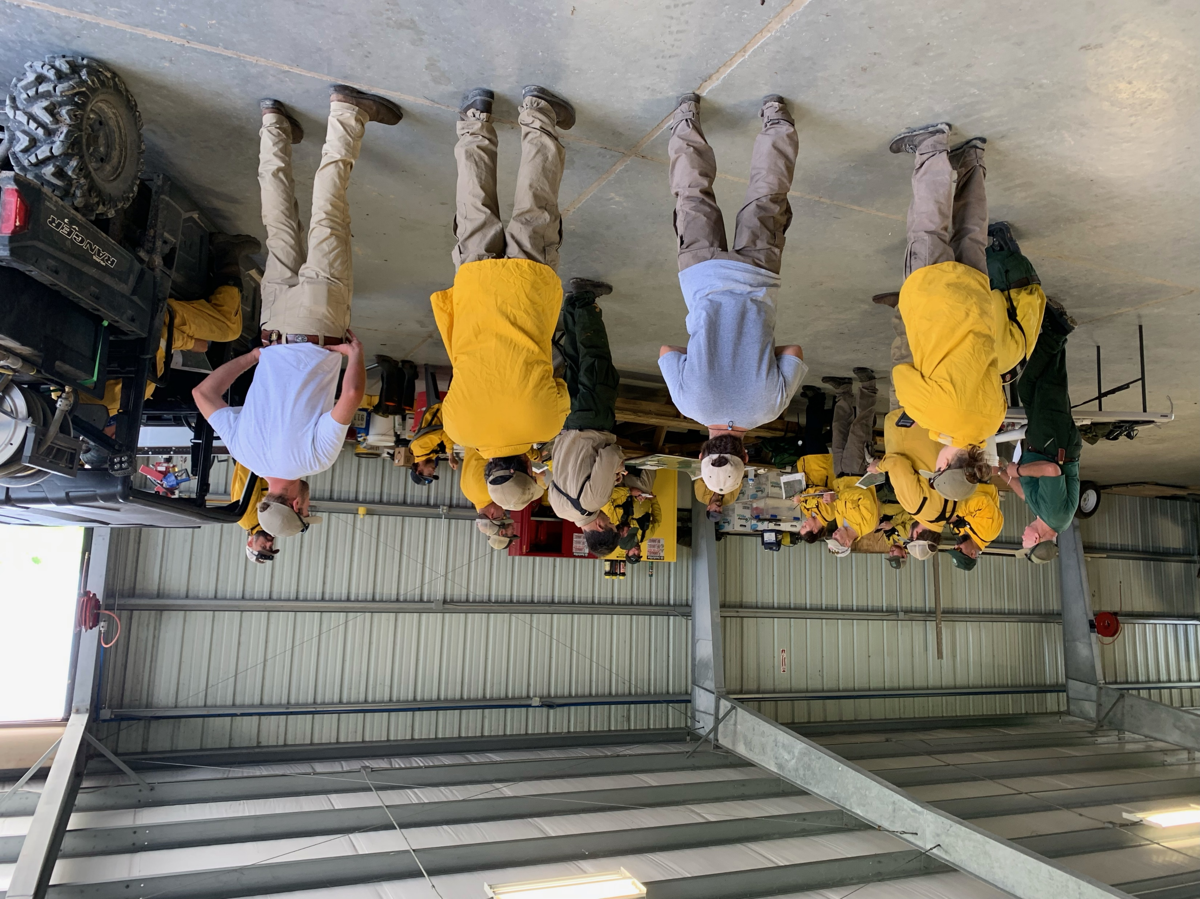
Roadblocks
Weather
Burn moratorium
Manpower

Slide 47
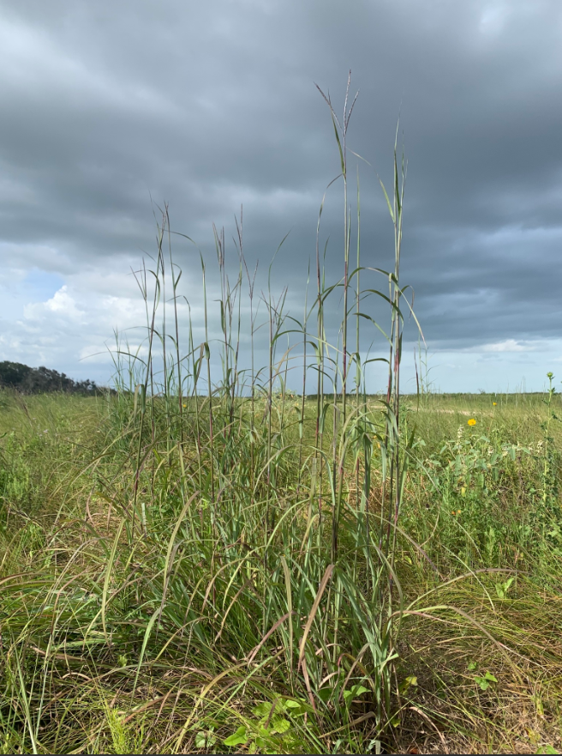
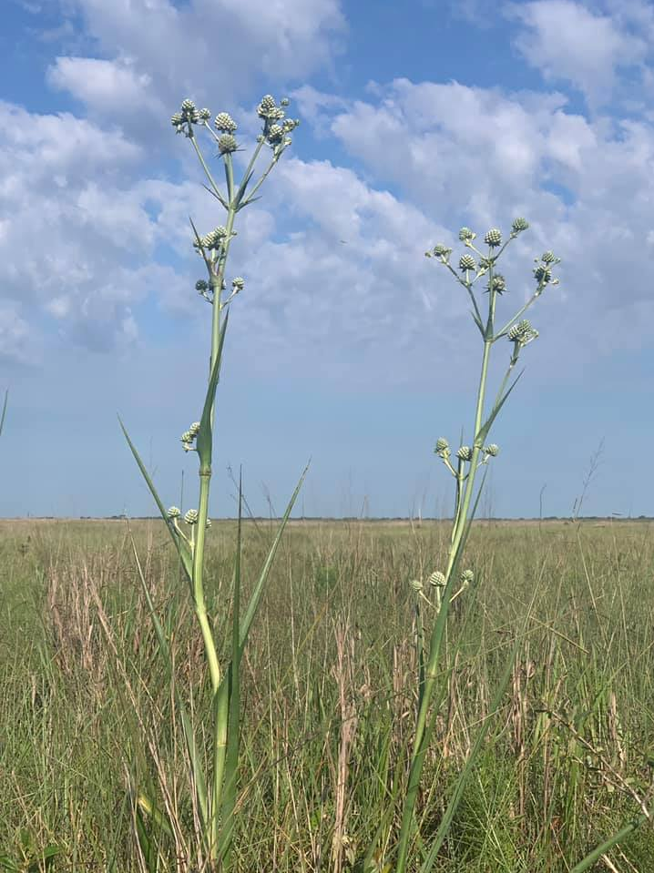

Slide 48
