Slide 1
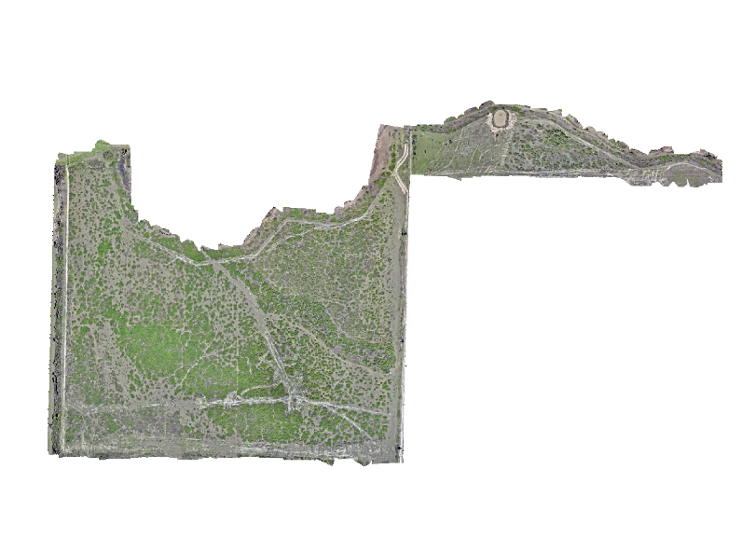
Quantifying the Spatial Distribution of Macartney Rose (Rosa bracteata) in Rangelands Using Very-Fine Resolution Imagery
Shanna R. Gleason*, William C. Longoria*, Michael C. Allison**, Jacob E. Lucero*, Javier M. Osorio Leyton*, William E. Rogers***, Alexandria M. DiMaggio****, Humberto L. Perotto-Baldivieso*
*Department of Rangeland, Wildlife, & Fisheries Management, Texas A&M University
**Raptor Aerial Services LLC
***Department of Ecology and Conservation Biology, Texas A&M University
****Coastal Prairie Conservancy

Slide 2
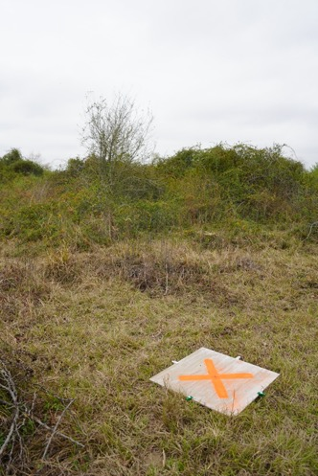
Background
Invasives threaten rangelands globally
Inventory & monitoring key
Drone imagery
  High sampling coverage
  Very-fine spatial resolutions
  Less time and labor requirements

Slide 3
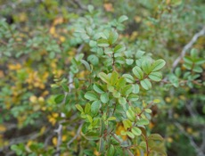
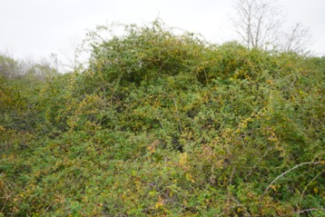
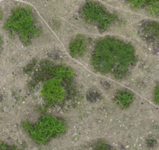
Background - Macartney rose (Rosa bracteata)
Evergreen thorny shrub
Introduced as hedge-fencing
Limits forage production
Hinders movement of livestock and wildlife

Slide 4
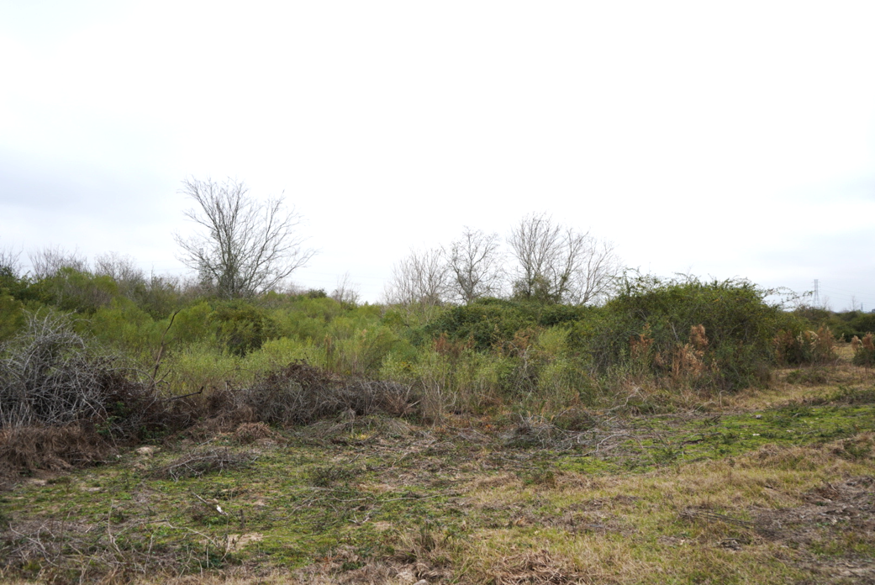
Objectives
To quantify the spatial configuration of Macartney rose cover using very-fine resolution imagery.
To determine the optimal season for classifying Macartney rose cover.

Slide 5
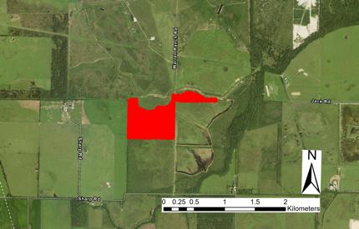

Study Site
Warren Ranch, Harris Co., TX
Gulf Coast Prairies
46-ha pasture
Grazing, roller-chopping and spraying
Notes:
Change map

Slide 6
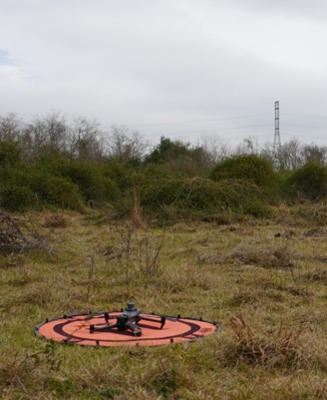
Data Collection - Drone imagery
Flew in:
  March 2024
  July 2024
  September 2024
  March 2025
DJI Mavic 3, on-board camera
  20 MP
  Single grid, 70-80% overlap
  47m AGL
Imagery
  RGB
  1.32 cm resolution

Slide 7
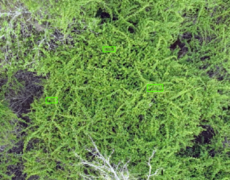
Data Processing - Macartney rose
Supervised, object-based classification
  ArcGIS Pro
Support Vector Machine classifier
  >100 training samples per class
  Classes:
    Light Macartney rose
    Dark Macartney rose
    Other woody species
    Woody Litter
    Bareground
    Herbaceous
  Merge both Macartney rose classes

Slide 8
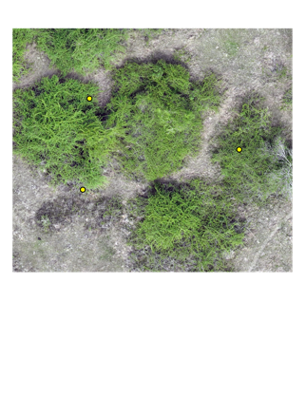
Data Analysis
Accuracy Assessment
  ~500 random points
  Cover type manually verified at each point
  Compared with classified cover type at each point
  Compute confusion matrix

Slide 9

Data Analysis
FragSTATS Metrics
  Percent cover
  Mean patch size
  Patch density

Slide 10
Results

Slide 11
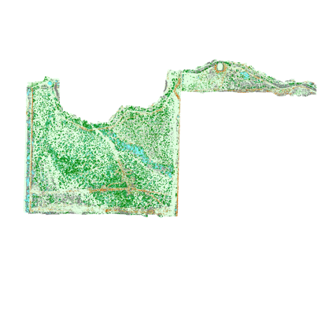
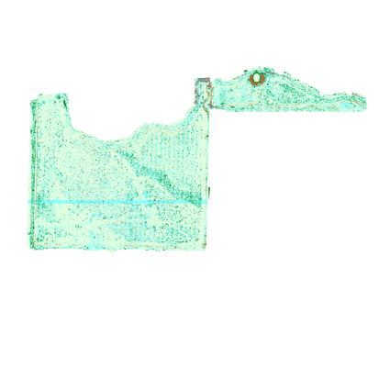
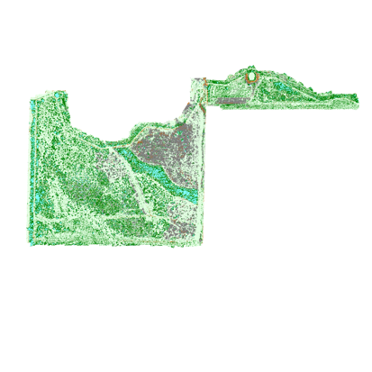
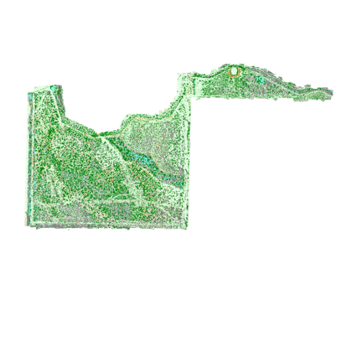

March 2024 – 67.07%
July 2024 – 45.93%
September 2024 – 49.59%
March 2025 – 44.93%

Slide 12
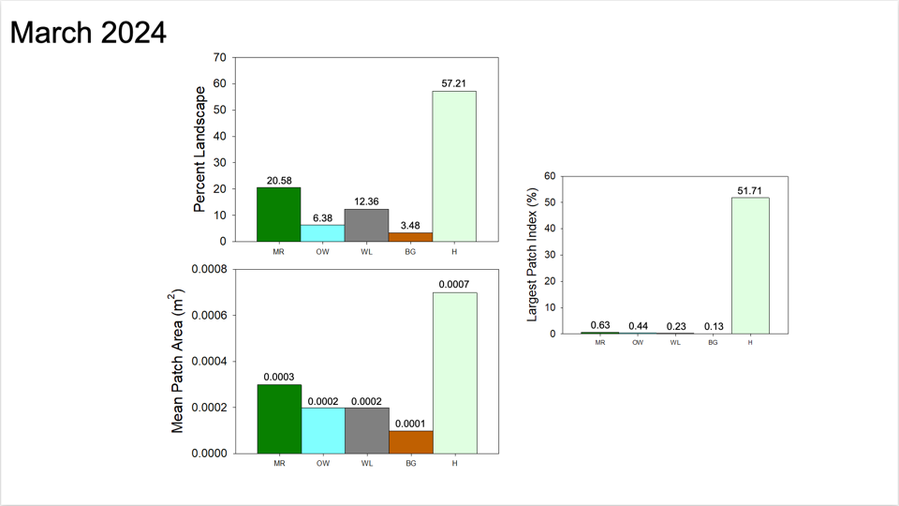
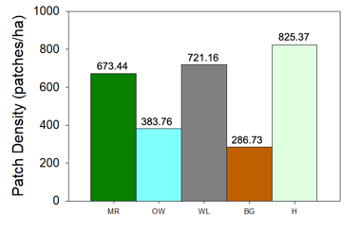
Percent cover
ha

Slide 13
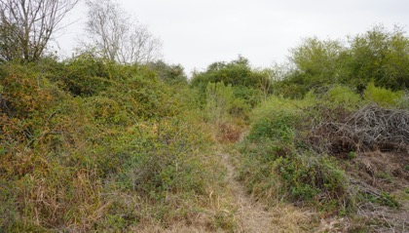
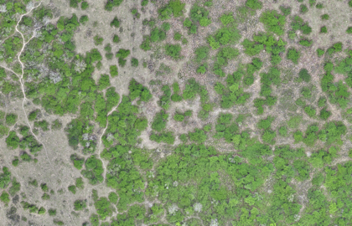
Conclusions
Early spring better results
  Herbaceous dormant
Invasions with numerous large patches
Temporal changes to provide insight to spread

Slide 14
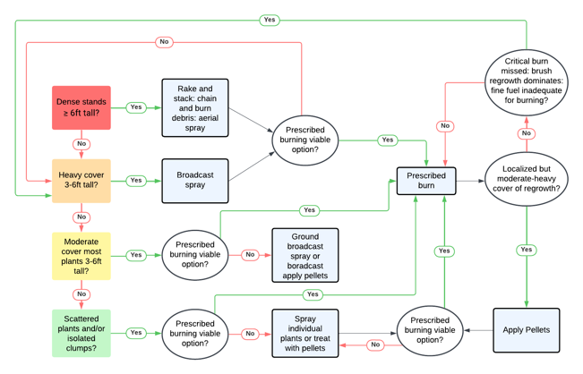
Implications
Adapted from Welch and Scifres (1985)

Slide 15
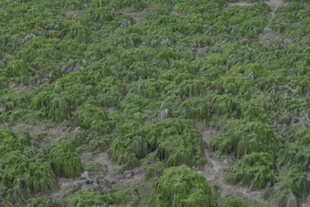
Implications
Adapted from Welch and Scifres (1985)

Slide 16
Implications
Adapted from Welch and Scifres (1985)

Slide 17
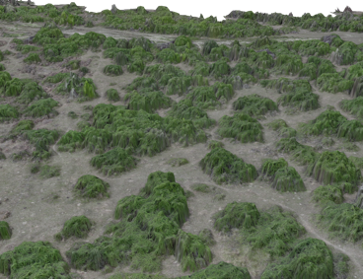
Implications
Adapted from Welch and Scifres (1985)

Slide 18
Implications
Adapted from Welch and Scifres (1985)

Slide 19
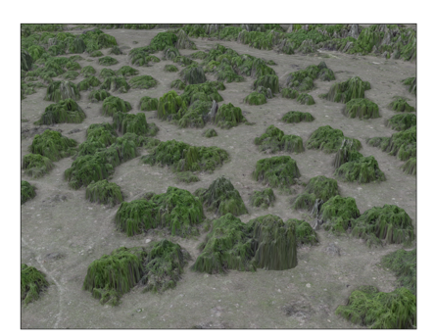
Implications
Adapted from Welch and Scifres (1985)

Slide 20
Implications
Adapted from Welch and Scifres (1985)

Slide 21
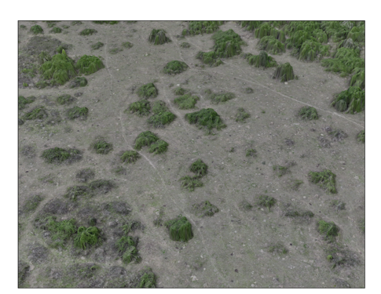
Implications
Adapted from Welch and Scifres (1985)

Slide 22
Implications
Adapted from Welch and Scifres (1985)

Slide 23

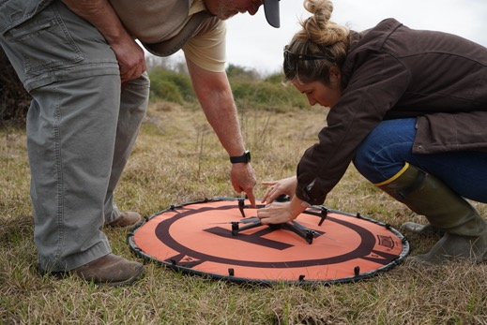



Acknowledgements

Slide 24
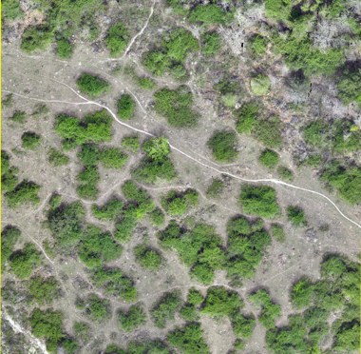
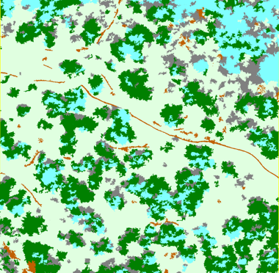
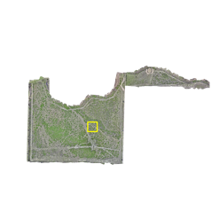
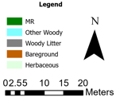
March 2024
Accuracy: 67.07%
Notes:
Take out rgb

Slide 25
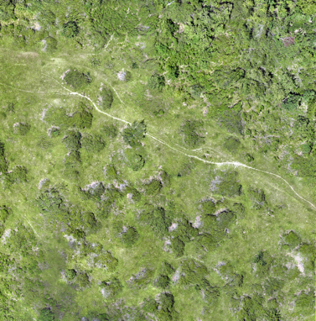
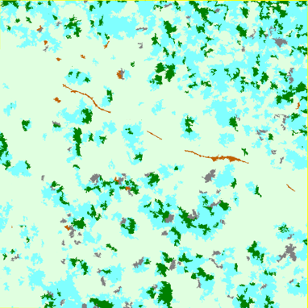
July 2024
Accuracy: 45.93%
Notes:
Take out rgb

Slide 26
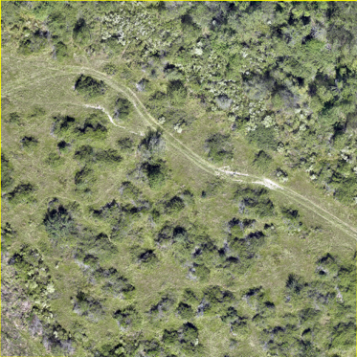
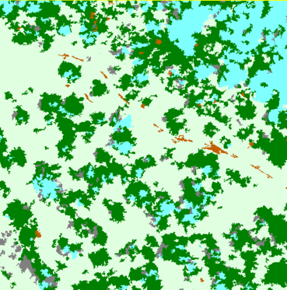
September 2024
Accuracy: 49.59%
Notes:
Take out rgb

Slide 27
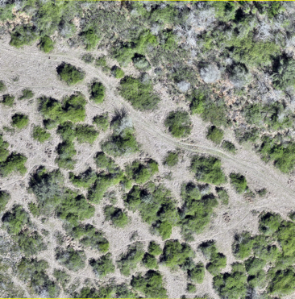
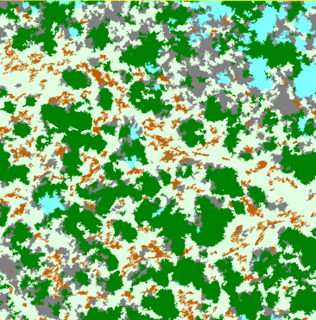
March 2025
Accuracy: 44.93%
Notes:
Take out rgb

