Slide 1
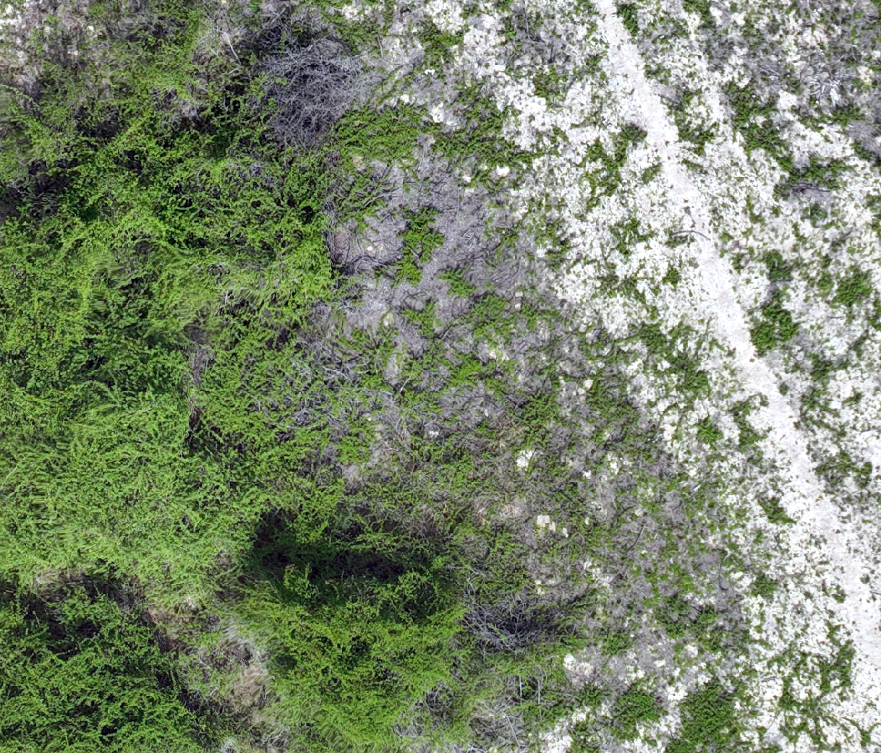
Detecting Emergent Macartney Rose (Rosa bracteata) Using Very Fine Resolution Imagery
William C. Longoria*, Shanna R. Gleason*, Michael C. Allison**,
Jacob E. Lucero*, Javier M. Osorio Leyton*, William E. Rogers***,
Alexandria M. DiMaggio****, Humberto L. Perotto-Baldivieso*
*Department of Rangeland, Wildlife, & Fisheries
Management, Texas A&M University
**Raptor Aerial Services LLC
***Department of Ecology and Conservation Biology,
Texas A&M University
****Coastal Prairie Conservancy

Slide 2
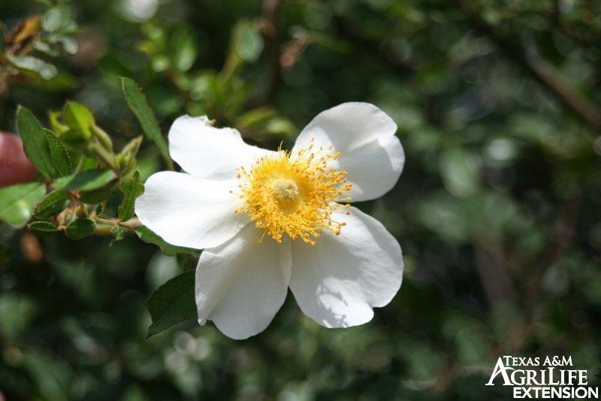
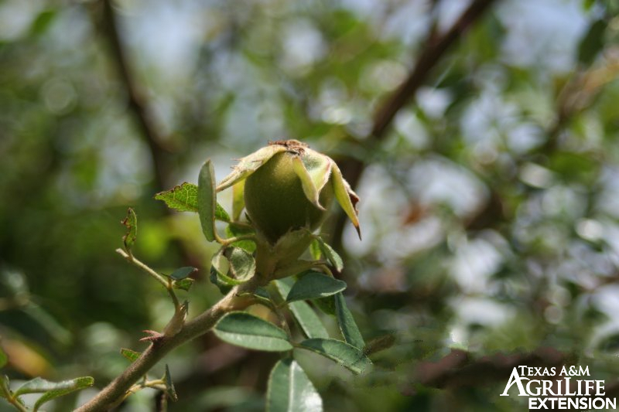
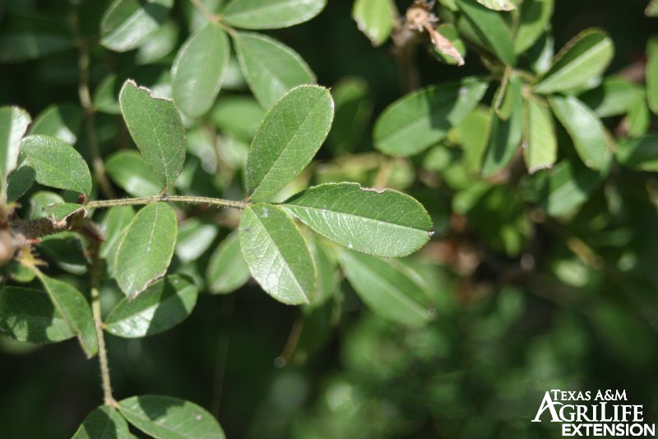
Target Species: Macartney Rose
Macartney Rose (Rosa bracteata) presents a unique challenge to ranchers as an invasive woody species in Texas.

Slide 3
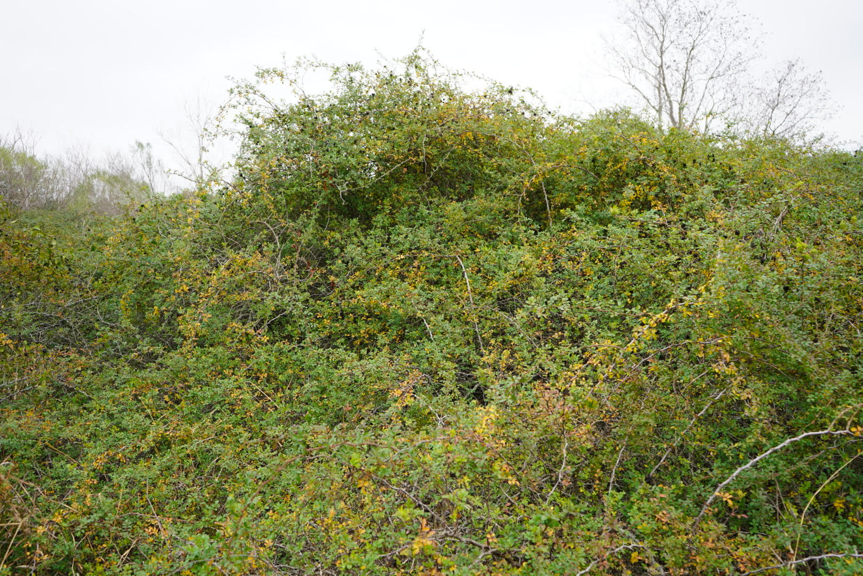
Why Does This Matter?
Cons of Macartney Rose
Little-to-no forage value
Competes for resources
Disrupts native wildlife habitat

Slide 4
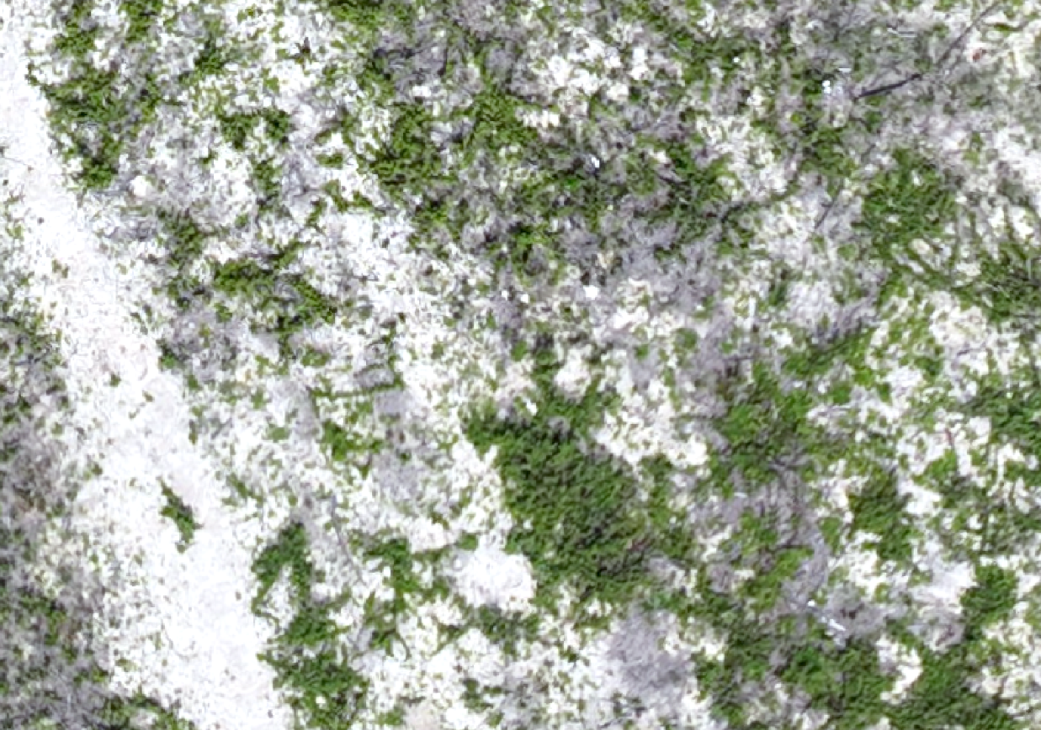
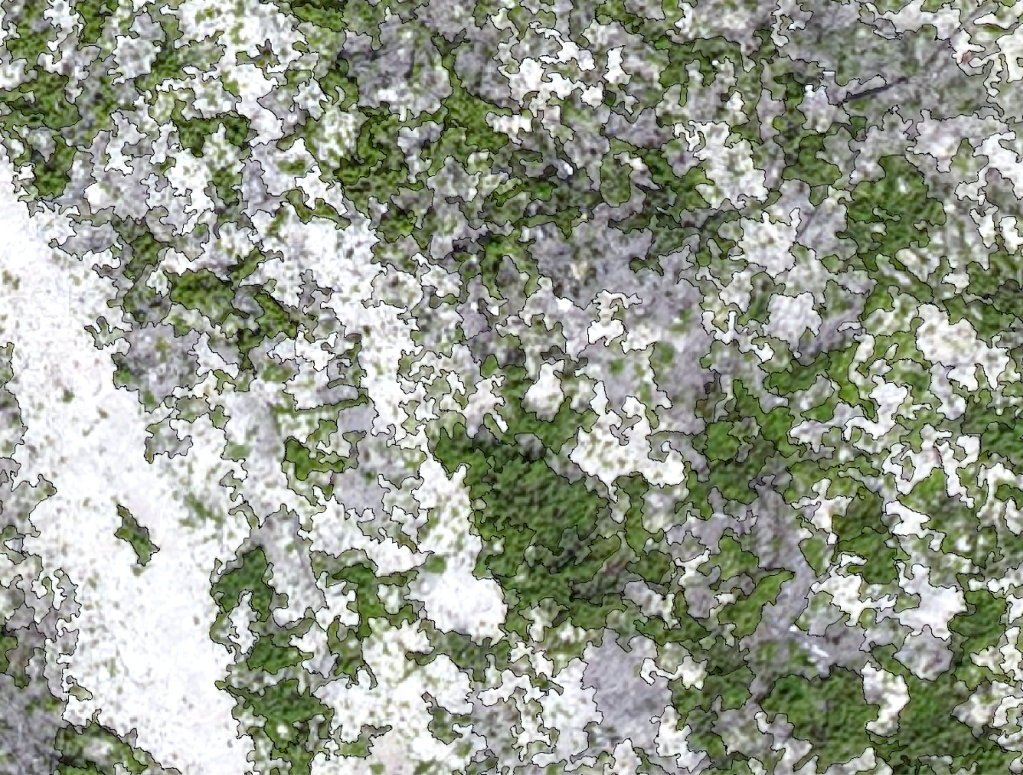
What is Image Segmentation?
Groups pixels according to color and neighboring pixels
Ideally segment of Macartney rose = patch of Macartney rose
Imagery before segmentation and boundaries were applied.
Imagery after segmentation and boundaries were applied.

Slide 5
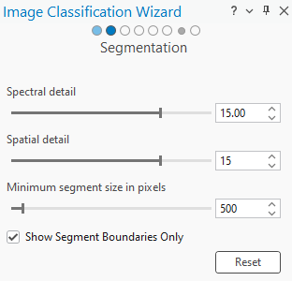
Spectral and Spatial Detail: What Are They?
ArcGIS Pro segmentation parameters:
Spectral Detail
Spatial Detail
Minimum Segment Size in Pixels

Slide 6
Objectives
1. Determine the optimal segmentation parameters that yield the highest accuracy for object-based classification of Macartney rose.
2. Determine the minimum detectable patch size of emergent Macartney rose.

Slide 7
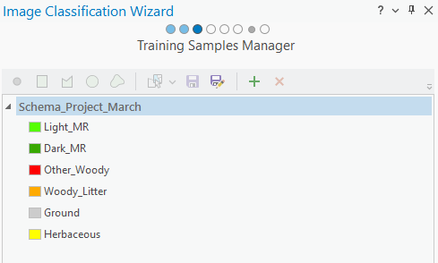
Methodology
1.32cm resolution imagery
500 accuracy points
3 values for spatial and spectral detail 5, 15, and 17.

Slide 8
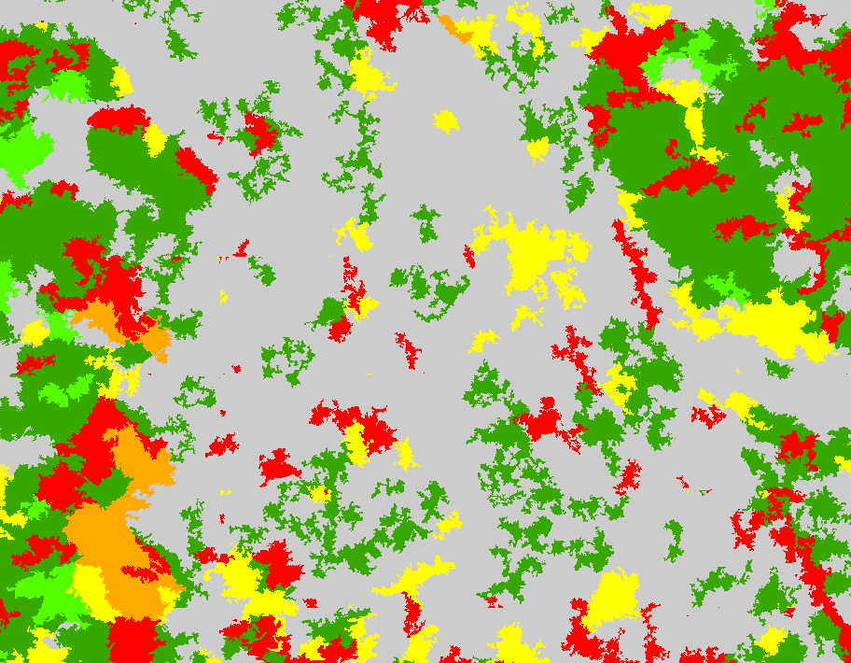
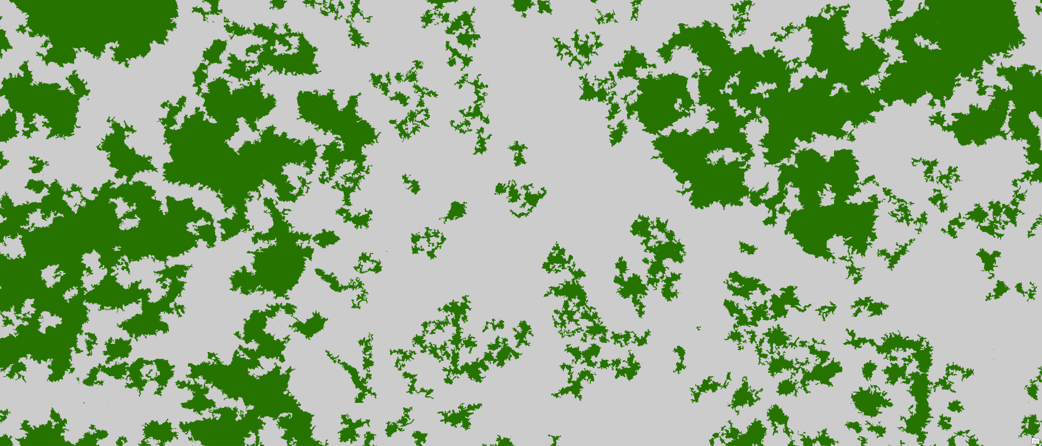
Methodology Continued
6 classes are reclassified down to 2.
Classification using 6 classes.
Classification using 2 classes.

Slide 9
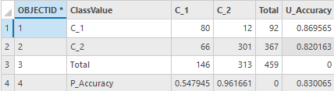
Methodology Continued
Accuracy points are updated to include the classified raster.
A confusion matrix is created to determine accuracy.

Slide 10
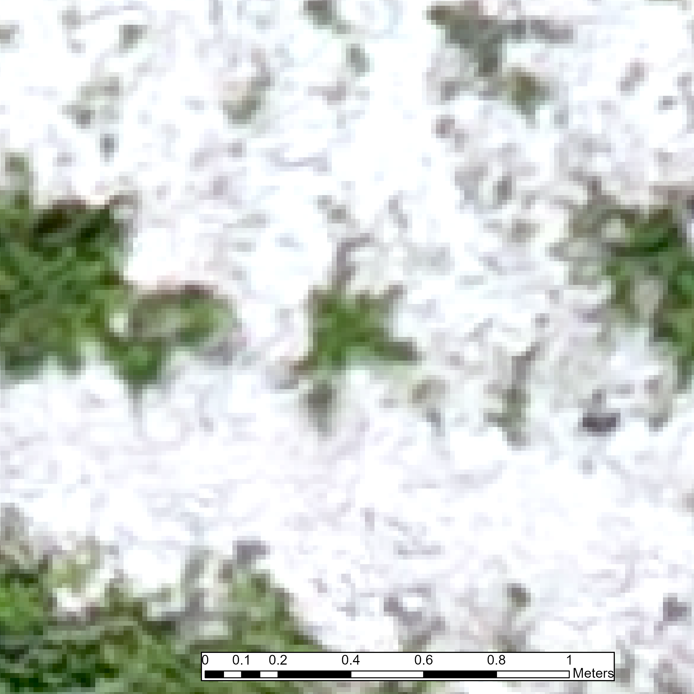
Methodology Continued
One pixel has an area of 1.32cm².
Our pixel count for a target patch of emergent Macartney rose is 20.
By multiplying the # of pixels of the patch by (1.32*1.32cm²), we can determine the minimum detectable area.

Slide 11
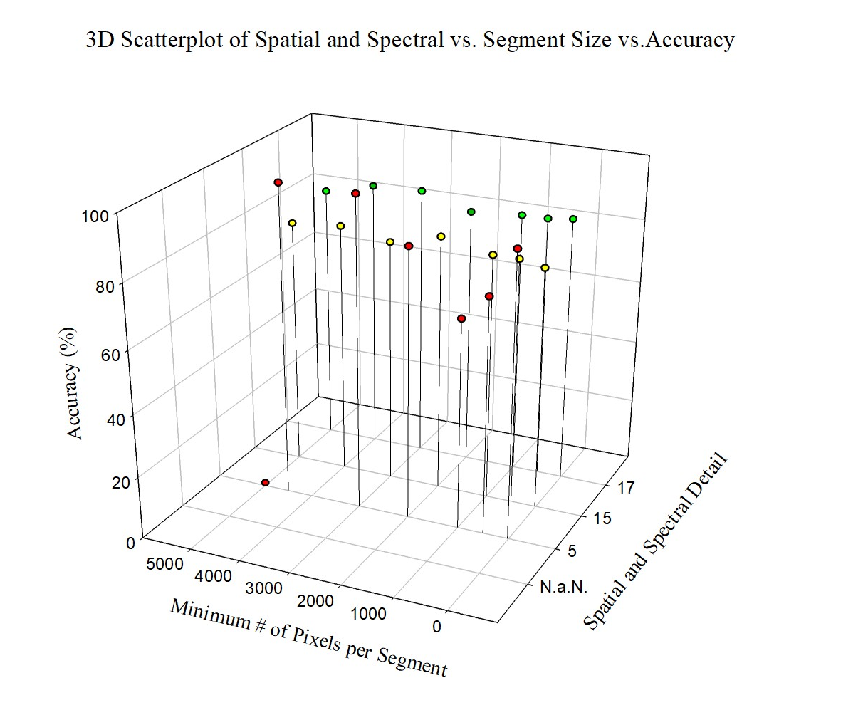
Highest accuracy settings:
Spectral Detail:17
Spatial Detail: 17
# of Pixels per Segment: 3000
Overall Accuracy: 86%
Lowest accuracy settings:
Spectral Detail: 5
Spatial Detail: 5
# of Pixels per Segment: 1000
Overall Accuracy: 64%
Smallest Patch Size: 33cm² ~ 2 in²
Results

Slide 12
Conclusions
Higher spatial and spectral detail = higher accuracy of Macartney rose.
Smaller segment sizes = smaller detectable patch size.
More classes may result in higher accuracy.

Slide 13
What Comes Next?
Creating an improved range of settings.
Decreasing the minimum detectable patch size to <33cm².
Photo of NAIP Imagery

Slide 14



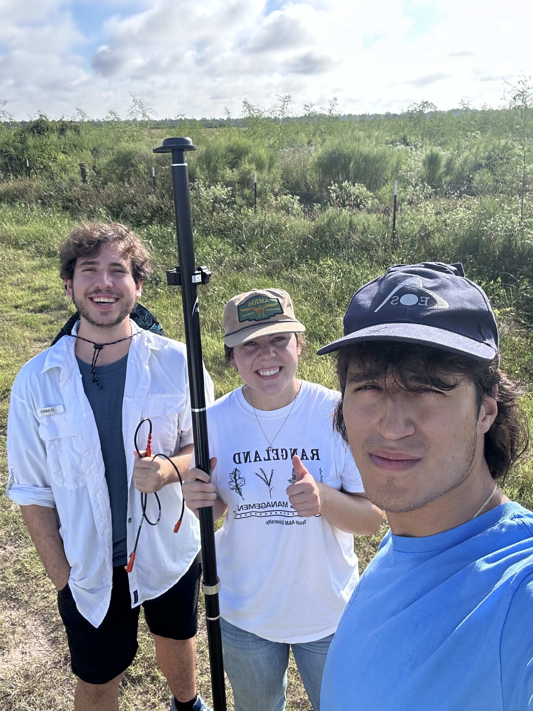



Acknowledgements

